Slide 1

SAFEX Webinar N° 6
MANAGEMENT OF CHANGE
April 9th, 2024
America & Europe – 09:00-11:00 Cleveland Time
Asia & Pacific – 18:00-20:00 Cleveland Time
Hosted by EPC Groupe, chaired by Thierry Rousse
With a special WG dedicated to MOC including:
Dawn Goosen, Nadia Engler, Diana Lazarte, Johanne Dellarovere
Paulo Siqueira, Joao Roorda, Joseph Sindane, Bob Woolley

Slide 2
introduction
1

Slide 3



INTRODUCTION

Slide 4

INTRODUCTION
Notes:
Team: key success
New Format for this second session
Best solution will be our solution

Slide 5
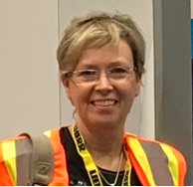








WORK GROUP MEMBERS
Dawn Goosen
Bob Wolley
Nadia Engler
João Roorda
Diana Lazarte
Johanne Della Rovere
Thierry Rousse
Joseph Sindane
Paulo Siqueira
Notes:
A special WG dedicated: Team effort
New Format for this second session
Innovative
Passion
Diversity

Slide 6
AGENDA
1
INTRODUCTION
5 min
2
MANAGEMENT OF CHANGE – CONCEPT , TYPES AND HOW TO SUCCEED
25 min
3
GROUP ACTIVITY & FEEDBACK
60 min
4
DISCUSSION & CLOSURE
20 min
Notes:
Introduction - 5 mn- Thierry
Presentation - 25 Minutes - Dawn
Instructions for exercise – 5 Minutes Joao
Exercises - 30 Minutes – 5 leaders/ Facilitators
Feedback (only highlights!) - 35 Minutes – Each Facilitator
Discussion & wrap up - 20 Minutes - Bob
Closure

Slide 7
Management of change
Why is Management of Change important?
How do we succeed at Management of Change?
What do we mean by change?
2

Slide 8

MANAGEMENT OF CHANGE
A change is defined as any alteration that can result in deviation to any part of plant & equipment , process, methods/ procedures, specifications, transport routings, waste/ emissions (not an inclusive list)
Changes may be permanent or temporary and related to:
Equipment
Design / Drawings
Infrastructure
Operational / Process
Procedures / Standards
Organisational / People
Raw Materials / Suppliers
Product
Software
Contractors
What do we mean by change?
Excluding the replacement of a plant hardware component which, in the professional judgement of a qualified engineer, is of an identical or equivalent specification to that which has been removed.

Slide 9

OPERATING REALITY
Changes will be made to the process
Improve productivity & efficiency
Keep up with industry standards and requirements
Rectifying design issues/ equipment/ process problem
Improve safety
Reduce health & environmental impact

Slide 10

OPERATING REALITY
What keeps us from recognizing change?
Pressure to perform
Going too fast
Lack of knowledge
Never happened before
Been doing it forever

Slide 11
MANAGEMENT OF CHANGE
CHANGE = RISK
80% of large-scale accidents in process industry can be traced back to improperly managed change.
Management of change process ensures change does not inadvertently introduce new risk or hazards.
Why is Management of Change important?

Slide 12
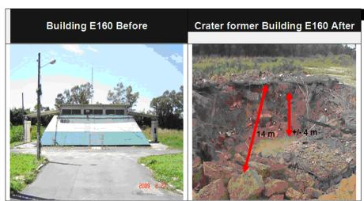
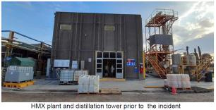
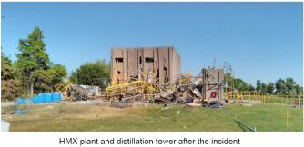
INCIDENT EXAMPLES
April 2nd, 2010
PETN Dryer building before and after decomposition reaction lead to detonation of PETN, leaving a 3.5 m deep crater.
Change to external supplier not fully considered. 1st batch of PETN – drying started before quality release was issued.
March 9th, 2022
Explosion took place on the main evaporator of the acetic acid distillation system next to HMX plant (10 kg explosive material)
Changes to the installation and procedure did not follow a formal process (HAZOP, MOC).

Slide 13
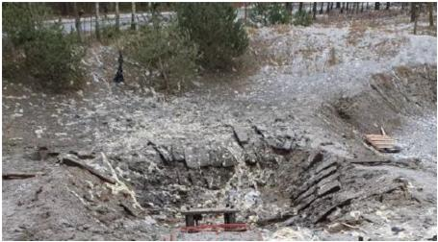
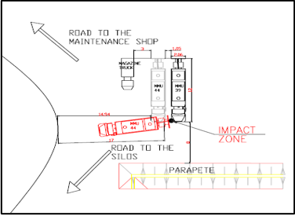
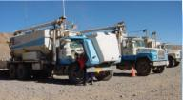
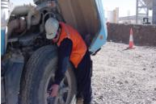
INCIDENT EXAMPLES
January 14th, 2021
During the standard procedure of burning waste cartridged emulsion explosives there was an explosion (160 kg cartridged emulsion explosives).
Changes to the quantity of explosive waste being burned.
July 29th, 2004
Maintenance contractor checking engine oil level on MMU was fatally injured when another MMU impacted the MMU he was working on.
Change in layout leaded to more congestion and insufficient space to turn and exit.

Slide 14
MANAGEMENT OF CHANGE
Management of change needs to be formally:
Documented
Reviewed
Approved
Implemented
Implement a Management of Change process / system that everybody will use.
Implement consistent business rules and checklists.
Ensure stakeholder involvement and risks assesment of all changes.
Ensure all tasks required to manage the change are completed before introducing the change.
Make sure temporary changes do not become permanent without oversight or confirmation evaluation of permanent change.
How do we succeed at Management of Change?

Slide 15





MOC PROCESS
REQUEST FOR CHANGE
Description of the proposed change.
CHANGE ANALYSIS /
RISK ASSESSMENT
Proposal is analyzed/ assesed by personnel with knowledge, skill , training and experience to identify hazards, assess risk, and determine controls associated with proposed change.
CHANGE APPROVAL / REJECTION
Approval by Manager with operational control of the process where the change will be implemented.
CHANGE IMPLEMENTATION & SHE ACCEPTANCE
All controls in place and change is as intended before change is made operational.
CHANGE COMPLETION
Complete all tasks related to the change and verify the objective of the change was achieved.
15

Slide 16





ROLES AND RESPONSABILITIES
Initiator
Owner
Reviewer
Approver
Implementers
Trained and Authorised person, who defines the change request and initiates the change.
Ensures all process steps for management of change are adhered to and requirements are met before implementation and change is appropriately communicated.
* May also be the initiator and implementer.
Review the information supplied and act as area subject matter experts
Approve the change to start implementation. Manager of the area where change is being implemented.
Execute authorised and approved changes or modifications.
BUSINESS MANAGER: ENSURES MANAGEMENT OF CHANGE SYSTEMS ARE IN PLACE AND USED.
16

Slide 17
DOCUMENTATION
Change Register
Review and Approval
Change Identification Checklists
Defines the scope and details of the change.
Explains reasons or justification for the change.
Provides traceability for the analysis and approval process.
Formal review and approval is required.
Demonstrate that change has been considered by appropriate people and that is has been agreed that it is safe to continue its implementation.
Reviewers and Approvers must be qualified and include affected people.
E.g. Relevant Line managers, SHES representatives, Responsible engineers, Operators, Quality representatives, Legal Counselors, etc.
Equipment
Organisational Issues
Changes to materials of construction
Changes to rates or corrosion or erosion
Changes to potential for foreign objects
Changes to arrangements to secure fasteners
Changes to potential for concealed energetic materials
Changes to inspection or maintenance requirements
Changes to design pressure or temperature of equipment
Changes to skill and competency of the people to complete the task safely.
Changes to job functions performed by individuals
Changes to position descriptions / additional responsibilities
Changes to the number of people required to safely perform tasks
Changes to the likelihood of critical errors.
Changes to availability of supervisory resources
Changes to work hours or shift arrangements Changes to communication between individuals or workgroups Changes to selection criteria for new recruits or transfers
17

Slide 18





SUMMARY
Uncontrolled change leads to safety issues/ incidents, incorrect purchases, costly downtime and rework.
Lack of Management of Change Systems has been identified as the cause of many incidents, accidents and fatalities in the industry.
Change needs to be critically considered for potential to introduce new or change current risk level
Change must be formally documented , registered, reviewed and approved prior to implementation
Everyone is responsible to ensure any change within their work area is managed though our Management of Change System / Process

Slide 19
GROUP ACTIVITY & fEEDBACK
3

Slide 20


INSTRUCTIONS
For this Webinar, we will split the attendees in rooms for the group activity:
Each room will have a leader and a facilitator:
Leader: Will Ensure the meeting is working properly. more on the “tech” side of things.
Co Leader: Will drive the discussion and provide feedback about the discussion later on.
For each group, there is a MOC case for discussing:
What should have been done differently?
What makes this case special?
Return to the main meeting and share feedback.
Notes:
1 – Supplier or other: Nadia / Martin, AUSTIN Study Case N°1
2 – Raw Material: Dawn / Diana, ORICA Study Case N°1
3 – Raw material or other: Joao / Paulo, looking for a case
4 – Equipment: Thierry / Johanne, EPC Study Case
5 – Organization: Bob / Rob Chapman, EPC Study Case

Slide 21
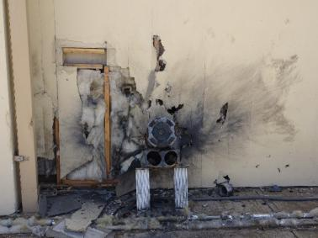
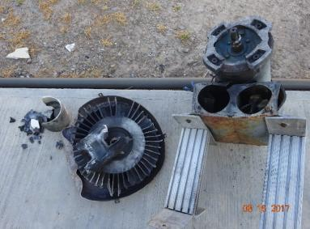
Nadia & Martin
CASE N°1 – FEEDBACK
Lead Azide Dust Explosion
Incident description & impact
The building where this incident occurred is comprised of three individual bays where lead azide and/or PETN is brought in wetted and then washed with alcohol and dried in a heated bowl.
A detonation occurred inside an extractor of the washing and drying lead azide bay.
Change:
However, at some point it was replaced with a different model. Replacement unit was similar in appearance but over time it accumulated explosive dust/residues inside.
Impacts:
No injuries occurred as a result of this event.
Damage to extractor and false wall
Shrapnel impact to Barricade
What went wrong?
Friction between impeller and housing initiated the detonation, the replacement model was similar in appearance but not rated for hazardous environments.
Documentation of when the replacement took place is unknown.
Extractors were not part of a preventive maintenance program.
Rather than placing orders to maintain spare parts, units were substituted out from a different process.
Notes:
2 – Raw Material: Dawn / Diana, ORICA Study Case N°1

Slide 22
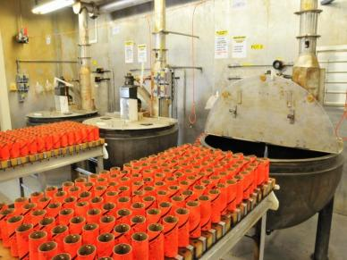
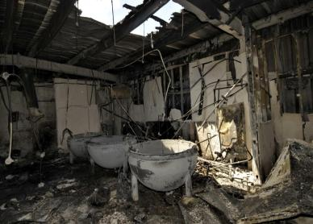
Dawn & Diana
CASE N°2 – FEEDBACK
Booster Fire incident at Minden , Louisiana - March 2011
Incident description & impact
At ~ 07h20 on 21 March 2011 a pouring operator removed booster trolley from cooling oven and noticed that two of the boosters were emitting smoke.
Operator immediately activated the emergency evacuation of the plant – fire engulfed building 927 at ~ 07h25 am. The fire burned for approximately 3 hours with no detonation and no injuries.
Change:
Boosters that were smoking were first boosters poured using new degrading agent tablet.
Impacts:
Challenges in removal of solidified Pentolite from kettles in second production house.
Production plant was down for recovery and rebuild for 6 months
What went wrong?
Organization failure to anticipate the potential runaway reaction with new DA.
Failure to follow existing procedures, e.g. apply management of change process.
Flawed assumption that analytical testing methods will generate equivalent results for all degradable systems to be tested.
Notes:
2 – Raw Material: Dawn / Diana, ORICA Study Case N°1

Slide 23
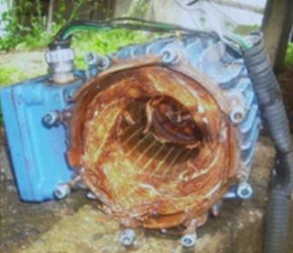
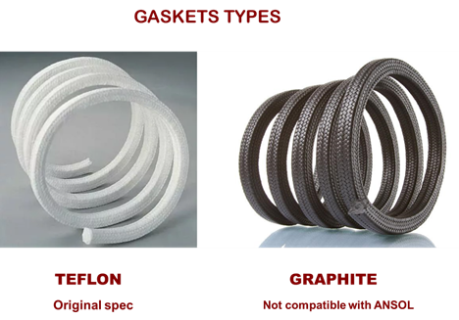
João & Paulo
CASE N°3 – FEEDBACK
Explosion of a ANSOL Pump
Incident description & impact
A Bulk Emulsion production plant operator noticed a leak in an ANSOL (ammonium nitrate solution) transfer pump.
The mechanic’s examination pointed to excessive wear of the gasket. He found a replacement gasket that fit and replaced the damaged one – operation was back up and running.
Three hours later the pump exploded.
Change:
Replacing the original Teflon gasket with a graphite one.
Impacts:
The centrifugate pump used to transfer ANSOL exploded.
There were no injuries
The plant stopped production.
What went wrong?
Failure in the MOC system and to assess the risks of the change.
  Failure in the MOC training of the operator and mechanic.
  Absence of original spare parts for pump maintenance .
  Lack of BOS knowledge by the operator and mechanic.
Notes:
3 – Raw material or other: Joao / Paulo, looking for a case

Slide 24
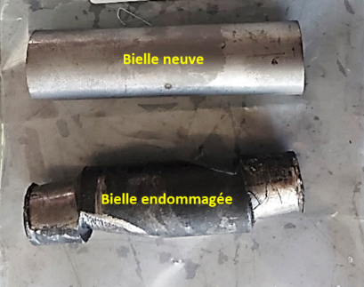
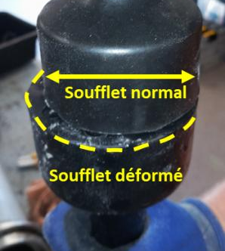
Johanne & Thierry
CASE N°4 – FEEDBACK
Abnormal pump damage
Incident description & impact
At the end of a production run, a popping noise was heard from the matrix pump (progressive cavity pump). The operator immediately stopped production and alerted his superiors.
On dismantling, it was found that a retaining pin between the connecting rod and the rotor was badly damaged.
Change:
The process temperature had to be increased following the use of an aqueous phase with a higher concentration of ammonium nitrate, resulting in an increase in the crystallisation temperature from 72°C to 80°C.
Impacts:
Significant damage on the pump
What went wrong?
Higher concentration of ammonium nitrate was used in other plants; however bellows had been replaced by nitrile ones. In Belgium the bellows were made of Hypalon.
The change was considered not significant
Notes:
4.- Equipment: Thierry / Johanne, EPC Study Case

Slide 25
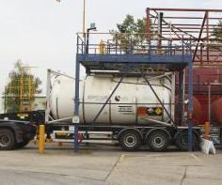
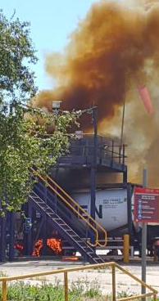
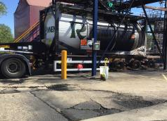
Robert & Marion
CASE N°5 – FEEDBACK
Nitric acid leak and fire
Incident description & impact
ISO tank full of concentrated nitric acid was positioned on the discharge point and prepared for offload.
When the valve was opened, nitric acid leaked from one of the connections. No attempt was made to close the valve or dilute the acid. Nitric acid made contact with the tires of the trailer and started a fire.
Change:
The task of connecting the tanker changed from plant operators to tanker drivers.
Numerous changes in management and personnel over the preceding years.
Impacts:
There were no injuries but there was major asset damage by the leak and fire.
3 weeks loss of production.
Investigation by the regulators.
What went wrong?
Failure to properly manage creeping change including: Personnel and competence, Techniques, Equipment and Suppliers.
Procedure was not standardised
Inadequate immediate response
Notes:
2 – Raw Material: Dawn / Diana, ORICA Study Case N°1

Slide 26
DISCUSSION & CLOSURE
4

Slide 27


DISCUSSION & CLOSURE
SAFEX MoC Webinars
  November 2023
  April 2024
Next Steps
  Management of Change e-Learning Module
  Any other ideas? You can be a part of this journey!
Help us improve!
https://forms.office.com/r/W4vaV40Sma

Slide 28

DISCUSSION & CLOSURE
SAFEX MoC Webinars
  November 2023
  April 2024
Next Steps
  Management of Change e-Learning Module
  Any other ideas? You can be a part of this journey!
Help us improve!
https://forms.office.com/r/w3fnHhE02E​

Slide 29
SAFEX Webinar N° 6
MANAGEMENT OF CHANGE
Thank you for your participation!
Hosted by EPC Groupe, chaired by Thierry Rousse
With a special WG dedicated to MOC including:
Dawn Goosen, Nadia Engler, Diana Lazarte, Johanne Dellarovere
Paulo Siqueira, Joao Roorda, Joseph Sindane, Bob Woolley

