Slide 1

SAFEX WEBINAR No.5
Management of Change
(examples of incidents by Andy Begg. Presentation by Paulo Siqueira)
November 27, 2023

Slide 2

MOC Webinar
Examples of incidents
caused by failure in
Management of Changes

Slide 3
MOC Webinar
Incident # 1

Slide 4
MOC Webinar
Explosions in
Nitroglycerine
refuse acid station
Simple change in supply of a piece of PVC connecting tube killed 9 persons

Slide 5
The explosions
MOC Webinar
First explosion in refuse acid station killed 3 persons
Following day a second explosion in the refuse acid tanks killed another 6 persons.

Slide 6
Process
MOC Webinar
Glycerine/glycol mix is nitrated with nitric/sulphuric acids, continuous process
NG and Refuse acid separated using centrifuge
Refuse acid sent to storage tanks for treatment, NG (some residual acid) sent for washing and stabilising

Slide 7
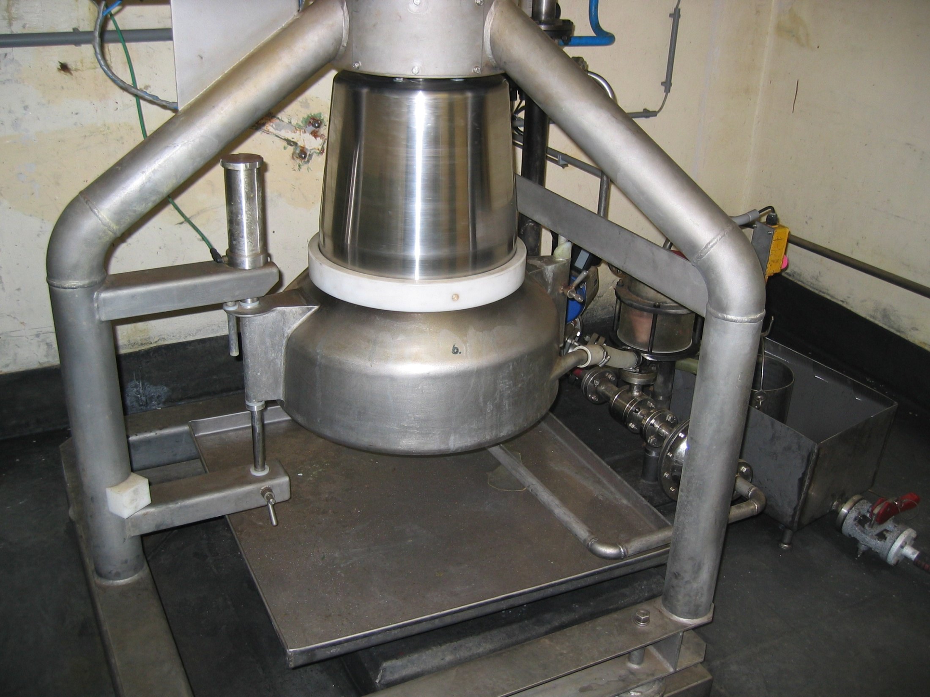
Centrifuge
MOC Webinar

Slide 8
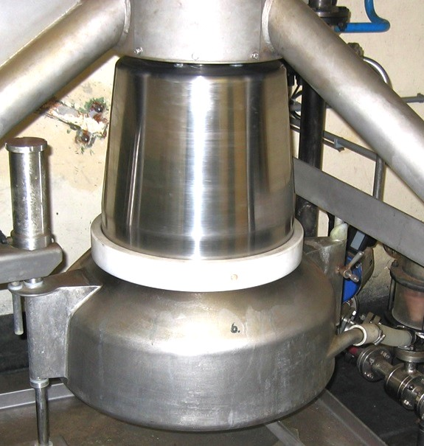
MOC Webinar
Centrifuge
Refuse acid line
to acid station and
storage tanks
NG line
for processing

Slide 9
Investigation
MOC Webinar
Evidence of increased NG in refuse acid the day prior to first explosion
Liquid NG collected in pipelines and pump in station
Detonation in pump shortly after starting
Unknown quantity of NG in the refuse acid storage tank
Decomposed over time and detonated the following day

Slide 10
Main finding
MOC Webinar
Connecting hose on NG line had de-laminated
Partially blocking flow of NG
Excess NG now forced down the refuse acid line
Line/equipment is not designed for NG (pumps)
First explosion in pump
Excess NG in refuse acid starts to decompose
Explosion following day.

Slide 11
MOC Webinar
PVC connector hose
Centrifuge
Refuse acid line
to acid station and
storage tanks
NG line
for processing

Slide 12
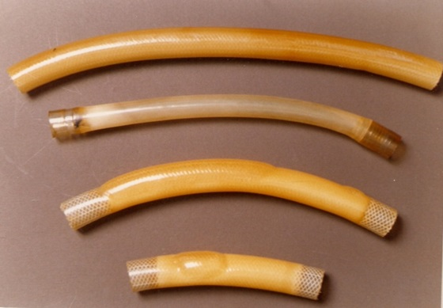
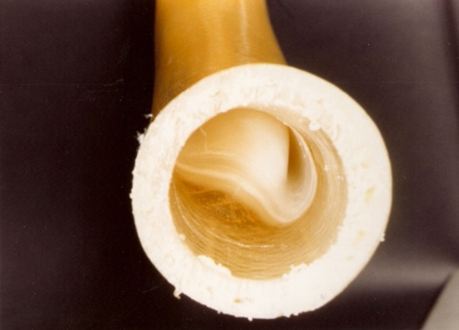
MOC Webinar
Photos of connecting hose after prolonged
contact with refuse acid

Slide 13
MOC Webinar
PVC connector hose
Partially blocked
Refuse acid line
to storage tanks and
acid station
NG line
for processing

Slide 14
Why?
MOC Webinar
Original hose was crystal PVC
Later replaced with local equivalent
Purchasing Dept changed to cheaper source
Quality of new material was not consistent
Plant maintenance looked for alternative - identified nylon reinforced garden hose
Tested for compatability with NG and OK
Did not test compatability with refuse acid
Acid reacted with nylon causing delamination

Slide 15
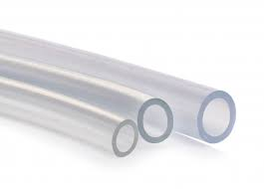
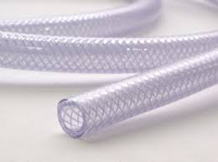
MOC Webinar
Original hose was crystal PVC
Nylon reinforced garden hose
changed by

Slide 16
Causes of Incident
MOC Webinar
Simple change in supply of a piece of PVC connecting tube
Failure to test thoroughly

Slide 17
MOC Webinar
Incident # 2

Slide 18
MOC Webinar
Emulsion pilot plant explosion
30th September 1988
Two small changes made to formulation
4 Fatalities, 1 Injuries
Destruction of facility

Slide 19
Process
MOC Webinar
Process well established in production
Basic formulation well proven
Ammonium nitrate solution
2 stage emulsification
  Rotary mixer for preparation of coarse emulsion
  High Pressure double piston pump – up to 1200 psi - to feed through the static mixer for refinement
High pressure pump hydraulically driven double piston constant speed

Slide 20
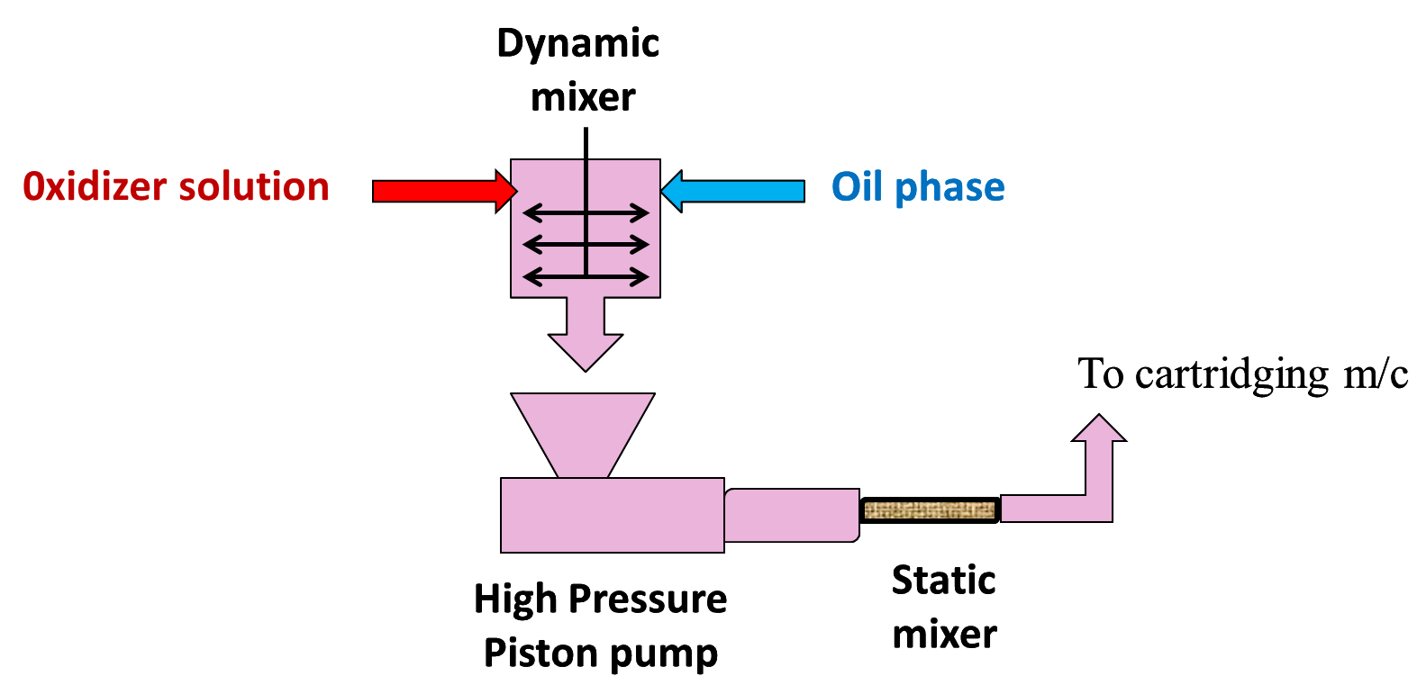
MOC Webinar

Slide 21
Background
MOC Webinar
R&D work to try to get smaller droplet size emulsion for better sensitivity and stability
Standard plant equipment
Normal formulation base
Changes
  Increasing amount of surfactant
  Decreasing amount of water

Slide 22
Likely scenario
MOC Webinar
Coarse emulsion had much higher viscosity than expected
Flow into pump hopper was not fluid – fell in as lumps
Lumps encapsulated air voids
Voids sucked into cylinders of pump
Voids were compressible
High viscosity “blocked” line to static mixer

Slide 23
Likely scenario
MOC Webinar
Pump continued to cycle
Generated mist of oil or oil/emulsion to form
Adiabatic compression of voids raised temperature to 600ºC – contained organic vapour from surfactant/oil mix
“Diesel” ignition of fuel/air mix in cylinder
Bursting the walls of pump.
Product in hopper did not react

Slide 24

MOC Webinar

Slide 25
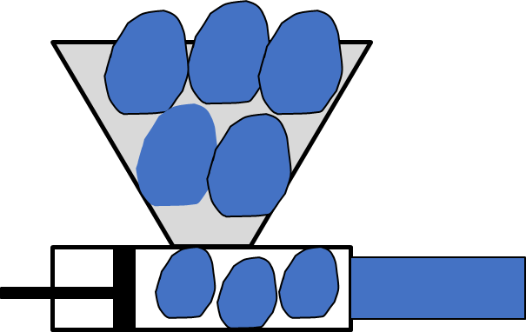
MOC Webinar

Slide 26
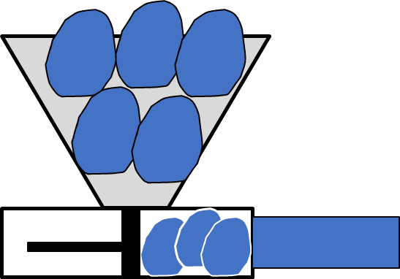
MOC Webinar

Slide 27
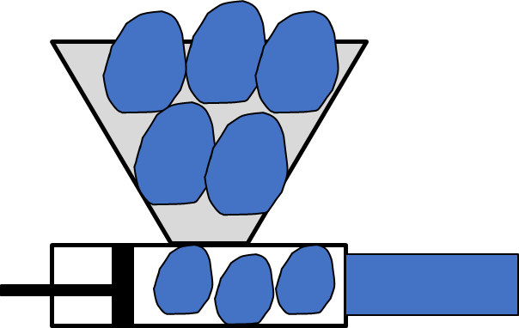
MOC Webinar

Slide 28
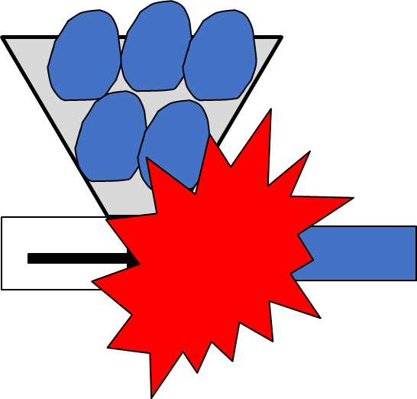
MOC Webinar

Slide 29
Causes of Incident
MOC Webinar
2 small changes made to formulation
Changes had significant effect on viscosity of product
Changed the flow characteristics
Resulted in unanticipated effect in pump
Explosion

Slide 30
Actions from investigation
MOC Webinar
Limits set on formulation variations
New specification for volatile content of all fuels
Changes in formulation to be studied before approval.
Applied to all R&D activities

Slide 31
MOC Webinar
Incident # 3

Slide 32
MOC Webinar
Fire and Explosion
in explosives delivery truck
March 1989
Change in packaging
A delivery van, with 800 Kgs of explosives caught fire and detonated
One person was killed and €40 million damages caused

Slide 33
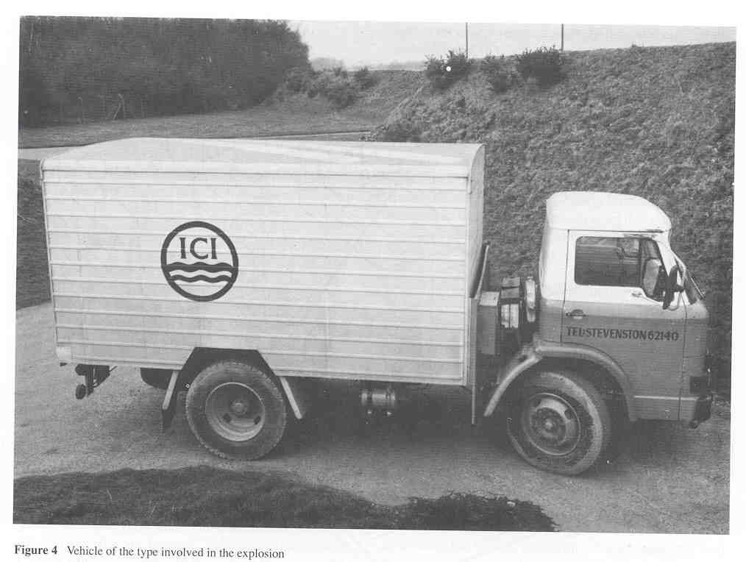
Materials in the truck
MOC Webinar
NG based explosives
Packaged emulsions
Detonators
One case of “Cerium” fuseheads
One case of “Vulcan” fuseheads
Detonators and Fuseheads separated from rest of load, but in the same compartment
This was an approved method of transport at the time

Slide 34
Sequence of events on the day
MOC Webinar
Truck was on a routine delivery
Driver took a wrong turn and entered a small industrial estate
Realised his mistake and drove into a small yard to turn round
As he went into the yard he went over a speed control bump

Slide 35
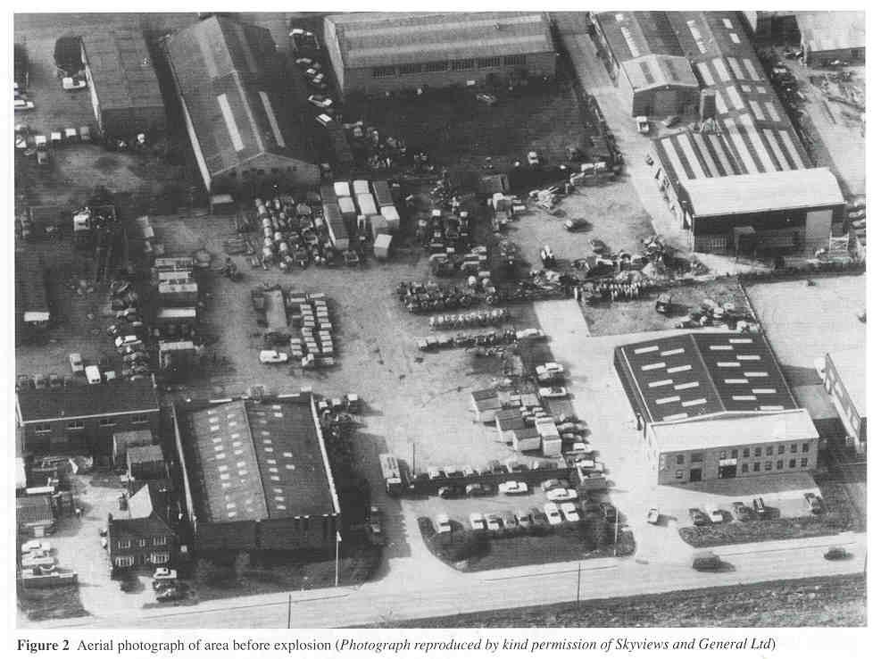
MOC Webinar

Slide 36
Sequence of events on the day
MOC Webinar
Heard a noise from behind
Stopped vehicle, got out and saw smoke coming from inside the cargo space
Raised the alarm and evacuated the area.
Emergency services called
Area secured
Firemen advised not to tackle the fire
Everyone exited the yard
Truck exploded after 12 minutes and one fireman killed by piece of shrapnel

Slide 37
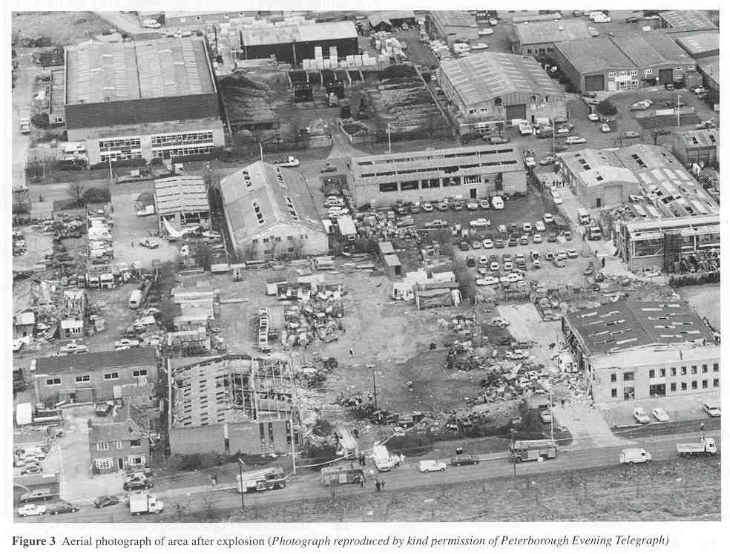
MOC Webinar

Slide 38
Investigation
MOC Webinar
Transit of vehicle over speed bump initiated sequence of events
Evidence pointed to fire preceding explosion
Fire spread to detonators and rest of cargo
Quickly focussed on the cerium fuseheads as likely cause

Slide 39
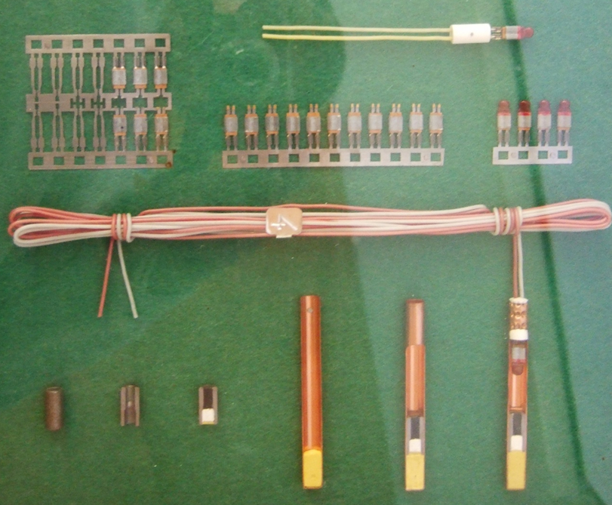
Fuseheads
MOC Webinar

Slide 40

Properties of cerium fuseheads
MOC Webinar
Cerium fuseheads normally used for
igniting delay elements in detonators
They burn with very high temperature
They are heat and friction sensitive
Fusehead composition was examined and found to be
extremely sensitive both to impact and friction.
Mixtures with rust (1 %)had a 10 fold increase in impact sensitivity.

Slide 41
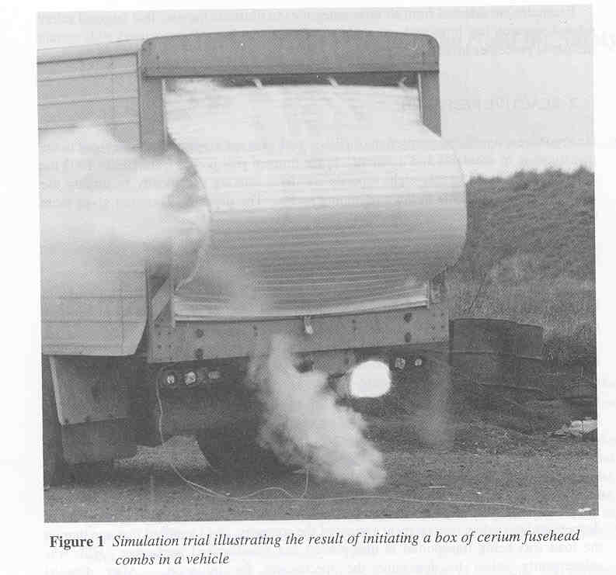
Drop tests on boxes of fuseheads
MOC Webinar
Boxes of combs dropped from a height of 1.2 metres exploded in some tests but not others.
Ignition trials on one box of cerium combs produced a fireball approximately 2.5 m in diameter, and lasting 0.3 seconds.

Slide 42
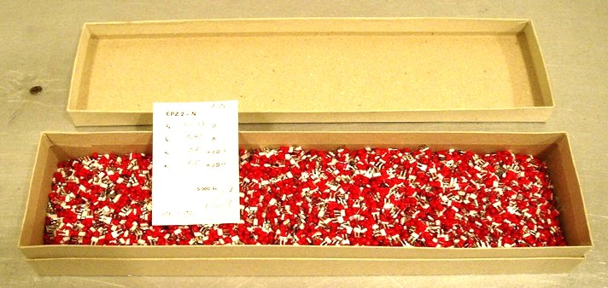
Packaging change
MOC Webinar
Normally fuseheads were supplied already cut
Buyers started to pressure the salesman on price

Slide 43
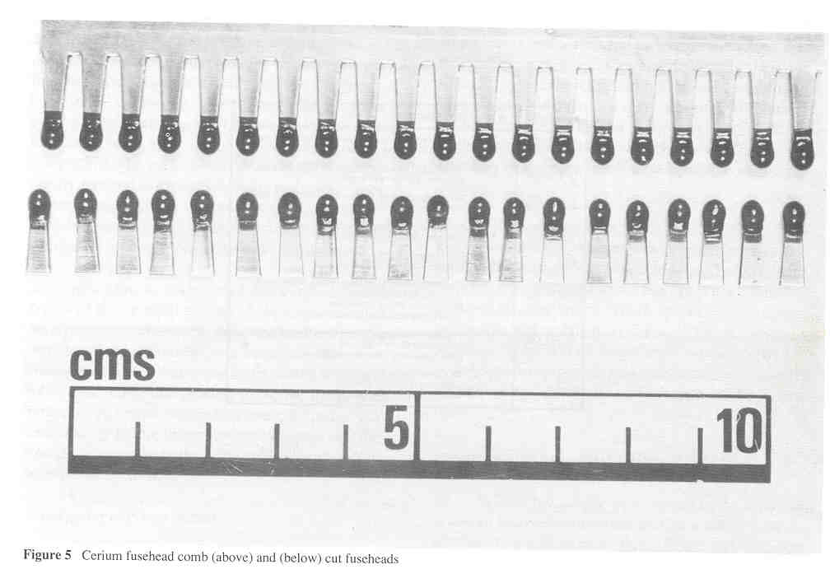
MOC Webinar
Agreed to a price reduction provided he could supply the fuseheads in an “uncut” state - ie fusehead combs
Change agreed with production foreman

Slide 44
Changes
MOC Webinar
Original packaging
Small square tins, each the size of a match-box
Each one of these tins contained 500 cut fuseheads
10 of these tins were then placed inside a larger tin
5 of these larger tins were then placed inside a wooden box - making 25,000 fuseheads per package
New packaging
Now that he supplying combs. Small matchbox size tins cannot be used
So this small tin is left out of the packaging
The combs are now packed directly into the larger tins 400 combs in each (20 fuseheads per comb)
2 tins placed in the large wooden box which now contains 16,000 fuseheads

Slide 45
Change in packaging
MOC Webinar
The foreman saw no need to consult his superiors on this move, because:
  The outside packaging looks exactly the same
  No new product has been produced
  The wooden case now contains 16,000 fuseheads when previously it held 25,000 and in his mind this was sure to be an improvement in safety !
Supplier of outer tin box had been changed – new tins had higher levels of rust

Slide 46
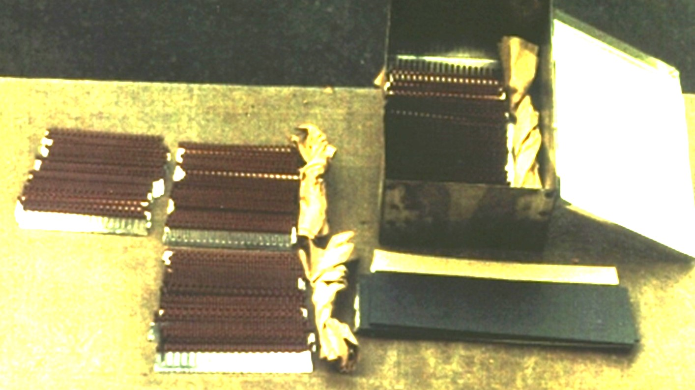
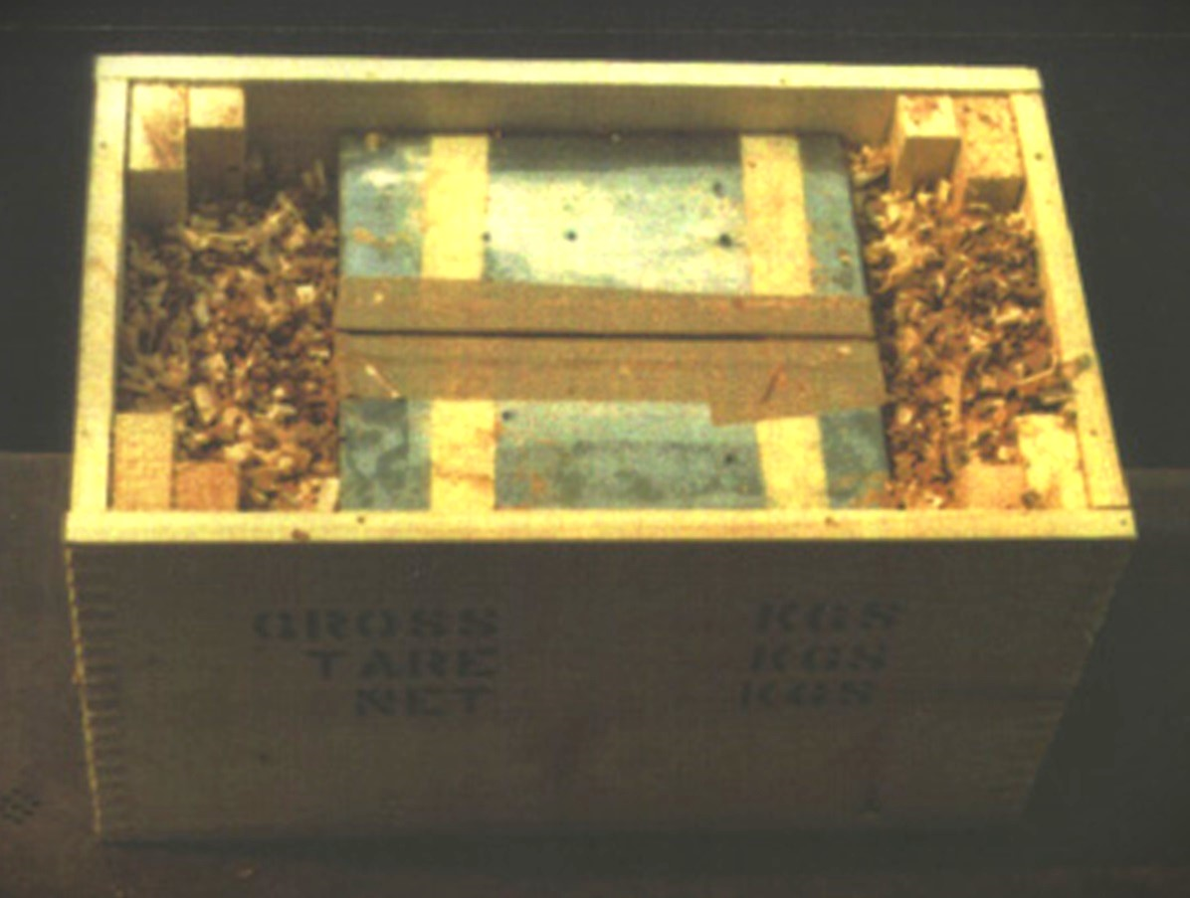
MOC Webinar

Slide 47
Changes
MOC Webinar
Apparently very small
Considered to be safer as quantity was reduced
But
  Fusehead combs can generate more friction between units than when cut
  Rust increases sensitivity to friction
Result was 2 small changes increased the sensitivity to friction and impact and explosion resulted.

Slide 48

Always Look for Details
MOC Webinar
We tripped over small rocks. The big ones we see and bypass.

Slide 49
MOC Webinar
end of presentation
Thank you

