Slide 1
FIRES EXPLOSIONS/DETONATIONS AND HAZARDS INVOLVING PETN SAFEX WEBINAR INPUTS FROM THE PETN GPG TEAM SESSION 1 SESSION 2 PRESENTED BY MD TRAUT PRESENTED BY D GOOSEN of of MD TRAUT CONSULTING ORICA (CANADA) trautmd@telkomsa.net dawn.goosen@orica.com

Slide 2
INTRODUCTION
This presentation briefly discusses:
Access to the SAFEX Incidents Database
PETN Manufacturing process,
Uses of PETN and
Basis of safety (BoS) of PETN.
and then in some detail
Accidents/Incidents /Detonations involving PETN are covered.

Slide 3
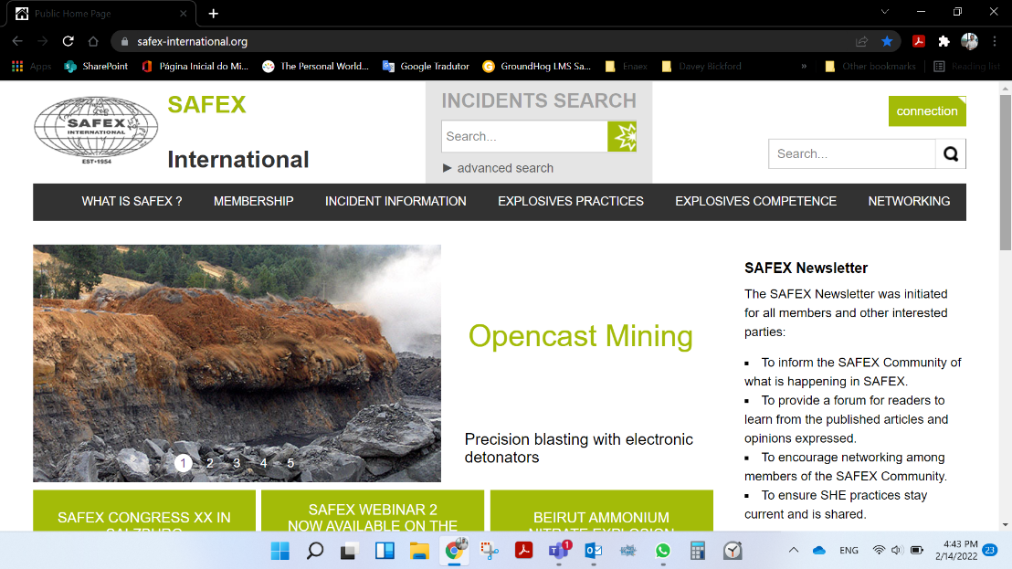

HOW TO ACCESS SAFEX INCIDENTS DATABASE
Access www.safex-international.org
Click on “connection” and type your login credentials
If you don’t have credentials, ask for it by emailing secretariat@safex-international.org

Slide 4

HOW TO ACCESS SAFEX INCIDENTS DATABASE
Type key words relate to your search on the search bar using semicolon to separate the words.
E.g.: PETN; explosion;

Slide 5

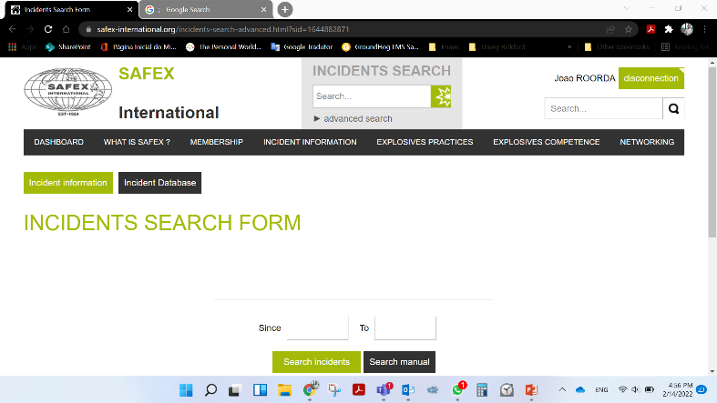
HOW TO ACCESS SAFEX INCIDENTS DATABASE
Alternatively, click on advanced search, right under the search bar
Type key words relate to your search on the search bar using semicolon to separate the words.
More information on how to use the search tool can be obtained by clicking on “Search Manual”

Slide 6
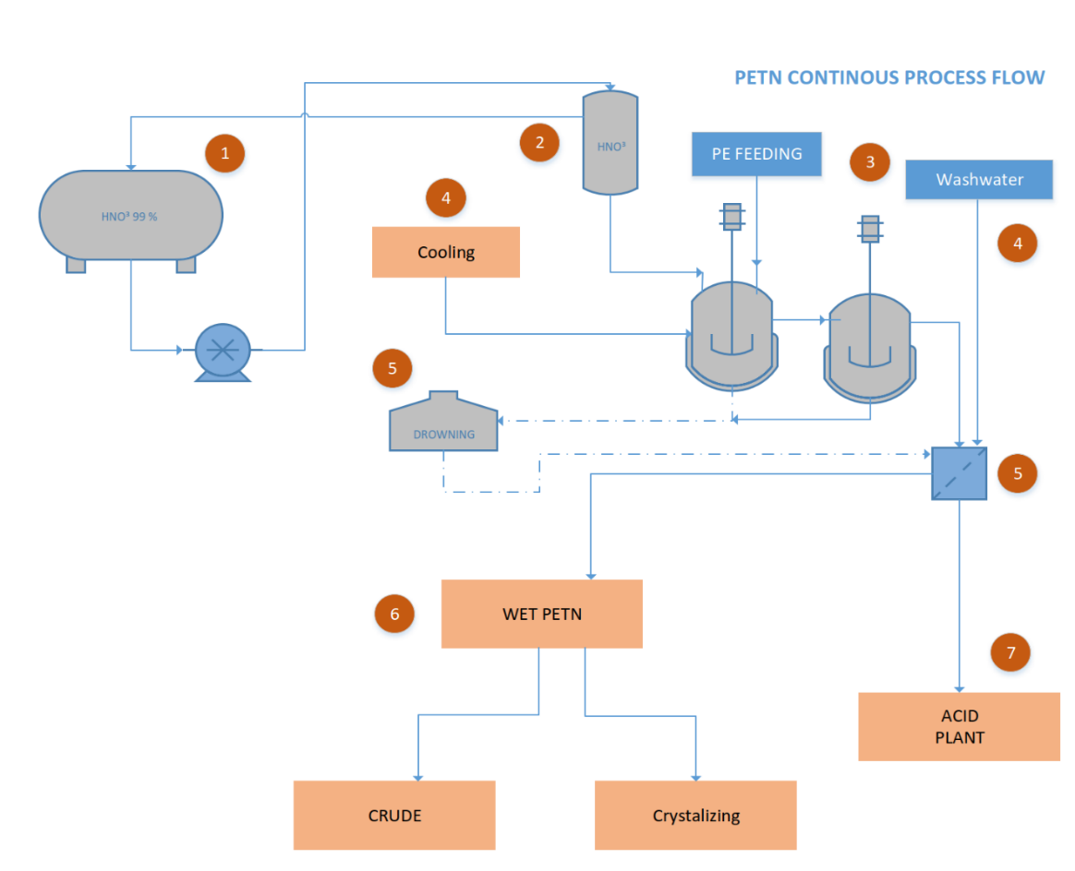
PETN PROCESS OVERVIEW (CONTINUOUS)
Non-stabilised PETN and Spent Acid/Refuse Acid (RA) are the products of the reaction when nitrating penta-erythritol with strong nitric acid.
The RA is separated from the crude PETN (by vacuum).
The RA is heated/boiled to destroy and or decompose any organics present.
The crude PETN is washed several times with water and a weak alkali (Na₂CO₃) solution to remove the external acidity.
After this crystallisation can take place.

Slide 7
PETN PRODUCTION OVERVIEW CONT.
In most processes the crude semi-neutralised PETN, is dissolved in acetone, the occluded acidity is then neutralised and the PETN is recrystallised, in an alkali/acetone/water medium. PETN needs a stabilization process.
This is because normally, only the surface acid is neutralized by washing the surface with water and or a weak alkaline solution - remaining acidity occluded in the PETN crystals, may lead to instability and possible decomposition. The most used stabilisation processes are the following:
Stabilizing by using hot water containing sodium/calcium carbonate or another weak alkali.
Recrystallisation, by dissolving in acetone ,controlling the pH by using an alkali in the liquor.
Additives may be introduced during the recrystallisation process or even later on in the process. This is to improve water resistance, particle size distribution or anti-static properties.
After stabilization and recrystallisation the PETN is dried ready for use.
For later use in manufacture or for sale, it may be packed 25% water-wet. This reduces the PETN sensitivity during transport and/or storage.
During various stages of production and storage the PETN’s stability is normally monitored on a regular basis

Slide 8
PETN GENERAL PROPERTIES AND USES
PETN is also known as corpent, pentrit(e), pentaerythrityl tetranitrate and nitropenta.
It is an organic nitrate ester in the same “family” of high explosives (i.e. the nitric acid esters of polyalcohols) as nitrocellulose (NC), nitroglycerin (NG), and ethylene glycol dinitrate (EGDN) to name a few.
While it contains nitro groups which are similar to that in TNT and the NG, the presence of more of nitro groups, results in a more powerful detonation.
The main uses of PETN are in the cores of detonating cords, in the base charges of commercial detonators, in industrial boosters, in linear shaped charges and commercial and military detonators. It is also used with small amounts of desensitizing additives when used as boosters and fillings for small calibre projectiles.
Its toxicity is relatively low and has medicinal properties as a vasodilator.

Slide 9
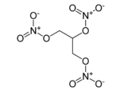
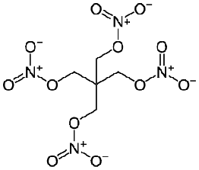
PETN compared to NG
PETN is chemically very similar to nitro glycerine (NG), except PETN is a solid at room temperature, as opposed to NG which is a liquid. PETN is also less sensitive and less toxic than NG.
NG = CH ONO₂ (CH₂ ONO₂)₂ = C₃H₅N₃O₉
PETN = C (CH₂ ONO₂)₄ = C₅H₈N₄O₁₂
NG
PETN

Slide 10
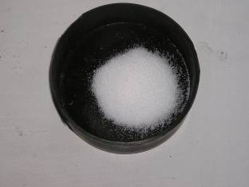
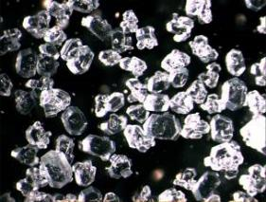
GENERAL PETN PHYSICAL PROPERTIES (GENERIC)
NOTE: This is a slide generally used as a guide for purposes of training / audits. It should be noted that these figures are generic , not absolute
Specific Gravity: ≈ 1.76 g/cm³
Melting point: ≈ 141 ºC
Deflagration point: ≈ 202 ºC
Thermal decomposition: Starts ≈ 120 ºC
Solubility: Soluble in most organic solvents
Practically insoluble in water
Appearance: White crystalline solid
PETN pH changes on heating @120 C in presence of TNT.
Notes:
Data from Urbanski below - pH reducing from pH of 7 to 3 – 4 in approx. in 3 – 4 hrs when heated in presence of TNT

Slide 11
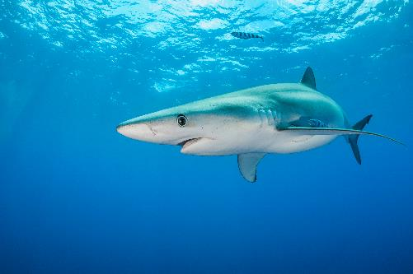


PETN BASIS OF SAFETY (BoS)
Basis of Safety defines key principles and guidelines for operating and process safety. The guidelines are developed from scientific knowledge about material properties and industry experience of accidents.
The levels of sensitivity of PETN to ignition with respect to the following stimuli are as follows:
Sensitivity to impact and friction is significantly increased by the presence of hard particles such as grit, glass and rust.
Elevated temperatures may cause PETN containing acid residues to spontaneously decompose, overheat and lead to a detonation. PETN containing acid residues may decompose even under the ambient conditions. This is discussed in slides 14-16 below
FRICTION | HIGH - leading to detonation
IMPACT | HIGH - leading to detonation
STATIC | MEDIUM - leading to explosion
HEAT | HIGH - fire leading to explosion
CHEMICAL DECOMPOSITION | HIGH - fire-leading to explosion
FISH(C) Principle
FISH(C)

Slide 12
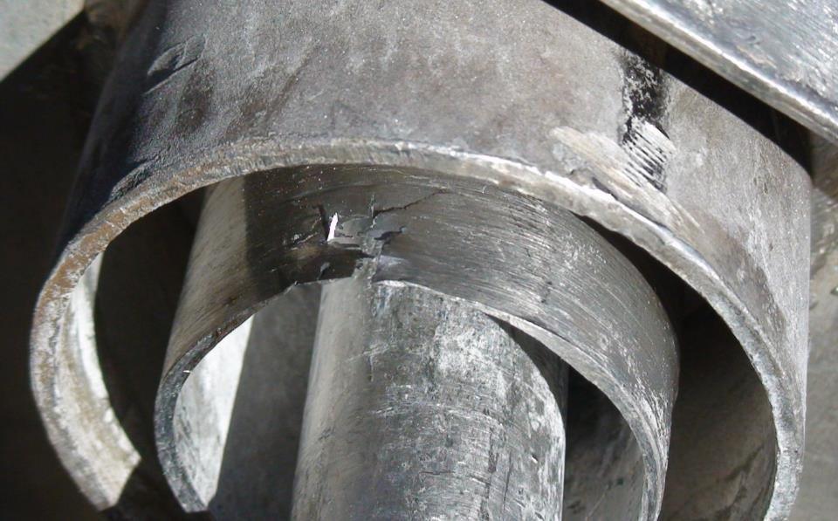
PETN BASIS OF SAFETY (BoS)
PETN may deposit and build up on the insides of valves, pipelines and vessels and fine dust may also migrate into cracks and crevices. Under most of these conditions PETN can/will propagate accidentally even in thin films. These could present a major hazard during maintenance activities.
The adjacent photograph shows cracks, score marks and PETN deposits all of which could potentially contain PETN
NOTE: Alcoholic Potassium Hydroxide (KOH) is normally used for the destruction (decontamination) of PETN. However when used incorrectly the reaction could lead to partial decomposition which in turn may lead to increased sensitivity of the PETN.

Slide 13
FIRES, EXPLOSIONS AND INCIDENTS INVOLVING PETN MANUFACTURE
AND THE PROBABLE INITIATING STIMULI THAT CAUSED OR HAD LED TO THESE TAKING PLACE.
THE REFERENCE TO THESE IS MAINLY THE EIDAS (EXPLOSIVES INCIDENTS DATABASE ADVISORY SERVICE) AND SAFEX DATA BASES. (UNLESS SPECIFIED DIFFERENTLY)

Slide 14
PETN INCIDENTS DURING NITRATION
DATE | INCIDENT | LIKLEY CAUSE
1972 | A fire was caused by the spontaneous ignition of unstable nitration products. These products were formed when nitric acid (containing 12% sulphuric acid) supplied as 96% was used to nitrate pentaerythritol. The testing of the acid had not been routinely carried out. | The likely cause was the use of out of specification nitric acid as a raw material. Presence of sulphates are known to exacerbate PETN decomposition
1993 | PE contaminant on/in the PE feeding chute reacted with nitric acid (splashed up from nitration unit) in an uncontrolled way and caused a spillage which was cleaned up . Subsequently however after the discharge of the next batch into the filter, a fire developed inside the filter. | Nitric acid present in feeding chute reacting with PE during feeding causing decomposition

Slide 15
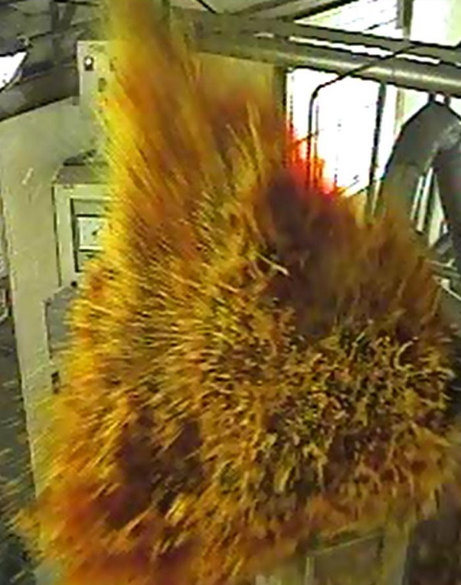
PETN INTERMEDIATE STORAGE POST NITRATION AND PRIOR TO STABILISATION
Three significant explosions occurred and were extremely similar to one another.
All involved PETN that had been placed in an intermediate storage magazine prior to stabilization.
NOTE: Under certain conditions acidic PETN can decompose
which in turn may lead to an uncontrolled/runaway
reaction known as a “fume-off”. Photograph shows a typical
uncontrolled “fume-off”.
The control of all nitration parameters is therefore critical
if explosive decompositions of this nature are to be avoided.
Notes:
This what a violent reaction looks like

Slide 16
3 PETN EXPLOSIONS OCCURRED DURING THE INTERMEDIATE STORAGE OF PETN
DATE | TIME | SITE | EVENT | QUANTITY
08-11-1987 | SUNDAY 22h30 | LORENA BRAZIL | DETONATION FIRE | 29000kg 5000kg
20-11-1989 | SUNDAY 01h20 | SOMERSET WEST SOUTH AFRICA | DETONATION FIRE | 500kg 300kg
16-04-1994 | SATURDAY 02h40 | MODDERFONTEIN JOHANNESBURG SOUTH AFRICA | DETONATION FIRE | 670kg 2500kg

Slide 17
WHY DID IT HAPPEN?
CHEMICAL DECOMPOSITION
DUE TO:
PLANT WORKING UNDER PRESSURE
ACIDIC PETN-NO CHECKS
‘LONG STORAGE’-POOR PRODUCTION PLANNING
POOR ROTATIONAL SYSTEM
VERBAL INSTRUCTIONS
NO TRACKING OF PRODUCT
POOR OPERATING PROCEDURES
SHORT CUTS TAKEN
Notes:
Long storage ?? What is long – 4 hours – 24 hours

Slide 18
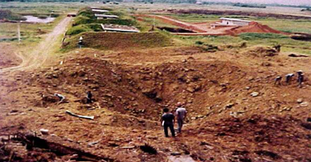
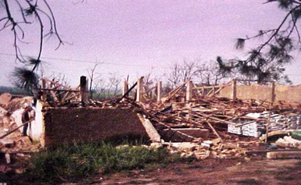
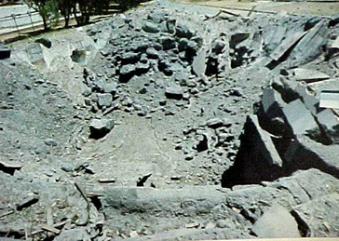
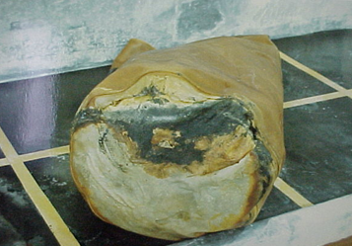
THE RESULT OF THESE DETONATIONS
BRAZIL LORENA
SOUTH AFRICA MODDERFONTEIN
SOUTH AFRICA SOMERESET WEST
PARTIALLY DECOMPOSED PETN IN BAG

Slide 19
PETN (ACETONE) INCIDENTS DURING RECRYSTALLISATION
.
DATE | INCIDENT | LIKLEY CAUSE
1970 | An explosion occurred on a PETN manufacturing plant and may have followed an acetone fire (Caused by autoignition due to sparks or ESD) or an impact event on the vessel lid. The preliminary explosion happened in the dissolving vessel which disintegrated into numerous missiles | POSSIBLE CAUSE FOR THE FIRST 2 INCIDENTS WAS DUE LIKELY TO ESD AND SPARKS AND FOR NO 3 FRICTION
2001 | An explosion of a tank containing 1300l of acetone with 200-250kg of dissolved PETN in it. This was followed by a fire of 2x 25³m acetone tanks.
2007 | A detonation followed by a fire occurred during a PETN recrystallisation process when the operator activated a valve to the distillation column used for recycling the acetone. Residues of di-pentaerythritol hexanitrate (DiPEHN) were later found in the pipes. This may have been an unstable by-product causing the detonation.
1945 | An explosion occurred in a still, formerly used for the recovery of acetone containing explosives (PETN). The accident happened when steam was inadvertently turned on to the still. | PROBABLE CAUSE WAS HEAT APPLIED TO NEGLECTED CONTAMINATED STILL

Slide 20
PETN INCIDENTS DURING DRYING
DATE | INCIDENT | LIKLEY CAUSE
1964 | 2000kg of PETN detonated during a drying operation. The immediate cause was found to be due to an uncontrolled temperature increase in a drier because of a malfunction of the thermostat controlling the steam valve. The thermostat failure was possibly due to, poor maintenance or the lack of redundancy in control system i.e. poor design | OVERHEATING DUE TO THERMOSTAT FAILURE
1987 | A powerful explosion of an estimated 250 kg of PETN disintegrated the building where PETN was being dried in 2 hot air driers. Personnel were only slightly injured. | PROBABLE CAUSE OF INCIDENT MAY HAVE BEEN AN ELECTRICAL FAILURE OR FAULTY THERMOSTAT CAUSING
Not defined | In this operation PETN was dried in open, circular steam heated pans which are agitated at very slow speeds. Reportedly, the drying was completed at the end of the 2nd shift the previous day i.e. around 10 pm on 8 December. At about 07:00 am on the morning of 9 December, the supervisor accompanied by an operator went to the drying room to remove the dried PETN from the drying pans. It is possible that the explosion occurred while they transferring the PETN into bags. Both were killed. Plant damage was significant. | CAUSE NOT IDENTIFIED – NOTE HOT PETN HAS HIGHER SENSITIVITY
NOTE: It must be borne in mind that dry PETN is very sensitive to friction, impact and under certain conditions static electricity. These possible ignition sources must be eliminated during handling.

Slide 21
PETN DETONATIONS DUE TO IMPACT
DATE | INCIDENT | LIKLEY CAUSE
1980 | A trace of PETN ignited when an operator dropped a pair of scissors on to floor. | THE MOST PROBABLE CAUSE FOR ALL OF THE THESE WAS IMPACT
1954 | There was a minor detonation of PETN when a concrete sump cover of a drying oven/stove was dropped.
1982 | A man was seriously injured while he was repairing cracks on the concrete floor of a PETN drying room with hammer and chisel. The material in the crack was evidently contaminated with dry PETN possibly present after poor decontamination procedures.
1992 | A PETN explosion occurred while being transported in a vehicle. The probable cause of the product’s detonation was the impact action, caused by the high speed of the truck moving along a rough road, on the product which had spilled and lodged between the sleeves and the bottom of the box.
1976 | While cleaning scale from a nitrator, the workman, after having failed to remove the scale by other means, used a steel chisel. This led to a powerful explosion hurling pieces of metal around. The man was killed by one of these fragments.
 | At the PETN stabilisation unit, the operator removed an empty 200 litre plastic container with an open top from the elevator. As he placed it on the emergency exit platform of the unit’s second floor, the container bumped against the platform’s metal grating and a minor detonation occurred. The detonation was probably due to impact on the PETN which had accumulated on the outside of the container. It had become normal practice for the contaminated container to be placed outside the designated operational area where it should have been kept wet.

Slide 22
PETN DETONATION DUE TO HEAT
DATE | INCIDENT | LIKLEY CAUSE
1997 | The explosion of waste PETN, polluted by rust, occurred 4 mins after ignition on burning ground. The explosion caused the destruction of the metallic plate which contained the waste, with debris projected up to 300 m. | LAYERS OF CONTAMINATED PETN PROBABLY EXCEEDED LICENCE OR CRITICAL THICKNESS/HEIGHT AND WERE CONFINED.
2000 | An explosion of approximately 50 kg of PETN occurred in the PETN destruction pan on the Burning Ground. There were no injuries, but extensive damage was caused to the surrounding buildings
1945 | During the burning under of 20 lbs. of waste Penta-erythritol-tetranitrate on a burning ground, the material burnt for a short time and then detonated. No injuries | LAYERS OF CONTAMINATED PETN PROBABLY EXCEEDED LICENCE OR CRITICAL THICKNESS/HEIGHT AND WAS CONFINED.
1976 | A grass fire reached a magazine area. In spite of the efforts of the firemen, the fire progressed and reached the magazines. Only one of them, containing about 30 tons of wet PETN, detonated. The detonation took place after the heat of the fire had evaporated most of the water. No personnel injuries were reported. | DUE TO HEAT AND CONFINEMENT
1980 | An explosion due to detonation of PETN present in the bore of a mild steel pipe. This was lying with other PETN contaminated pipes in a mixed pile of metal scrap and being prepared (cut up) for disposal. | HEAT OR SPARKS (from oxy-acetylene torch used for cutting these)

Slide 23
PETN DETONATION DUE TO FRICTION
DATE | INCIDENT | LIKELY CAUSE
1951 | When unclamping the lid of the stabilizer a minor explosion of PETN between nut and bolt threads occurred. Minor injury. | LIKELY CAUSE FRICTION OR STATIC
1954 | A minor detonation of PETN occurred when a cover of a concrete sump (with effluent from drying oven/stove) was dropped. No injuries. | LIKELY CAUSE IMPACT
2007 | At a military explosives and blasting accessories plant, on the third shift (10:45 pm-06:45 am), the operator was busy with the process of recycling/reclaiming acetone during the re- crystallization of PETN. A detonation occurred and a fire initiated when the bottom drain valve of the distillation column’s containing acetone with dissolved or partially dissolved PETN and DiPEHN was activated. The operator received extensive injuries and burns. | LIKELY CAUSE WAS FRICTION CAUSED BY THE ACTIVATION OF THE VALVE

Slide 24
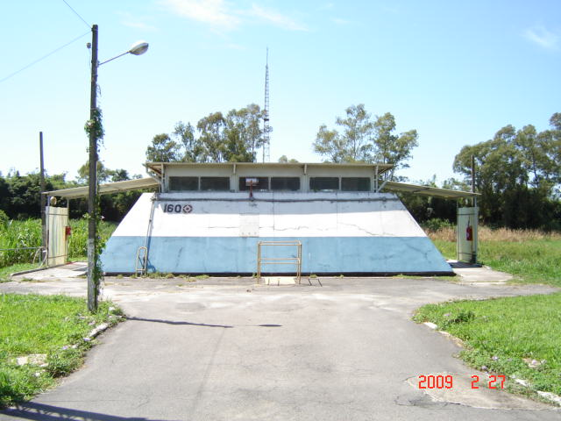
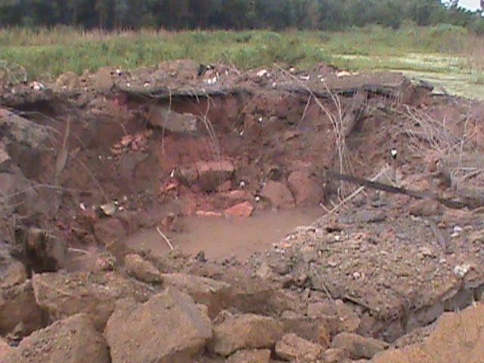
PETN EXPLOSIONS DUE TO DECOMPOSITION
DATE | INCIDENT | LIKELY CAUSE
1993 | A violent decomposition in the nitrator on a PETN plant, led to fire on the PETN filter. The accident occurred due to the instrument for controlling the amount of nitric acid not having been calibrated. This led to a reduced flow of nitric acid in the reactor. | DECOMPOSITION OF ACIDIC PETN/ POOR MECHANICAL MAINTENANCE
Not defined | An operator found that a fire had ignited on the top of the acid spray tank in the BLAZZ1 PETN compound. It is believed that the fire had been caused by the combustion of the non-stabilised acidic PETN | SPONTANEOUS COMBUSTION OF A FILTER CLOTH IMPREGNATED WITH UNSTABILISED PETN
2010 | In a PETN sieving building, a waste bag in a bin in sieving house autocatalyzes , a fire occurred at the end of the shift. This led to a detonation of the PETN. The PETN had been outsourced and was found to have had a high acid content. As the PETN dried it decomposed and caused a fire which under confinement resulted in a detonation. | DECOMPOSITION OF ACIDIC PETN

Slide 25
DETONATIONS INVOLVING DETONATING CORD/FUSE MANUFACTURE
(EXPLOSIVES COMPONENT PETN)

Slide 26
DURING DETONATING CORD EXTRUSION
Date | Incident | Likely cause
13/02/1990 | In South Africa on the 13/02/1990 two explosions occurred in the same week during the process of extruding detonating fuse. No one was killed but 1 person was injured. In both cases residual PETN in the extruder crosshead assembly detonated about 5 minutes after completion of the operation of extruding a 1500m reel of 10g/m detonating fuse. Damage was very similar in both cases. | Heat exposure of accumulated PETN in extruder cross head assembly. To remove the PETN fines an extraction system was installed
1989 | In South Africa 1989. A detonation occurred when Premium Cordtex 10 was left in the extrusion head at 162ᵒC for approximately 3 minutes. This was in contravention of the stipulated 30 seconds. This was before an auto cutter was installed. | Cord left for extended time in extrusion head @162°C
References EIDAS and http://www.eig2.org.uk/wp-content/uploads/2016/04/RemoteManfrExplosGuide-edn1_2.pdf

Slide 27
DURING DETONATING CORD SPINNING
DATE | INCIDENT | LIKELY CAUSE
1984 | A detonation occurred on a spinning machine at the Detonating Fuse plant. The incident occurred immediately after the introduction of the PETN powder. New dies had been installed on machine. Dies did not meet the specification and were too small. | MOST LIKELY CAUSE WAS EXCESSIVE FRICTION EXACERBATED BY THE CRUSHING OF THE PETN CRYSTALS IN THE FUSE CORE IN OR ABOVE THE SPINNING PLATE DIE.
2010 | During the spinning stage of manufacturing detonating cord, the operator had to enter the spinning cubicle to attend to a stopped the machine. While working on the machine an explosion occurred. The operator was killed and there was extensive damage to both the machine and the building. Feed funnels were changed to soft conductive materials. | THE CAUSE WAS NOT IDENTIFIED BUT WAS SUSPECTED TO BE IMPACT FROM DROPPED METAL PETN FEED FUNNEL
Notes:
Can we add approx. dates – yrs?

Slide 28
DETONATING CORD SPINNING CONT.
DATE | INCIDENT | LIKELY CAUSE
1983 | In South Africa 02/04/1983. An explosion occurred in the spinning house of a detonating fuse plant killed 1 person. The machine on which the explosion occurred contained 15kg of explosive. The detonation did not propagate to other machines and timber from the roof thrown up to 120m | POSSIBLE CAUSE WAS FRICTION (IT WAS SUSPECTED THAT THE DIES WERE OUT OF SPECIFICATION BUT THESE WERE NOT FOUND)
1998 | In Germany, an explosion occurred in the spinning house due to unknown cause. The amount of dried PETN which detonated is estimated to be about 400 - 500 g. The detonation caused the SYMPATHETIC ignition of the blackpowder, semi safety fuses and igniter cords in the nearby safety fuse compartment | POSSIBLE CAUSE NOT DETERMINED OR STATED BUT INDICATIONS OF POOR EXPLOSIVES PRACTICE

Slide 29
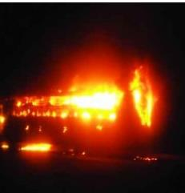
EXPLOSION-DETONATING CORD INDIA
At 02h00 on the 01-08-2014 at the Navbharat Fuse Company Ltd., five workers were killed in a major explosion which occurred in the detonating cords manufacturing unit. This was part of a 200-acre factory. Two other persons, including the factory supervisor, were also on duty but were not on site at the time.
A unit with 142kg of PETN stored in it, was destroyed. According to eyewitnesses, the explosion was followed by a fire which gutted everything.
The other units and buildings on the premises, including the store where stocks of explosives were kept, were not affected. According to RC Srivastava, Director of the State Forensic Laboratory, an inspection by his team, revealed that the explosion affected about 200 ft² area and the entire building around it collapsed and the explosion left a 12ft x12 ft crater, which was 3ft deep.

Slide 30
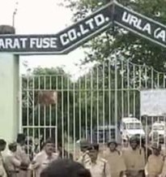
EXPLOSION-DETONATING CORD INDIA CONT.
RC Srivastava also stated that seven bundles of detonating cord each having a length of 1800 -2000 m were inside the premises. 16kg of PETN was contained within each of detonating cord bundle and 30kg of PETN explosive powder was also kept in containers inside the unit. It is estimated that 142kg of PETN was inside the unit.
A senior official of the Explosive Controller department, said a preliminary investigation also indicated that a large amount of PETN was stored on the premises. This was not allowed,.
He also alleged that the factory did not have adequate safety equipment and claimed that workers have been demanding proper safety arrangements for many years but the management had paid no heed to it.
He claimed that the factory had been established in 1985 and most of the equipment used there was out-dated and worn out, that no technical employee was present in the factory when the mishap occurred and that unskilled labourers were handling highly explosive materials.
msiac.nato.int/news/accidents-july-august-2014
LIKELY CAUSE – POOR SYSTEMS, MANAGMEMENT , OUTDATED EQUIPMENT , UNSKILLED LABOUR OF ASSETS, CAUSE WITH POOR PRACTIVES

Slide 31
THREE DETONATIONS INVOLVING BOOSTER MANUFACTURE EXPLOSIVES COMPOSITION
PETN AND TNT
OR
PETN AND TNT AND COMPOSITION “B” 60/40 RDX/TNT

Slide 32
THE INFAMOUS HAMMER AND SCREWDRIVER INCIDENT
On the 21-08-1989 a plant in the USA was manufacturing Pentolite PETN/TNT boosters.
The workers were mixing TNT and PETN in two kettles. These were heated to ~ 100ᵒC using steam heated water.
The flow of the hot water was reduced due to a pump malfunction.
This caused the TNT-PETN mixture to solidify in a pipe beneath one kettle.
Employees #1 and #2 tried to remove the blockage by using hot water, with the pipe in place. This was unsuccessful.
The pipe containing the solid mix was removed and placed on the floor. An employee then tried to unblock the pipe by using a screw driver and a rawhide mallet.
This caused the shock-sensitive TNT-PETN mixture to explode causing the death of two employees and injuring two others.
CAUSE IMPACT

Slide 33
EXPLOSION AT THE SIERRA CHEMICAL COMPANY USA BOOSTER PLANT
THIS INCIDENT HAS MANY TAKE HOME LESSONS
Reference
https://www.researchgate.net/publication/280085816_Accidents_in_Explosive_Manufacturing
THE EXPLOSION/ INCIDENT
On January 7, 1998, on a facility used for booster manufacturing and PETN drying an explosion occurred during a “Melt-Pour” operation involving TNT/ PETN and Composition B (60/40 RDX/TNT .
Two massive explosions just seconds apart destroyed the explosives manufacturing plant 10 miles east of Reno, Nevada, KILLING 4 WORKERS AND INJURING 6.
The initial explosion occurred in a room (Booster room 2 see next slide RED circle) where the boosters were manufactured.
3.5 seconds later, a second and more powerful blast destroyed the adjacent PETN building (See next slide BLUE circle) used for drying explosives, leaving a 40-by-60-foot (12mX18m) crater 6 feet (1.8m) deep.
The total mass of explosive involved was estimated at 47,000 lbs (~21329kg)

Slide 34
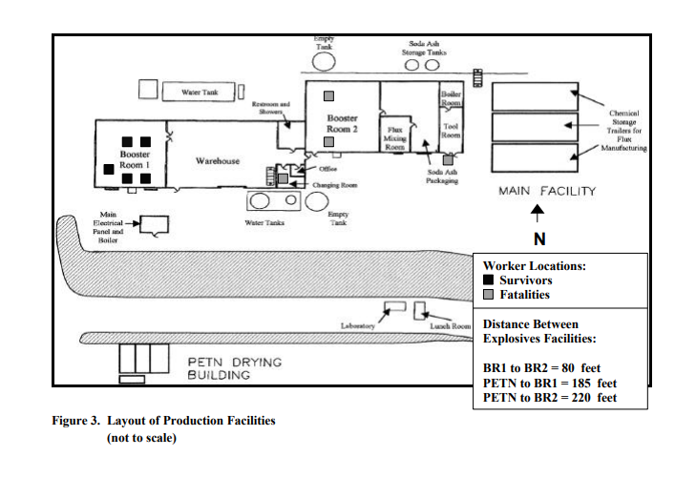

Slide 35
FINDINGS/NOTES INVESTIGATORS BY THE U.S. CHEMICAL SAFETY BOARD (USCSB)
There was no physical evidence or eyewitnesses to conclusively pinpoint the cause of the explosion, however the identified the following most credible scenario:
The base booster mix which had been left overnight in a mixing pot stratified and solidified. It was calculated that about 50 to 100 pounds (45-90kg) of explosive was in the mixing pot.
The day before the incident only one operator was in the booster. The next morning, the same operator did not inspect the mixing pots before starting up again.
When the mixer was turned on, the mixer blade DETONATED THE EXPLOSIVES.
THIS WAS PROBABLY DUE TO IMPACT, SHEARING DUE COLD START / FRICTION.
It was hypothesized that a heavy piece of equipment or burning debris (MISSILES)from the first blast most likely fell through the roof or the skylight of the PETN building, initiating the second explosion just 3.5 seconds later.
DETONATION WAS PROBABLY DUE TO IMPACT AND OR HEAT OR THE SHOCKWAVE FROM THE FIRST DETONATION

Slide 36
FINDINGS/NOTES CONT.
The facility melted, mixed, and poured cast boosters in two separate production areas using large heated stainless steel melting/mixing “kettles”.
The company was getting some of its “raw materials” from military explosives such as torpedoes; rockets; motor shells and bombs. Sometimes; nuts, bolts and other objects from the above materials would be discovered in explosive mixing pot.
Management had the misconception (firmly believed), that unless a cap is used, it was nearly impossible to detonate the product. TECHNICALLY THIS WAS NOT ACCURATE.
The production room had been in service for less than four months and several substantial changes compared to the old production area had been made. These include “kettles” heated by steam as opposed to hot water and direct drive mechanical agitation instead of hydraulic agitation had been installed.
A metal hammer was being used to break up lumps of explosive
Management had the misconception (firmly believed), that unless a cap is used, it was nearly impossible to detonate the product. TECHNICALLY THIS WAS NOT ACCURATE.

Slide 37
BOOSTER MANUFACTURING PLANT EXPLOSION CONCLUSIONS BY THE INVESTIGATION TEAM
THE FOLLOWING WERE POSED AS POSSIBLE CAUSES OF THE EXPLOSIONS AND INCLUDED:
RAW MATERIAL CONTAMINATION. (THE RISK POSSIBLY POSED AS A RESULT OF USING CONTAMINATED EXPLOSIVE MATERIAL WAS NOT ADEQUATELY STUDIED)
IMPACT
SHEARING/FRICTION DUE A COLD START UP
THE INVESTIGATION ALSO RESULTED IN CITATIONS BEING HANDED DOWN FOR VIOLATIONS OF THE PROCESS SAFETY MANAGEMENT (PSM) SYSTEMS DEALING WITH:
EMPLOYEE PARTICIPATION,
PROCESS SAFETY INFORMATION (THE LACK OF),
PROCESS HAZARD ANALYSIS,
OPERATING PROCEDURES,
TRAINING,
PRE-START UP SAFETY REVIEWS,
MECHANICAL INTEGRITY
MANAGEMENT OF CHANGE PROCESS

Slide 38
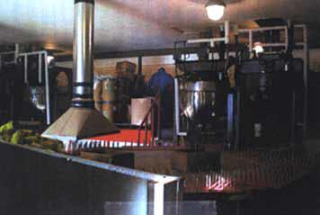
BOOSTER ROOM BEFORE EXPLOSION

Slide 39
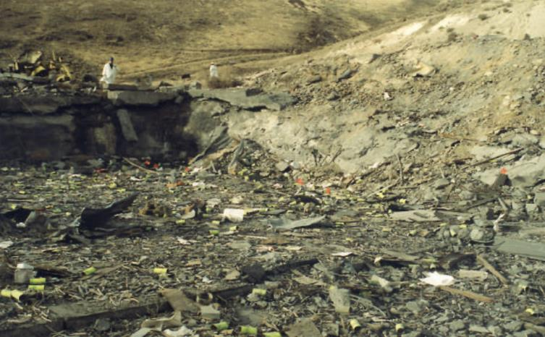
BOOSTER ROOM AFTER EXPLOSION
Aftermath of the Sierra Chemical explosion.
12,000 lbs of Pentolite were in Building 2

Slide 40
THE REPORT ON THE SIERRA INCIDENT
IN THE INVESTIGATION REPORT REFERENCE:
https://www.csb.gov/assets/1/20/final_sierra.pdf?13909
OF THE
U.S. CHEMICAL SAFETY AND HAZARD INVESTIGATION BOARD
IN APPENDIX G IS GIVEN:
A LIST OF 13 ACCIDENTS INVOLVING MELT/POUR INCIDENTS FROM ELSEWHERE. (The source of this data is the U.S. Army and the IME) AND WAS FROM FROM 1916 TO 1989.
THESE RESULTED IN 126 FATALITIES, 250 INJURIES
AND
WORTH MANY MILLIONS OF $$$$ OF ASSETS AND INFRASTRUCTURE WAS DESTROYED

Slide 41
SAFEX – E-LEARNING MODULE
AN E-LEARNING MODULE, SPECIFIC TO THE SIERRA INCIDENT, WILL BE COMPILED
AND
ONCE COMPLETED WILL BE AVAILABLE AT:
https://www.safex-international.org/

Slide 42

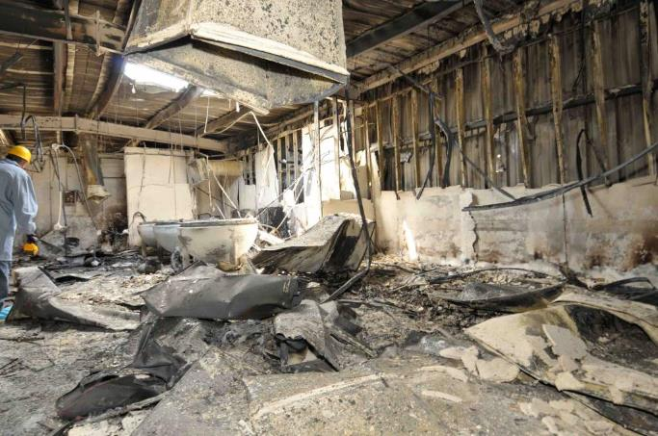
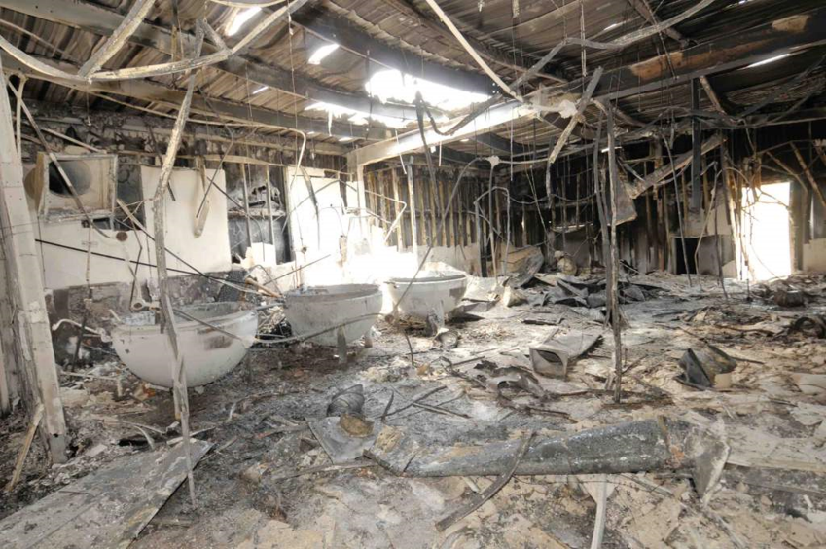
Booster Manufacture - DECOMPOSITION
DATE | INCIDENT (SAFEX INCIDENT REF: IN04-11) | LIKELY CAUSE
2011 | A tray involved had been pulled out of the cooler when an operator noticed fumes coming out of one of the boosters. The operator followed the prescribed evacuation procedure. A fire subsequently broke out in the building. The exact time it took for fire to spread from boosters to consume all materials in room is unknown. | PROBABLE CAUSE - EXOTHERMIC REACTION OCCURRING BETWEEN THE DEGRADING AGENT AND THE BOOSTER INGREDIENTS LEADING TO A FIRE. SUCH A REACTION COULD GENERATE SUFFICIENT HEAT TO CAUSE A RUNAWAY REACTION IN THE BOOSTER

Slide 43
LESSONS LEARNED FROM THE ABOVE AND OTHERS
Maintenance and other
43%
Operations
55%
Nitrator related incidents
45%
Decomposition of acidic PETN
25%
Clearing of clogged pipes – 20%
Decontamination or usage of incorrect tools
Plant design
30%
Nuts/ bolts explosions
Disposal of contaminated material
Hot work
PETN in dangerous acidic range
Nitration rate
PETN acidic
Incorrect raw material specification
Ball valves
Trapped Material
Metal friction
Notes
Data of 130 incidents .
10 taken from G.S. BIASUTTI (Jan. 1985) and 118 from SAFEX/EIDAS.
The presentation is qualitative rather than accurately quantitative.
Classification is according to author’s focus.
Some speculation on cause is not excluded.
% figures have been heavily rounded.
NOTE:
Older plants used a mixed acid consisting of H₂SO₄ AND HNO₃ – THE PRESENCE OF SULPHATES PROBABLY CAUSED 4 OF THESE INCIDENTS.

Slide 44
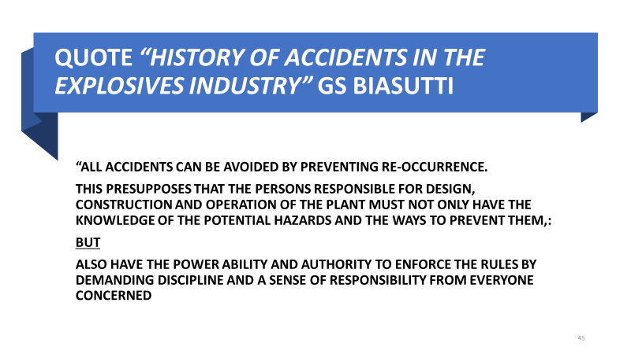
SUMMARY
118 accidents
ANALYSES OF 118 PETN ACCIDENTS IN 24 COUNTRIES (INFO FROM EIDAS)
ACTIVITIES NUMBER OF INCIDENTS
DETONATOR PRESSING AREAS 18
MAGAZINES 6
NITRATION -INTERMEDIATE STORAGE 8
GRANULATION/RECRYSTALLISATION 4
ACETONE 4
DRYING 10
SPINNING 13
BURNING GROUND 6
BOOSTERS 4
IMPACT/FRICTION (HAMMER+CHISEL) 6
WELDING
THERE WERE 23 FATALITIES,18 INJURIES AND EXTENSIVE DAMAGE TO MANY BUILDINGS
EXTRUSION 9
OTHER 22
ELECTRICAL AND THERMOSTATS 6

