Slide 1
October 2021
Nitrite and Other Contaminants
Scott Pelling
Senior Manager – Global Safety

Slide 2

AT A GLANCE
MORE THAN 12,000 EMPLOYEES
145⁺ YEARS OF INNOVATION
200⁺ TECHNOLOGISTS
CUSTOMERS IN MORE THAN 100 COUNTRIES
Safety is our Priority. Always.
5 MAJOR TECHNICAL CENTRES

Slide 3
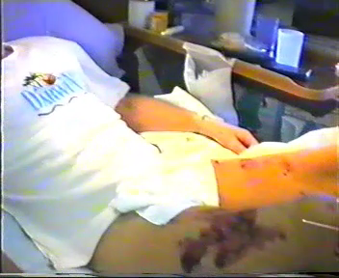
CORPORATE MEMORY?

Slide 4
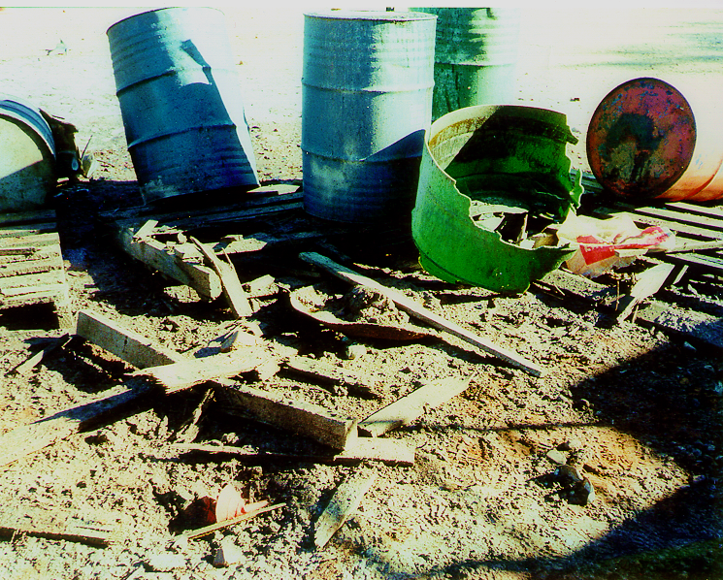
THE “ARGYLE EVENT”
Inadvertent mixing of SNi, AN and other wastes in a plastic drum on a pallet
Fuming occurred after delay
Operators tried to extinguish
Explosion occurred, seriously injuring 2 operators
Both were unable to resume their careers with Orica
Plastic shrapnel travelled 55m, plastic projectiles split a hard hat and damaged a truck tyre at close range

Slide 5
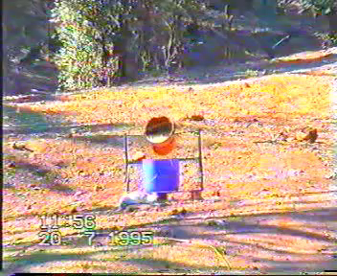
ARGYLE “LEARNINGS”
Reaction of SNi, AN and other wastes is complex in the real world
Segregation is critical
Segregation without identification is impossible to manage
Emergency Response - what steps to take?
Knowledge of the hazard and controls is essential

Slide 6
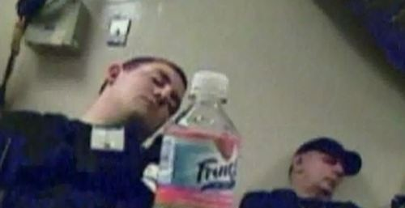
Nitrite Contamination - Mechanism
We know Ammonium Nitrate can explode – it pays our bills!
We know AN and Sodium Nitrite react – this is the basis for “gassing” emulsions:
NH₄⁺_{(aq)} + NO₂⁻_{(aq)} N_{2(g)} + 2H₂0_{(l)}
We know this reaction is complex, and involves intermediate species, including NOx
We know that it is affected by pH and water content
We know that AN and SNi can react to form Ammonium nitrite, which is unstable and explosive
We know that mixtures of AN and SNi are more reactive than either material alone ⁽¹⁾
BUT – who needs to know what?
Operators when chemical equations appear on screen
(1) Stefania Cagnina, Patricia Rotureau, Shanti Singh, Richard Turcotte, Guillaume Fayet, et al.. Theoretical and experimental study of the reaction between ammonium nitrate and sodium salts. Indus- trial and engineering chemistry research, American Chemical Society, 2016, 55 (47), pp.12183-12190. ‌10.1021/acs.iecr.6b02834‌. ‌ineris-01863107‌

Slide 7
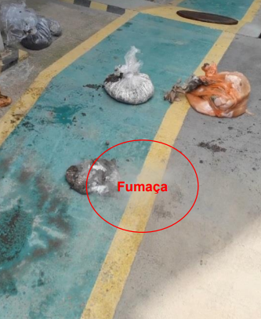
A more recent example…
WHAT
Operator noted fumes coming from an emulsion waste container
Operator emptied the container and applied water
No explosion…..this time
HOW
Nitrite waste came from a leaking truck
Spill was not cleaned up promptly, and dried out
Person who cleaned it up assumed it was AN residue and placed it with other AN wastes
Fumes were noted half an hour later

Slide 8
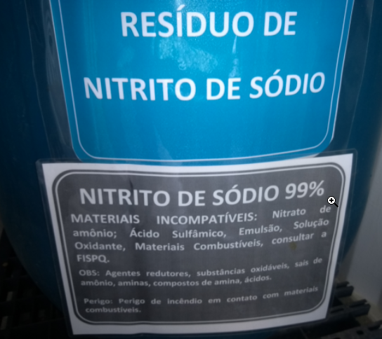
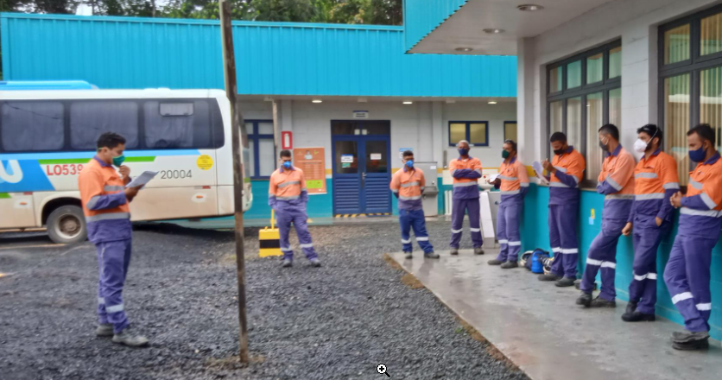
A more recent example…
WHY
Housekeeping in maintenance area was not applied
Not all site personnel were trained in hazards of incompatible materials
Formulations did not include dyes for gasser solution
Waste Management Plans had not foreseen SNi presence outside designated areas
Emergency Response Plan was not specific on this type of event
“Do not fight fires involving explosives” was well understood, but not applied
Other scenarios advised “combat if not out of control”

Slide 9
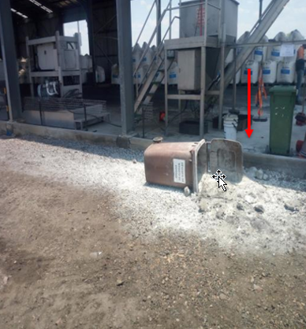
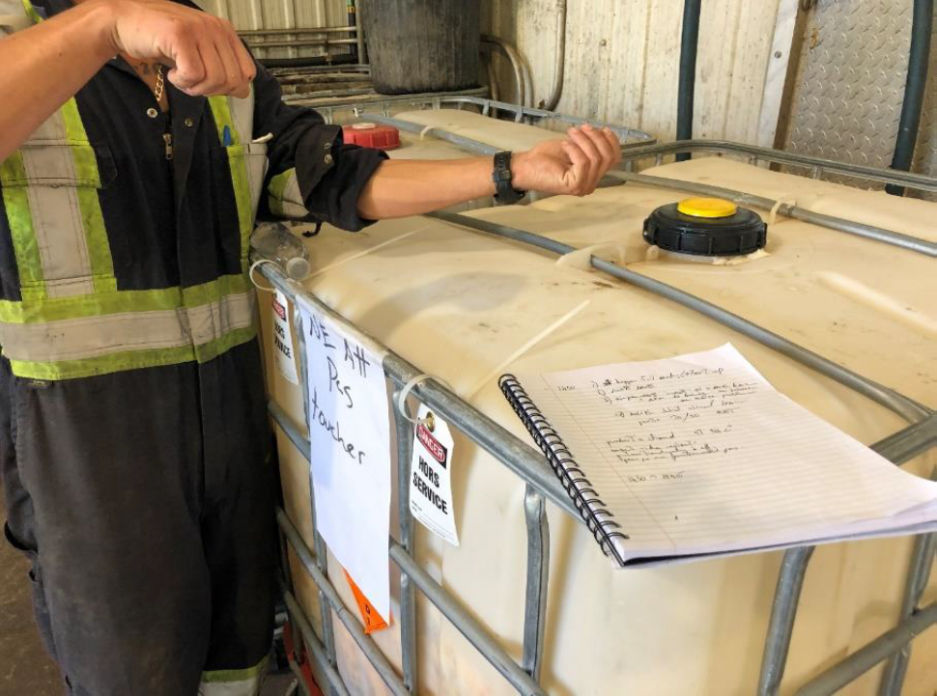
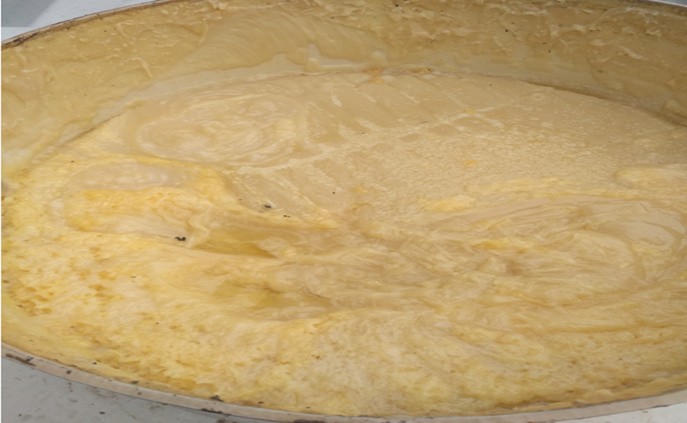
Other examples…
Event | AN Prill waste bin smoking | NOx generated In Waste IBC | Emulsion tanker reaction
Actual Impact | Minor Clean-up and investigation | Low Employee exposed, no lasting effect | Minor Product loss, clean up and investigation
Segregation? | Present | Present, did not prevent inadvertent mixing | Present, did not prevent inadvertent mixing
Hazard Awareness? | Partial | Good | Good
Waste Management? | Poor | OK | Good
Emergency Response? | Adequate, not followed | Good | Good

Slide 10
New Learnings from these Events…

Slide 12
RE-Learnings from these Events…

Slide 13
Re-learnings…
All personnel need to understand the hazards of nitrites and other contaminants
Not just operators or managers or technical staff
Need to make sure the information is relevant and “consumable” for the audience
Need to be creative when thinking about wastes
How and where they might be generated
What might go wrong
How changes (to plant/equipment/processes) might affect waste management plans
Emergency Plans
Need to be clear, specific and conservative
Segregation needs to be considered in design and operations
Consider human factors to improve chances of success

Slide 14
“wise men profit by the mistakes of others, while fools will not learn even from their own blunders” - Benjamin franklin
“IT is unwise to be too sure of one's own wisdom. It is healthy to be reminded that the strongest might weaken and the wisest might err.” - MAHATMA GANDHI
Questions?

