Slide 1
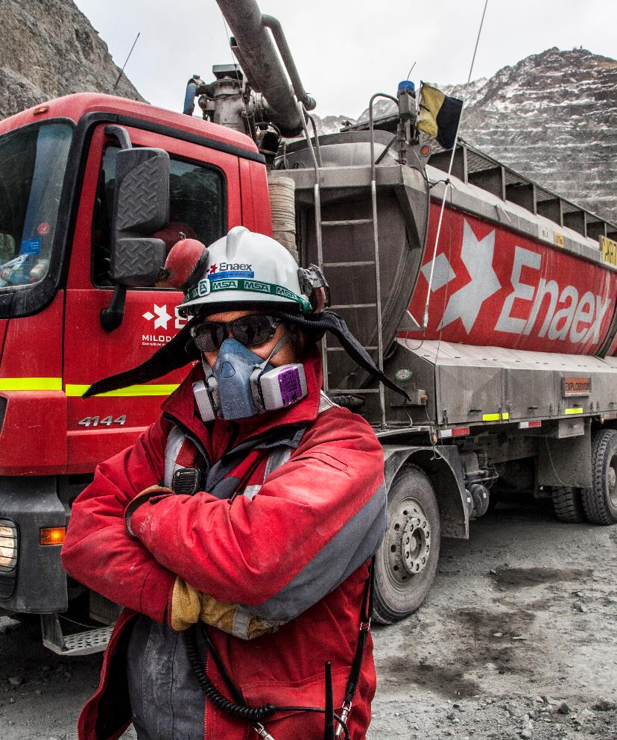
Flashing mixture initiation
October, 2021

Slide 2
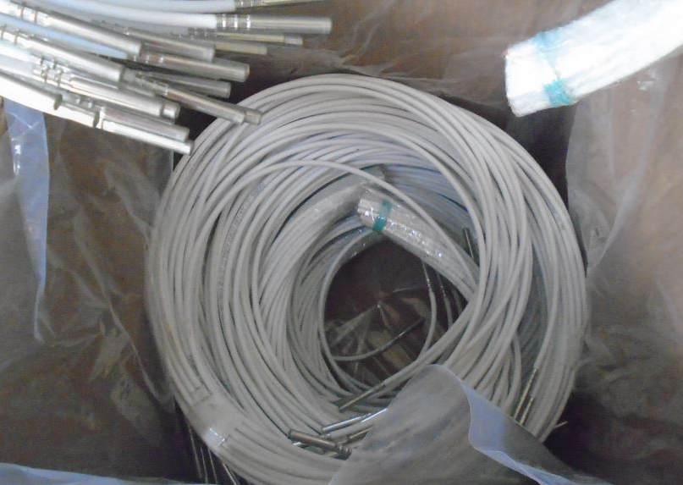
Flashing mixture initiation
INCIDENT DESCRIPTION
During normal operation at the cap and fuse assembly line, an unexpected deflagration occurred resulting in
1st and 2nd degrees burn to one operator (LWC).
The flashing mixture was prepared (mixed) and kept in a primary conductive pot that could hold up to 200g. The operator would take a small quantity on a secondary conductive pot for further handling.
As the operator was removing the lid on the primary pot the flashing mixture initiated. When the incident occurred, there was approx. 60g of the mix in the pot.
Flashing mixture: Zarcon, Boron, Nitrocellulose and Ethyl Acetate.

Slide 3
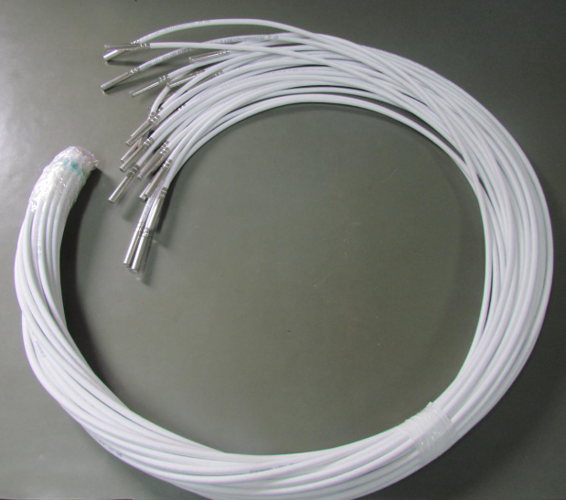
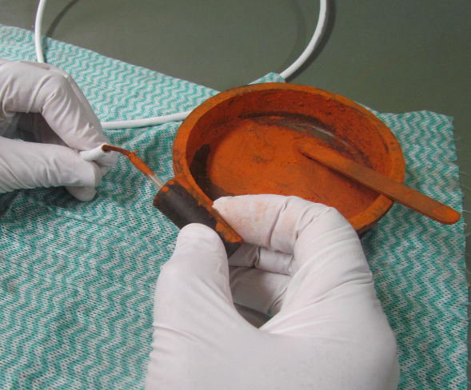
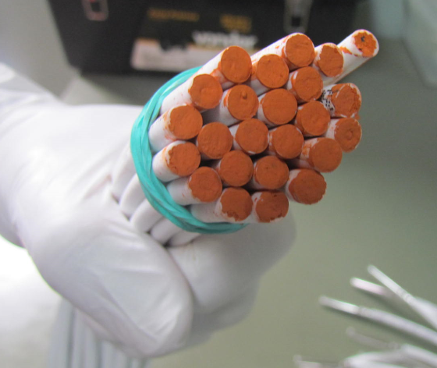
Flashing mixture initiation
PROCESS DESCRIPTION
The assembly of the cap and fuse consists of:
Crimping the cap to the fuse
Diluting of the flashing mixture with ethyl acetate
Apply the flashing mixture to the edge of the safe fuse (to prevent ingress of humidity and easier lightning).

Slide 4
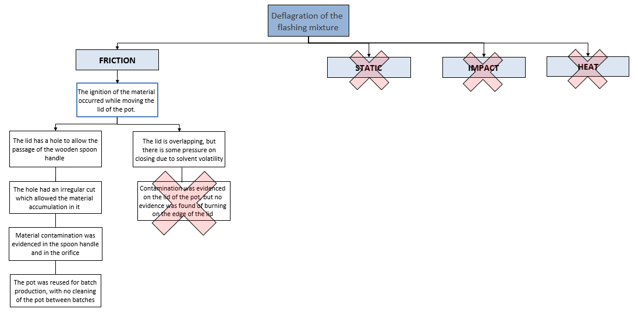
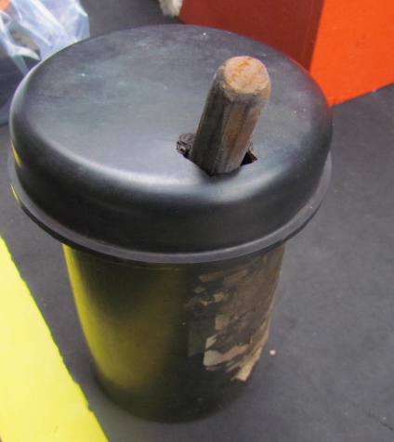
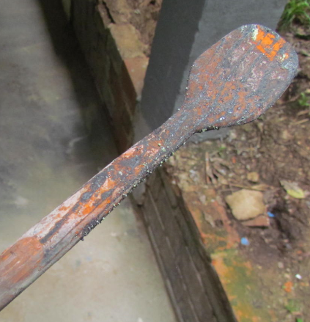
Flashing mixture initiation

Slide 5
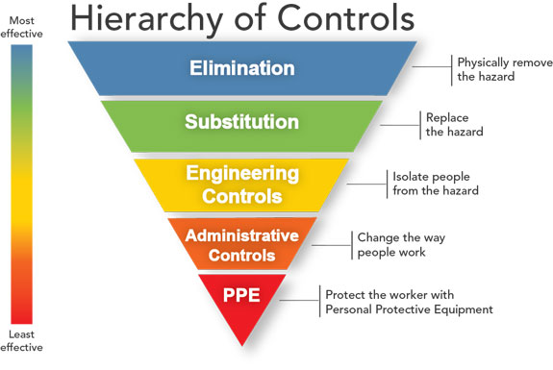
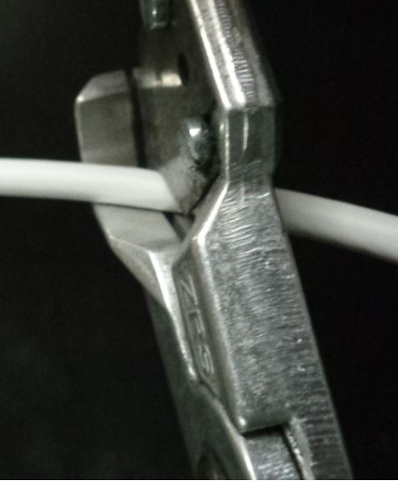
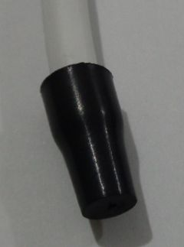
Flashing mixture initiation
ACTION PLAN
Full revision of the product / process
Elimination of the entire production process of this flashing mixture.
MOC analysis in order to eliminate the flashing mixture.
Field analysis to assure that the change would not affect client's operations
Update of Safety Data Sheet.

Slide 6
Thank you!
Bianca Sella
bianca.sella@enaex.com
Joao Roorda
joao.roorda@enaex.com

