Slide 1

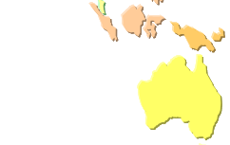

SAFEX Activities Update
SAFEX International

Slide 2
Incident Reporting
Incident Notices Filed :
        2022 - 11 Notices
        2023 - 11 Notices
        2024 – 17 Notices

Slide 3

WEBSITE
Upgraded Search Software Platform
Upgraded Search Engine
Addition of Learning Modules:
        Emulsion Explosives Safety
        ENAEX Periodic Hazard Studies
        Sierra Explosion Animation
        Dedicated BoS page
        Webinar Page
        Newsletter
Under Preparation:
  Argyle Incident – Orica
  Porgera incident -Dyno
Incident database:
      Oldest Notice -1927
      Total Notices/Reports till date 16315

Slide 4

eLearning
7 Learning Modules with Assessments
Available Languages:
      English
      Spanish
      Portuguese
      French
      Russian
Active Users : 1352

Slide 5

Good Practise Guides
Developed by International Work Groups
Currently 12 GPGs available
English / Spanish
7 More under preparation completion 2024/2025

Slide 6
Good Practice Guides
GPG 01 Foreign Bodies
GPG 02 TGAN Storage
GPG 03 ESD Technical Guide
GPG 04 Disposing of Blasting Explosives
GPG 05(1) Remediation-Historical Reviews
GPG 05(2) Site Investigation
GPG 05(3) Remedial Options and Techniques
GPG 05(4) Implement and Monitor the Remedial Options
GPG 06 Transportation of Technical Grade AN
GPG 07 Transportation of AN Solution
GPG 08(1) Emulsion Good Practice document
GPG 08(2) Emulsion Good Practice document
GPG 09 Decontamination of Equipment
GPG 10(01) Watergel Suspension Best Practice
GPG 10(02) Watergel Suspension Best Practice
GPG 11 PETN Manufacturing
GPG 12 Transport of ANE’s
Under Preparation:
    ESD Update
    Explosives Transport
    Shock Tube
    Primaries
    Process Safety Incidents
    Management of Change
    Explosives Security

Slide 7
Webinars
Commenced in 2021 to fill gap between Congresses
Attendance:
Webinar 1-203 - Lessons Learned from Past Incidents - Austin Powder
Webinar 2 -190 - Safety in Explosives Manufacturing and Application –Austin Powder
Webinar 3 -193 - Safety in PETN Manufacturing- PETN Working Group
Webinar 4 -133 - Transportation of Explosives - ORICA
Webinar 5 -179 - Management of Change - EPC
Webinar 6 -195 - Management of Change - EPC
Webinar 7 -260 – Learnings from Packaged Explosives Incident - ORICA

Slide 8
Media
Two Newsletters Annually
      Current publication is No 81
LinkedIn Page
      Currently 0ver 900 followers
      Need your support for posting SHE related news/incidents

Slide 9
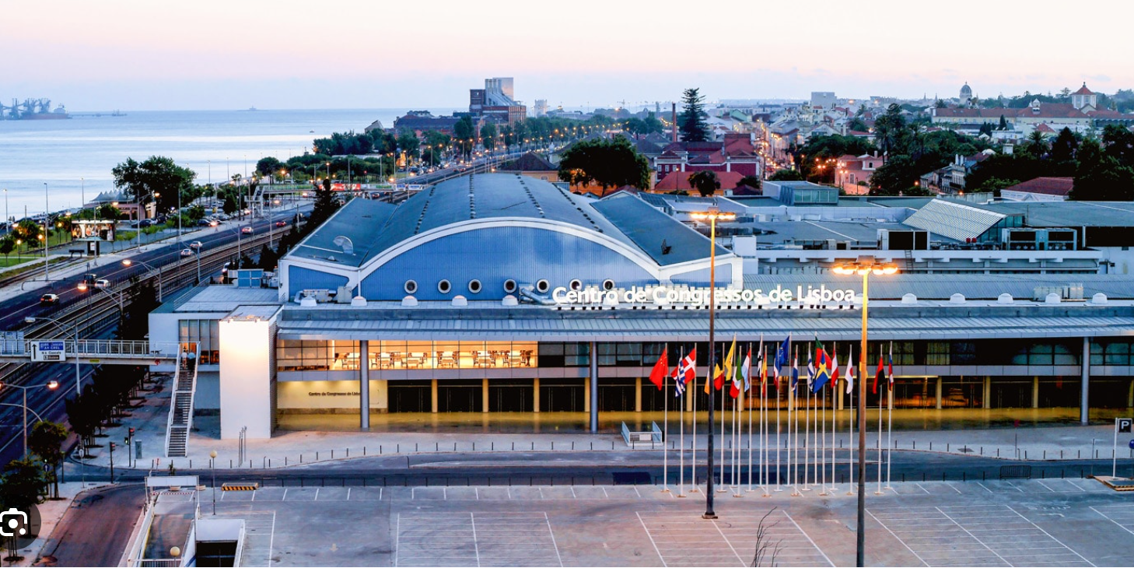


Congresses
Next Congress XX1 To be held in Lisbon in 2026 -20th-24th April
Local Host: ORICA

