Slide 1
An analysis of incidents involving PETN
Source SAFEX/EIDAS database/review by Paulo Siqueira
Andy Begg

Slide 2
Value of reviewing old incident reports?
Increase personal knowledge about the process and products
Identify specific areas of process safety that may apply to your facility
Identify process activities that have higher probability of being involved in an incident in the future and therefore can be given increased attention.

Slide 3
Total incidents reported involving PETN
122 total -- Includes all sources - some detonator, detonating cord and cast booster incidents.
67 - If exclude those where PETN was not directly a primary factor
  17 fires (includes decompositions)
  48 explosions (some with fire)

Slide 4
Scale of explosion
Majority of reports are for ignition events involving small amounts and no fatalities
Larger explosions:
  Centrifuge with 9 fatalities
  Drying 2t and 2 fatalities
  Grass fire –magazine30t
  Dying operation 250kg, 140kg
  Storage 12 t, 500kg, 672kg
  Dissolver 250kg

Slide 5
By process
Nitration - 2 incident reports with 2 explosions
  1 no information
  1 in nitrator/reactor – due to power failure but PE feed continued for 15 minutes followed by explosion
Centrifuge – 1 incident reported but looks like an operator caused the incident
Drying – 5 incidents
  2 due to heating failure
  2 involved operator action
  1 friction event in a clamp
Stabilization – 2 incidents due to heating malfunction
Storage – 4 incidents, 3 due to residual acid content of PETN

Slide 6
By activity involving manual work
Maintenance - 10 explosions
Explosion whilst clearing a choked pipe.
Minor explosion of PETN as fitter was removing bolt from a dissolving tank being dismantled. The fitter sustained slight injuries to one of his hands.
Explosion in PETN-stabilising house. The building and equipment were in process of being freed from explosive & the explosion occurred as a joint on a pipe between the dissolver and the precipitator was being opened.

Slide 7
Minor ignition of PETN while removing lid of stabilizer/dissolver. Slight damage caused.
A detonation occurred when an instrument fitter was tightening an instrument screw on a detonating fuse spinning machine. The machine was not operating and had been superficially cleaned.
Fitter hammered counterweight arm to remove it from shaft. Materials had not been decontaminated. Blow caused counterweight to slide on arm & friction detonated a surface film of PETN. Counterweight shattered & a piece struck fitter on his chest.

Slide 8
While cleaning scale from a nitrator, the workman used a steel chisel, after having failed to remove the scale by other means. This led to a powerful explosion hurling pieces of metal around. The man was killed by one of these fragments.
A welder working on a PETN plant to carry out some modifications to it, initiated an explosion while he was cutting a piece of pipe with an acetylene torch. The pipe had some PETN residue in it. The welder intended to smuggle out a brass valve attached to it. 8 fatalities

Slide 9
A man was seriously injured while he was repairing cracks on the concrete floor of a PETN drying room with hammer & chisel. The material in the crack was evidently contaminated with dry PETN.
Two mechanics were removing a metal plate form the wall of a detonating cord spinning machine room when a detonation occurred. The plate was projected from the wall and hit one of the mechanics, who sustained bruises to his chest and a cut to his lip.

Slide 10
By activity
Decommissioning – 2 explosions
  Both due to workplace not being adequately decontaminated – in one case 4 fatalities.
Transport – 1 explosion
  during internal transport due to free PETN on outside of the containers and impact/friction due to high speed of truck

Slide 11
Conclusions?
Process safety statistics are good particularly considering there have been many very basic reactors in use in the industry – old batch processes with limited automated process control.
Many explosion incidents involve human action in some way.
Explosions during maintenance due to failure to adequately decontaminate prior to carrying out work
  Very small quantities of residual PETN in bolt threads can cause nuts to be projected with sufficient force to cause fatal injury
  If there is a pathway small localised explosion can result in propagation to larger quantities and mass explosion.

Slide 12
Preventing repeat?
Stress to maintenance personnel and supervisors the potential effects of traces of residual PETN in threads and other small confined locations.
Effective cleaning and decontaminating procedures
Effective integration of decontamination procedure/documentation with the permit to work procedure.

Slide 13
Additional points to consider
Use of search words when using the incident database
Can get misleading information if you don’t analyse in detail

Slide 14
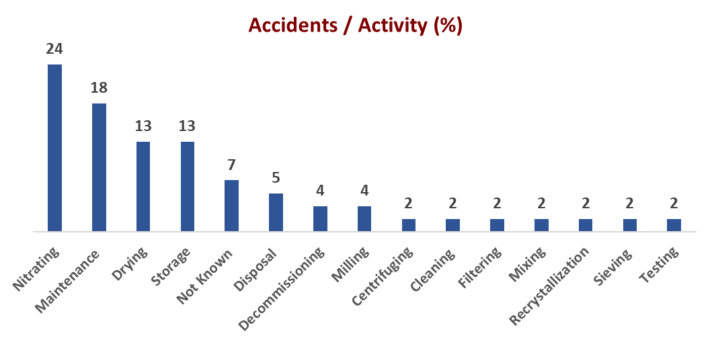
From SAFEX database

Slide 15
Comments
Only 1 explosion in nitrator/reactor and 5 decompositions/fire/fume-off
  Acid in the nitrator is a very good heat sink so that energy released in decomposition can be absorbed to some degree and prevent transition to detonation.
Many incidents due to PETN instability in acidic conditions in subsequent processes.
Manual intervention/action in many incidents
Complete decontamination prior to any maintenance or dismantling is critical.
Water is a very good desensitiser – “heat sink” quickly dissipates the ignition energy so preventing or reducing probability of propagation.
Keep PETN wet for as long as possible unless it is needed in dry form.

Slide 16
Thoughts to take away
The next reported incident is likely to be due to:
  Inadequate decontamination during maintenance or other manual intervention
  Residual acid induced decomposition - can be exacerbated by higher temperature e.g.drying

Slide 17
“Explosion” search on database
90 incidents
Inclusive of burning grounds, detonating cord, cast boosters - - - -
Exclude these and focus on PETN process from reaction through, drying, storage to maintenance.

Slide 18
An explosion occurred in the crystallisation plant of a PETN manufacturing site. The explosion may have occurred during the removal by a workman of a charge of PETN from a centrifuge.
Explosion whilst clearing a choked pipe.
Wet explosive probably lodged in outlet valve, decomposed and eventually exploded.
Minor explosion of PETN as fitter was removing bolt from a dissolving tank being dismantled. The fitter sustained slight injuries to one of his hands.

Slide 19
Slight explosion of PETN between nut and bolt threads when unclamping lid of stabilizer.
Minor explosion on thread of clamping screw of dissolver while tightening.
An explosion occurred in a PETN plant being refurbished when a water main was cut out with a welding torch. The pipe acted as a detonating cord sending splinters throughout the building
Minor detonation of PETN when concrete sump cover of drying stove was dropped.

Slide 20
Explosion in PETN-stabilising house. The building and equipment were in process of being freed from explosive & the explosion occurred as a joint on a pipe between the dissolver and the precipitator was being opened.
Minor ignition of PETN while removing lid of stabiliser dissolver. Slight damage caused.
Explosion of PETN spent acid stabilization unit. A confined section of pipe contained unstabilized spent acid. There was some shrapnel damage of the unit and adjoining service lines and tanks; windows were broken in a building 30 feet away.

Slide 21
Two tons of PETN detonated during the drying operation. The cause of the accident was temperature increase in one of the driers due to a malfunction of a thermostat controlling the steam valve.
A detonation occurred when an instrument fitter was tightening an instrument screw on a detonating fuse spinning machine. The machine was not operating and had been superficially cleaned.
An explosion occurred in PETN manufacturing plant. The explosion may have followed an acetone fire or a blow on the rim of a vessel. The preliminary explosion occurred in a dissolver which disappeared and propagated by missiles.

Slide 22
Fitter hammered counterweight arm to remove it from shaft. Materials had not been decontaminated. Blow caused counterweight to slide on arm & friction detonated a surface film of PETN. Counterweight shattered & a piece struck fitter on his chest.
While cleaning scale from a nitrator, the workman used a steel chisel, after having failed to remove the scale by other means. This led to a powerful explosion hurling pieces of metal around. The man was killed by one of these fragments.
A welder working on a PETN plant to carry out some modifications to it,initiated an explosion while he was cutting a piece of pipe with an acetylene torch.The pipe had some PETN residue in it.The welder intended to smuggle out a brass valve attached to it

Slide 23
A powerful explosion disintegrated the building where PETN was being dried in 2 hot air driers.250kg of PETN detonated. There were only slightly injured people. Cause of incident may have been an electrical failure which caused overheating of the material.
A man was seriously injured while he was repairing cracks on the concrete floor of a PETN drying room with hammer & chisel. The material in the crack was evidently contaminated with dry PETN.
Explosion of PETN in a drying chamber, possibly caused by faulty thermostat or electrical short circuit.

Slide 24
Fire followed by deflagration in magazine during silent hours. Five minutes before explosion, high flame was noted as far as 12 km away - i.e. most PETN burned rather than exploded. Fire may have been started by lightning, vegatation fire or PETN decomp.
An expense magazine was destroyed when the PETN inside spontaneously initiated. Damage was caused to other buildings in the factory and to residential properties in the vicinity. The PETN had not been stabilized & had been stored longer than max period.
The magazine where crude PETN is stored after nitration prior to stabilisation exploded during the night without warning. Plant malfunction & operator error resulted in some of the crude PETN being externally acidic. This material decomposed & exploded.

Slide 25
A small explosion occurred when a fitter was removing a nut from the bolt on the flange below the granulator. The bolts had not been decontaminated and lubricated in the standard way (PETN destroying agent followed by a penetrating lubricant).
Explosion of a tank containing 1300 l acetone with about 200-250 kg of PETN dissolved, followed by the fire of 2 acetone tank 25 m3 .
The Serbian Home Office stated that an explosion occurred at the Prva Iskra chemical plant. The incident apparently occurred in a multipurpose nitration plant that was producing PETN in a batch operation

Slide 26
An explosion took place in MAXAM’s PETN plant at Páramo de Masa. The blast partly destroyed the stabilization building but caused no injuries as the plant was not running at the time. Steam valves may have malfunctioned.
A detonation followed by a fire occurred during the PETN crystallisation process when the operator activated a valve in the distillation column used for re-cycling acetone. Residues of dipentaerythritol hexanitrate (DIPEHN) were later found in the pipes.
While PE powder was being added during the PETN nitration process a power failure occurred. When power was restored 15 mins later, PE continued to be added to the nitrator and an explosion occurred.

Slide 27
An explosion at a plant operated by Tamil Nadu Industrial Explosives Limited (TEL) is reported to have injured seven persons. The incident occurred when workmen tried to break a PETN-contaminated concrete slab which had been attached to a reaction vessel.
An explosion occurred in the PETN sieving building. The PETN supply is outsourced and had a high acid content. As the PETN dried it decomposed and caused a fire, which under confinement resulted in a detonation. The building was destroyed.
A trace amount of PETN dust detonated in a PETN drying oven clamp handle. Fine airborne PETN dust is present during normal operations and it is thought dry PETN must have been trapped in the clamp handle due to wear and tear of its moving parts.

Slide 28
An operative removed an empty 200 litre plastic container with an open top from the elevator. As he placed it on the emergency exit platform, the container bumped against a metal grating and a minor detonation occurred - container probably contaminated.
A supervisor and operative were killed by an explosion in a PETN drying unit. The cause is under investigation, but it is possible the incident occurred during transfer of dried product into bags. The plant was severely damaged in the blast.

Slide 29
Decontamination procedure
Destroying Agent: Alcoholic Potash
4.6% Water
7.5% KOH
87.9% Ethyl Alcohol
It is mixed by adding 2 parts of Acetone to 2 parts alcoholic Potash to give:
1. 2% Water
2. 3% KOH
3. 35%Ethanol
4. 60% Acetone
Shelf Life: Not to be used more than 5 days after mixing.
Decontamination Process:
Remove all bulk explosives from the Equipment.
Remove as much as possible loose/visible powder from machine.
Wipe away loose dust with water wet cloth.
Freshly mixed destroying agent should be applied/sprayed to affect parts every 10-min for at least half an hour.
After using the agent, Bolts should be sprayed with Q10 penetrating oil. Let stand for 10 min.
Hazards:
Destroying agent can cause serious burns. Wear rubber gloves when handling.
Destroying agent must not come into contact with acid. Destroying agent reacts EXPLOSIVELY with strong acid and excess PETN.

