Slide 1
RAFAELA - ARGENTINA

Slide 2
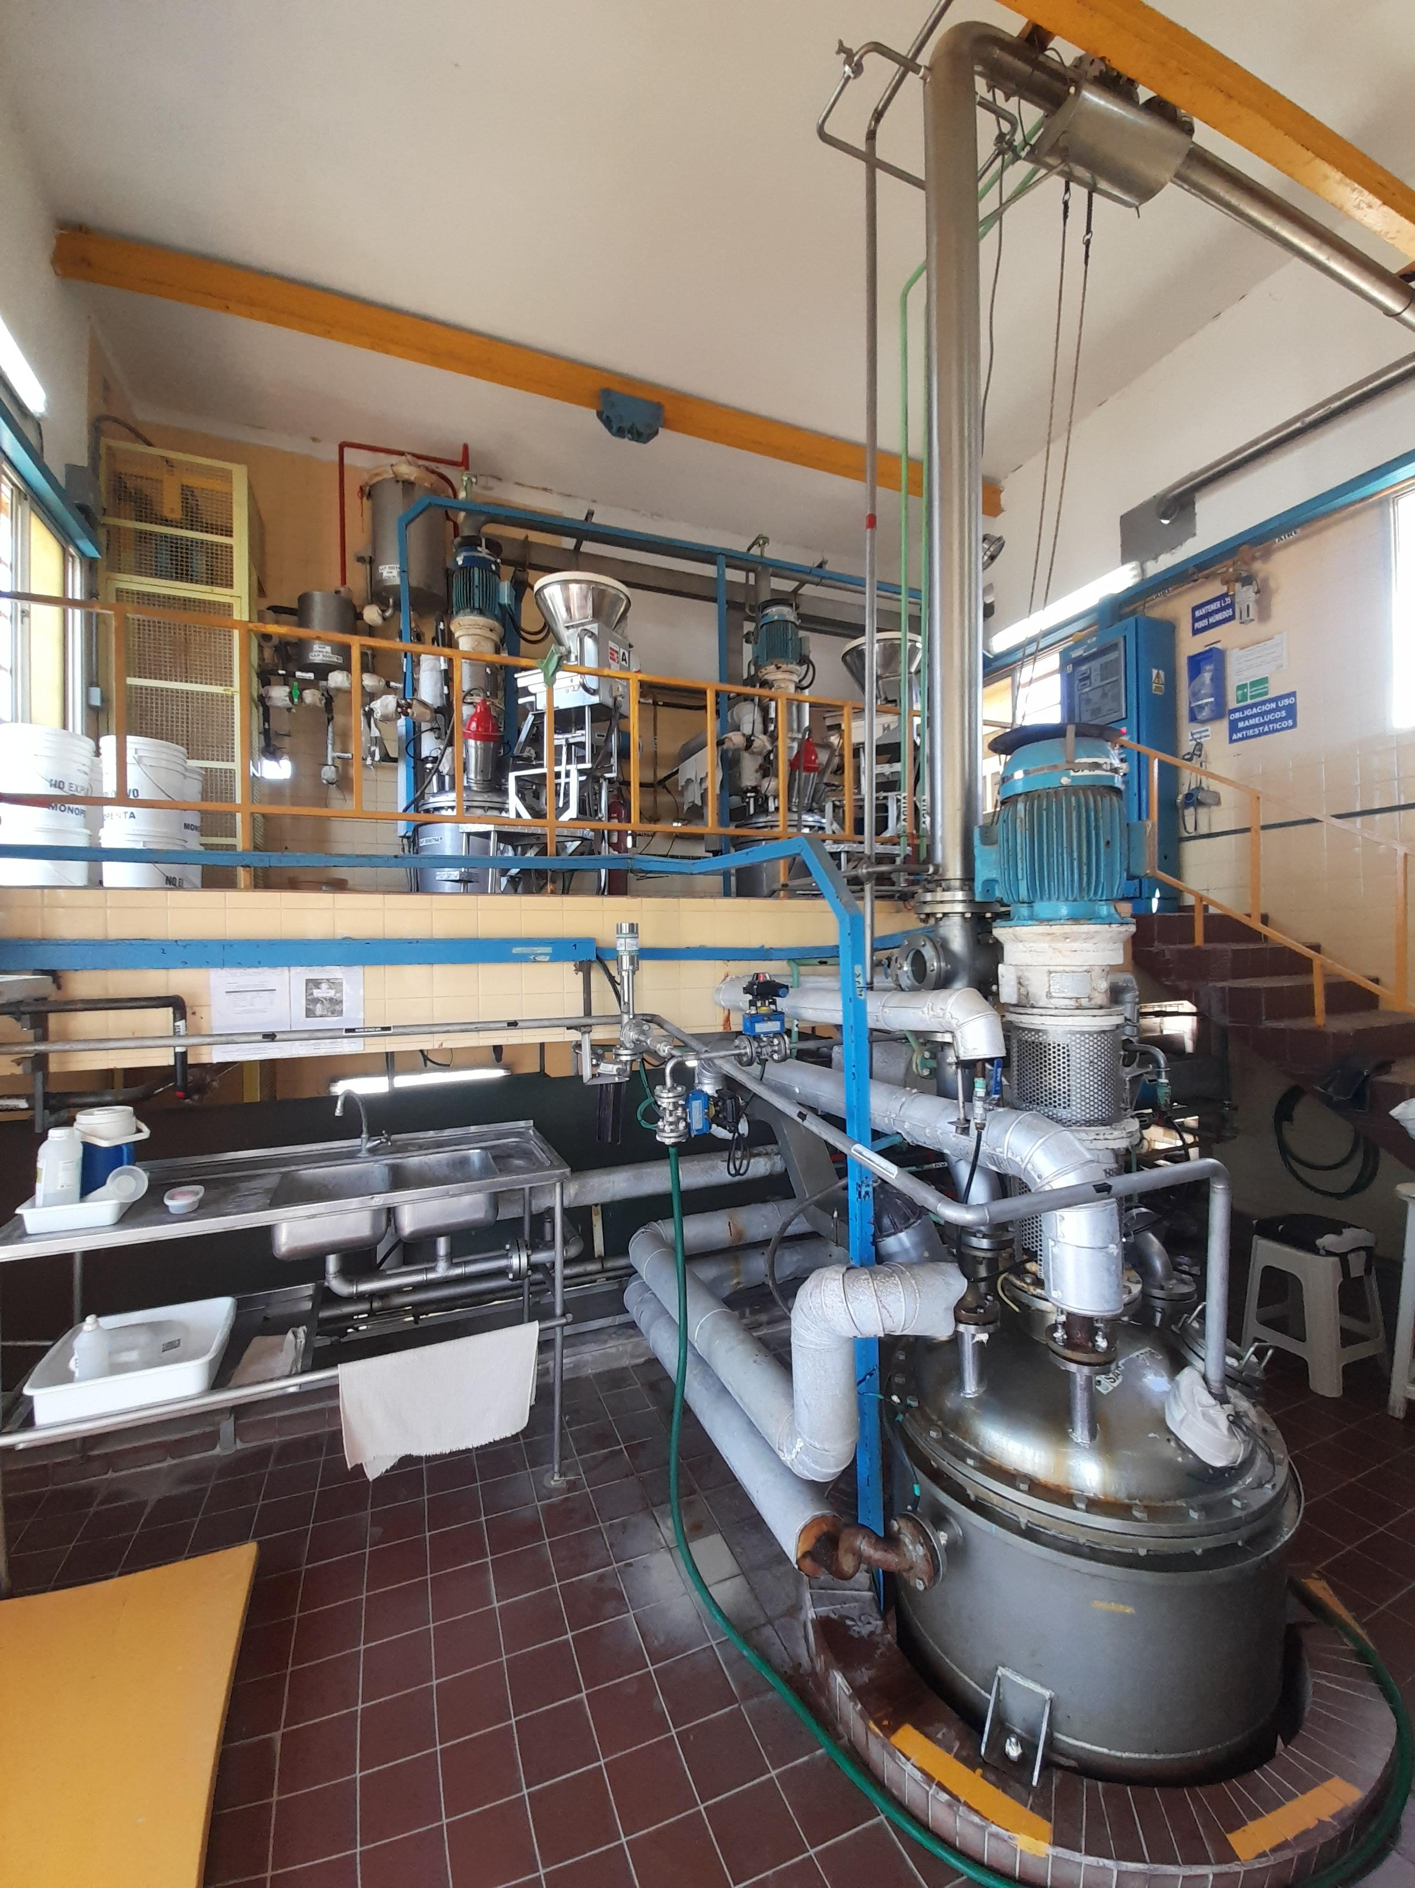
Plant Summary
PETN and RDX PLANT – ARGENTINA
Process & Tecnologhy: Batch Process / German company and know how from EEU Rio tinto
Constrution & commissionig plant: 1988/1989
Capacity: 100 kg/h PETN or 25 kg/h RDX

Slide 3
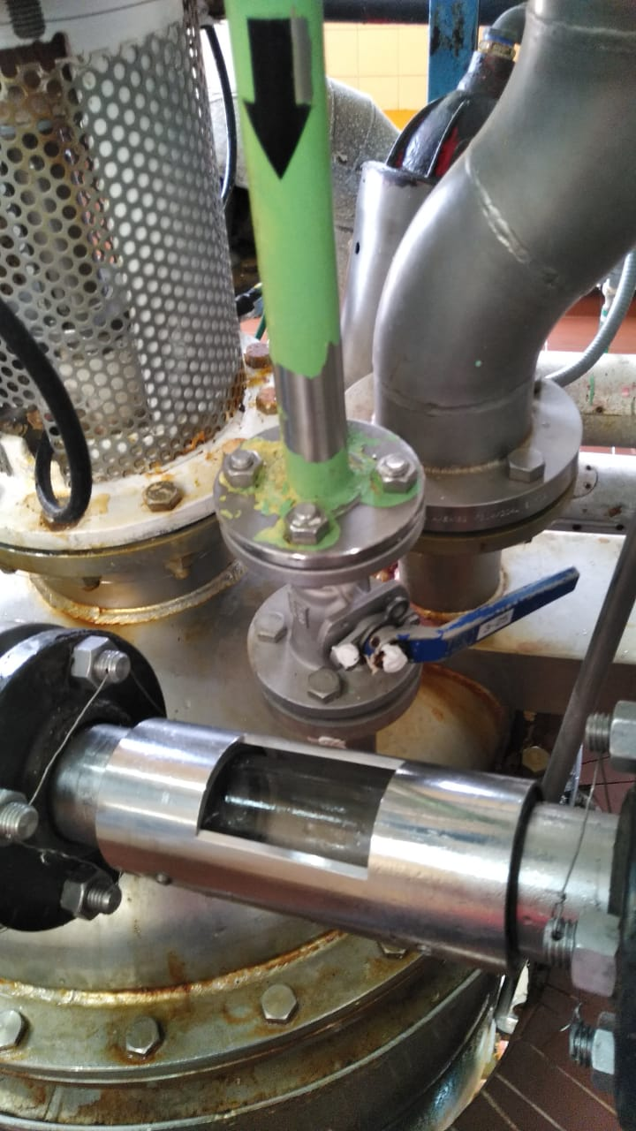
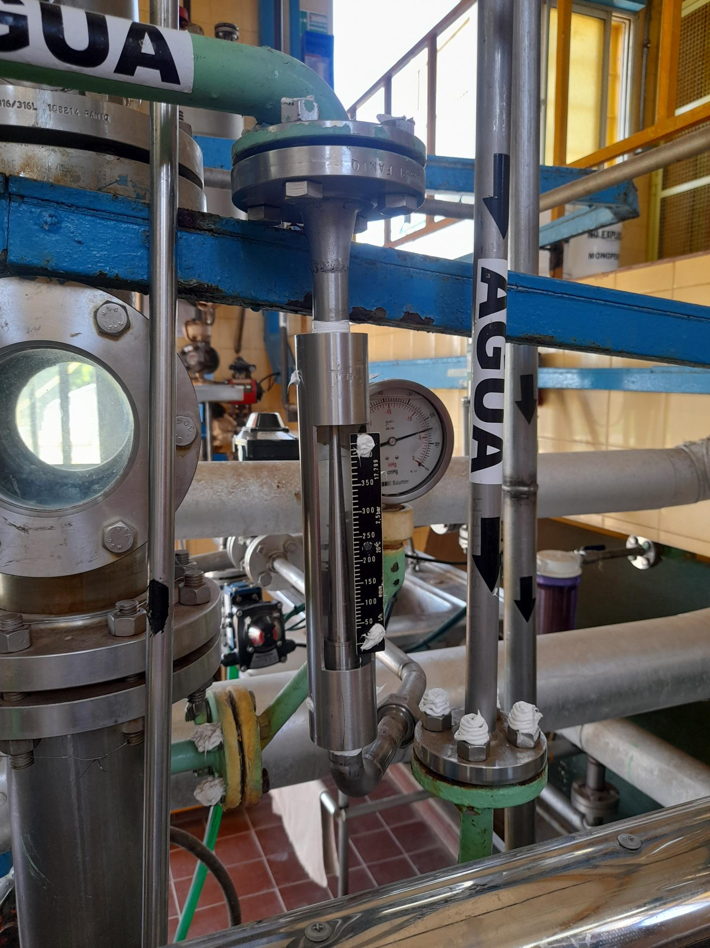
SUMMARY OF INCIDENTS
05/02/22: Discharge of PETN to the drown tank due to temperature increase in the diluter
Causes:
Operator distraction.
Inefficient water supply control
There was an increase in temperature in the diluter, during the PETN manufacturing process. Because of this, the emergency discharge valve opened automatically and most of the product was discharged into the drown tank. This event occurred when water was being added to the diluter

Slide 4
Action implemented: inlet water control
Before
Rotameter indicates flow
Worker opens-closes manually valve according to temperature.
Flowmeter closes valve when it reaches a predetermined amount.
Automatic emergency valve opens when it reaches the set temperature.
After
Electromagnetic flowmeter
PLC modulates the opening of the water inlet valve according to the set temperature and closes valve when it reaches a predetermined amount.
2 temperature set control
    First closes water inlet
    Second open emergency discharge
PLC records process

Slide 5
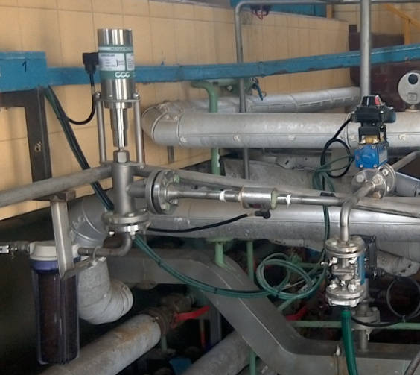
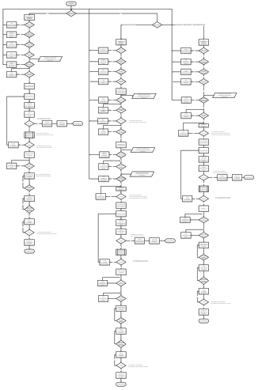
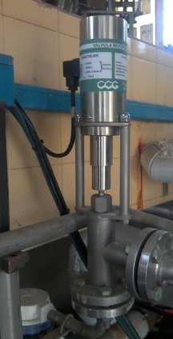
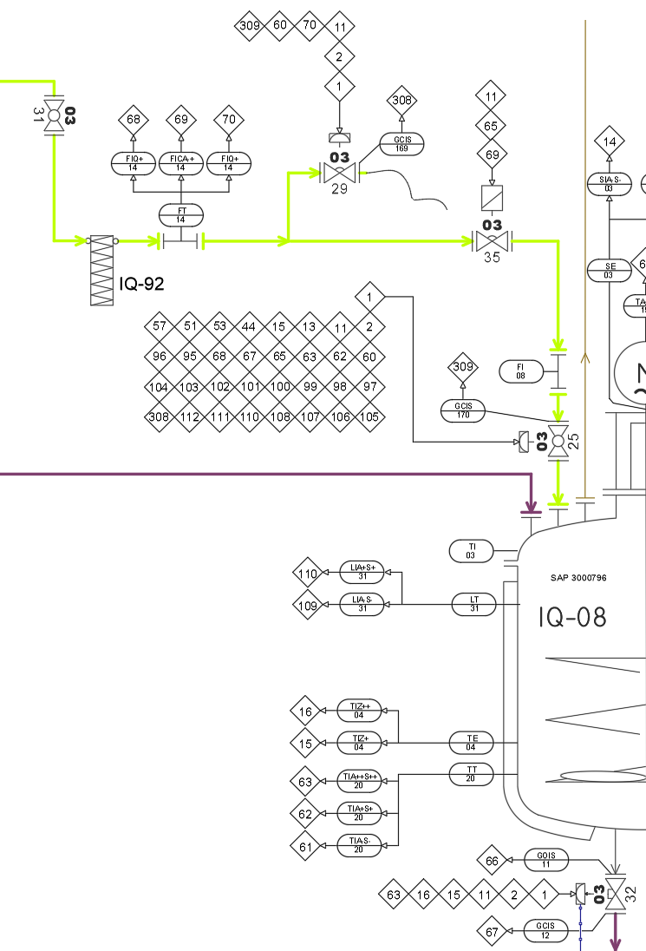
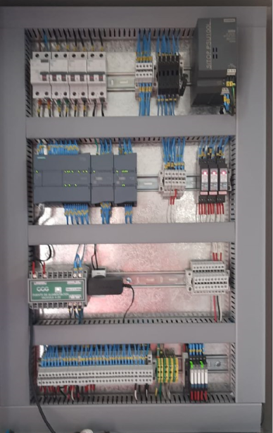
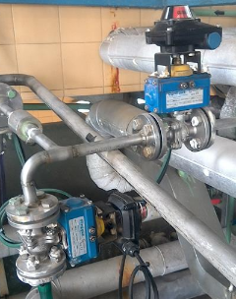
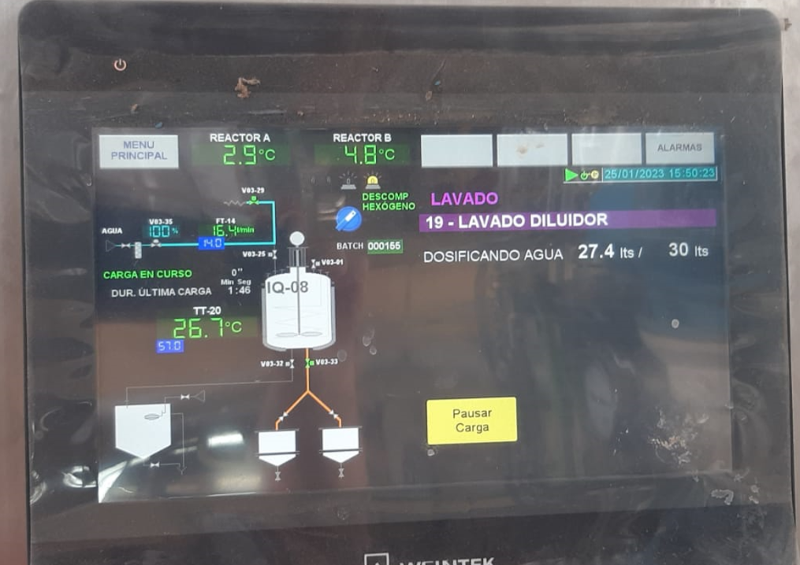
Action implemented: inlet water control

Slide 6
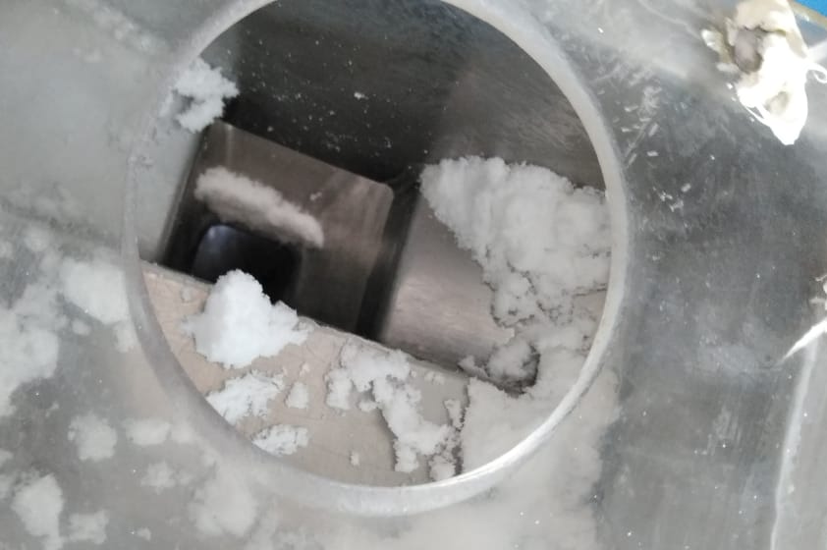
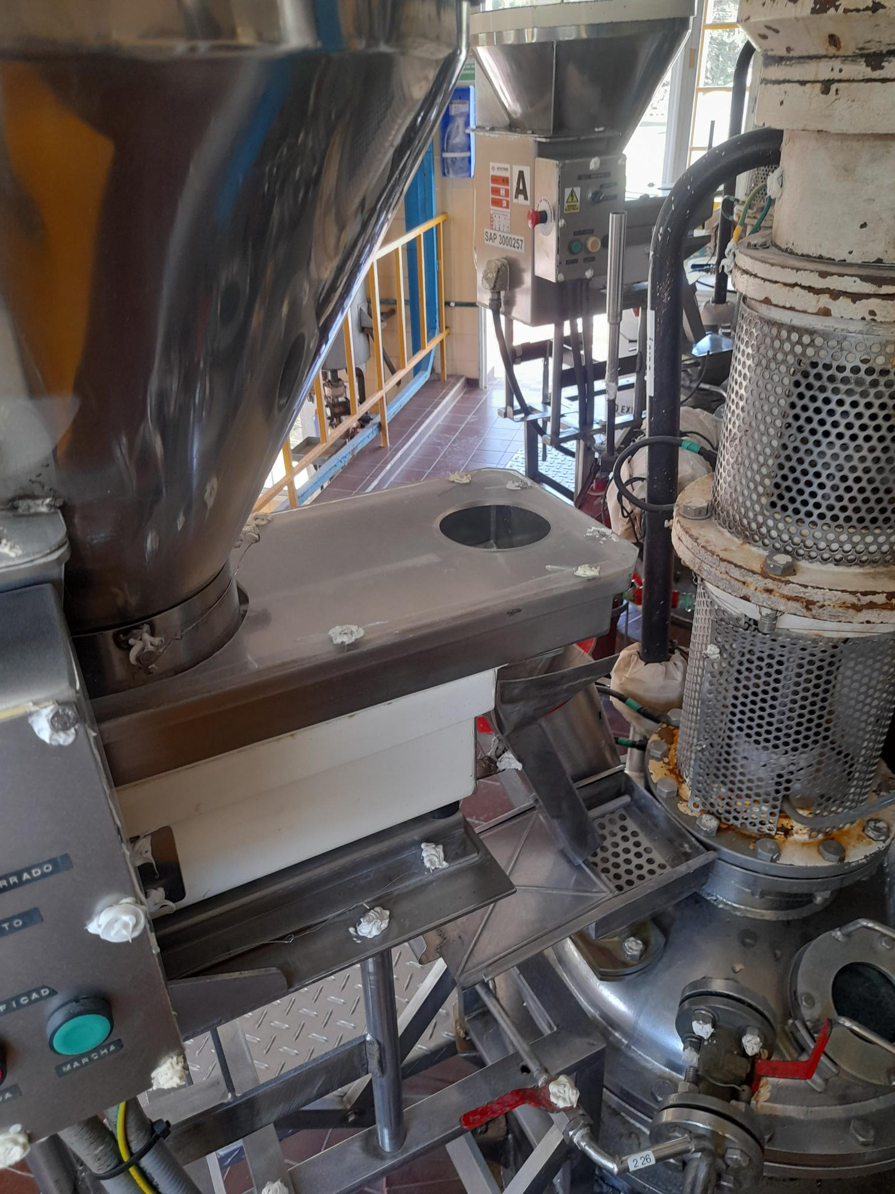
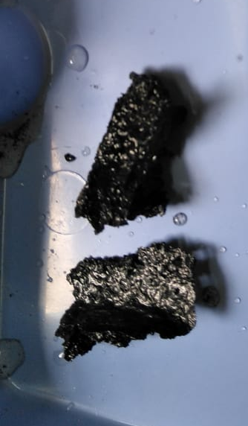
05/24/22: Hexamine inflammation inside nitrator B
During the afternoon shift, an operator was lowering the RDX reaction from nitrator B to the diluter, simultaneously he prepared to load Hexamine into the hopper for the next operation. At that moment, a small ball of hexamine fell into the inside of the nitrator, producing its inflammation
Causes:
Operator distraction (hexamine dispenser gate had not closed).
Operator did not followed procedure.

Slide 7
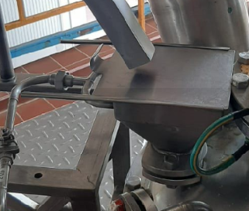
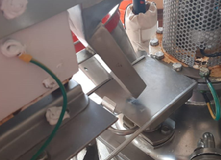
Action (on going): reactor discharge
Before
Worker opens and closes the solids entrance lid to the reactor
After
Worker opens and closes solids entry lid to the reactor with position sensor.
If it is open, does not allow
  Open the discharge valve.
  Put the agitation at low speed to open the discharge valve

Slide 8
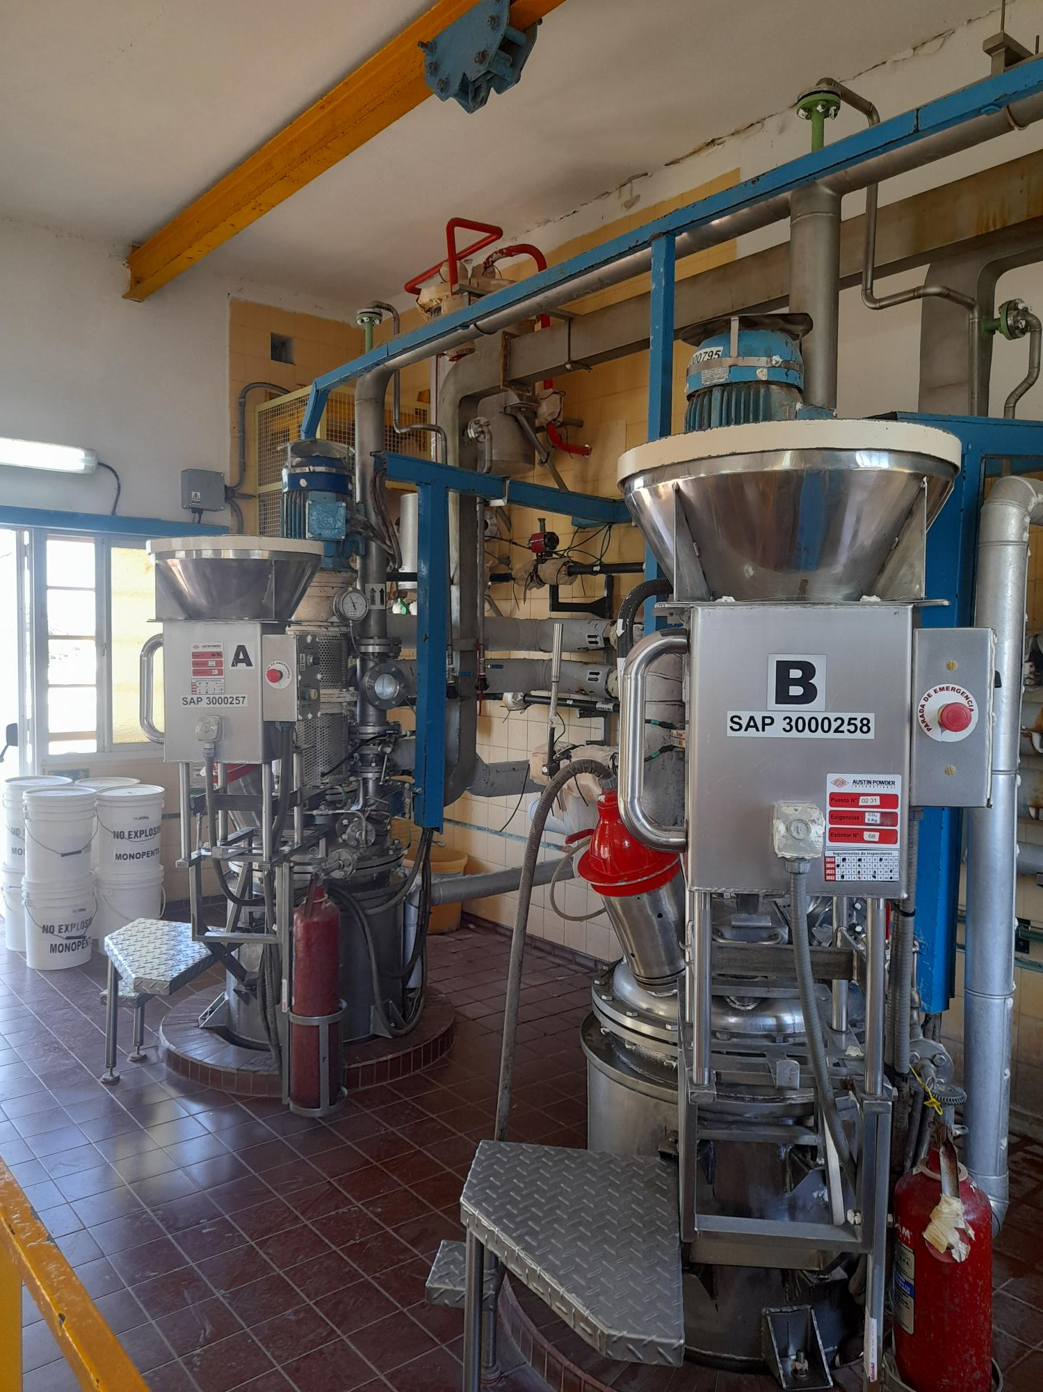
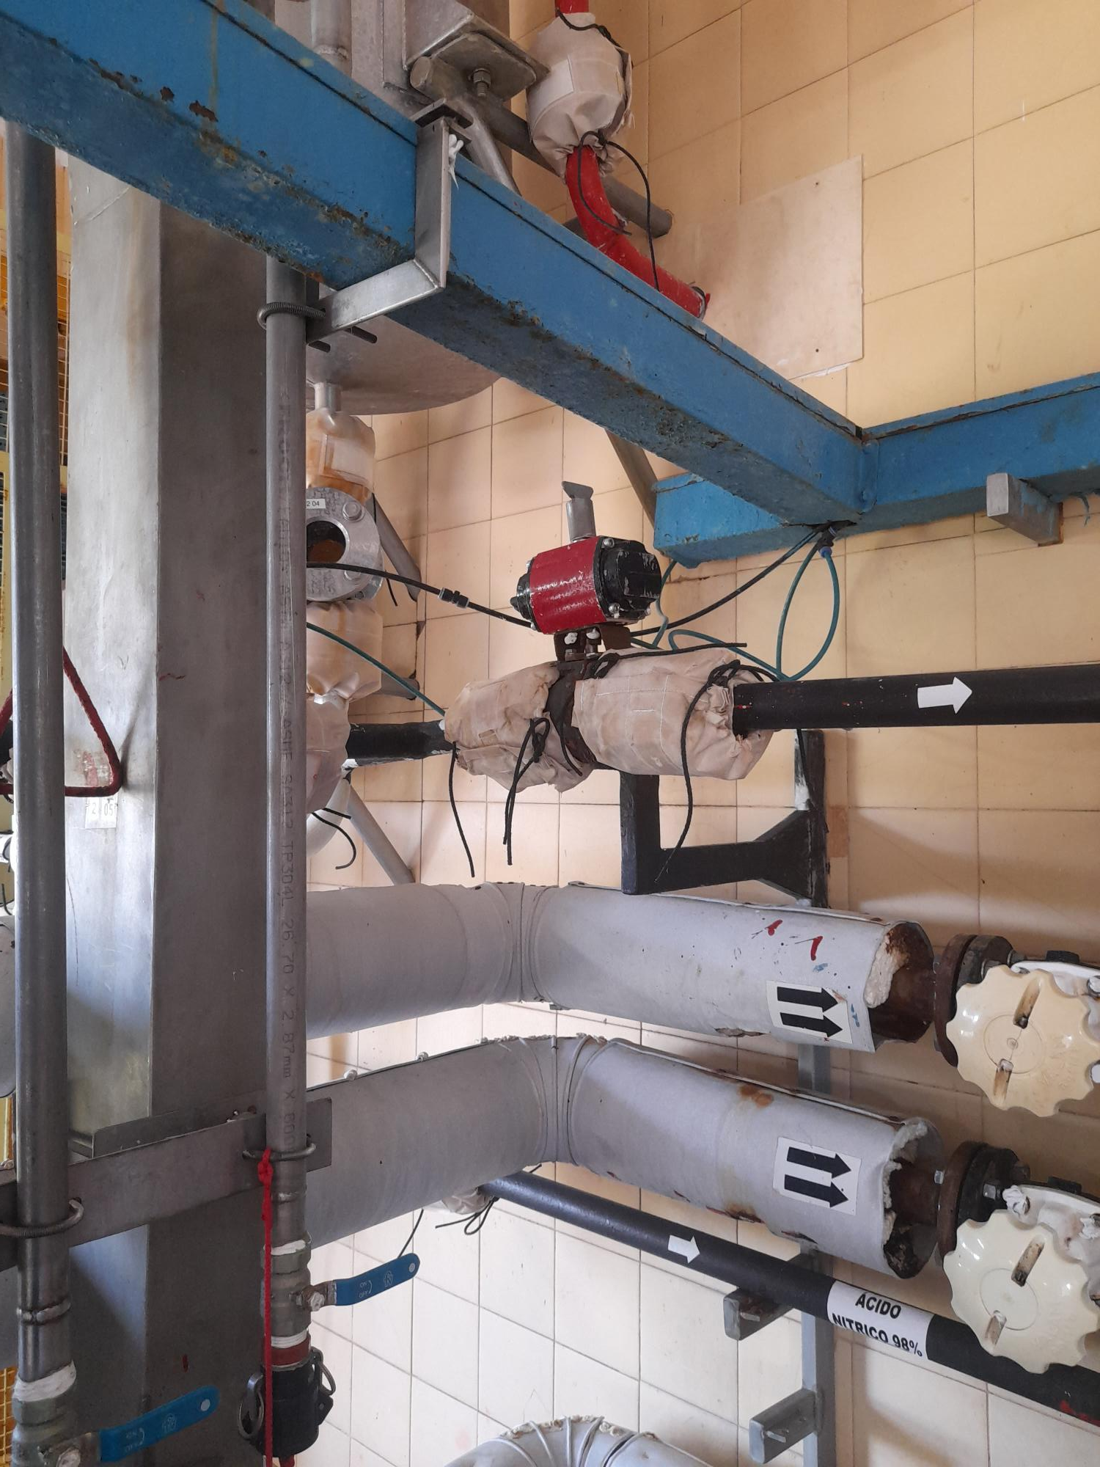
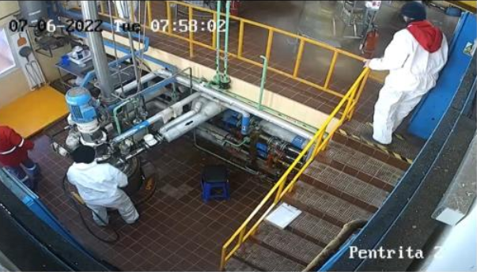
06/07/22: Overflow in Nitrator B with 98% nitric acid
While the nitration process in nitrator B was being carried out, the operator who was operating that equipment started to load 98% nitric acid in the dosing tank. Due a failure in a pneumatic valve located in the line from the dosing tank to the nitrator B, that did not close completely, all the acid that was being loaded into the dosing tank was transferred to nitrator B. This caused an overflow of the nitrator going out through the inlet of loading of PE connection.
Causes:
Valve pneumatic actuation system failure.
Operator distraction.

Slide 9
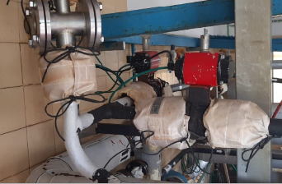
Action to be implemented: reactor HNO₃ load
Before
Without any control only SOP
Flag on pneumatic actuator indicates position of HNO3 discharge valve into reactor
After
PLC will control discharge of HNO3 to the reactors.
Levels in the reactors and measurement tank will control the correct levels and the moments of transfer, indicating to the worker when and what tasks he can do.
PLC will control reactor temperatures.

Slide 10
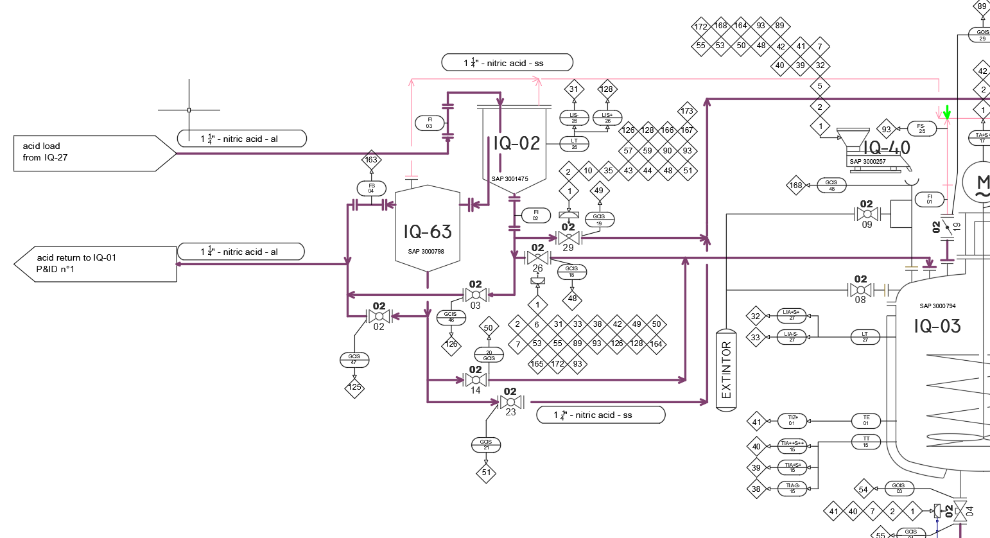
Action to be implemented: reactor HNO₃ load

Slide 11
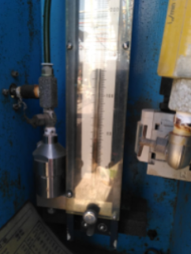
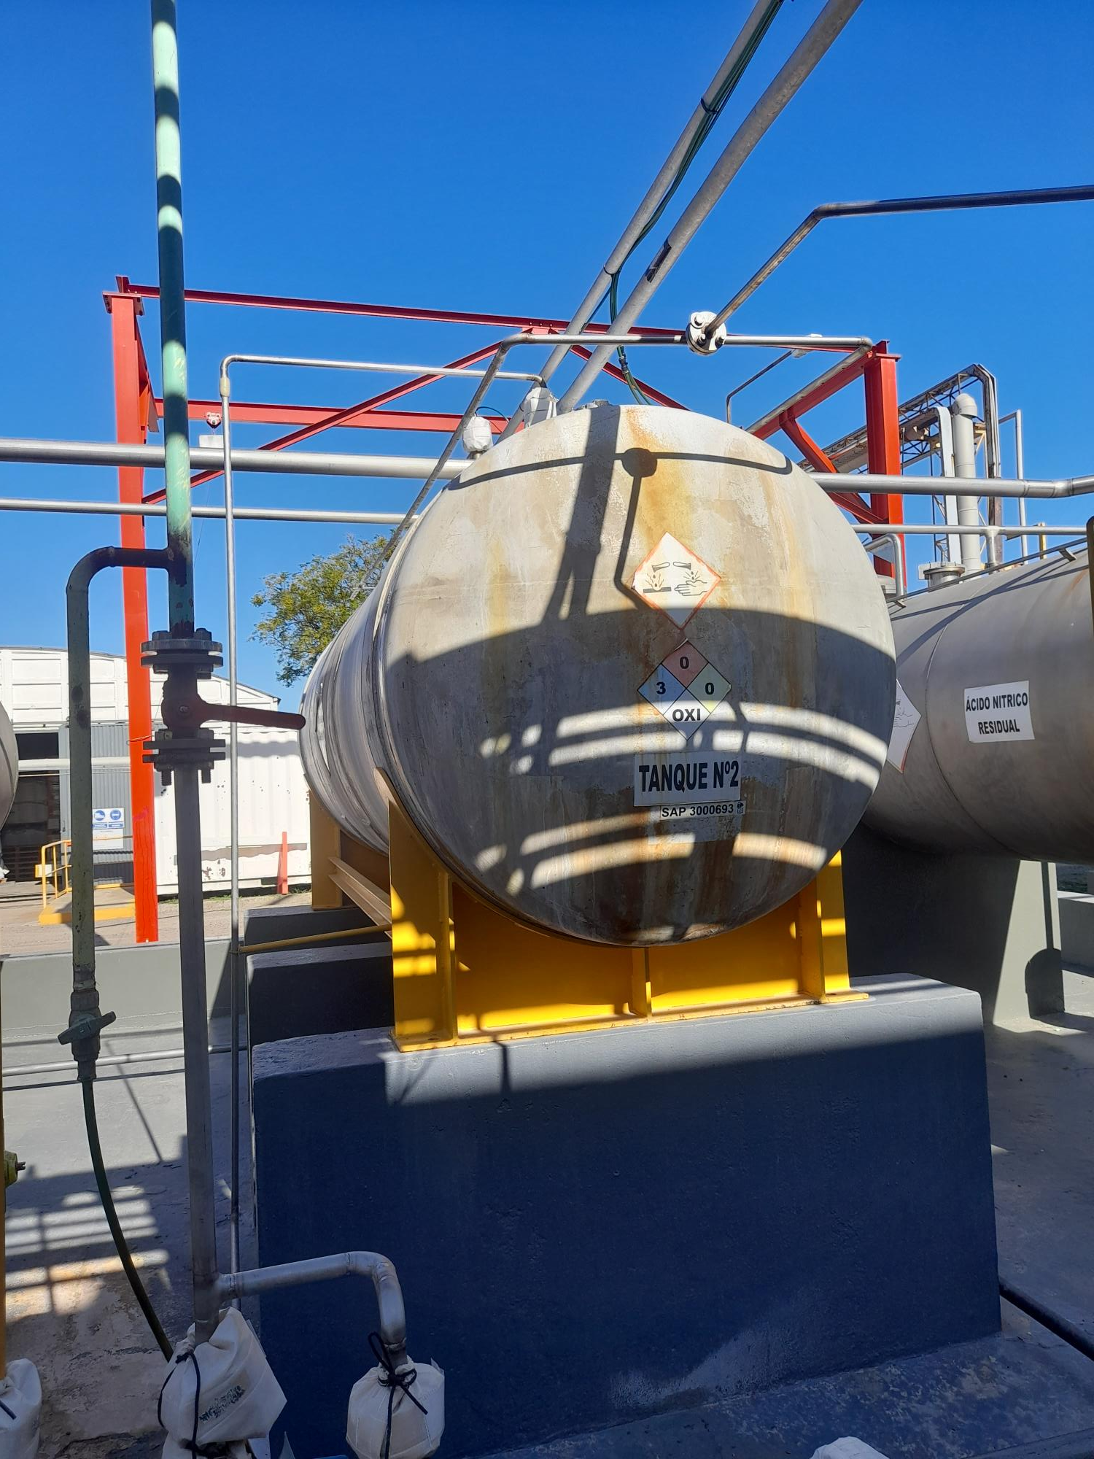
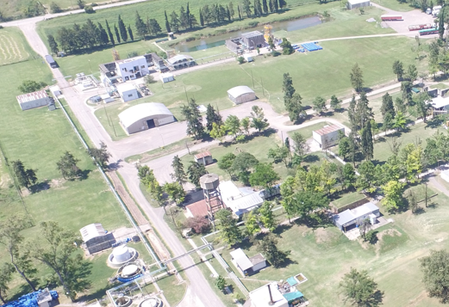
PETN TK
06/14/22: Small spillage of nitric acid- PETN plant
When the PETN operators were transferring 98% nitric acid from the storage tank located in NMMA to horizontal tank No. 2 located in the PETN plant, a spill of approximately 50 kg of acid occurred. The spill occurred because the level indicator was not working correctly and the operator who was controlling the operation, did not notify or stop the process for maintenance to review it. Due to that, the tank of PETN plant started to overflow.
Causes:
Distraction/ lack of communication between the operators performing the transfer of acid.
Failure in level indicator.
PETN
STORAGE TK.

Slide 12
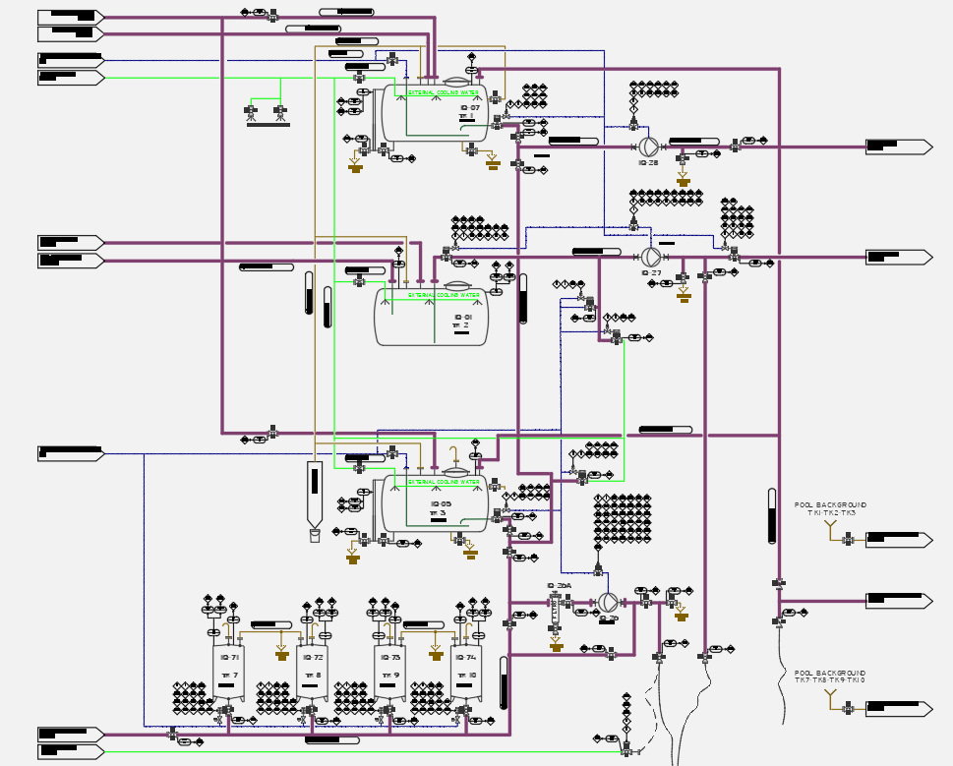
Action to be implemented: HNO₃ transfer
Before
One local indication level
Not overflow pipe
No connection between level and pump
Verbal communication between pump operator and receiving tank operator
After
Not fully automatic, operator assisted by PLC to transfer of HNO3 (high and low concentration) between tanks.
Operator selects in HMI operation to carry out, if valves not in the correct position or levels not correct, PLC does not enable tank bottom valve opening and pump operation
2 levels different meter: one radar type given high level visual and audible alarm and pump stop. One vibrating level given maximum permissible security level

Slide 13
CORRECTIVE ACTIONS
Re training for operators about SOP
Review of skill matrix of all PETN operators
Review of HPNM communication procedure
Re training about emergency procedure
Review pre operational check lists in PETN plant
Re training about use of PPE
Review and update of SOP
Development of improvement and automatization program for PETN plant
Review of HS3
Engineering audit
PETN plant audit and inspection by Ralf Weber and Antonio Mendez
LOPA analysis
Area classification

Slide 14
Thanks for your attention!
Ezequiel Stoffel Production manager
Daniel Bertoni Engineering manager

