Slide 1
February 2023
Crude stabilized PETN key controls and stability testing
José Paulino – Senior Engineer, explosives Manufacturing technology

Slide 2
TOPICS:
Introduction (PETN definition)
Preventive controls. (Before Nitration process)
Mitigation controls. (After Nitration process)
Stability and Quality test.
Incident involving instable PETN

Slide 3
PETN definition
Crude PETN: A generic term for PETN’s that have not been stabilised or recrystallised. Highly acidic material produced from concentrated nitric acid. Very unstable if stored for extended periods without removal of acidity. Highly unstable if heated.
Crude Stabilised PETN: Crude PETN treated in a separate additional process for blending an alkaline stabilising agent (solid, solution or suspension) with the PETN. Preferably blending is done with PETN present as a stirred water suspension and with heating of the water to assist leaching of occluded acid. Small amounts of residual acid present but much less than crude PETN. Storage life is still restricted (one year) due to the residual acidity. Stable when heated under safe operating window conditions
Recrystallised PETN: PETN obtained by dissolving crude PETN in a hot solvent followed by neutralization of the solution (typically by using ammonia or sodium carbonate) and crystallization of the PETN by addition of water or cooling without water addition. Very low acidity level and the most chemically stable of the PETN varieties. Can be stored for extended periods. Stable when heated under safe operating window conditions
Although these three different PETN’s have different levels of chemical stability, all are still highly hazardous materials and have been involved in major explosions in Orica plants and other plants globally

Slide 4
Preventive controls. (Before Nitration process)
Raw materials control (specs)
Keep levels of diPE to a minimum and never exceed 2% (on PE mass).
Keep levels of triPE to a maximum of 0.8%.
Control the Nitrous acid content on CNA.
Process control on the nitration process.
Ensure the correct ration PE : CNA (5:1 in our case)
Avoid work with higher temperature. (22.5°C in our case)
Ensure the residence time on the reactors.

Slide 5
Mitigating controls. (After Nitration process)
Test the PETN stabilization.
Control the time that PETN is exposure to higher temperature.
Storage of crude PETN is not permitted.
Do not ship crude PETN off site and do not release crude PETN for drying.
Qualify and control the external supplier of PETN

Slide 6
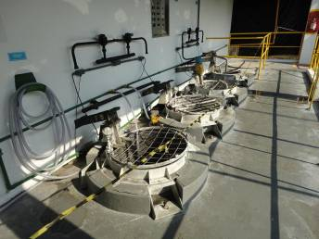
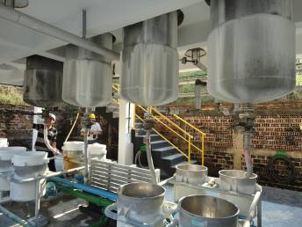
PETN Key Controls Crude PETN Stabilisation
Key Control: Test each lot of stabilized crude PETN prior to PETN drying or release for export packaging for:
total acid (HNO₃) not to exceed 0.3%;
melt point >140⁰C; and
Acetone Insoluble (calcium carbonate) maximum 2% by weight.
Why is this important? If PETN does not have sufficiently low acidity, it can cause explosions in downstream processes. Melting point > 140 ⁰C indicates that the PETN does not contain impurities that can cause it to decompose and explode. Keeping calcium carbonate below 2% ensures that we do not adversely impact the performance of the PETN in products
Crude PETN stabilisation at Lorena

Slide 7
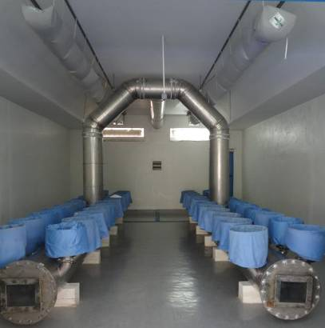
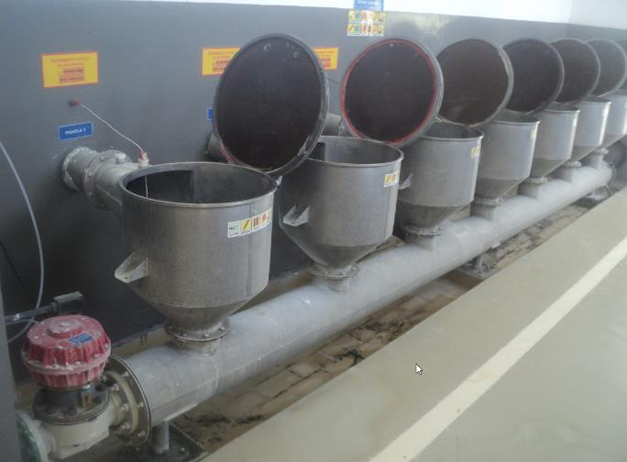
PETN Key Controls Drying
Key Control: Equip PETN drying vessels and drying rooms with instrumentation to monitor and alarm high temperature which trips the heat source when the maximum temperature is exceeded. 80ºC if drying for < 8 hours and 70ºC maximum if drying for 8-16 hours
Why is this important? If PETN gets too hot, it will decompose and explode.
PETN Drying at Limay (above) and Lorena (below)

Slide 8
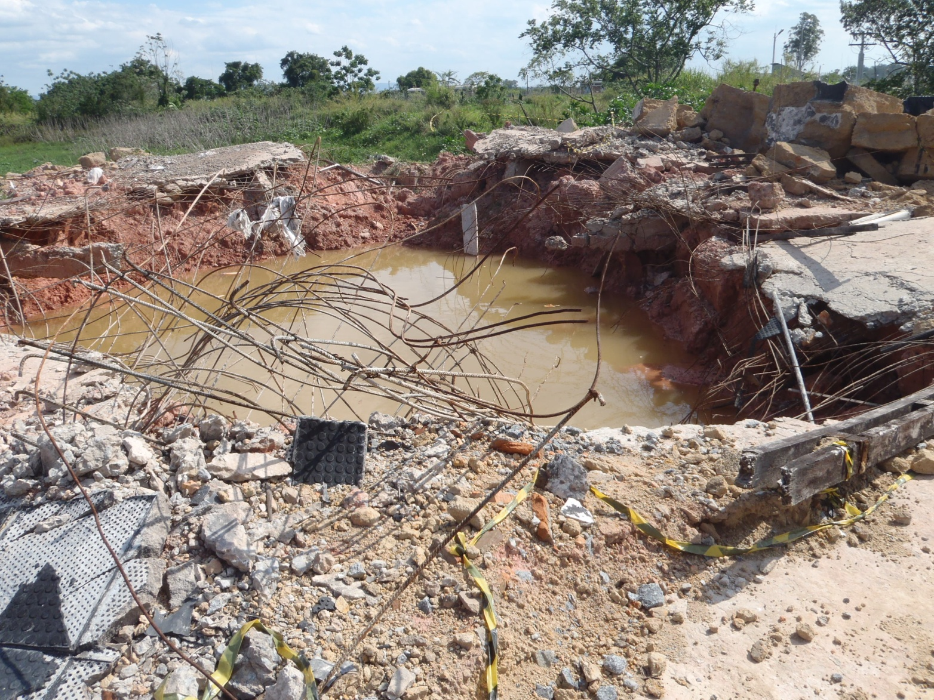
PETN Key Controls Chemical Stability
Key Control: Verify all external PETN suppliers have been qualified before supply begins.
Key Control: On receipt, test each crude stabilized PETN date code to ensure that specifications are met for:
Total Acid by titration not to exceed 0.3%; or
Thermal Stability either:
100⁰C Heat block test maximum 2% weight loss at 48 hours; or
Bergmann-Junk test <10 ml NO/gram.
Key Control: On receipt, test all recrystallised PETN lots to ensure that specifications are met for:
Acidity by titration maximum 0.01%; or
Thermal stability:
Abel Heat test – starch / iodine indicator paper change.
Why are these control important? If PETN with high acidity gets into downstream processes, there is a high probability that it might explode

Slide 9
Stability and Quality test.
Acidity analysis – Titration method (max 0.25%)
Melting point – 140°C minimum
Thermal stability:
Bergmman Junk test – <10 ml NO/gram.
100⁰C Heat block test - max 2% weight loss at 48 hours (Minden)

Slide 10
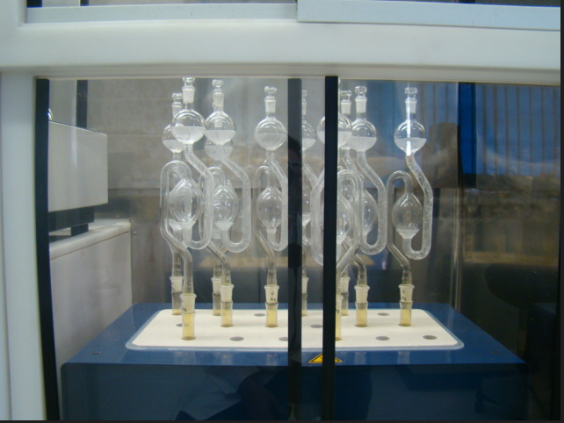
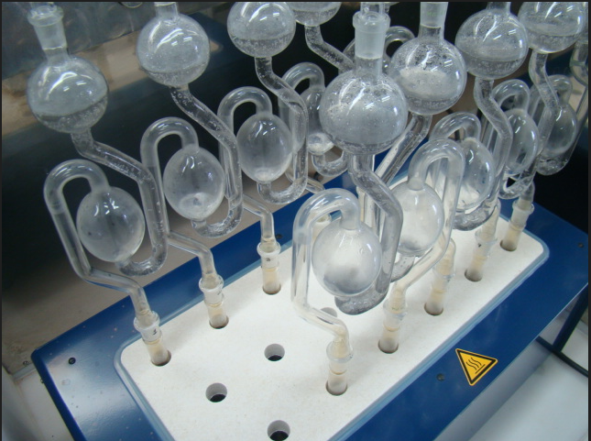
Bergmman Junk test.

Slide 11
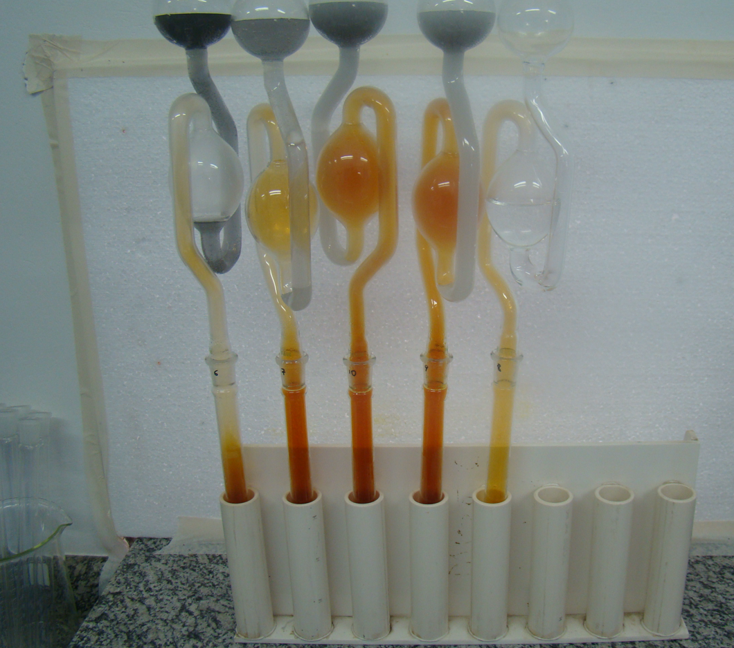
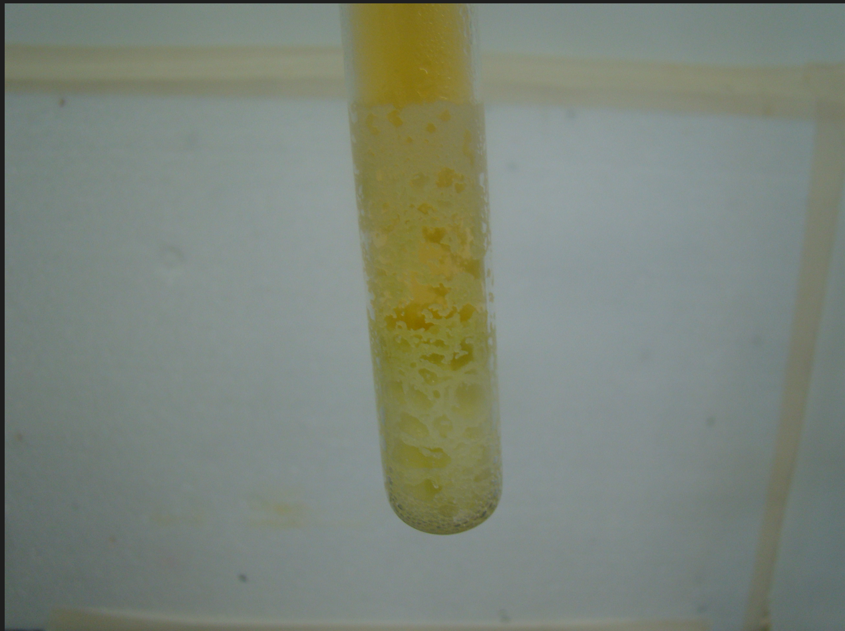
Bergmman Junk test.

Slide 12
Event involving instable PETN Lorena 2010. PETN Sieving. No Injuries
This event occurred 6 weeks after the Lorena Nitrator Spent Acid process chemical fume off event. The spent acid event had a direct bearing on this explosion event.
Because Lorena could not make its own PETN at this time due to the earlier event, a 3rd party PETN source was used. The quality of the 3rd party PETN manufacturing process was not as good as that used at Lorena and Lorena did not check the quality of the 3rd party PETN. It was subsequently found that the 3rd party PETN contained acidity at much higher levels than normally produced at Lorena and in a range that is highly hazardous
A further complicating factor is that the material had been dried twice, exposing the acidic PETN to heat for longer periods than normally allowed.
The PETN decomposed during dry sieving, caught fire, and then detonated. The operator escaped and managed to dive to the ground before the explosion occurred.
There was extensive structural damage to the plant. The sieving building was completely destroyed. There was severe structural damage to the PETN dryer, the booster pack house, the booster plant and the power station. Many other buildings were damaged up to 300m from the site of the explosion.

Slide 13
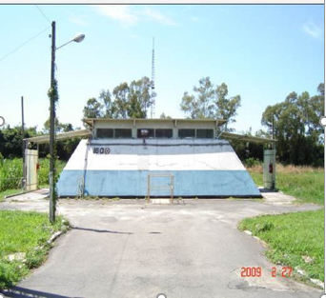
Event impact
The site of the Lorena PETN sieving operation. The crater was approx 3.5m deep.

