Slide 1
Developments at the UN 2017-2020 2021 2022 2023
Ken Price
Riskom International Pty Ltd
Salzburg 2023

Slide 2
Today’s Talk
The UN system, a brief re-introduction
Impending changes:
New Manual of Tests and Criteria.
FRP Portable Tanks and service equipment
Minimum Burning Pressure tests – some developments
Structural serviceability of freight containers
Electronic detonators

Slide 3
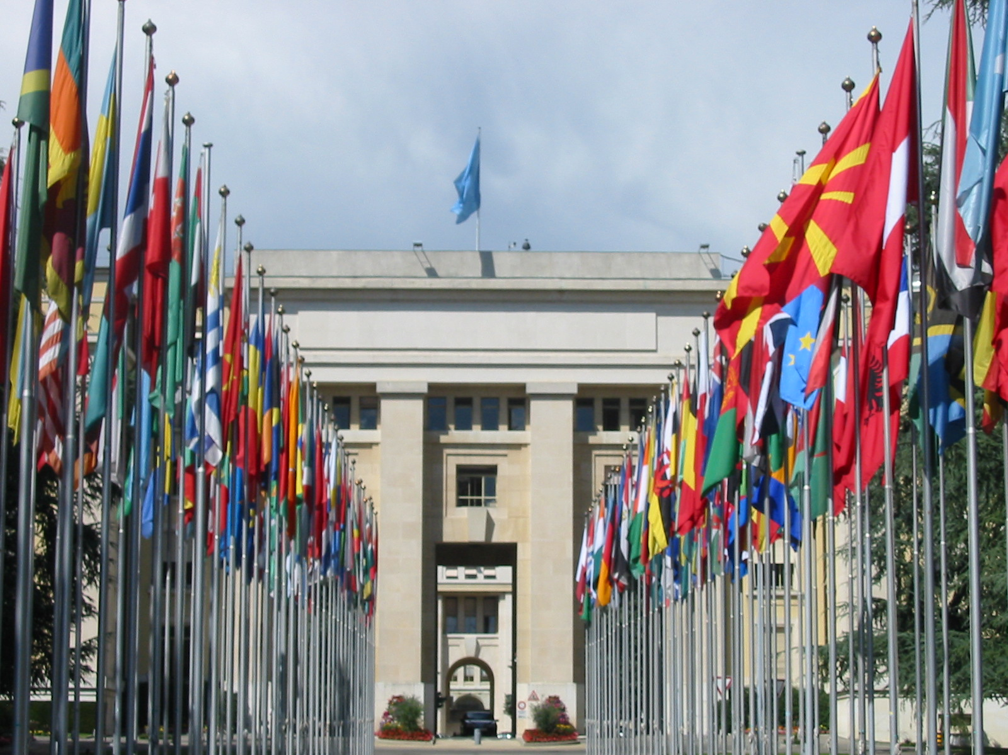
UNOG Entrance
Notes:
The United Nations Committee of Experts meets in Geneva, at the Palais des Nations.
The Committee Secretariat is part of the United Nations Economic Commission for Europe, but it is responsible to the Economic and Social Council (ECOSOC) of the United Nations.

Slide 4
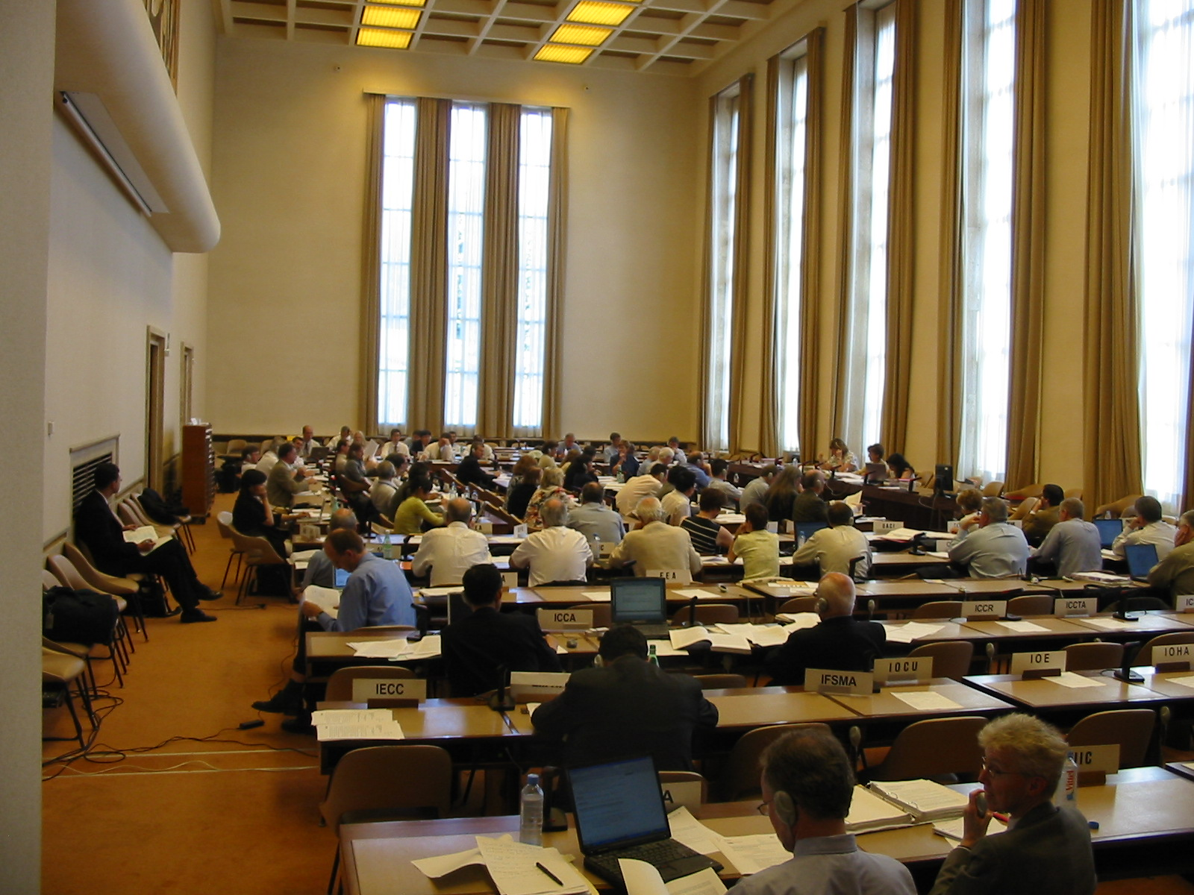
Who are these Experts?
Experts are representatives of nations (governments).
About 25 of them
Only Experts may vote on issues
Other participants are observers
Observers may speak but not vote.
Industry, NGO, other governments..
Notes:
The concept of a globally harmonized system for classifying and labelling chemicals has been around for many years. It was first given life at the United Nations Conference on Environment and Development (UNCED), in Rio de Janeiro in 1992. Through the rest of that decade various groups worked on the different elements of the document, which ultimately became the property of the United Nations Committee of Experts on Transport of Dangerous Goods and the Globally Harmonized System. That committee recommended to ECOSOC in December 2002 that the Purple Book be published and it duly appeared in mid 2003.
In comparison with the Orange Book, the ongoing drafting process for the GHS is much less transparent, with much more extensive use of intersessional working groups and third party organisations.
Though the GHS operates to ECOSOC rules, the chairman has successfully avoided any vote over the past 4 years and has achieved a consensus decision on all issues.

Slide 5
CETDG GHS
Committee of Experts
on Transport
of Dangerous Goods
and the Globally
Harmonized System.
Notes:
The Committee is little more than a conduit for decisions of its two subcommittees, which meet every six months, on their way to ECOSOC,

Slide 6
SCETDG
Committee of Experts
on Transport of Dangerous Goods
and the Globally Harmonised System.
Subcommittee of Experts
on Transport
of Dangerous Goods
Notes:
The United Nations Orange Book comprises some brief Recommendations and an extensive annex, which is the Model Regulations. The Recommendations effectively give guidance to regulators on the scope and intent of the Model Regulations.
Annexed to the Recommendations are 750 pages of Model Regulations, spread over two volumes, which address such things as:
What are dangerous goods;
How are they classified;
How they must be packaged, consigned and transported;
What standard of containment systems (tanks, packages etc) must be used.
The Orange Book is now at a point where it provides practical guidance for the transport of dangerous goods:
Across all transport modes (road, rail, sea, air);
Within nations and across state and national boundaries;
For countries with large or small economies.
The book is very technical and tries to give detailed guidance on almost every aspect of the safe transport of dangerous goods.
Drafting.
The process of drafting the Orange Book is slow and incremental. It has taken place over some 50 years and 13 revisions.
The drafting process involves the United Nations Subcommittee of Experts, which is a body of some 100-200 Experts and Observers from about 70 countries, NGOs and industry associations. In its simplest form the subcommittee considers proposals for change, votes on whether to accept or reject them and the successful ones result in changes to the Model Regulations.
Every two years the Committee of Experts reviews and endorses the decisions of its subcommittee, which are then consolidated into the Model Regulations and published as the next revised edition.
What it does.
The United Nations Orange Book is potentially a ready made set of regulations and at least a “world’s best practice” source of guidance for any nation that wants to transport, import or export dangerous goods safely and economically. The book is drafted in a form that is suitable for adoption into national laws with minimal alteration.
The book is a similar model for the modal organisations such as the International Maritime Organisation (IMO), which drafts the SOLAS convention that includes the International Maritime Dangerous Goods Code (IMDG Code). The European land transport codes (RID and ADR) are now written in a form that effectively mirrors the United Nations Model Regulations and Australia is going the same route.
Implementation
The Model Regulations have no authority as they stand. They come into effect only when adopted by national laws and this may be done in any of several ways:
Direct adoption;
Rewriting into national laws;
Redrafting into national laws;
Incorporating the principles into national laws.
No country yet seems to have taken the first option; most do options two or three and some continue to persist with option four.
This biennium the SCETDG will consider how it might transform the Model Regulations into an international convention, similar to the ICAO TIs or the IMDG Code.

Slide 7
SCEGHS
Committee of Experts
on Transport of Dangerous Goods
and the Globally Harmonised System.
Subcommittee of Experts
On Transport of Dangerous Goods
Subcommittee of Experts
On the Globally Harmonized System
For Classification and Labelling
of Chemicals
Notes:
The Purple Book is by comparison a much slimmer tome of only 450 pages. The book has a lengthy introduction but then sets out the criteria for classifying chemicals according to the multitude of hazards they may present to people. These are broadly divided into two groups: physical hazards, and health and environmental hazards.
The second half of the book is a series of annexes that includes:
detailed information on how to inform people about the hazards once they have been identified;
methodology for testing the effectiveness of labelling;
examples of labels, classification procedures; and
guidance on environmental issues.
In the Purple Book, the methods of passing on the information are currently limited to labelling, (precautionary statements and pictograms.) There is reference to Safety Data Sheets in the introduction and the requirements for GHS are on schedule to be introduced in the next edition. This inclusion was approved in December 2004.
Drafting.
The GHS Subcommittee has 7 intersessional working groups three of which are managed by national experts; the remainder are managed by OECD. Each of these working groups develops its proposals to amend the Purple Book and its progressive deliberations are posted electronically to all members of the GHS Subcommittee.
Then the recommendations of these working groups are formally put to the GHS Subcommittee for consideration at a July or December meeting. Endorsed positions are then ratified by the full Committee of Experts at the end of the biennium and from there the procedure is the same as that for the Orange Book: recommendation to ECOSOC and publication by the ECE Secretariat.
The Purple Book has just achieved its first revision, which was endorsed in December 2004 and should be published around July this year.

Slide 8
To ECOSOC and the world.
Committee of Experts
on Transport of Dangerous Goods
and the Globally Harmonised System.
Subcommittee of Experts
On TDG
Subcommittee of Experts
On GHS
Explosives Working Group
Industry, Governments, NGOs.
Notes:
Australia is a voting member ECOSOC and of the Committee of Experts and both Subcommittees.

Slide 9
Orange Book
Classification for transport - List
Packing and Tank provisions-intermodal, international
Consignment procedures – marking, placarding, labelling, documents.
Packaging standards (+ tanks, IBCs)
Loading, segregation etc.
HARD Information..

Slide 10
Purple Book – What it Covers
Guidance on Classification and Hazard Communication – including explosives
Sets of classification criteria.
“Test Method Neutral”… except explosives
A Few Test Methods
Hazard communication information
All chemicals, all modes, all nations..
Notes:
The book has a lengthy introduction but then sets out the criteria for classifying chemicals according to the multitude of hazards they may present to people. These are broadly divided into two groups: physical hazards, and health and environmental hazards.
Several delegates consistently refer to the GHS as being “Test Method Neutral”, but there are some recommended test methods in the book, notably some OECD test methods either prescribed or recommended by reference, for environmentally hazardous substances.

Slide 11

Questions so far?

Slide 12
FRP Tanks TDG
Kicked off by Russia
Working group chaired by USA
Consequences for SAFEX?
May facilitate transport of ANE and 1.5 explosives.
Final text now in 22Rev

Slide 13
Changes to Manual of Tests and Criteria
MTC classification tests for Transport
It is referred to in GHS.
Four years editorial work
broadly applicable
8th Rev Edition to be published 2023
So What! .

Slide 14
Changes to Manual of Tests and Criteria
So Nothing! (for explosives)
Same Tests
Same classifications
COMPETENT Authorities can use to assess explosives

Slide 15
MBP test MTC
ANE may now be assessed using MBP
Must fail Koenen test
MBP <5.6MPa
Compromise
Australia…

Slide 16
Structural Standards for Freight Containers TDG
IMO requirements
Rust, Lap joints, 19 mm bends etc
Did not apply to other dangerous goods.
Germany proposed to broaden application
USA opposed.
Ultimately passed – in effect for two years.

Slide 17
DETONATORS, ELECTRONIC programmable for blasting TDG
Enough difference to justify unique UN number
Can use old numbers until 2025.
Hazard division | UN No
1.1B | 0511
1.4B | 0512
1.4S | 0513

Slide 18
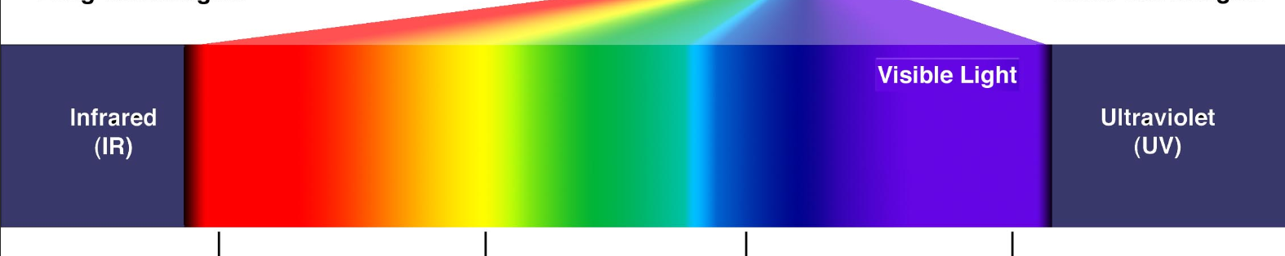
Explosives vs Class 1 Dangerous Goods
/-------------------------------The entire EMR spectrum covers explosives --------------------------------\
Too Dangrs …. Class 1 …. V Insensitive
HgFu, Azide || 1.1A, 1.1B, 1.1D 1.2 1.3 1.4 1.5 ||| AN ANE

Slide 19
Chapter 2.1 Classification (and Labelling in GHS)
This amended chapter appeared in 2021.
Recognizes that packaging is a critical determinant
Simplified Labelling
Classification may change as unpack

Slide 20
Issues of concern – Class and label
No reclassification when unpacked for use
No relabelling …
Verbiage reduced. (Unstable Explosives, Mass Explosion Hazard, fire hazard etc)
May use Different hazard diamond.
processing operations – risk based approach.

Slide 21
Coming Issues
Desensitized Explosives – classify and transport as Hazard Division 4.1
May use TS6c (bonfire) or tests in Chapter 51 of Manual of Tests and Criteria.
Chapter 51 Tests are a bonfire test, similar to but different from 6c tests.

Slide 22
Conclusion
Competent Authorities more rule driven
Less technical competence and confidence
SAFEX higher competence and knowledge.
Use that competence to work with regulators – IME, FEEM, AEISG.

Slide 23

Questions?

