Slide 1
Risk Evaluation & Risk Treatment
Understanding and managing risks to operations and maintenance personnel involved in the manufacture of explosives
Greg Walker, Group GM Integrity Engineering & Process Safety

Slide 2
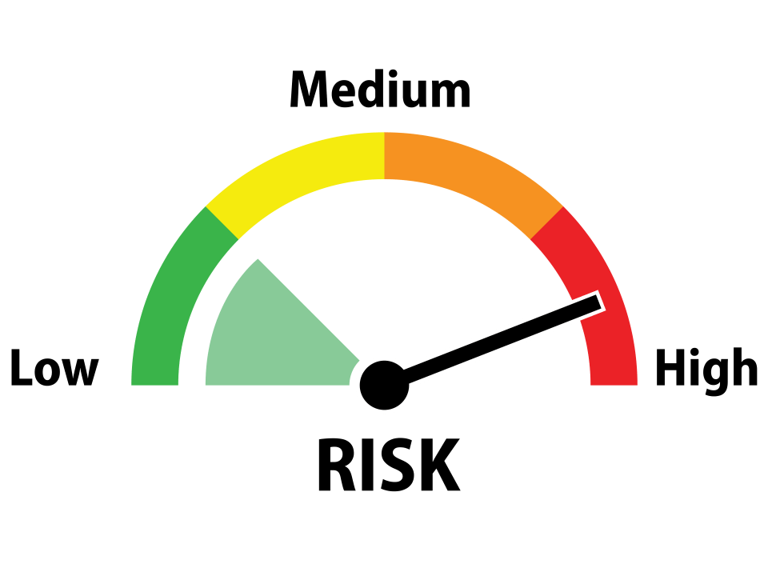
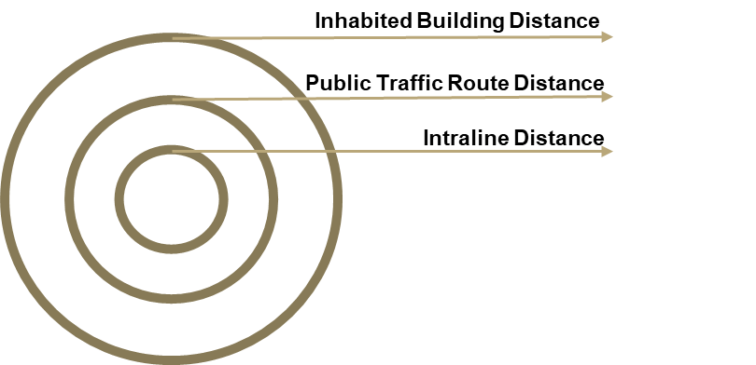

Risk Acceptance Criteria
The Dimensions of Risk Tolerability
Quantity / Distance Risk
Tolerability Criteria
Qualitative Risk Tolerability Criteria
1.00E-1
1.00E-2
1.00E-3
1.00E-5
1.00E-6
1.00E-7
Semi-Quantitative Risk Tolerability Criteria
This Photo by Unknown Author is licensed under CC BY-NC

Slide 3
Process Safety Information
Key to Understanding Explosives Safety Risk
Information on Explosive Materials
Explosive classification
Information on Process Technology
Block Flow & Process Flow Diagrams
Information on Process Equipment
Engineering Drawings
TNT equivalency
Incompatibilities
Minimum initiation energies (friction, impact, electrostatic discharge and heat)
Probit data, where available
Desensitisation controls for handling
Process Chemistry
Maximum Intended Inventory
Safe Upper & Lower Process Limits
Consequences of Deviation
Dimensional Tolerances
In-Process Sources of Energy
Blast / Fragment Protection Design
Equipment Specifications
Materials of Construction
Confinement Potential

Slide 4
Process Hazard Analysis
Risk Characterisation & Control Identification
Consequence Modelling
Logic Diagram (see below)
Qualitative Risk Analysis
Quantitative Risk Assessment

Slide 5
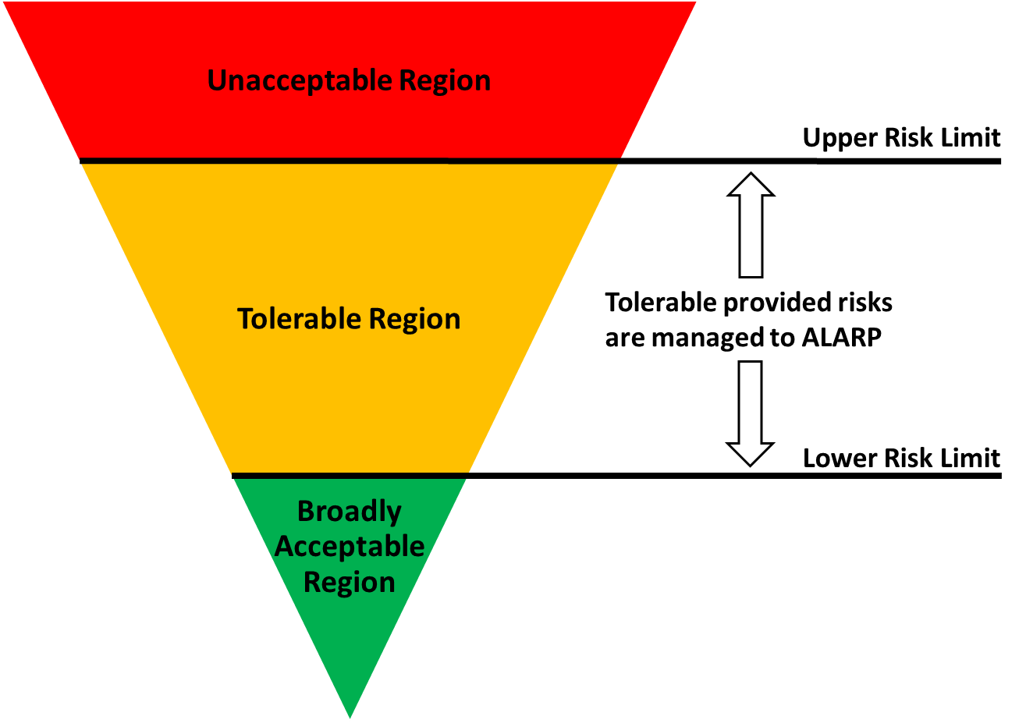

Risk Treatment
The Risk Decision Making Process
Risk Categorisation
Tolerability of Risk
ALARP
Risk
Likelihood
Consequence
Risk
Benefit
Cost
Likelihood and consequence are used to categorise risk
Established enterprise risk criteria are required to determine whether additional risk action is required
“Upper Risk Limit” defines the boundary between unacceptable and tolerable risk
“Broadly Acceptable” defines the risk treatment target
Progress towards the Lower Tolerability Limit until the cost of further risk reduction is disproportionate to the risk benefit gained

Slide 6

Critical Control Management
Critical Controls
“Critical Controls are those controls that are critical to preventing or mitigating a potentially fatal event”
Effective
Independent
Auditable
Risk / Hazard
Engineering
Administrative
Behaviors
Critical Control
Critical Control Attributes:
Understood – Personnel know the critical controls, their role in ensuring they are effective and what to do if they are not
Working – Performance measures are showing that controls are in place and effective and reported to Senior Leadership
Layers of Protection
Fatality

Slide 7




The Role of Mindfulness
Some Basic Principles
“Organisations Have No Memory”
It only takes a short time for the collective knowledge of risk and controls to deteriorate
Mindful leadership counterbalances the belief that “It cannot happen here”
We must tell our stories

Slide 8
Conclusion
Preventing Unwanted Explosions Requires Vigilance
Effort to understand and document the energetic properties of explosive materials and devices
Effort to understand the equipment and in-process energies used in the manufacture of explosives
Systematic analysis of hazards
Critical Control identification and verification
Mindfulness

Slide 9
Questions
?????

