Slide 1
Operations Risk Management for Explosives Manufacturing
What IPL learned through piloting a refreshed risk management approach at its explosives manufacturing sites
Kelly Dumesnil, Process Safety Engineer
Health, Safety, Environment & Operations Excellence

Slide 2
Operations Risk Management
This presentation describes Incitec Pivot Limited’s journey in piloting a refreshed approach to risk management to its explosives manufacturing sites across North America and Australia.
It documents the challenges, successes, learnings, and insights to date.
Operations Risk Management The introduction of a refreshed approach to risk management in explosives manufacturing

Slide 3
The Case for Change
Risk Identification
No differentiation of risk treatment based on consequence category (i.e. financial, safety, environmental).
Bow Ties
Sites left to facilitate bow ties without corporate support after minimal training.
Lack of clarity/guidance on defining critical controls.
Critical Control Verification
Lack of clarity/guidance on CCV requirements and structure
Did not define required frequency for CCVs, sites left to determine.
Impacts to:
HSE Performance
  Increase in Process Safety Events, TRIFR, Environmental excursions
Regulatory compliance
  Difficulty proving compliance
Assurance
  Unable to demonstrate that controls are in place and effective
IPL Risk Management Procedure (Pub. 2016)

Slide 4
Development of Operations Risk Management
Process Safety Risks
  Typically includes engineered controls
  Depend on collective actions of many across an organization (designers, installers, maintenance, operations, management)
  Potential to result in large-scale loss of life both on-site and off-site
Personal Safety Risks
  Typically includes administrative and procedural controls
  Heavily dependent on behavior and direct action of individuals involved in a task
  Impact to fewer personnel

Slide 5
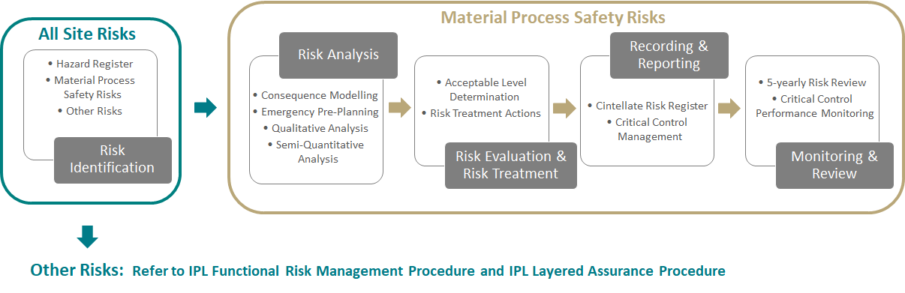
Development of Operations Risk Management
Overview of Operations Risk Management Process

Slide 6
ORM Implementation to Date
2019-2020: Pilot
  Trial implementation at Phosphate Hill site (manufactures ammonium phosphate fertilizers)
2020-2021: Readiness Assessments
  Used to develop site-specific implementation plans
  Assessed:
    Availability and quality of existing information/processes
    Competency of personnel to implement
    Capacity of site to take on work
2021-Present: Implementation
  Full implementation across Australian and North America Manufacturing sites
  Includes six Initiating Systems sites (five in North America, one in Australia)

Slide 7
Observations and Lessons Learned
“Tell me and I forget, teach me and I may remember, involve me and I learn.”
- Benjamin Franklin

Slide 8

Lessons Learned – Project Resourcing
Availability of site resources is vital
Each step of implementation requires significant collaboration between key people on site
Risk management is the responsibility of all, and should not be viewed as an “add-on” to normal operation
Long-term, ORM activities must be integrated into standard work
Leadership support is important
Sites in which leadership attends progress meetings, seeks progress updates, openly champions ORM, have made greater implementation progress and a more positive impression of ORM overall
Risk champion(s) greatly influences implementation
The level of experience and understanding of Process Safety varies significantly across IPL’s Initiating Systems sites
Demonstrated need for greater availability of Process Safety-specialized resources, either at sites or as part of a central team
Implementation must be well-supported centrally
There must be a central pool of specialists that is available for sites to use as needed
Centralized support also ensures a level of oversight, consistency, and quality of implementation

Slide 9
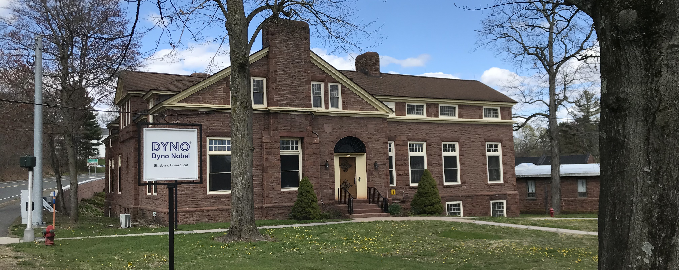
Lessons Learned – Integration into Existing Site Processes
Existing work that already satisfies ORM intent should be credited
U.S. sites have existing Process Hazard Analyses and Facility Siting Analyses as required by OSHA Process Safety Management and EPA Risk Management Program
Flexibility is important – ORM Procedure was updated to allow for inclusion of the above
Where applicable, ORM implementation schedules should be aligned with existing schedules for regulatory compliance activities
OSHA PSM and EPA RMP require 5-yearly PHA revalidation, and sites have already committed resources to these activities
ORM objectives can be achieved by integrating them into the scope of U.S. compliance activities

Slide 10
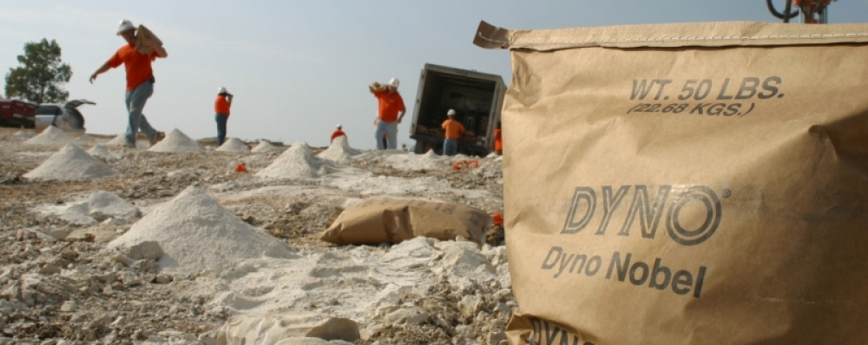
Lessons Learned – Initiating Systems Specific
Critical Control performance data must be readily accessible
CCVs are still appropriate for administrative controls
Risk assessment methodologies for explosives manufacturing sites may differ from fertilizer sites
Many sites still use paper-based records that make automatic tracking challenging
Business must modernize data tracking
Explosives manufacturing sites often rely on administrative controls
These controls are not monitored through a maintenance management system
Many techniques were developed for the chemicals and oil & gas sectors
Explosives processes are typically batch or manual assembly and frequently dependent on procedural/administrative controls

Slide 11
Next Steps and Looking to the Future
“When to use iterative development? You should use iterative development only on projects that you want to succeed.”
- Martin Fowler

Slide 12
Next Steps and Looking to the Future
Establish Subject Matter Expert Teams
Propose a “task-force” model
Process Safety professionals provide in-depth support to sites
Implementation in condensed time-frame
Sites are in the process of converting to centralized maintenance management processes
Transition from paper-based to electronic Critical Control Verifications
Improve Critical Control Dashboard Data
Develop ORM Training and Awareness Packs
Enable sites to independently and confidently maintain the process long after implementation
Build systems and processes that are not dependent on individuals
Collaboration with Human Resources and Learning & Development functions
Develop ORM Assurance Process and Tools
Assure consistent application of ORM across the business
Develop assurance tools to incorporate into regular audit programs

Slide 13
Questions
Any questions or comments?

