Slide 1
The Importance of Management of Change in New Plant Construction
SAFEX Salzburg, 27th & 28th April 2023
By :
- Adam Williams

Slide 2
Introduction to EPC-UK
EPC-UK is a leading force in the field of commercial explosives and drilling & blasting services in the UK.
There are five distinct divisions:
    Explosives
    Drilling & blasting
    Fuel additives
    Defence
    Logistics
Each providing unique services, whilst ensuring safety remains their number one priority.
Notes:
Introduce self as Operations Manager at the Rough Close Works Facility at EPC-UK.
Highlight EPC-UK activities, explain my role managing the Bulk Emulsion explosive manufacture facility and detonator manufacture facility.

Slide 3
Importance of Managing Change
The aim of this presentation is to:
Demonstrate the importance of the Management of Change process in the design and construction of new plants.
Provide an overview of design elements, relevant standards of compliance, and some of the complications that can arise throughout the construction process.
Highlight both the positive and negative learnings from the construction of EPC-UK’s new Bulk Emulsion Plant.

Slide 4
The Challenges of Change
Major plant construction projects are subject to the challenge of both enforced and desired changes.
Additionally, each project will be subject to influences that affect change decisions, primarily budget and timescale.
Regardless of these influences it is imperative that a rigorous Management of Change (MOC) Process is correctly applied.
Notes:
{After Point 1 } - The challenge for a high hazard industry like explosives manufacture is how to safely manage these changes.
{After Point 2 } - Such influences need to be considered but should not compromise the safety considerations of any potential change.
{After Point 3 } - This will ensure the integrity of design is maintained and the resulting construction will facilitate safer operations.

Slide 5
Management of Change Process
Review / Verify
Change
5
1
Identify Change
Record the Lessons Learned
Implement Change
4
2
Conduct Impact Analysis
3
Obtain Approval to Proceed
Notes:
{Slide Intro} – As seen in the previous slide, process and plant modifications are an inevitable part of the lifecycle of any installation and therefore it is vital that high hazard organisations have a robust MOC process in place.
The Chemical Industries Association Safety Advisory Group advises that all plant modifications “…should be subject to formal management procedures”
A typical process may look something like this:

Slide 6
Leading the Change
Leadership is essential in the execution of a successful MOC process.
Leaders must ensure:
That each change is subject to sufficiently detailed scrutiny and analysis by an expert team of contributors.
Following this analysis, the actions required to implement the change should be clearly defined, resourced and then implemented.
Pre and post implementation safety reviews should also be completed to control any deviations.
Notes:
{Following Leadership Intro} - The MOC procedure requires ownership from an appropriate level within the organisation. The person should have the relevant knowledge to understand the change and the authority to make decisions and ensure it is implemented fully.
Leaders must ensure:
{After Point 1} – In the case of plant construction this may be a combination of Engineering, Technical, Safety, Environmental and Operator reviews to give a comprehensive appraisal of all relevant aspects.
{After Point 3} – Once the change can be considered successful and part of normal operations, it is good practice to verify the change is complete and formally close out the change process.

Slide 7
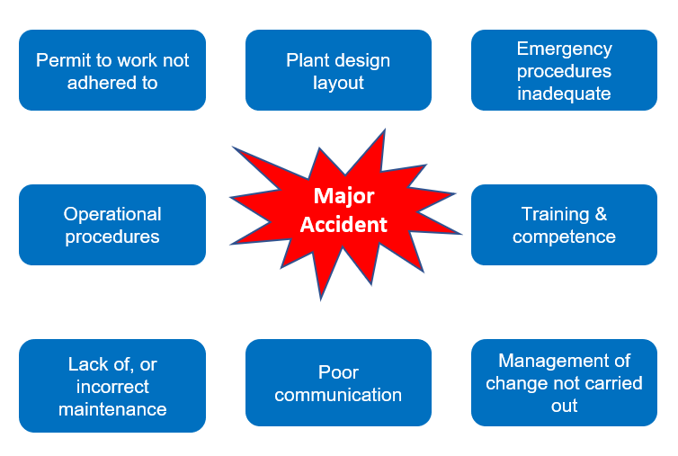
Major Accident - Root Causes
Notes:
{Slide Intro} - In Europe the Seveso Directive has resulted in a significant focus on Process Safety and the avoidance of major accidents.
In the UK, the Health & Safety Executive have considered the root causes of major accidents: {Show slide}
It is not surprising that poor management of change is listed as a root cause of a major accident.
I am confident that almost every organisation could provide examples where changes have been poorly managed.

Slide 8
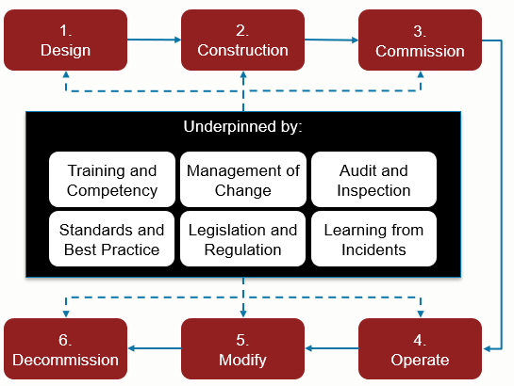
Process Safety Lifecycle
Notes:
[Slide Intro} - When planning the project for the new Bulk Emulsion Manufacturing Plant EPC-UK assessed all aspects of the Process Safety Lifecycle.
{Key Point} - Management of Change is a key element which underpins all stages, but it is arguably most important during the critical design and construction stages.
Explosive manufacturing plants simply cannot afford to make fundamental errors since ultimately these can cost lives and jeopardise the very future of the organisation.

Slide 9
Plant Design & Construction
Plant design should always be subject to a rigorous Hazard Operability Study (HazOp).
    EPC-UK completed a HazOp for the design of their new plant in 2016, but a change of contractor prompted a full review and resulted in a re-design late in 2017. Following the change the decision was taken to complete a second HazOp.
Modern plant design is increasingly subject to compliance with functional safety standards.
    The new EPC plant was designed and built to BS EN 61511 (Functional Safety – Safety instrumented systems for the process industry sector).
Notes:
{Slide intro} - The opportunity to be involved in the design and construction of a new plant is potentially a once in a lifetime event.
Having been fortunate enough to experience what’s involved, I can attest that it is a unique environment and a true test of an organisation’s teamwork. It takes tremendous focus to ensure that the inevitable changes that occur during a project are rigorously managed.
{After Point 1 } - this detailed analysis of all potential deviations, can highlight design deficiencies, which in turn may result in significant change. Whatever the outcome all necessary changes should be captured within the HazOp process.
{After Point 2 } - This standard sets out a defined approach through a process of risk assessment, specification, design, installation, testing and commissioning. This can be an incredibly long and detailed process and can actually enforce change at different stages.

Slide 10
Construction, Installation, Testing & Commissioning
It is always possible that the plant design does not translate exactly through to construction and installation.
Testing and commissioning, to validate the design and construction, may necessitate further change.
A well implemented MOC policy should challenge this assumption. Ensuring that all possibilities are identified, documented and well managed, ultimately contributing to a positive organisational safety culture.
Notes:
{After Point 1 } - This can be for any number of reasons, but at this point in a project any change is likely to cause delay.
The natural instinct is to find a workaround and resolve the problem quickly to maintain the schedule, however, this is probably the most crucial time to take a step back and assess the potential for change thoroughly.
{After Point 2 } - Any changes may seem obvious, and the solution dangerously simple to implement. {Move to point 3}

Slide 11
MOC – Areas of Focus
The MOC policy for EPC-UK highlights three key change areas:
Technical changes to
Plant, materials, electrical systems, processes, safety instrumented systems, shutdown systems
Administrative changes to
Safety critical policies, procedures and processes, requirements in controlled documents e.g. work instructions
Organisational changes to
Personnel, organisational structure, acquisitions or mergers, changes to safety critical roles or a change in specific knowledge or experience
If there are changes in any of these areas then the use of the MOC policy and process must be followed.
Notes:
{End of Slide Note} – This is by no means an exhaustive list and any change that is deemed significant should be managed under the MOC process.

Slide 12
MOC - Design & Construction
Once the need to follow the MOC process has been identified, the onus then falls to the relevant experts to provide specialist feedback on the potential impacts.
Aspects to consider may include:
    Upstream & downstream impacts
    Operator inputs
    Basic Process Control System settings/parameters
    Maintenance requirements
    Changes to procedures/work instructions
    Environmental impact
Notes:
Changes to Safety Instrumented Systems (SIS) for example are among the most complex and should be managed through the Functional Safety Lifecycle.

Slide 13
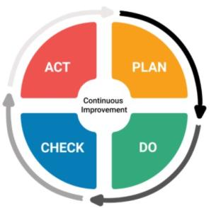
MOC - Design & Construction
During EPC-UK’s project several changes were identified and subsequently managed under the MOC process.
A relatively simple pipeline addition led to several important change considerations:
    Control System software changes
    Impact on Safety Instrumented Systems
    Installation standards assessment
    Testing & commissioning changes
    Document changes - P&ID & Maintenance plan
    Timescale & cost changes
    Internal resources & contractor control changes
Notes:
{After Point 1} - During testing it was realised that a shared pipeline would not give suitable accuracy for the specification of a production phase and as a result a proposal was made to install a separate pipeline.
{After Point 2 List} - The Senior Management Team were provided with a detailed appraisal which might be considered a simplified cost benefit analysis, and approval to proceed was granted.
The change was implemented successfully and safely.
Most importantly though, the MOC team were not pressurised and were able to focus on the details of the change without distraction.
A post implementation check was carried out as part of a comprehensive change audit with full involvement from the Safety team.
To summarise, it was an extremely positive experience that benefitted from previous learnings on the implementation of MOC in the organisation, and having been documented in the Quality Management System it serves as a historical reference point.

Slide 14
MOC - Organisational Change
While I have so far focussed mainly on plant related change, it is important to recognise that organisational change should also be subject to the MOC process.
The movement of key personnel in or out of an organisation can have a huge impact on a project.
Managing these changes are vital to retaining the knowledge and experience and understanding of the project history. However, new knowledge and experience can also prove highly beneficial.
Notes:
{following Point 2} - This was certainly true for EPC-UK, the project duration for its new plant spanned from 2015 to 2019.
There were no less than 5 key personnel changes during the project –
January 2018 – New Operations Manager
April 2018 – New Maintenance Technician
August 2018 – New Project Manager
April 2019 – New Safety Advisor
June 2019 – Departure of Maintenance Technician

Slide 15

In Summary…
When managing a plant construction project, the detail required can be huge, as such the impact of a minor change is often underestimated.
The importance of establishing the right team of skilled individuals, to identify and detail any necessary changes and subsequently implement them safely, cannot be overstated.
Arguably, in high hazard environments it is most important to rigorously manage change during the design and construction phase. Underestimating requirements at this early stage can facilitate major accident risks being built in to the new plant.
Finally, as safety leaders it is vital that we have clear and concise policies and procedures to effectively evaluate change, coupled with an organisational discipline to implement all changes safely.
Notes:
{Slide opening} - The opportunity to design and build a new plant does not occur often, therefore it is imperative that the inevitable changes that arise during these projects remain well managed.

