Slide 1
Decontamination of the SmartDet Facility
Kaylee Baker
April 2023

Slide 2
01. Background 02. Problem statement 03. literature review 04. approach 05. proximity to neighbours 06. blast effect mitigation and monitoring 07. Decontamination blasting 08. completion of site work

Slide 3
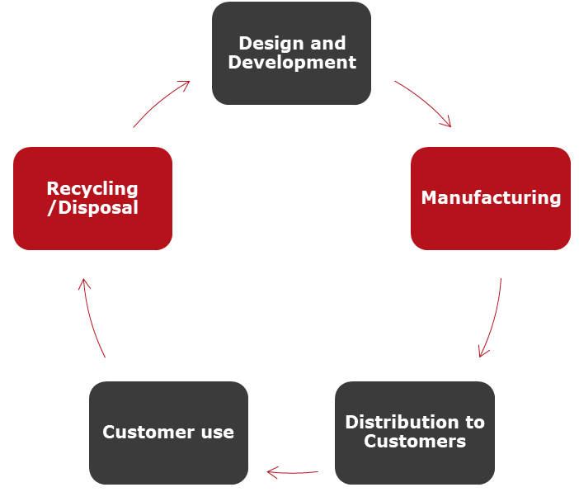
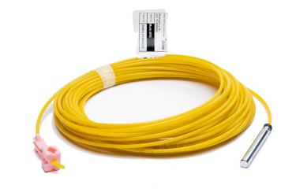
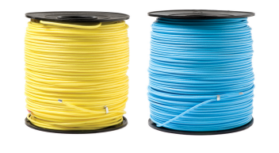
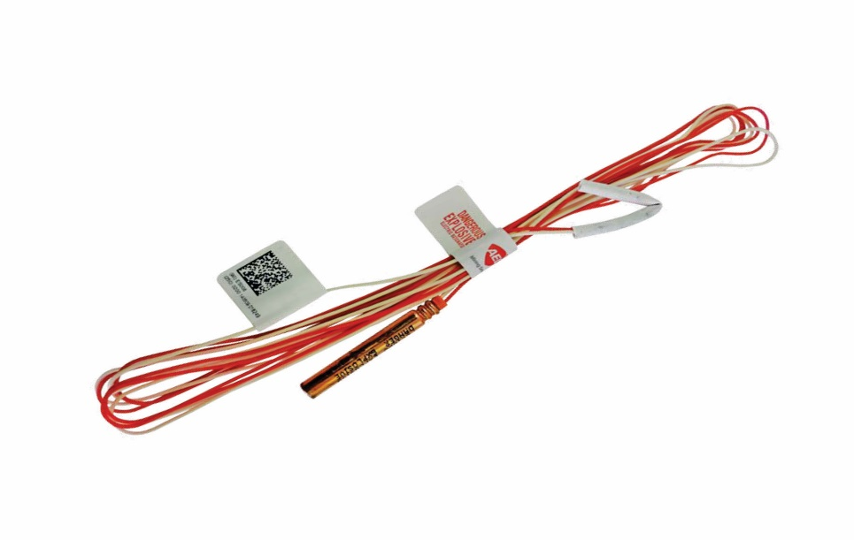
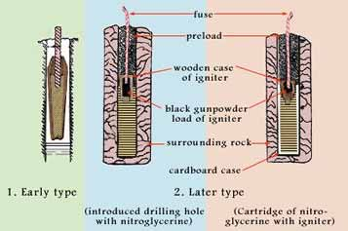
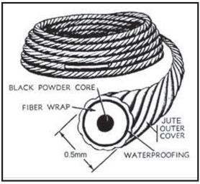
Background
History of Initiating Systems
Safety fuse – 1831
Electric bridge wire blasting cap – 1832
Plain detonator – 1864
Electric detonator – 1870
Delay electric detonator – 1895
Detonating cord – 1902
Igniter cord – 1957
Shock tube – 1980
Electronic detonators – 1970s
Early electronics manufacturing facility
Manufacture SmartDet Electronic Detonators 1993 to 2011
Decommissioned to allow for newer technology

Slide 4
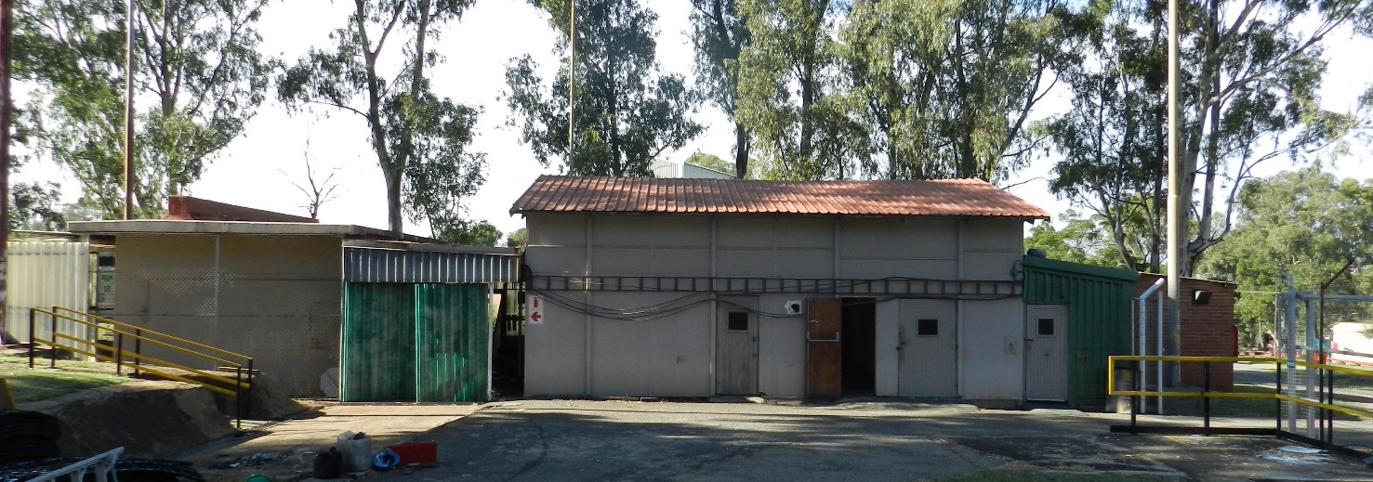
Problem Statement
Inside of building was decontaminated
A drain was situated outside of the building linked to a French drain to cater for non-hazardous effluent
During a risk assessment, the possibility of lead styphnate contamination of the French drain was raised
Extent of contamination not known
Extrapolation of the probability showed that the area could be contaminated with up to 40kg
Soda Ash used periodically during operations to assist with desensitization

Slide 5
Approach
GPR (2012)
Remote Drilling
Involvement of legislators
Decontamination Options
Chemical Neutralisation
Digging
Soda Ash
Blasting

Slide 6
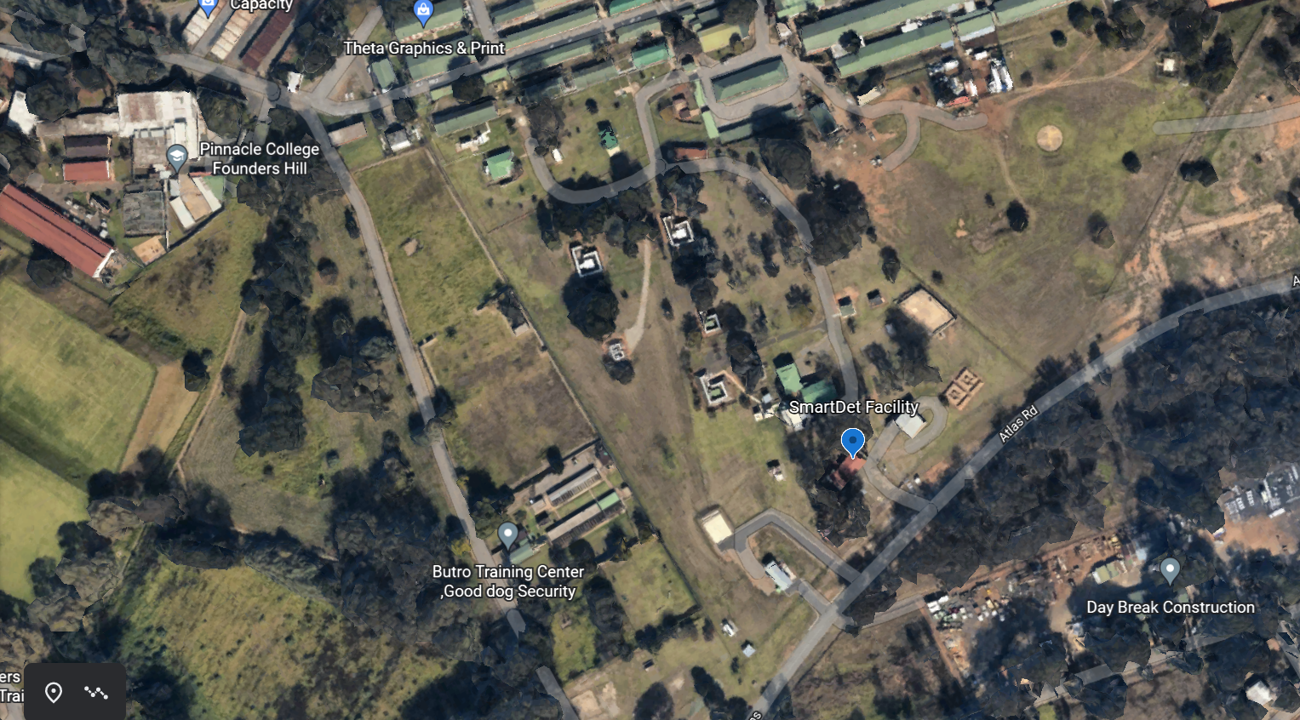
Proximity to Neighbours

Slide 7
Blast effect mitigation and monitoring
Experts were consulted
Exclusion zone of 210m determined
Tenants evacuated the area when blasting took place
Drones used to monitor surrounding area for activity
Security monitoring area
Blasting done during school holidays
Dogs moved to SPCA during the week of the blasting
Blast barricade erected to protect nearby buildings
Sand bags used to minimise flyrock and assist with containing blast
Four NOMIS Seismographs
Position 1 – 1,090 m – Shell garage
Position 2 – 445 m – Pinelands business park gate
Position 3 – 130 m – Contractor facility
Position 4 – 352 m – Founders Hill College
Notes:
Ground cratering
Ejection of soil lumps and other missiles over a large area
Propagation of a blast wave, exerting dynamic pressure forces on structures
High intensity (i.e. high dB-level) sound waves

Slide 8
Decontamination blasting
Explosive charge – 5kg per blast
Total of 18 shots – approximately 90kg
3 craters formed
Drone footage of blasting taken
Drain area was also blasted
No evidence of a French drain could be found
Layer of white powder found in the ground
Four NOMIS Seismographs
Position 1: Max 123.2 dB
Position 2: Max 128.7 dB
Position 3: Max 148.1 dB
Position 4: Max 136.3 dB
Notes:
134 USBM threshold for possible cosmetic damage to residences*
All blasts registered an air blast reading at station 3 that exceeded the USBM recommended maximum level for prevention of human irritation (this area was evacuated prior to blasting). Four blasts registered an air blast reading at station 4 that exceeded the USBM recommended maximum level for prevention of human irritation. No blasts registered an air blast reading at stations 1 and 2 that exceeded the USBM recommended maximum level for prevention of human irritation.

Slide 9

Drone footage

Slide 10
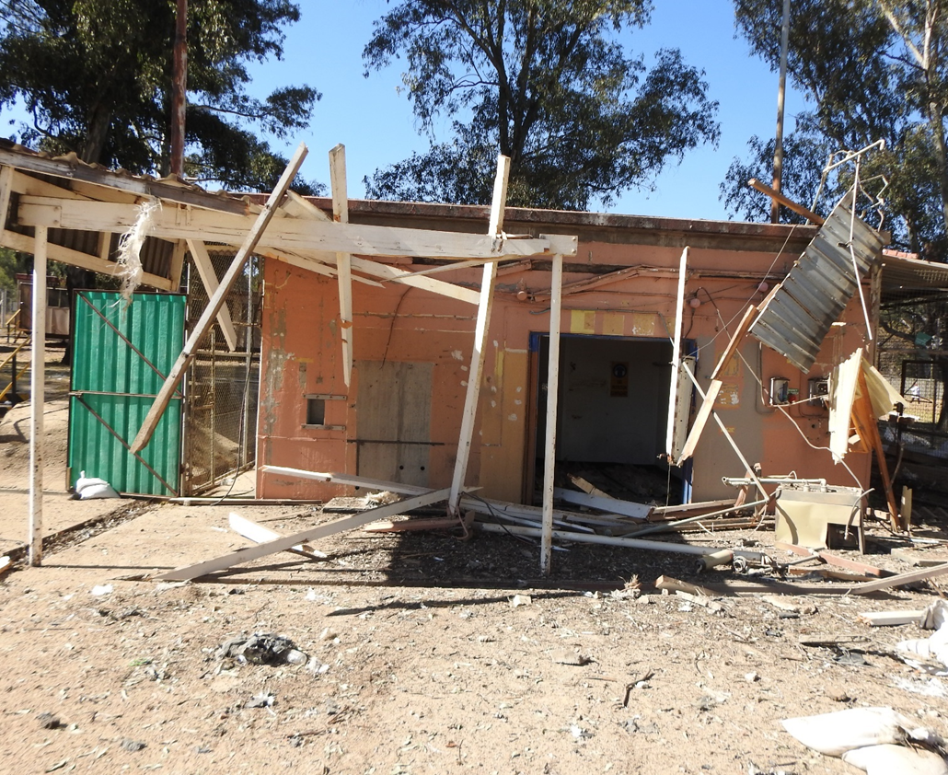
Completion of site work
Building refurbished
Earmarked for Schedule III non-explosive store

Slide 11
Thank you

