Slide 1
AN solution manufacture- product and safety issues for emulsion plant consumers
Ron Peddie
Peddie Engineering Pty Ltd
24-28 April 2023

Slide 2
Origin Of Presentation
SAFEX congress in Helsinki showed that many people lack awareness of ANS manufacturing.
This presentation to cover the issues.
Very major part of emulsions manufacture
Describes direct chemical manufacture from nitric acid and Ammonia
Not redissolving

Slide 3
Ammonium Nitrate manufacture
ANS the main raw material for all emulsion explosives
The neutralisation reaction to ammonium nitrate is straightforward:
NH₃(g) + HNO₃ (l) NH₄NO₃ + heat
It is an acid - base reaction- so therefore neutralisation.

Slide 4
Type of ANS plants
Many different types
Loops pipes tanks
They all make the same material.
About the fifth largest chemical manufactured in the world
Very efficient and low cost
2 * cost of natural gas

Slide 5
Ammonium Nitrate Solution in Emulsion Explosives
Used as the oxidiser part on emulsion.
About 70 – 80% of the total mass
Enables very large-scale blasting.
No practical alternatives

Slide 6
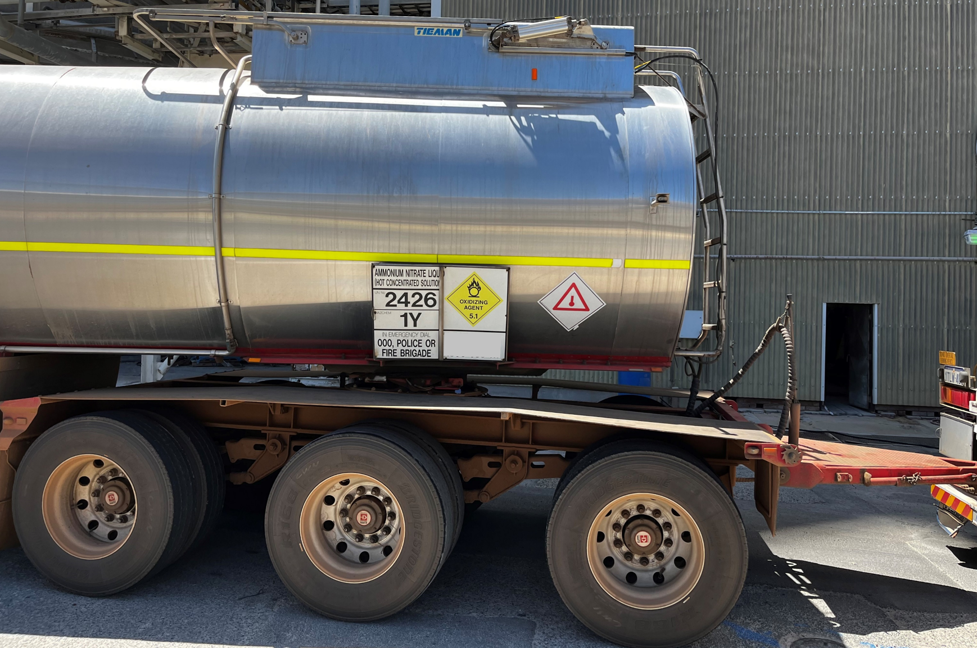
Manufacture of Ammonium Nitrate Solution Issues with Strength
Used at about 75 % strength.
All neutralisers produce above this strength.
Modern plant can make 92 – even 96% AN
UN DG code max 92%

Slide 7
Issues with strength of solution
Normal transport about 90 – 85%
Still requires dilution at site.
Higher strength lower transport cost
Lower strength able to be moved longer distances easily.
Final decision on strength is a business and logistics one

Slide 8
Issues with pH.
Neutral pH of AN is about 5.
So, such thing as AN above neutral point
Ammonia cannot be held.
So, a pH of reading of 6 means neutral AN and some ammonia gas

Slide 9
pH for emulsion manufacture
pH ex plant will be close to neutral.
Acid needed to make emulsion formulation slightly acidic.
Normally weak acids like citric
If too much NH3 maybe strong acid

Slide 10
Ph Adjustment
Safer just for weak and more economical not to much
Supply ANS pH as close to required.
DG constraint
Cost to supply plant close to zero.

Slide 11
Issues with the temperature of solution
ANS off reactors about 140º to 160ºC
Too hot for emulsion
Needs to be cooled and diluted.
Higher temperature longer distances
Lower temperatures easier to handle.
Be careful of boiling.

Slide 12
Contamination
Produced im massive quantities.
Raw materials also very pure
Difficult to contaminate at anything but ppm level.
Red solution possible
Caused by corrosion of stainless steel in reactor.
Very easy to see but very low levels few PPM.

Slide 13
Role in Emulsion Manufacture Trouble Shooting
ANS quite often blamed for emulsion problems.
Too me it is unlikely
As described pure chemical
Many other variables to check.
However can be convenient target

Slide 14
Safety
Physical and chemical dangers in handling ANS
Not the subject of this paper
Excellent guide by fertilisers Europe
https://www.fertilizerseurope.com/fileadmin/user_upload/publications/tecnical_publications/guidence_techn_documentation/New/Hot_Ammonia_VJ_05112014.pdf

Slide 15
Conclusions
ANS vital raw material
Keeps volume up and costs low.
Normally clean and on spec
Perhaps pay a visit to your friendly Chemical Plant

