Slide 1

The Ammonium Nitrate Explosion at the Port of Beirut
SAFEX Salzburg Congress
April 2023
Joshua Hoffman Ph.D., P.E. (IME)
June 2021

Slide 2





Slide 3
Founded in 1913
Mission:
To Promote the Safety and Security of the Commercial Explosives Industry

Slide 4
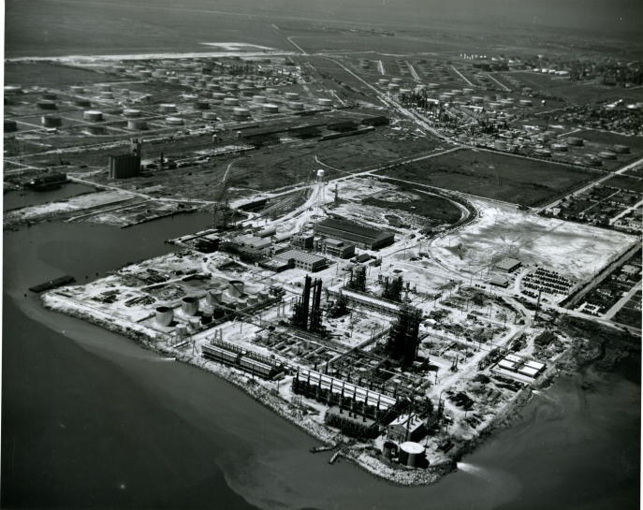
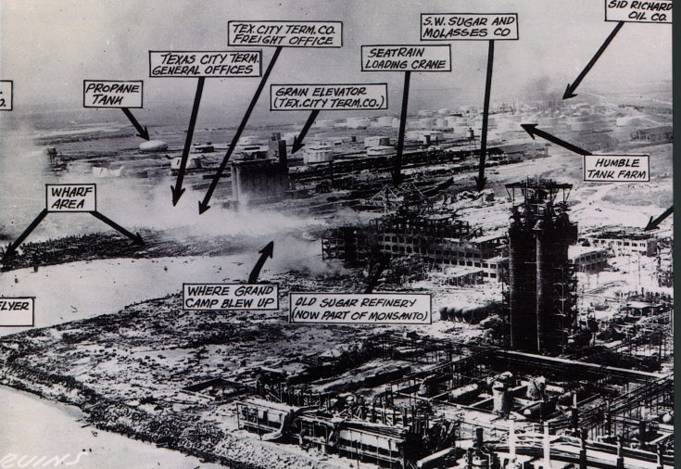
Texas City, TX
April 16, 1947
2,100 metric tons of ammonium nitrate

Slide 5
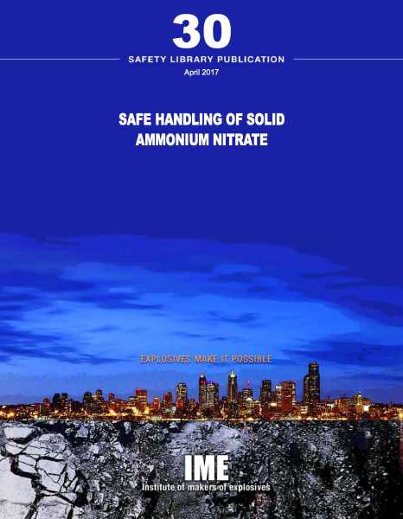

Slide 6
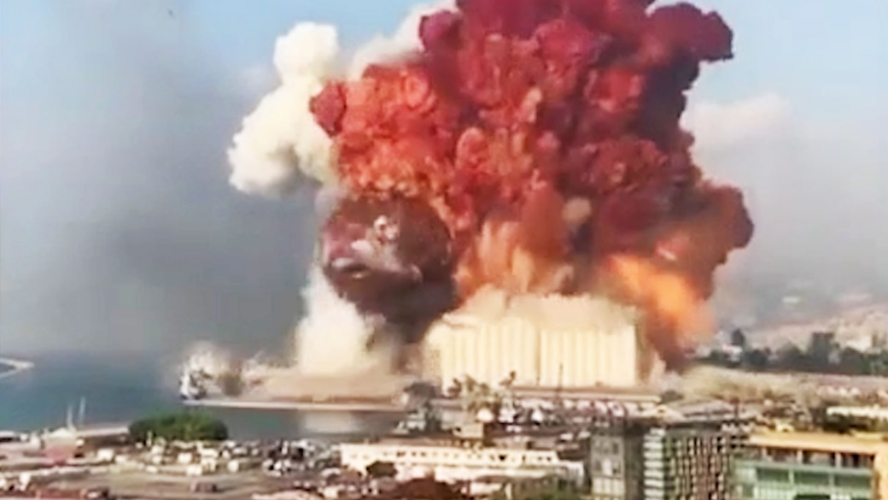
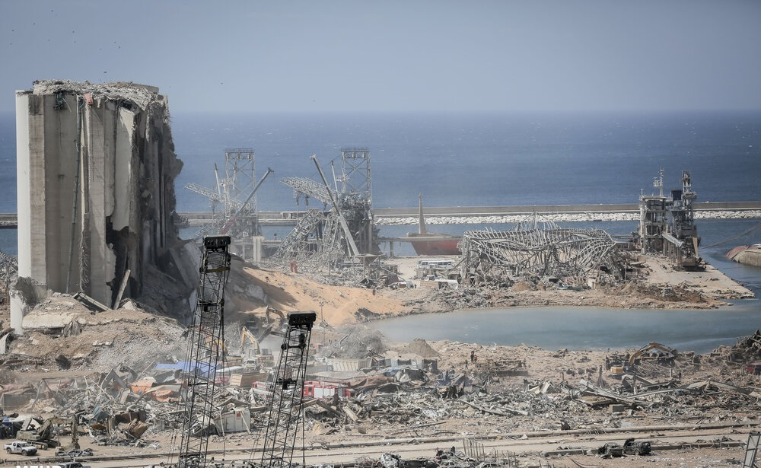

Beirut Lebanon
August 4, 2020

Slide 7
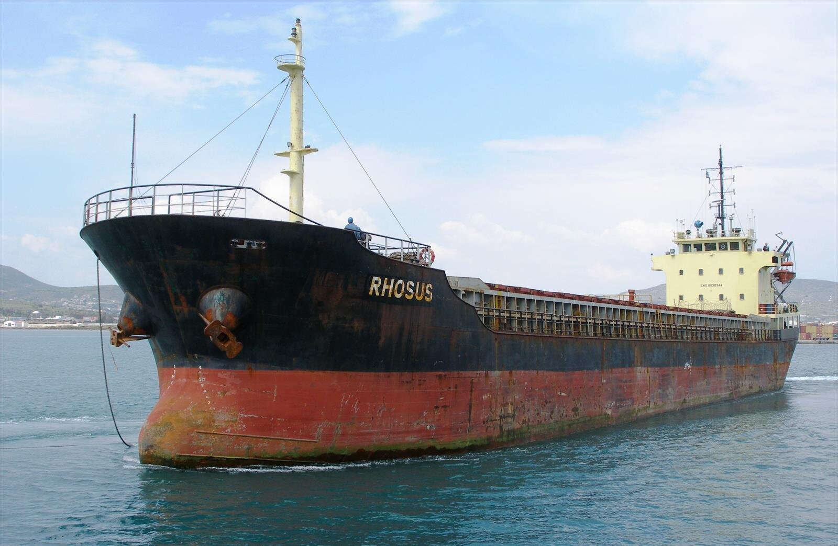
Rhosus (Moldovan Flagged) In Port 2013
2,740 Metric Tons AN (1 Metric Ton Supersacks) – High Density AN
2,531,760 lbs TNT Equiv. (42%) – USBM RI 6773
August 4, 2020 Event

Slide 8
2016 – 2018 – Correspondence who had authority to issues order to re-export AN.
Oct. 2018 – Request to sell ship approved but AN not mentioned.
Feb. 2020 – Inspector recommended a special committee apprise to auction.
June 2020 – Prime Minister notified. Ordered posting of guards.
Sept. 2013 – Bill of Lading 2,750 MTS HDAN
(Georgia to Mozambique)
Nov. 25, 2013 – Ship inspection found violation of maritime safety regs and vessel was detained.
June 2014 – Lebanese Judge rules Rhosus refloated and cargo appropriately moved stored
2015 – Correspondence between Lebanese authorities urging sale, noting poor condition, and requesting nitrogen test.
Nov. 21, 2013 – Put in at Port of Beirut to take on cargo or repair.
Unified Cargo List states “2750 Big Bags” not AN
April 2014 – Inspection Services Captain reported the Rhosus contained hazardous cargo and recommended its removal. Beirut authorities receive letters from harbormaster and law firm of ship’s captain advising of hazards.
Oct. 2014 – Cargo move to Hangar 12. Manifest Dept. advised Director of Port to immediately approve transferring of AN to Lebanese Army.
April 2016 – Nitrogen grade was reported confirming it was restricted explosives material. Lebanese army stated they have no need for it and suggest reselling.
Feb. 2018 – Rhosus sinks. March 2018 – Case Authority requests ship sold.
Dec. 2019 – Report alerting authorities to condition and security of Hangar 12.
May 2020 – Report on hazards present to Army and Causations Prosecutor.
Aug. 4, 2020 – Explosion Occurred after a fire.
A tragedy years in the making

Slide 9
The timeline begins at 5:54 PM, but even prior to that the warehouse fans were seen depositing plumes of white smoke into the air.
5:56 PM. While this initial plume of smoke was very light in color, the smoke quickly darkened within two minutes to black. This color change indicates that different materials were beginning to burn.
According to witness footage, Fire brigades arrived at approximately 5:58 PM - four minutes after a call to emergency services was placed regarding the smoke. The sound of pyrotechnics can be heard in the background of the brigade’s footage.
The heat within the warehouse would have continued to increase, and by 6:07 PM an additional, larger, and darker, plume of smoke, accompanied by visible flames and sparks, could be seen from St. George’s Hospital.
At 6:08 PM, approximately thirty-five seconds after the sparks were witnessed, a spherical blast was visible encapsulating the warehouse.

Slide 10
Initial reports from quick coverage media outlets such as CNN, NPR, and the BBC depict the explosion at the Port of Beirut as an accident, and then quickly evolve into speculation of regulatory neglect, and governmental corruption.
Initial reports detailed 135 deaths, which later increased to over 200 deaths and over 7,000 injuries after further investigation.
These reports also originally indicated that the explosion was due to a major fire at the warehouse, as well as the “firecrackers” stored in the warehouse.
Only two days after the blast, most reports included the Prime Minister’s disclosure of 2,700 tons of ammonium nitrate being stored in Hangar Twelve “without preventative measures”.
In the media

Slide 11
As more information became available, investigative news outlets began reporting on the incident, and its potential causes.
On August 5th, AP News reported that a U.S. Defense Department Official told AP that at that time the explosion was believed to have been caused by “improper storage of explosives”. AP references a letter from the Lebanese customs department, which confirms ammonium nitrate has been stored in the port.
AP describes ammonium nitrate as “a component of fertilizer that is potentially explosive” and establishes a timeline of events where 2,750 tons of ammonium nitrate caught fire, and then detonated.
In the media

Slide 12
Similarly, a corrected version of Reuter’s initial report: Beirut's accidental cargo: how an unscheduled port visit led to disaster, indicates that the explosion was due to the ammonium nitrate stored in Hangar 12 “for safety reasons”. Reuters describes the chain of events as beginning with the stored ammonium nitrate catching fire, and then exploding.
On August 14th, Reuters published a deeper analysis of the event, comparing the explosion to a scaled down nuclear bomb. At this time, Reuters published an estimate TNT equivalency of 200 to 300 tons of “high explosives.” The same article provided an infographic demonstrating this equivalency as parallel to percentages of military weaponry, such as the hellfire missile, and an analogy was made to the 1995 Oklahoma City bombing.
Reuters also provided an analysis of seismological data that indicated six blasts, at eleven second intervals, occurred during the incident.
In the media

Slide 13
In November of 2020, Legal Action Worldwide (LAW) published their Report on Behalf of the Victims of the Beirut Explosion which states that the August 4th blast killed over 200, injured 7,000, and displaced approximately 300,000 people. Furthermore, it is reported that the blast destroyed “thousands” of buildings and “incinerated” the Beirut’s grain storage facilities.
It should be noted that at this time, nearly three months after the blast, LAW was advocating for an independent and impartial investigation, to be followed by prosecution, and requesting that any information related to the explosion be publicized. This indicates that even three months after the accident there were still uncertainties about the cause and full impact of the explosion.
In the media

Slide 14
In August of 2021, Human Rights Watch published their report They Killed Us from the Inside, after nearly a year of investigations into the explosion had elapsed.
Their report details the timeline of the cargo ship Rhosus, using publicly available records and correspondence from Lebanese government officials.
This report includes several recommendations to Lebanese governing bodies and international associations, including that Lebanese guidelines and investigative practices related to hazardous material be updated to reflect international guidelines.
In the media

Slide 15
The New York Times (NYT) compiled coverage from social media and first responders, and unearthed years of government documents to create a timeline of the incident, as well as its potential causes.
At the time of publication, it is clear from this editorial that the NYT believed the explosion to be the result of a preventable accident. The report crucially outlines the hazardous environment the ammonium nitrate was stored in. The report notes that Hangar 12 was not outfitted with smoke alarms or sprinklers, as would be required by current best practices. Visuals of Hangar 12 before the explosion show the ammonium nitrate being stored alongside fireworks, “fuses” and “fuel”.
Additionally, while no theories of the cause of the explosion have been confirmed, the NYT offers a “most likely scenario”. Their report states that on August 4th a team of welders was sent to fix Hangar 12, and that perhaps the welders accidentally ignited a fire during their work, which subsequently led to the explosion.
In the media

Slide 16
Theoretically, the TNT equivalency of TGAN is no more than 42%.
This maximum theoretical value of TGAN is not considered realistic.
TNT equivalency of TGAN is conditionally dependent.
TGAN Energy
Confinement
Prill Density
Mode of Initiation
Shock
Contamination
Fire

Slide 17
Hazard | Chemical Equivalency | Explosives Yield | Overall TNT Equivalency | SAFEX Recommended TNT Equivalency
Shock | 0.32 | 100% | 25-32% | 32%
Contamination | 0.32 | 10-50% | 3-16% | 16%
Fire | 0.32 | 10% | 3-5% | 5%
Shock
The SAFEX table indicates TGAN detonated by a shock has a TNT equivalency of 32%.
The shock hazard for TGAN detonation typically requires supersonic velocities such as from an explosive.
If explosive materials are accidentally detonated, the resulting shock wave has the potential to detonate adjacent AN.
Reducing the weight of the donor, separating the donor from the acceptor and blocking the donor shock wave by incorporating a substantial barricade are the primary means to eliminate the shock hazard.
Regulations promulgated by ATF at 27 C.F.R. 555 prescribe mandatory separation distances for AN and explosives. When stores of AN are located side by side with explosive materials, AN is considered an “acceptor” and explosive materials are considered a “donor”.
Notes:
Shock
The SAFEX table indicates TGAN detonated by a shock has the potential to release energy equivalent to 32% of TNT. Thus, a quantity of 100,000 lbs. of TGAN has the potential energy release of 32,000 lbs. of TNT. The SAFEX table also indicates that shock will derive the highest energy release of any of the three modes of initiation. The shock hazard for TGAN in storage must be sufficiently high to cause a detonation to occur. This typically requires supersonic velocities such as from an explosive.
When stores of AN are located side by side with explosive materials, AN is considered an “acceptor” and explosive materials are considered a donor. If explosive materials are accidentally detonated, the resulting shock wave has the potential to detonate adjacent AN. Reducing the weight of the donor, separating the donor from the acceptor and blocking the donor shock wave by incorporating a substantial barricade are the primary means to eliminate the shock hazard. When barricades are not used, further reducing the donor weight and increasing the separation distance between the donor and acceptor are measures to prevent the sympathetic detonation of the acceptor.
Regulations promulgated by ATF at 27 C.F.R. 555 prescribe mandatory separation distances for AN and explosives when located side by side. See the above regulations at Subpart K - Storage, for additional information.
Contamination
Contamination is a hazard of concern associated with TGAN that may cause an energy release equivalent to 16% of TNT (See SAFEX Table). Conducting a workplace hazard assessment to eliminate the known TGAN contaminants is an essential step to eliminating this potential risk.
Organic chemicals and acids or other corrosives are identified TGAN contaminants that can cause explosive reactions. Compressed flammable gases, flammable and combustible materials and solids or liquids, including wood chips, saw dust, lubricants, greases and oils are known organic contaminants. Keep these materials away from TGAN to eliminate the potential explosive hazard.
Inorganic substances are known TGAN contaminants that contribute to its sensitivity to explosion. These include, but are not limited to, chlorides, phosphorus, sulfur, and some metals, such as chromium, copper, copper alloys (brass and bronze), cobalt, and nickel, and finely divided or powdered metals such as aluminum and magnesium. Keep these inorganic substances away from TGAN to eliminate the potential explosive hazard.
Tetra Amine Copper Nitrate (“TACN”), is a friction and impact sensitive explosive. Tests of impact sensitivity involving a 2 kilogram drop-hammer indicate the impact sensitivity of TACN is between Lead Azide (1.1A explosive) and PETN (1.1D explosive). TACN is formed when TGAN comes into the presence of moisture and in contact with copper or copper alloys, such as brass and bronze. As such, copper and alloys of copper must not to be used in the construction of bins, tanks, equipment or tools used for handling, storing or transporting TGAN. If these metals are located anywhere in the facility then they should be painted or coated to prevent TACN generation.
Fire
Fire is a hazard concern associated with TGAN that may lead to an energy release equivalent to 5% of TNT (See SAFEX Table). Of particular importance regarding fire safety is the high percntage of oxygen present in the TGAN compound - 60%. The high percentage of oxygen provides one of the critical parts of the fire triangle (air, fuel and eheat) required to ignite and to sustain a fire. In a fire, TGAN will not burn, because it is not combustible. However, when TGAN is involved in a fire, it becomes an excellent source of oxygen to sustain combustion.
If TGAN becomes involved in a fire, it may be heated above its melting point at 170⁰C (337⁰F). TGAN will begin to decompose once the temperature reaches 210⁰ C (410⁰ F). When TGAN melts it becomes more sensitive to detonation by shock, especially if any part of its mass is confined and/or contaminants are present. When TGAN decomposes, it will release highly toxic fumes (oxides of nitrogen), normally identified by visible red, orange and brownish smoke.
When heated, TGAN will decompose into a number of different chemical products. At lower temperatures, it decomposes into nitrous oxide and water. Nitrous oxide supports combustion since it is an excellent oxidizing agent. This reaction is accompanied by some decomposition that creates ammonia and nitric acid. Increasing the temperature will significantly decompose TGAN to potentially dangerous levels.
Combined Hazards of Heat, Contamination and Shock
When contaminated with a fuel and a fire occurs, or When TGAN is heated beyond its melting point, it is significantly more sensitive to shock. both senerios significantly increase the probability of an event.

Slide 18
Hazard | Chemical Equivalency | Explosives Yield | Overall TNT Equivalency | SAFEX Recommended TNT Equivalency
Shock | 0.32 | 100% | 25-32% | 32%
Contamination | 0.32 | 10-50% | 3-16% | 16%
Fire | 0.32 | 10% | 3-5% | 5%
Contamination
Contamination is a hazard of concern associated with TGAN that may cause an energy release equivalent to 16% of TNT (See SAFEX Table).
Organic chemicals and acids or other corrosives are TGAN contaminants that can cause explosive reactions.
Compressed flammable gases, flammable and combustible materials and solids or liquids, including wood chips, saw dust, lubricants, greases and oils are known organic contaminants.
Inorganic substances are known TGAN contaminants that contribute to its sensitivity to explosion.
Such as: chlorides, phosphorus, sulfur, some metals, such as chromium, copper, copper alloys (brass and bronze), cobalt, and nickel, and finely divided or powdered metals such as aluminum and magnesium.
Copper and alloys of copper must not to be used in the construction of bins, tanks, equipment or tools used for handling, storing or transporting TGAN. If these metals are located anywhere in the facility then they should be painted or coated to prevent TACN generation.
Keep these materials away from TGAN to eliminate the potential explosive hazard.
Notes:
Shock
The SAFEX table indicates TGAN detonated by a shock has the potential to release energy equivalent to 32% of TNT. Thus, a quantity of 100,000 lbs. of TGAN has the potential energy release of 32,000 lbs. of TNT. The SAFEX table also indicates that shock will derive the highest energy release of any of the three modes of initiation. The shock hazard for TGAN in storage must be sufficiently high to cause a detonation to occur. This typically requires supersonic velocities such as from an explosive.
When stores of AN are located side by side with explosive materials, AN is considered an “acceptor” and explosive materials are considered a donor. If explosive materials are accidentally detonated, the resulting shock wave has the potential to detonate adjacent AN. Reducing the weight of the donor, separating the donor from the acceptor and blocking the donor shock wave by incorporating a substantial barricade are the primary means to eliminate the shock hazard. When barricades are not used, further reducing the donor weight and increasing the separation distance between the donor and acceptor are measures to prevent the sympathetic detonation of the acceptor.
Regulations promulgated by ATF at 27 C.F.R. 555 prescribe mandatory separation distances for AN and explosives when located side by side. See the above regulations at Subpart K - Storage, for additional information.
Contamination
Contamination is a hazard of concern associated with TGAN that may cause an energy release equivalent to 16% of TNT (See SAFEX Table). Conducting a workplace hazard assessment to eliminate the known TGAN contaminants is an essential step to eliminating this potential risk.
Organic chemicals and acids or other corrosives are identified TGAN contaminants that can cause explosive reactions. Compressed flammable gases, flammable and combustible materials and solids or liquids, including wood chips, saw dust, lubricants, greases and oils are known organic contaminants. Keep these materials away from TGAN to eliminate the potential explosive hazard.
Inorganic substances are known TGAN contaminants that contribute to its sensitivity to explosion. These include, but are not limited to, chlorides, phosphorus, sulfur, and some metals, such as chromium, copper, copper alloys (brass and bronze), cobalt, and nickel, and finely divided or powdered metals such as aluminum and magnesium. Keep these inorganic substances away from TGAN to eliminate the potential explosive hazard.
Tetra Amine Copper Nitrate (“TACN”), is a friction and impact sensitive explosive. Tests of impact sensitivity involving a 2 kilogram drop-hammer indicate the impact sensitivity of TACN is between Lead Azide (1.1A explosive) and PETN (1.1D explosive). TACN is formed when TGAN comes into the presence of moisture and in contact with copper or copper alloys, such as brass and bronze. As such, copper and alloys of copper must not to be used in the construction of bins, tanks, equipment or tools used for handling, storing or transporting TGAN. If these metals are located anywhere in the facility then they should be painted or coated to prevent TACN generation.
Fire
Fire is a hazard concern associated with TGAN that may lead to an energy release equivalent to 5% of TNT (See SAFEX Table). Of particular importance regarding fire safety is the high percntage of oxygen present in the TGAN compound - 60%. The high percentage of oxygen provides one of the critical parts of the fire triangle (air, fuel and eheat) required to ignite and to sustain a fire. In a fire, TGAN will not burn, because it is not combustible. However, when TGAN is involved in a fire, it becomes an excellent source of oxygen to sustain combustion.
If TGAN becomes involved in a fire, it may be heated above its melting point at 170⁰C (337⁰F). TGAN will begin to decompose once the temperature reaches 210⁰ C (410⁰ F). When TGAN melts it becomes more sensitive to detonation by shock, especially if any part of its mass is confined and/or contaminants are present. When TGAN decomposes, it will release highly toxic fumes (oxides of nitrogen), normally identified by visible red, orange and brownish smoke.
When heated, TGAN will decompose into a number of different chemical products. At lower temperatures, it decomposes into nitrous oxide and water. Nitrous oxide supports combustion since it is an excellent oxidizing agent. This reaction is accompanied by some decomposition that creates ammonia and nitric acid. Increasing the temperature will significantly decompose TGAN to potentially dangerous levels.
Combined Hazards of Heat, Contamination and Shock
When contaminated with a fuel and a fire occurs, or When TGAN is heated beyond its melting point, it is significantly more sensitive to shock. both senerios significantly increase the probability of an event.

Slide 19
Hazard | Chemical Equivalency | Explosives Yield | Overall TNT Equivalency | SAFEX Recommended TNT Equivalency
Shock | 0.32 | 100% | 25-32% | 32%
Contamination | 0.32 | 10-50% | 3-16% | 16%
Fire | 0.32 | 10% | 3-5% | 5%
Fire
Fire is a hazard concern associated with TGAN that may lead to an energy release equivalent to 5% of TNT.
TGAN will not burn, because it is not combustible.
When TGAN is involved in a fire, it becomes an excellent source of oxygen to sustain combustion.
When heated, TGAN will decompose into several different chemical products.
TGAN will begin to decompose once the temperature reaches 210⁰ C (410⁰ F).
At lower temperatures, it decomposes into nitrous oxide and water. Nitrous oxide supports combustion since it is an excellent oxidizing agent.
At higher temperatures TGAN decomposes into highly toxic fumes (oxides of nitrogen), normally identified by visible red, orange and brownish smoke.
Combined Hazards of Heat, Contamination and Shock
TGANs melting point is at 170⁰C (337⁰F). When TGAN melts it becomes more sensitive to detonation by shock, especially if any part of its mass is confined and/or contaminants are present. This significantly increases the probability of an event.
Notes:
Shock
The SAFEX table indicates TGAN detonated by a shock has the potential to release energy equivalent to 32% of TNT. Thus, a quantity of 100,000 lbs. of TGAN has the potential energy release of 32,000 lbs. of TNT. The SAFEX table also indicates that shock will derive the highest energy release of any of the three modes of initiation. The shock hazard for TGAN in storage must be sufficiently high to cause a detonation to occur. This typically requires supersonic velocities such as from an explosive.
When stores of AN are located side by side with explosive materials, AN is considered an “acceptor” and explosive materials are considered a donor. If explosive materials are accidentally detonated, the resulting shock wave has the potential to detonate adjacent AN. Reducing the weight of the donor, separating the donor from the acceptor and blocking the donor shock wave by incorporating a substantial barricade are the primary means to eliminate the shock hazard. When barricades are not used, further reducing the donor weight and increasing the separation distance between the donor and acceptor are measures to prevent the sympathetic detonation of the acceptor.
Regulations promulgated by ATF at 27 C.F.R. 555 prescribe mandatory separation distances for AN and explosives when located side by side. See the above regulations at Subpart K - Storage, for additional information.
Contamination
Contamination is a hazard of concern associated with TGAN that may cause an energy release equivalent to 16% of TNT (See SAFEX Table). Conducting a workplace hazard assessment to eliminate the known TGAN contaminants is an essential step to eliminating this potential risk.
Organic chemicals and acids or other corrosives are identified TGAN contaminants that can cause explosive reactions. Compressed flammable gases, flammable and combustible materials and solids or liquids, including wood chips, saw dust, lubricants, greases and oils are known organic contaminants. Keep these materials away from TGAN to eliminate the potential explosive hazard.
Inorganic substances are known TGAN contaminants that contribute to its sensitivity to explosion. These include, but are not limited to, chlorides, phosphorus, sulfur, and some metals, such as chromium, copper, copper alloys (brass and bronze), cobalt, and nickel, and finely divided or powdered metals such as aluminum and magnesium. Keep these inorganic substances away from TGAN to eliminate the potential explosive hazard.
Tetra Amine Copper Nitrate (“TACN”), is a friction and impact sensitive explosive. Tests of impact sensitivity involving a 2 kilogram drop-hammer indicate the impact sensitivity of TACN is between Lead Azide (1.1A explosive) and PETN (1.1D explosive). TACN is formed when TGAN comes into the presence of moisture and in contact with copper or copper alloys, such as brass and bronze. As such, copper and alloys of copper must not to be used in the construction of bins, tanks, equipment or tools used for handling, storing or transporting TGAN. If these metals are located anywhere in the facility then they should be painted or coated to prevent TACN generation.
Fire
Fire is a hazard concern associated with TGAN that may lead to an energy release equivalent to 5% of TNT (See SAFEX Table). Of particular importance regarding fire safety is the high percntage of oxygen present in the TGAN compound - 60%. The high percentage of oxygen provides one of the critical parts of the fire triangle (air, fuel and eheat) required to ignite and to sustain a fire. In a fire, TGAN will not burn, because it is not combustible. However, when TGAN is involved in a fire, it becomes an excellent source of oxygen to sustain combustion.
If TGAN becomes involved in a fire, it may be heated above its melting point at 170⁰C (337⁰F). TGAN will begin to decompose once the temperature reaches 210⁰ C (410⁰ F). When TGAN melts it becomes more sensitive to detonation by shock, especially if any part of its mass is confined and/or contaminants are present. When TGAN decomposes, it will release highly toxic fumes (oxides of nitrogen), normally identified by visible red, orange and brownish smoke.
When heated, TGAN will decompose into a number of different chemical products. At lower temperatures, it decomposes into nitrous oxide and water. Nitrous oxide supports combustion since it is an excellent oxidizing agent. This reaction is accompanied by some decomposition that creates ammonia and nitric acid. Increasing the temperature will significantly decompose TGAN to potentially dangerous levels.
Combined Hazards of Heat, Contamination and Shock
When contaminated with a fuel and a fire occurs, or When TGAN is heated beyond its melting point, it is significantly more sensitive to shock. both senerios significantly increase the probability of an event.

Slide 20
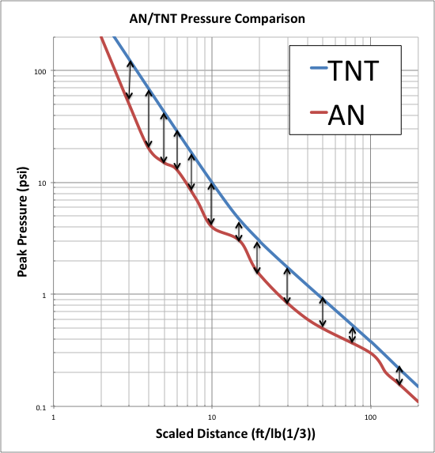
Examined differences in peak pressure and impulse characteristics.
(APT RESEARCH - IMESAFR AN MODULE BASED)

Slide 21
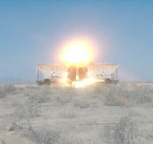
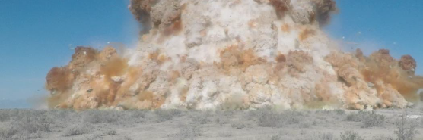
FIELD
TESTING

Slide 22
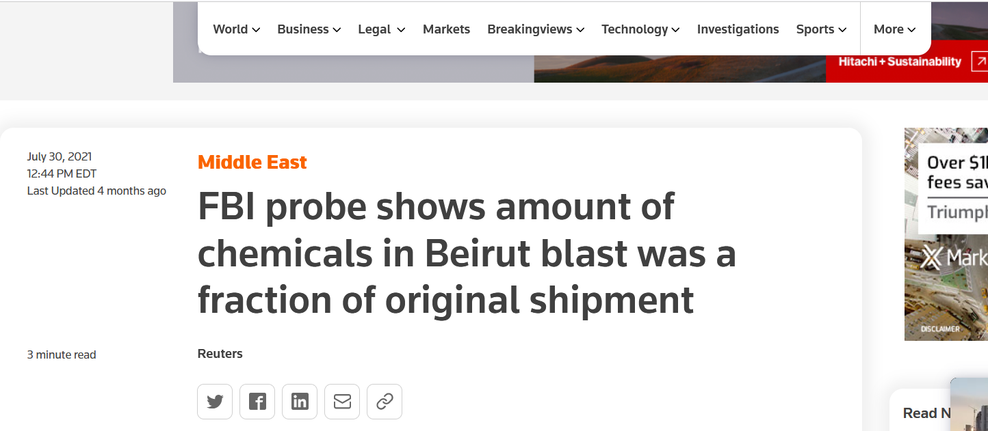
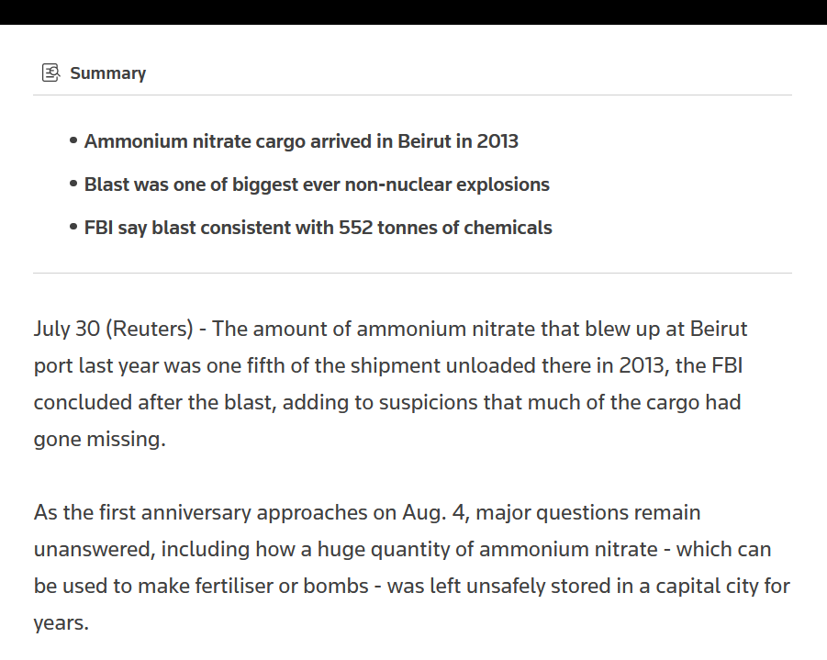
The FBI report said "an approximate amount reaching around 552 metric tonnes of ammonium nitrate exploded in warehouse 12".
Notes:
Water, grain, week after

Slide 23
Two international organizations of note that have or addressed the port of Beirut incident include:
The Global Congress on Chemical Security and Emerging Threats
United Nations and the Organization for Economic Co-operation and Development
UN/OECD seminar in follow-up to the 2020 Beirut port explosion: Lessons learned, experiences and good practices in managing risks of ammonium nitrate storage, handling and transport in port areas, preventing accidents and mitigating their consequences
International Discussions

Slide 24
IME’s Recommendations
Briefs
Ammonium Nitrate Detonability Question - (April 2019)
Strengthen Ammonia Nitrate Regulations - (April 2019)
Eliminate Duplicative Regulations: Exempt ATF Facilities from CFATS - (March 2019)​
Explosives Precursor Chemical Regulation - (April 2019)
Guidance
IME Guideline for the Responsible Transportation of Solid Ammonium Nitrate by Motor Vehicle - September 2020
Guidance Document Regarding Acceptors Under ATF Regulations at 27 CFR 555.220 - October 2017
Safety Library Publication
SLP 28: Recommendations for Accountability and Security of Bulk Explosives and Bulk Security Sensitive Materials – Sept 2019
SLP 30: Safe Handling of Solid Ammonium Nitrate – April 2017

Slide 25
Any accident must be explored and explained. This may never be fully possible for the incident at the Port of Beirut, but from what is known, improper storage practices were the primary underlying factors leading to the explosion.
IME has the following policy recommendations regarding the presence of AN at ports:
Focus should be made on raising awareness among government and industry on the risks and potential impacts of poorly managed AN;
Efforts should be made to clarify roles and responsibilities for implementing known best practices;
Safety and security risk vulnerabilities should be assessed for AN; provided quantitative risk assessments are best made using accepted tools that incorporate AN explosion physics.
International Discussions

Slide 26
Additional Resources:
The Beirut Port Explosions (English) by Forensic Architecture on Vimeo and Youtube
https://vimeo.com/479844049
How a Massive Bomb Came Together in Beirut’s Port New York Times
https://www.nytimes.com/interactive/2020/09/09/world/middleeast/beirut-explosion.html

Slide 27
SAFETY IN KNOWLEDGE

