Slide 1
Preventing Serious Incidents
How an increasing focus on Significant Events is strengthening learning culture and embedding a process of learning, sharing, and fixing for good
Stephenie De Nichilo, Chief HSE & Operations Excellence Officer

Slide 2
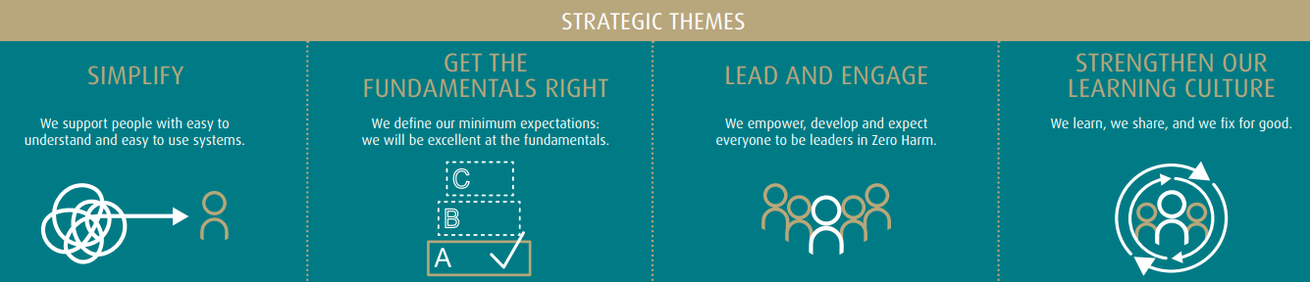
IPL Group Safety Strategy
Zero Harm Strategic Themes driving improvement initiatives

Slide 3
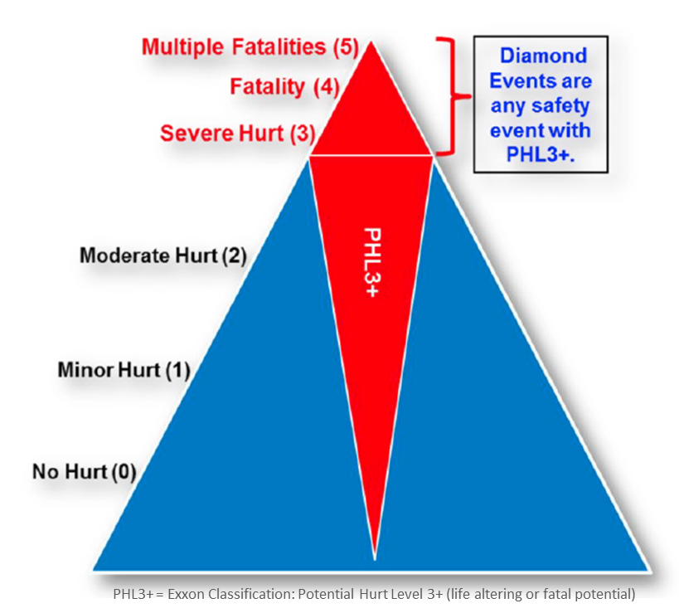
Significant Event Definition
Based on the principle of Exxon Mobil’s “Mining the Diamond”
Actual AND Potential Consequences
Health & Safety – severe injury, fatality or multiple fatality
Process Safety – Tier 1 or 2 LOCI or fire/explosion
Environment – long term impacts, major event or repeat non-compliance

Slide 4

Change Management
How new requirements implemented and sustained
Engagement
Performance Scorecard
Management System
Governance Forums
Learning Forums

Slide 5
Results to date
Leading indicators are improving
Simplify: “We support people with easy to use and easy to understand systems”
A focus on simplification has ensured that the conformance requirements are clear, including the WHY, WHAT and HOW.
Get the Fundamentals Right: “We define the minimum expectations. We are excellent at the fundamentals”
Clear minimum standards ensured that operational discipline can be monitored, and expectations reinforced.
Lead and Engage: “We empower and develop and expect everyone to be leaders in Zero Harm”
Leaders are involved at all levels of the organisation in monitoring the key performance metrics associated with event management including investigation review, management review, business unit learning forums, Executive Team Zero Harm Committees and HSEC Committee of the IPL Board.
Strengthen our Learning Culture: “We learn, we share, we fix for good”
Regional and global learning forums create an environment of “SafeGround” where Zero Harm leaders openly share learnings from events and determine actions at local and organisational level which embed learnings into site and organisational standards and processes.
Strong reporting culture
Hazard & Near Miss to Incident reporting ratio improved
Hazard awareness
High level of operational discipline

Slide 6

Conclusion
Embedding a process of learning, sharing, and fixing for good
Clarity on what events are important to the organization
Increased focus and visibility of the highest consequence events
Controls to prevent significant harm shared and embedded
Learning culture built on psychological safety
Success is measured by the number of hazards and near misses reported, investigated, actions closed, and incidents shared

Slide 7
Questions
?????

