Slide 1
Monitoring of in-process explosive/hazardous material during shift break – learnings from incidents Martin Held, Global Emulsion Director | 2023-02-12

Slide 2
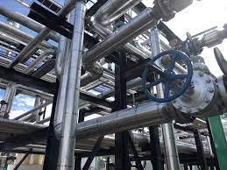
Definition
In-process explosive and hazardous material
material or goods that are partially completed and are somewhere in the manufacturing process but not yet ready for sale

Slide 3

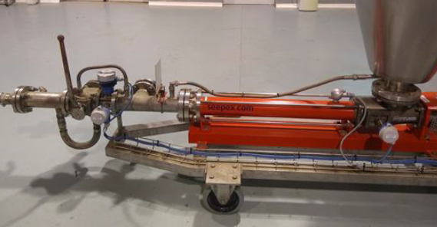
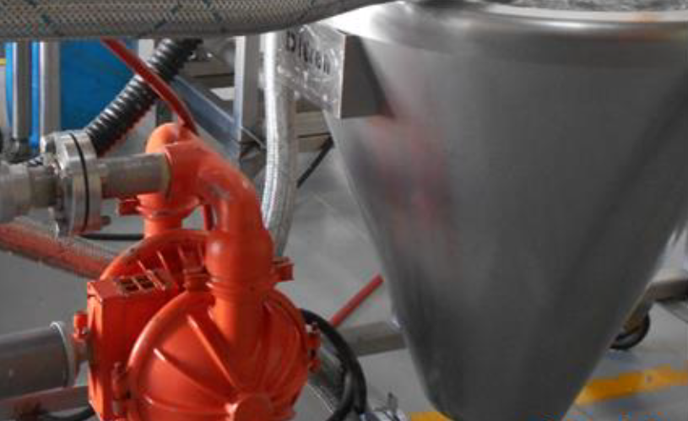
Background
safety devices usually will be switched off-line and perhaps the plant’s power may be shut down during a shift break
large amounts of in-process explosive and other hazardous material may be left inside the pipelines or equipment during a shift break for easier restart of production

Slide 4
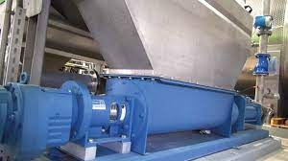

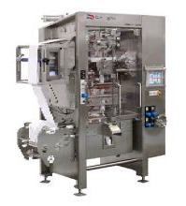
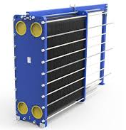
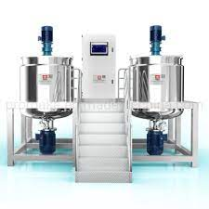
During plant operation
Explosives and raw material being transferred
Storage bin
Silos
Mixing modules
Hoppers
Pumps
Cartridging and packing machines
Final product storage
These are with in-line alarm trips and safety sensors

Slide 5
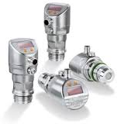
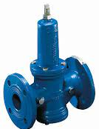

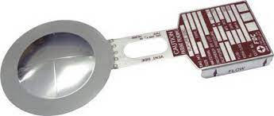
In-process monitoring, alarm, relief, and trip safety devices during plant operation
Item | Equipment | Purpose | Hazardous condition | Suitable Alarm, Trips and Sensors, other safety devices
1 | Raw material preparation and holding storage | Storing and preparing explosive raw material as solution. | Overfill spillage overheat | high level alarm and trip sensor steam pressure reducing valve/temperature alarm and trip sensor pressure relief valve/breathing outlet, burst disc load cell/low level alarm trip sensor
2 | Pumps (progressive cavity, lobe pump, gear pump, centrifugal pump) | Dosing/Transferring raw material | dead heading overheat dry running | high pressure alarm and trip sensor, valve contact limit switch, burst disc high temperature alarm and trip sensor low pressure alarm and trip sensor, no flow alarm and trip sensor
Table 1: In-process monitoring, alarm, relief, and trip safety devices during plant operation

Slide 6
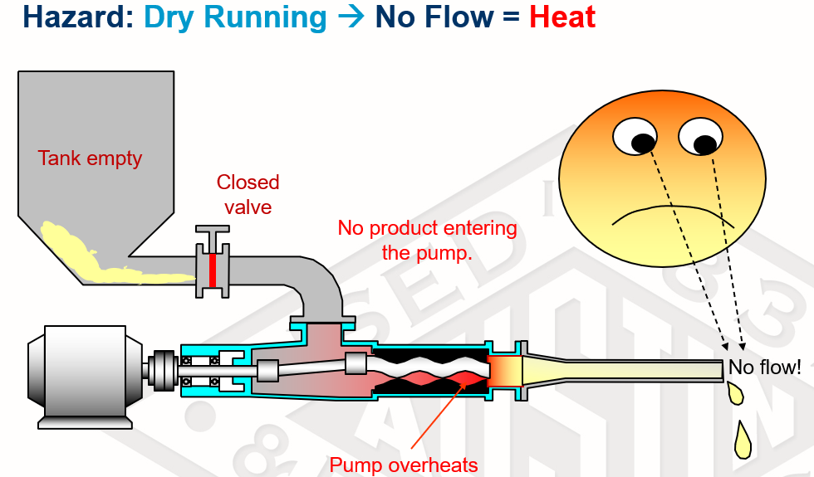
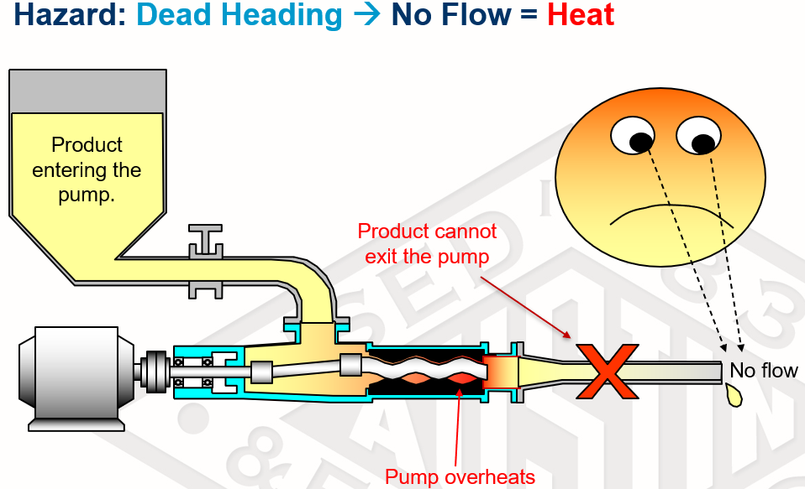
In-process monitoring, alarm, relief, and trip safety devices during plant operation
Item | Equipment | Purpose | Hazardous condition | Suitable Alarm, Trips and Sensors, other safety devices
3 | Mixing skid/blender/ CR mixer/jet mixer/stir pot static mixer | Mixing, blending, emulsifying | a. overfill spillage b. friction | a. high and low level alarm and trip sensors b. RPM limit c. valve/temperature alarm and trip sensor, high/low pressure sensor, no flow sensor, burst disc
4 | Intermediate product holding storage (e.g. hot & cold hoppers) | Transit, batching | a. overfill spillage b. dead heading c. dry running | a. high level alarm and trip sensor b. high pressure alarm and trip sensor, valve contact limit switch, burst disc c. low pressure alarm and trip sensor, no flow alarm and trip sensor
Table 1: In-process monitoring, alarm, relief, and trip safety devices during plant operation

Slide 7
In-process monitoring, alarm, relief, and trip safety devices during plant operation
Item | Equipment | Purpose | Hazardous condition | Suitable Alarm, Trips and Sensors, other safety devices
5 | Heat exchanger | Cooling down emulsion explosives | dead heading | high pressure alarm and trip sensor, valve contact limit switch, burst disc
6 | Cartridge machine/packaging | Final product packaging | a. dead heading b. overheats c. interlocking with pumps | a. high pressure alarm and trip sensor, valve contact limit switch, burst disc b. high temperature alarm and trip sensor c. low level alarm and trip, low pressure alarm and trip, no flow alarm and trip
Table 1: In-process monitoring, alarm, relief, and trip safety devices during plant operation

Slide 8
What’s in the plant during shift break?
Explosives/raw material left in pipes, hoppers, pumps, mixers during breaks
Trip and safety devices can remain in idle mode or shut off during shift break
Assume no energy entry on the material during this period
But these explosives/raw material left uncontrolled/unchecked

Slide 9
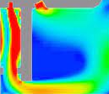

#1 What if?
Explosive/raw material started to decompose when exposed to excessive heating
in dead spots, or;
due to an unrecognized failure of the heating system
Decomposition continued when heat no longer dissipated after production was stopped and created a fire with subsequent explosion (e.g. BME packaged plant incident)

Slide 10
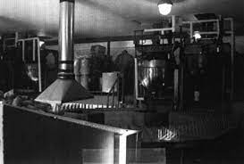
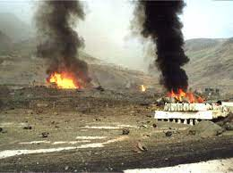
#2 What if?
when explosive material had been
left and solidified before the next shift started and was then exposed to friction or overheating (Sierra booster incident).

Slide 11
Incident in 2020
An explosion occurred in a packaged emulsion plant during lunch break (Austin Powder Malaysia, SAFEX incident notice 20-04).
-38 years old, semi batch process plant (constructed in 1983)
-stopped for lunch break with in-process material remaining in hoppers, pumps and pipes when an explosion occurred almost an hour later.
all process equipment had been deenergized
the PLC control was not monitoring sensor signals during the stopped operation.
no CCTV in the production room
no smoke or heat detection (e.g. infrared camera)
the building was not secured and no access control.
no one observed any smoke in the sky prior to the incident.
All these circumstances complicated the root cause analysis and also prevented an early indication of an initial event that subsequently resulted in an explosion.

Slide 12
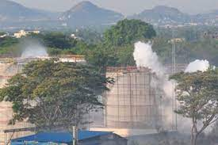
In-process explosives/hazardous material monitoring and isolation
Item | Hazardous scenarios to be considered | Common safety defenses in place | Proposed in-process explosives/hazardous material monitoring and isolation methods
1 | Contamination of emulsion explosive with chemicals and causes explosion/toxic gas release incident in-process or during shift break | a) prevention -segregate incompatible chemicals with proper labelling or locked in a separate location to prevent accidental incompatible mixture -CCTV that serves as deterrent in case of sabotage - isolation and control access of the plant during shift break b) mitigation -reduce the quantity of incompatible materials available on site | a) prevention - Nil b) mitigation - detection of known gas released (e.g. CO, NOx) after mixing of incompatible material with alarm (to give an early alarm and evacuation consideration) and trip sensor (on equipment that will need to be running during shift break)
Table 2: Common and proposed in-process explosives/hazardous material monitoring and isolation methods

Slide 13
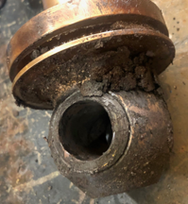
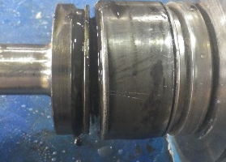
In-process explosives/hazardous material monitoring and isolation
Item | Hazardous scenarios to be considered | Common safety defenses in place | Proposed in-process explosives/hazardous material monitoring and isolation methods
2 | Failure of pumps’ joint/mixer pin caused by foreign object or lack of maintenance creating a hot spot in between production or during shift break, resulting in accelerated decomposition and explosion when heat is no longer dissipated by moving material | prevention -mesh screen to prevent foreign object -predictive/preventive maintenance mitigation -operators report unusual sounds and stop work | a) prevention - Nil b) mitigation -hot spot detection alarm and isolation method during shift break -do not shut down the safety devices during shift break or install hardwire standalone alarm and trip panel for continuous monitoring/tripping functionality even during shift break and connected to plant-wide alarm for evacuation purpose with early detection. Access to this safety devices system should be controlled and supported by UPS (uninterrupted power supply) battery. -reduce the explosive quantity contained in process piping, hoppers, mixers, blenders during shift break
Table 2: Common and proposed in-process explosives/hazardous material monitoring and isolation methods

Slide 14

In-process explosives/hazardous material monitoring and isolation
Item | Hazardous scenarios to be considered | Common safety defenses in place | Proposed in-process explosives/hazardous material monitoring and isolation methods
3 | Accidental activation of pumps/failure to shut off the pump during shift break | a) prevention - key lock or password control for power, PLC (only authorized personnel) and safety devices -low- and high-pressure alarm and trip, high temperature alarm and trip -prevent access to the explosive plant during shift break and also CCTV b) mitigation -minimize product explosive inventory in the pump or production area | a) prevention -assigned supervisor during shift break to monitor and ensure proper shutdown and no activity during shift break (can be done remotely in some cases) -shutting down of KP machine also shutting down of all critical process equipment and pumps -fail-safe 3-way actuator valve to prevent deadheading in case of accidental activation b) mitigation -Nil
Table 2: Common and proposed in-process explosives/hazardous material monitoring and isolation methods

Slide 15
In-process explosives/hazardous material monitoring and isolation
Item | Hazardous scenarios to be considered | Common safety defenses in place | Proposed in-process explosives/hazardous material monitoring and isolation methods
4 | Overheating from electrical heating system | a) prevention -inherent safety design whereby not possible for overheating with decomposition temperature from supply (eg. hot water system instead of pressurized steam whenever possible) -temperature alarm and trip sensor b) mitigation -smoke detection and alarm system for evacuation | a) prevention -Nil b) mitigation -Nil
Table 2: Common and proposed in-process explosives/hazardous material monitoring and isolation methods

Slide 16
Conclusion
Need to explore more monitoring and isolation method of in-process explosive and hazardous material
LOPA (Layer of Protection Analysis) and CHAZOP (Control Hazard and Operability Study) review are essential to be implemented to cover the design phase of the plant particularly to consider hazards during shift breaks
Other hazards rarely to be considered need assessment such as network security breach like SCADA (supervisory control and data acquisition) system
Controlled access and standalone redundant safety devices come with training are important too
MOC (Management of Change) and restricting bypassing safety devices
Critical active safety devices should never be deactivated without proper assessment and approval

Slide 17

Questions and Answers
Q&A?

Slide 18
Austin Powder Malaysia Sdn Bhd
No. 8, Jalan SS 22/21, Damansara Jaya, 47400 Petaling Jaya, Selangor Malaysia
tel.: +603 7729 7464
https://www.austinpowder.com/malaysia/home/

