Slide 1
The Safety Journey Following Acquisition
SAFEX Salzburg, 27th & 28th April 2023
By :
- Evan Quinn

Slide 2
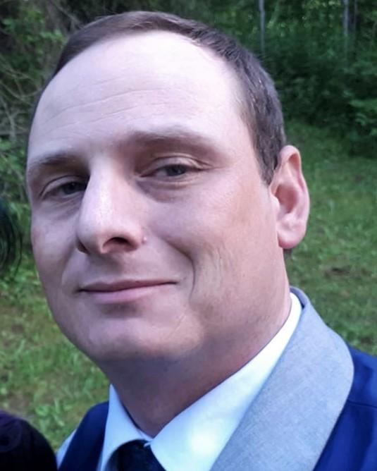

THE Safety Journey Following Acquisition
Evan Quinn
Canada, EPC Groupe
HSEQ Advisor. Joined EPC Canada December 2013. Became a worker representative on the Joint Health and Safety Committee and proceeded to work into the Technical and Quality Control Departments in 2014.
Attended Advanced Safety Systems course as a safety ambassador during 2016 and obtained the position of SHEAQ Advisor in 2018.
Has held a worker or management representative position on JHSC through various companies since 2008.
Knowledge of ISO systems (17025, 9001-2015, 45001)
equinn@epc-groupe.ca
Notes:
<<Producer: Transition to Dr Noël Hsu (ORICA)

Slide 3

The Safety Journey Following Acquisition Keywords
Behavioural Safety
Culture
Acquisition
Safety Survey

Slide 4
The Safety Journey Following Acquisition Topics
Abstract
Introduction
Main Body
Conclusions
Take Home Messages

Slide 5
The Safety Journey Following Acquisition Abstract
Does behaviour lead the culture or
does the culture lead the behaviour?
Notes:
Does behaviour lead the culture or does the culture lead the behaviour? This is a question that can be asked in any business but one that is especially prominent during a business acquisition.
Culture is the cumulative values, beliefs, perceptions and attitudes that exist with a group of people, but every employee as an individual contributes to that culture. The journey travelled by individuals differ from one person to another and this paper aims to tell of the challenges that faced them and the hurdles that needed to be overcome.

Slide 6
The Safety Journey Following Acquisition Introduction
The EPC Groupe, with its head office in Paris, France, comprises of 51 individual companies, located in 30 countries and 5 continents. The cultures within each of these are diverse but intrinsically connected by the importance of ensuring that everyone goes home safely every day…

Slide 7
The Safety Journey Following Acquisition Main Body
On acquiring Nordex Explosives, the announcement within the company itself induced an understanding that change was on its way.
This conditioned the management and staff.
Depending upon where you view change from, it is either positive, something to be apprehensive of or both.
Change to most of us is seen as positive, as long as it isn’t going to affect me!
Notes:
It was important at the very early stage of the acquisition to create new standards of working and also to gain an appreciation of how things had been done there in the past. The opportunity was taken to undertake a safety culture survey. This hadn’t been previously so team briefings prior to the survey were conducted to provide a reassurance that confidentiality was assured. The UK’s Health & Safety Laboratory’s “Safety Climate Tool” was chosen and rolled out over a 5-week period in November 2016 for all employees to complete. All 42 employees (ie 100%) completed the survey.

Slide 8
The Safety Journey Following Acquisition Main Body - Survey
The survey was structured into 8 separate areas that were;
Organizational commitment
Health and safety orientated behaviors
Health and safety trusts
Usability of procedures
Engagement in health and safety
Peer group attitude
Resources for health and safety
Accident and near miss reporting.

Slide 9
The Safety Journey Following Acquisition Main Body - Survey
The responses when compared to previous culture surveys conducted within EPC showed significant opportunity for improvement.
At a high level, these were;
2016 Safety Culture Survey POSITIVES
Resources for Health & Safety | The H&S equipment works well (70.7% Agree / Strongly Agree) People can always get the equipment (68.3%)
Usability of Procedures | There are too many procedures (63.4% Disagree / Strongly DA)
Areas for IMPROVEMENT
H&S Orientated Behaviours | Some pay little attention to H&S (70.7% Agree / SA) Not all procedures are followed (70.7% Agree / SA) Suggestions are not always acted upon (63.4% Agree / SA)
Organisation commitment | My Supervisor doesn’t do enough for H&S (41.4% Neutral)
Resources for H&S | I can get more people to do job for H&S reasons (46.3% Neutral)
Notes:
Management considered all of the data and agreed what could be done to improve the safety culture. A follow-up presentation was prepared to thank everyone for participating and to deliver the results of the survey along with what were the next steps.
Using the survey results as an initial benchmark, we were able to clearly articulate WHAT needed to be achieved. This was to;
Improve our COMMITMENT to Health & Safety,
Modify our BEHAVIOURS,
Build TRUST,
Gain greater ENGAGEMENT in H&S at ALL LEVELS,
CHALLENGE each other to do the right thing
Improve health & safety RESOURCES,
Introduce Near Miss REPORTING and improve INCIDENT INVESTIGATION

Slide 10
The Safety Journey Following Acquisition Main Body - Survey
Using the survey results as an initial benchmark, we were able to clearly articulate WHAT needed to be achieved. This was to;
Improve our COMMITMENT to Health & Safety,
Modify our BEHAVIOURS,
Build TRUST,
Gain greater ENGAGEMENT in H&S at ALL LEVELS,
CHALLENGE each other to do the right thing
Improve health & safety RESOURCES,
Introduce Near Miss REPORTING and improve INCIDENT INVESTIGATION
Notes:
Management considered all of the data and agreed what could be done to improve the safety culture. A follow-up presentation was prepared to thank everyone for participating and to deliver the results of the survey along with what were the next steps.
Using the survey results as an initial benchmark, we were able to clearly articulate WHAT needed to be achieved. This was to;
Improve our COMMITMENT to Health & Safety,
Modify our BEHAVIOURS,
Build TRUST,
Gain greater ENGAGEMENT in H&S at ALL LEVELS,
CHALLENGE each other to do the right thing
Improve health & safety RESOURCES,
Introduce Near Miss REPORTING and improve INCIDENT INVESTIGATION

Slide 11
The Safety Journey Following Acquisition Main Body - Survey
HOW this was going to be achieved was also communicated back to the workforce in the same presentation. The following was specified as the plan for going forward;
Achieve compliance with EPC Groupe SHE Standards,
Train all operational managers to minimum occupational health & safety standard,
Train all relevant personnel to a minimum level in Process Safety,
Introduce Behavioural Safety,
Commence risk assessing all activities that present a high level of risk,
Notes:
Management considered all of the data and agreed what could be done to improve the safety culture. A follow-up presentation was prepared to thank everyone for participating and to deliver the results of the survey along with what were the next steps.
Using the survey results as an initial benchmark, we were able to clearly articulate WHAT needed to be achieved. This was to;
Improve our COMMITMENT to Health & Safety,
Modify our BEHAVIOURS,
Build TRUST,
Gain greater ENGAGEMENT in H&S at ALL LEVELS,
CHALLENGE each other to do the right thing
Improve health & safety RESOURCES,
Introduce Near Miss REPORTING and improve INCIDENT INVESTIGATION

Slide 12
The Safety Journey Following Acquisition Main Body - Survey
HOW this was going to be achieved was also communicated back to the workforce in the same presentation. The following was specified as the plan for going forward;
Introducing adequate and sufficient control measures to reduce the risks,
Promote the reporting of Near Misses and all incidents on reporting system,
Introduce management STOP Audits,
Introduce Safety Pauses and regular Team Meetings (PDR’s),
Regular dedicated Safety Management Meetings.
Notes:
Management considered all of the data and agreed what could be done to improve the safety culture. A follow-up presentation was prepared to thank everyone for participating and to deliver the results of the survey along with what were the next steps.
Using the survey results as an initial benchmark, we were able to clearly articulate WHAT needed to be achieved. This was to;
Improve our COMMITMENT to Health & Safety,
Modify our BEHAVIOURS,
Build TRUST,
Gain greater ENGAGEMENT in H&S at ALL LEVELS,
CHALLENGE each other to do the right thing
Improve health & safety RESOURCES,
Introduce Near Miss REPORTING and improve INCIDENT INVESTIGATION

Slide 13
The Safety Journey Following Acquisition Conclusions
Merging safety cultures in high hazard industries is key in the overall success of acquisitions. Despite the financial and operational challenges faced during any acquisition, safety and the development of an appropriate culture contributes to that success…
Notes:
Management considered all of the data and agreed what could be done to improve the safety culture. A follow-up presentation was prepared to thank everyone for participating and to deliver the results of the survey along with what were the next steps.
Using the survey results as an initial benchmark, we were able to clearly articulate WHAT needed to be achieved. This was to;
Improve our COMMITMENT to Health & Safety,
Modify our BEHAVIOURS,
Build TRUST,
Gain greater ENGAGEMENT in H&S at ALL LEVELS,
CHALLENGE each other to do the right thing
Improve health & safety RESOURCES,
Introduce Near Miss REPORTING and improve INCIDENT INVESTIGATION

Slide 14

Take Home Messages

Slide 15

The Safety Journey Following Acquisition Take Home Messages
Safety needs to be considered and addressed within the acquisition process Companies being acquired require clear leadership, standards and direction.
The safety culture is what defines how things are done.
Developing it is crucial.

Slide 16

Any questions?
Feu dans un réservoir d’essence

