Slide 1
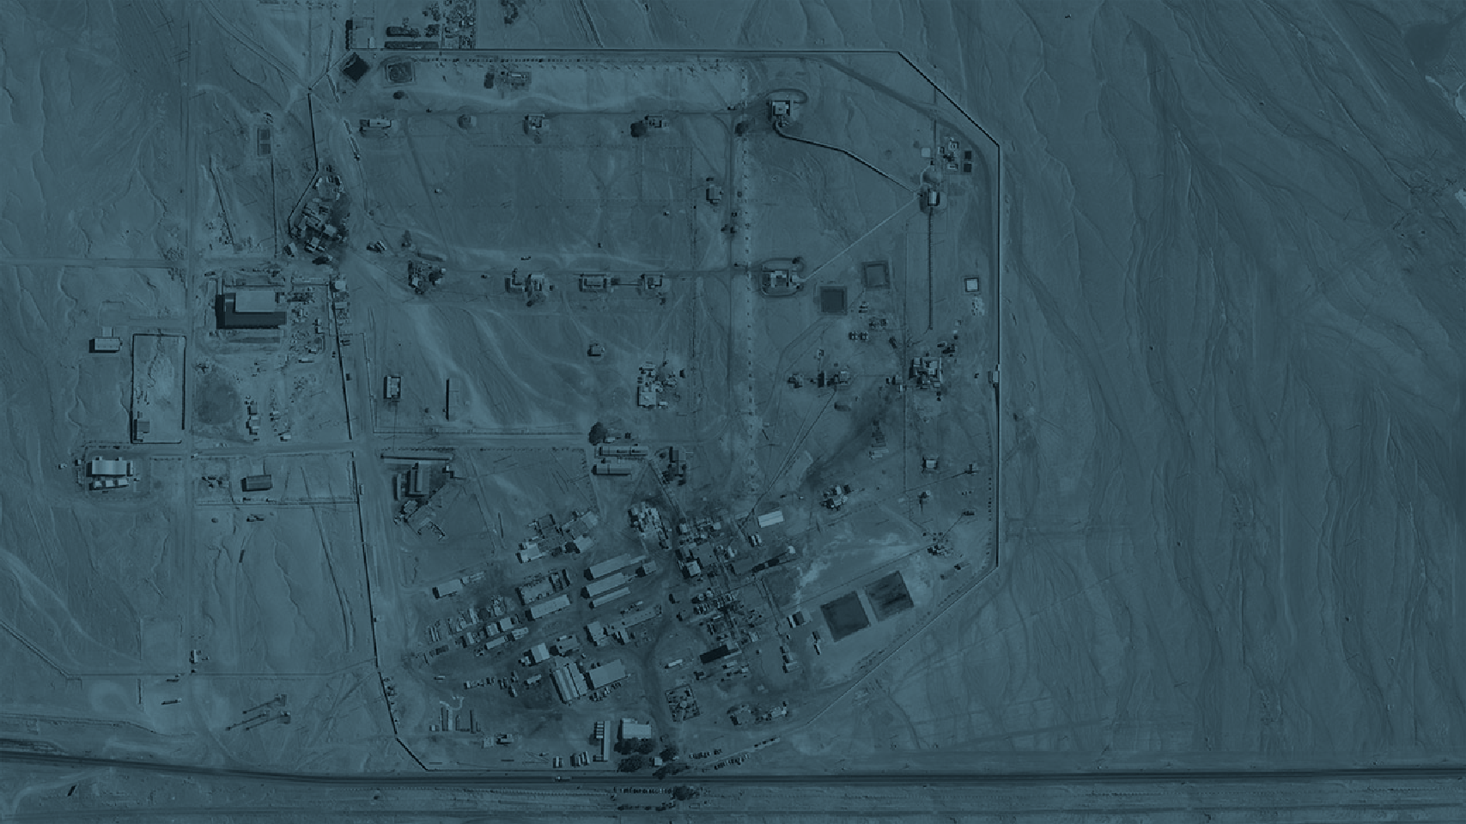
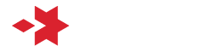
CHANGE MANAGEMENT THROUGH
COURAGEOUS SAFETY LEADERSHIP
Case study: Emmanation of nitrous gases in nitration process. Rio Loa Plant, Enaex Chile
María Virginia Ramírez
Explosive Specialist Manager,
Enaex Mining Technical Solutions, Chile
April 2023

Slide 2
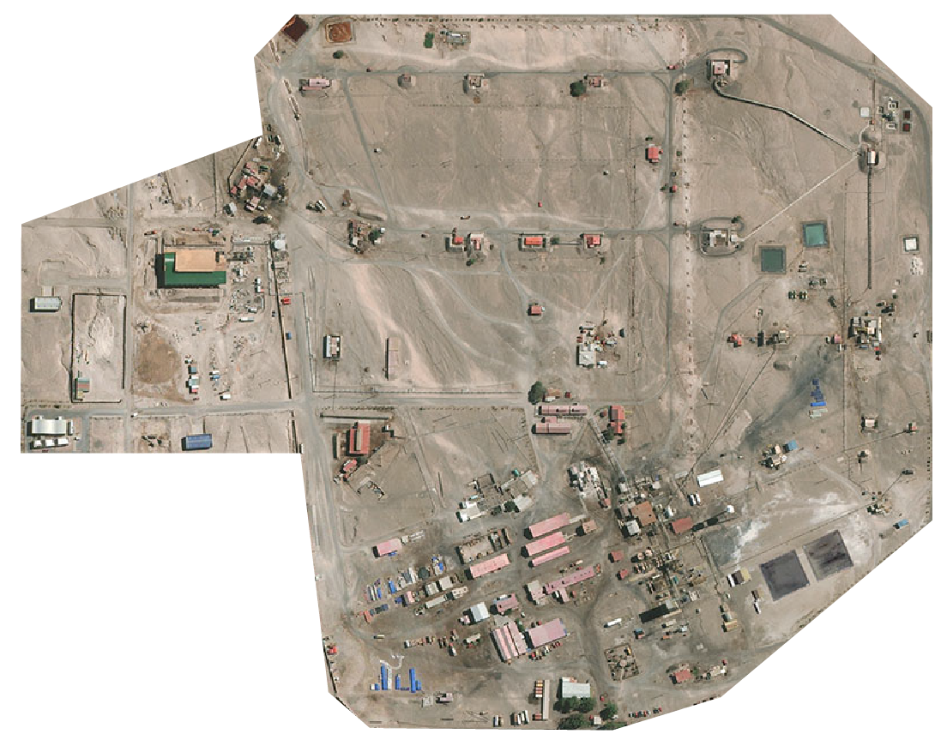
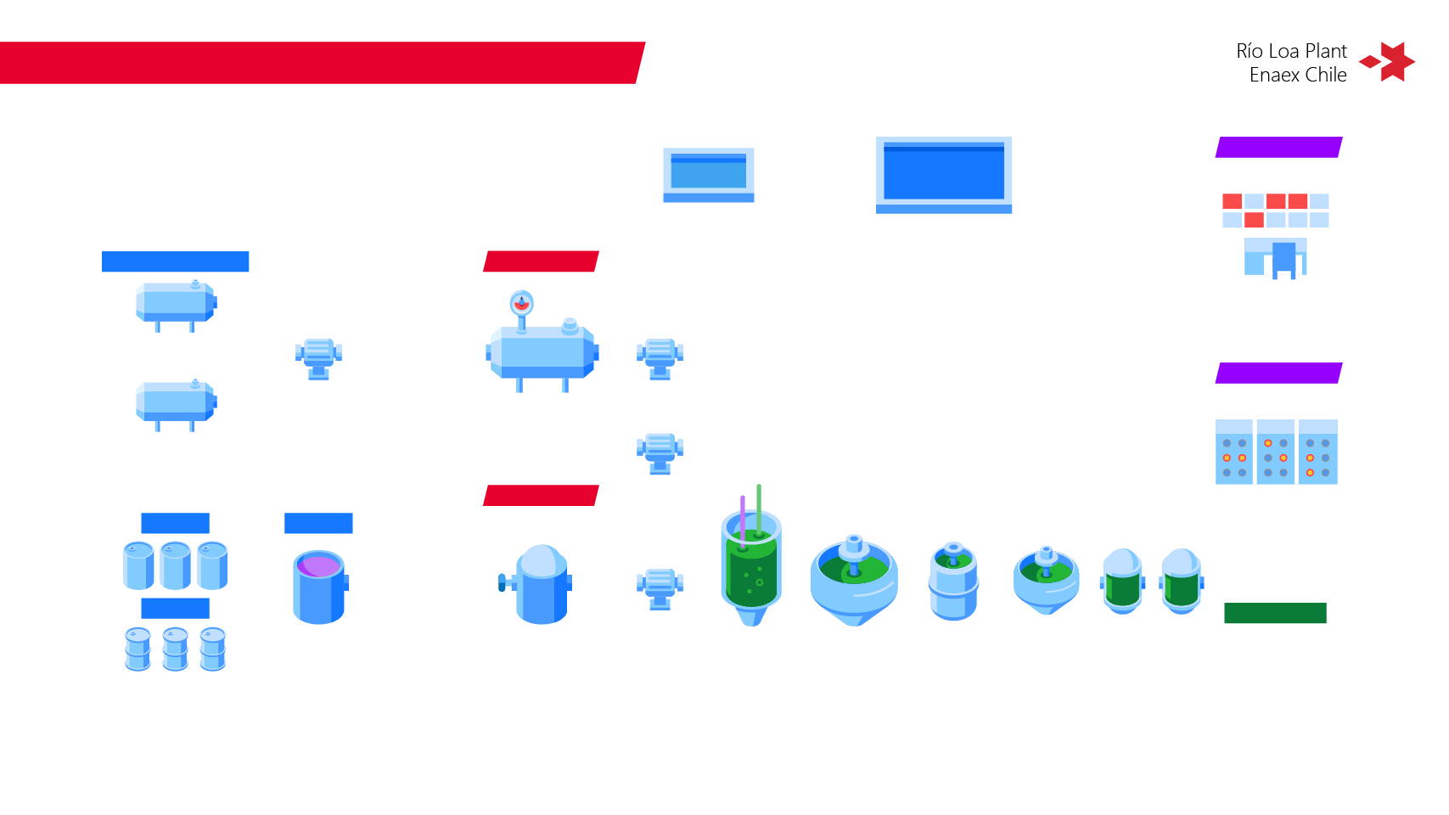
Río Loa Plant
Enaex Chile
Dynamite & PETN
9 Km from the
nearest city, Calama

Slide 3

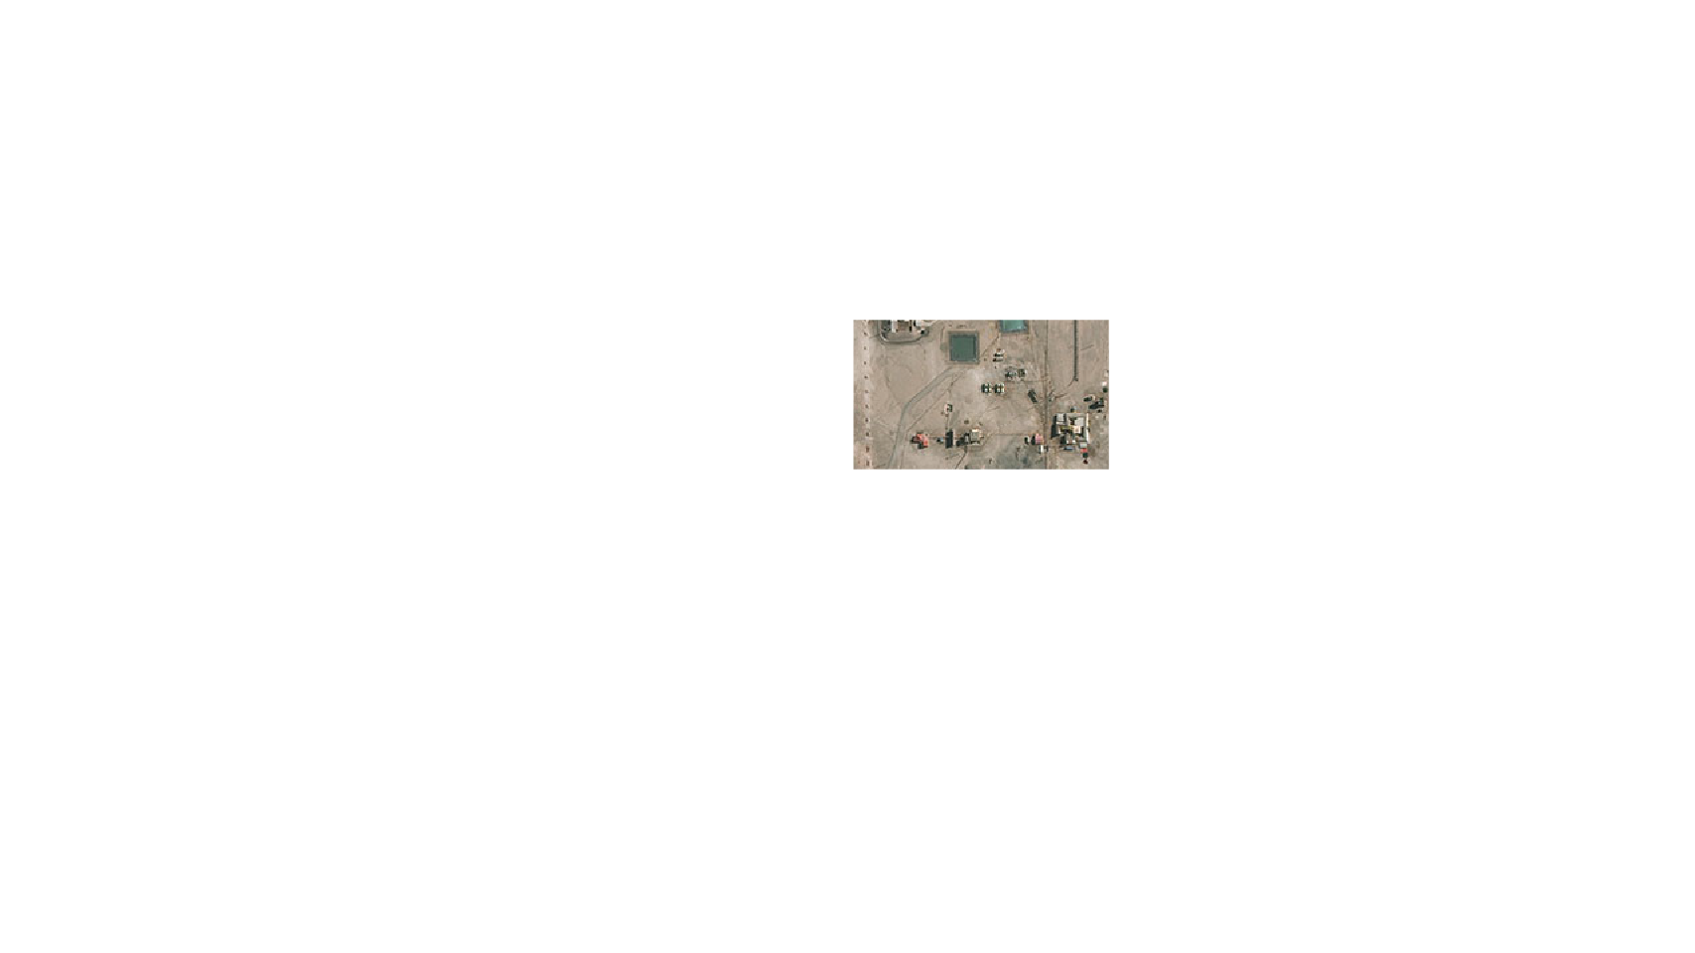
Río Loa Plant
Enaex Chile
NITRATION PLANT
9 Km from the
nearest city, Calama

Slide 4
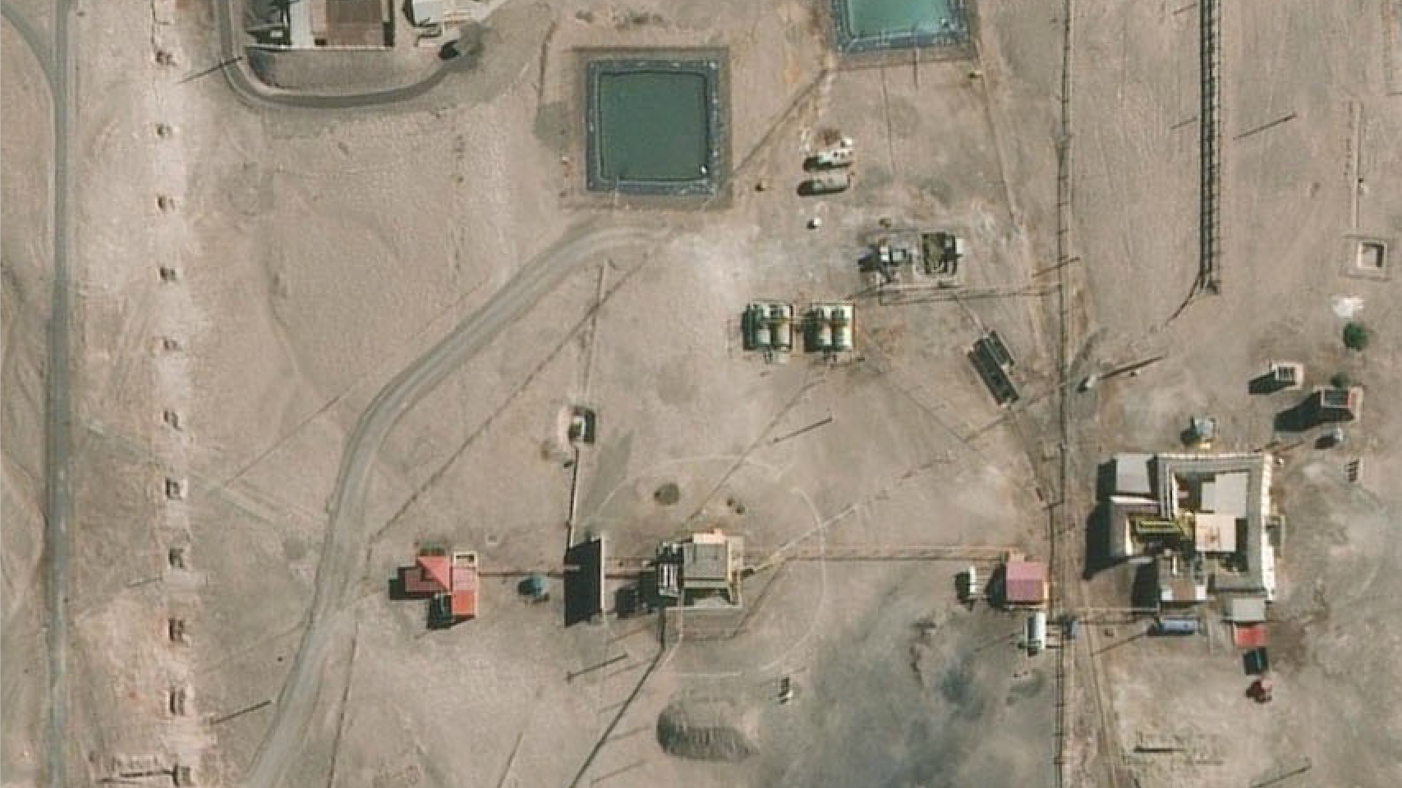




Slide 5






NITROGLYCERIN PRODUCTION PROCESS
Río Loa Plant
Enaex Chile
ACID-WATER SEPARATOR
WASTE POOL
CONTROL ROOM
PUMP
PUMP
MIXED ACID TANK
MIXED ACID TANKS
PUMP
ELECTRICAL ROOM
PUMP
NITROGLYCERIN
POLYOL TANK
BRINE TANK
BIAZZI
REACTOR
SEPARATOR
WASHING
EQUIPMENT
NG-WATER
SEPARATOR
ACIDITY
NEUTRALIZERS
POLYOL FACILITY
POWER HOUSE
NITROGLYCERIN NITRATOR

Slide 6


NITROGLYCERIN PRODUCTION PROCESS
Río Loa Plant
Enaex Chile
SEPARATION
REMOTE
ACID-WATER SEPARATOR
WASTE POOL
NITRIC + SULPHURIC ACID
FEEDING
CONTROL ROOM
MANUAL
PUMP
PUMP
MIXED ACID TANK
MIXED ACID TANKS
ACID WATER
COOLING
PUMP
GLYCOL
POLYOL
ELECTRICAL ROOM
GLYCERIN
PUMP
NITROGLYCERIN
POLYOL TANK
BRINE TANK
BIAZZI
REACTOR
SEPARATOR
WASHING
EQUIPMENT
NG-WATER
SEPARATOR
ACIDITY
NEUTRALIZERS
POLYOL FACILITY
POWER HOUSE
NITROGLYCERIN NITRATOR
RAW MATERIALS
REGULATION SYSTEMS
NITRATION PROCESS
EXT. CONTROLS

Slide 7















EXT. CONTROLS
NITRATION PROCESS

Slide 8






POLYOL FACILITY
RAW MATERIALS
REGULATION SYSTEMS
NITRATION PROCESS
EXT. CONTROLS

Slide 9

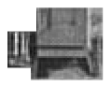
RAW MATERIALS
REGULATION SYSTEMS
NITRATION PROCESS
EXT. CONTROLS

Slide 10



NITROGLYCERIN NITRATOR
RAW MATERIALS
REGULATION SYSTEMS
NITRATION PROCESS
EXT. CONTROLS

Slide 11


RAW MATERIALS
REGULATION SYSTEMS
NITRATION PROCESS
EXT. CONTROLS

Slide 12


CONTROL ROOM
RAW MATERIALS
REGULATION SYSTEMS
NITRATION PROCESS
EXT. CONTROLS

Slide 13

RAW MATERIALS
REGULATION SYSTEMS
NITRATION PROCESS
EXT. CONTROLS

Slide 14







ELECTRICAL ROOM
RAW MATERIALS
REGULATION SYSTEMS
NITRATION PROCESS
EXT. CONTROLS

Slide 15
ELECTRICAL ROOM
RAW MATERIALS
REGULATION SYSTEMS
NITRATION PROCESS
EXT. CONTROLS

Slide 16
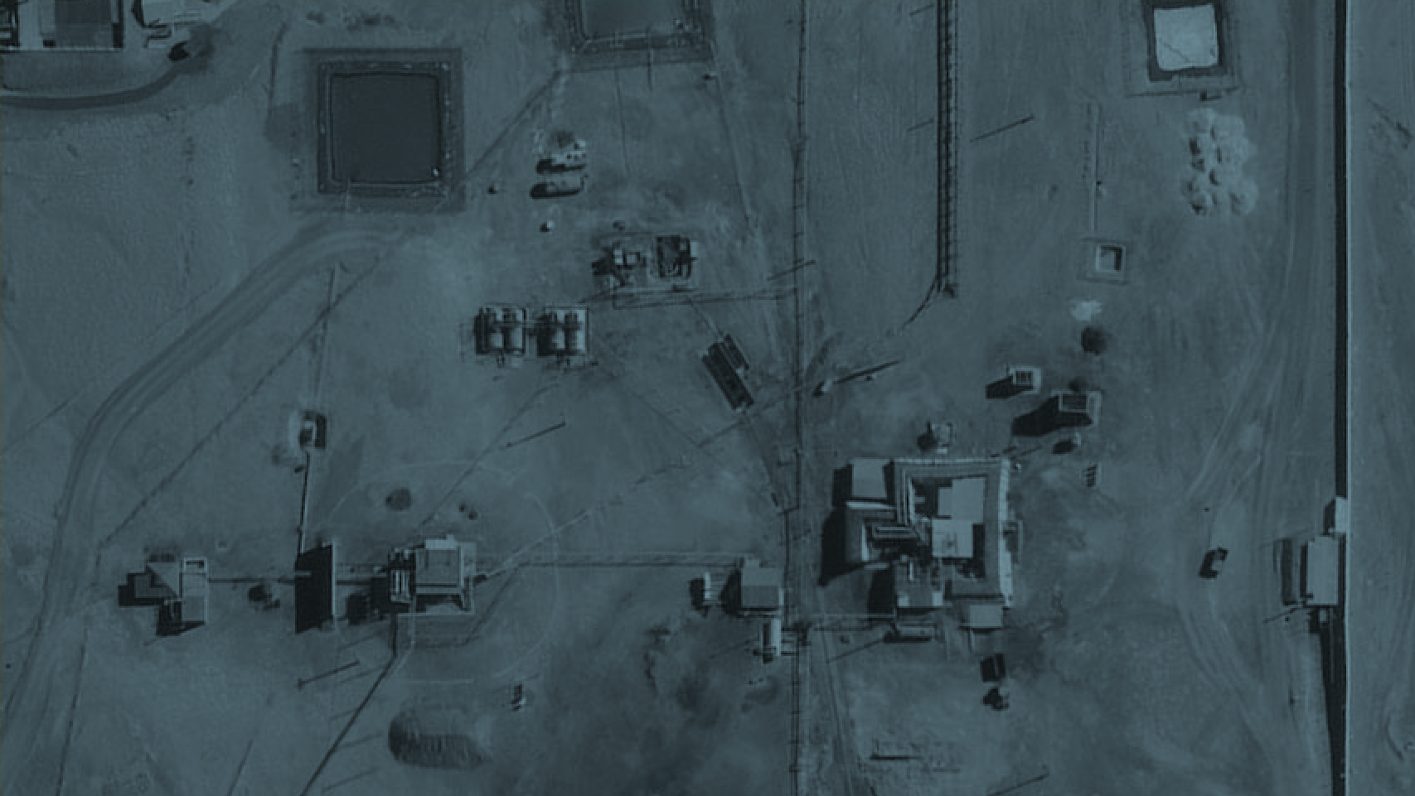

After the incident...
WHAT DID WE LEARN?
And what’s more important…
WHAT DID WE DO?

Slide 17


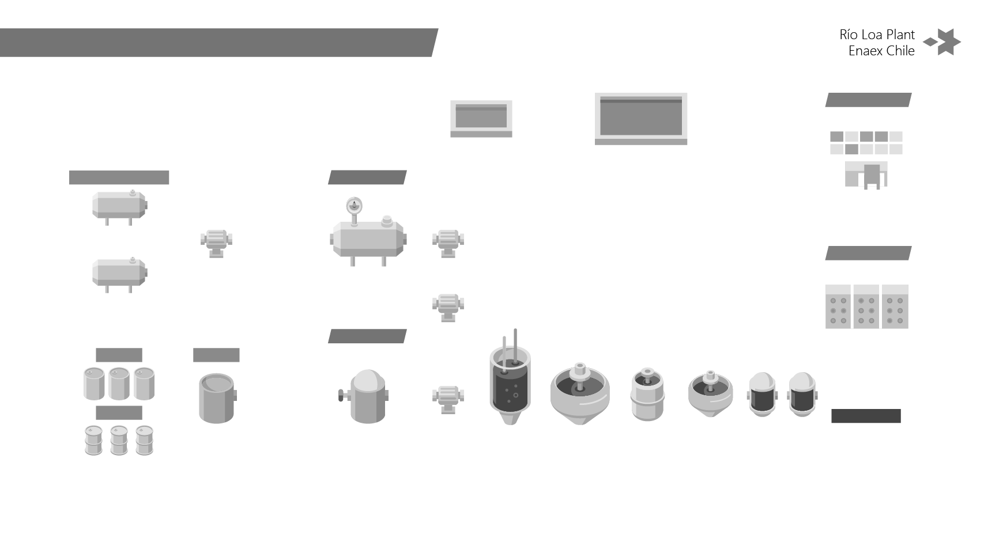
FINDINGS
CORRECTIVE ACTIONS
Río Loa Plant
Enaex Chile
REMOTE
ACID-WATER SEPARATOR
WASTE POOL
NITRIC + SULPHURIC ACID
FEEDING
CONTROL ROOM
MANUAL
PUMP
PUMP
MIXED ACID TANK
MIXED ACID TANKS
COOLING
PUMP
GLYCOL
POLYOL
ELECTRICAL ROOM
GLYCERIN
PUMP
NITROGLYCERIN
POLYOL TANK
BRINE TANK
BIAZZI
REACTOR
SEPARATOR
WASHING
EQUIPMENT
NG-WATER
SEPARATOR
ACIDITY
NEUTRALIZERS
POLYOL FACILITY
POWER HOUSE
NITROGLYCERIN NITRATOR
RAW MATERIALS
REGULATION SYSTEMS
NITRATION PROCESS
EXT. CONTROLS

Slide 18

FINDINGS
CORRECTIVE ACTIONS
Río Loa Plant
Enaex Chile
REMOTE
ACID-WATER SEPARATOR
WASTE POOL
NITRIC + SULPHURIC ACID
FEEDING
CONTROL ROOM
MANUAL
PUMP
PUMP
MIXED ACID TANK
MIXED ACID TANKS
COOLING
PUMP
THERE IS NO STOP INTERLOCKING
for the pump that feeds mixed acid to tank TK 04 when the nitration process trips.
GLYCOL
POLYOL
ELECTRICAL ROOM
GLYCERIN
PUMP
NITROGLYCERIN
Modify the security interlocking logic.
POLYOL TANK
BRINE TANK
BIAZZI
REACTOR
SEPARATOR
WASHING
EQUIPMENT
NG-WATER
SEPARATOR
ACIDITY
NEUTRALIZERS
POLYOL FACILITY
POWER HOUSE
NITROGLYCERIN NITRATOR
RAW MATERIALS
REGULATION SYSTEMS
NITRATION PROCESS
EXT. CONTROLS

Slide 19
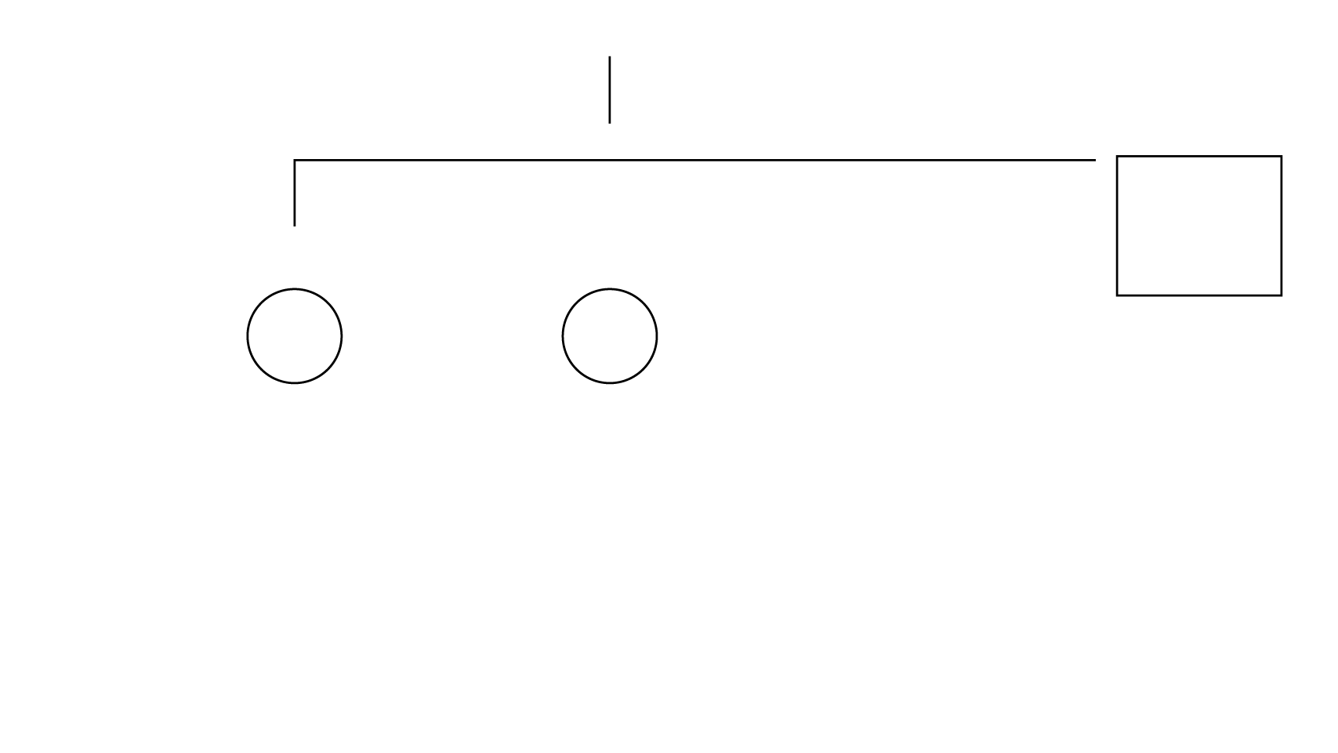
FINDINGS
CORRECTIVE ACTIONS
Río Loa Plant
Enaex Chile
THERE ARE NO PUSH BUTTONS OR A STOP SOFTWARE SYSTEM
in the Control Room for pumps
1 and 2 that feed tank TK 04.
REMOTE
ACID-WATER SEPARATOR
WASTE POOL
NITRIC + SULPHURIC ACID
FEEDING
CONTROL ROOM
Carry out a project to install a pump stop push button in the control room.
MANUAL
PUMP
PUMP
MIXED ACID TANK
MIXED ACID TANKS
COOLING
PUMP
GLYCOL
POLYOL
ELECTRICAL ROOM
GLYCERIN
PUMP
NITROGLYCERIN
POLYOL TANK
BRINE TANK
BIAZZI
REACTOR
SEPARATOR
WASHING
EQUIPMENT
NG-WATER
SEPARATOR
ACIDITY
NEUTRALIZERS
POLYOL FACILITY
POWER HOUSE
NITROGLYCERIN NITRATOR
RAW MATERIALS
REGULATION SYSTEMS
NITRATION PROCESS
EXT. CONTROLS

Slide 20

FINDINGS
CORRECTIVE ACTIONS
Río Loa Plant
Enaex Chile
PROTECTION AND CONTAINMENT:
There is no flooding, cooling or abatement of gas system for the industrial wastewater tank.
REMOTE
ACID-WATER SEPARATOR
WASTE POOL
NITRIC + SULPHURIC ACID
FEEDING
CONTROL ROOM
Carry out a project to install a flood system in the industrial wastewater tank.
MANUAL
PUMP
PUMP
MIXED ACID TANK
MIXED ACID TANKS
COOLING
PUMP
GLYCOL
POLYOL
ELECTRICAL ROOM
GLYCERIN
PUMP
NITROGLYCERIN
POLYOL TANK
BRINE TANK
BIAZZI
REACTOR
SEPARATOR
WASHING
EQUIPMENT
NG-WATER
SEPARATOR
ACIDITY
NEUTRALIZERS
POLYOL FACILITY
POWER HOUSE
NITROGLYCERIN NITRATOR
RAW MATERIALS
REGULATION SYSTEMS
NITRATION PROCESS
EXT. CONTROLS

Slide 21

FINDINGS
CORRECTIVE ACTIONS
Río Loa Plant
Enaex Chile
REMOTE
ACID-WATER SEPARATOR
WASTE POOL
NITRIC + SULPHURIC ACID
FEEDING
CONTROL ROOM
MANUAL
PUMP
PUMP
MIXED ACID TANK
THE OPERATOR DID NOT
TAKE TIMELY ACTIONS to stop
the feed pump from the Electric Room.
MIXED ACID TANKS
COOLING
PUMP
GLYCOL
POLYOL
ELECTRICAL ROOM
Incorporate alarms in the level transmitter
and level indicators (limit switches).
GLYCERIN
PUMP
NITROGLYCERIN
POLYOL TANK
BRINE TANK
BIAZZI
REACTOR
SEPARATOR
WASHING
EQUIPMENT
NG-WATER
SEPARATOR
ACIDITY
NEUTRALIZERS
POLYOL FACILITY
POWER HOUSE
NITROGLYCERIN NITRATOR
RAW MATERIALS
REGULATION SYSTEMS
NITRATION PROCESS
EXT. CONTROLS

Slide 22

FINDINGS
CORRECTIVE ACTIONS
Río Loa Plant
Enaex Chile
DESIGN: When the Programmable Logic Controller (PLC) system was implemented, the different operation scenarios and, in this case, the load of tank TK 04 were not foreseen.
REMOTE
ACID-WATER SEPARATOR
WASTE POOL
NITRIC + SULPHURIC ACID
FEEDING
CONTROL ROOM
Create a logical diagram for emergency stop.
MANUAL
PUMP
PUMP
MIXED ACID TANK
MIXED ACID TANKS
COOLING
PUMP
GLYCOL
POLYOL
ELECTRICAL ROOM
GLYCERIN
PUMP
NITROGLYCERIN
POLYOL TANK
BRINE TANK
BIAZZI
REACTOR
SEPARATOR
WASHING
EQUIPMENT
NG-WATER
SEPARATOR
ACIDITY
NEUTRALIZERS
POLYOL FACILITY
POWER HOUSE
NITROGLYCERIN NITRATOR
RAW MATERIALS
REGULATION SYSTEMS
NITRATION PROCESS
EXT. CONTROLS
Notes:
.

Slide 23

FINDINGS
CORRECTIVE ACTIONS
Río Loa Plant
Enaex Chile
REMOTE
ACID-WATER SEPARATOR
WASTE POOL
NITRIC + SULPHURIC ACID
FEEDING
PROCEDURE: Tasks that are not documented are performed and the information is transmitted verbally.
CONTROL ROOM
MANUAL
PUMP
PUMP
Review the IPER –Hazards Identification and Risk Assessment and Control- to ensure that all tasks are included in said analysis and Procedure.
MIXED ACID TANK
MIXED ACID TANKS
COOLING
PUMP
GLYCOL
POLYOL
Re-Train Operators and generate records of the training.
ELECTRICAL ROOM
GLYCERIN
PUMP
NITROGLYCERIN
POLYOL TANK
BRINE TANK
BIAZZI
REACTOR
SEPARATOR
WASHING
EQUIPMENT
NG-WATER
SEPARATOR
ACIDITY
NEUTRALIZERS
POLYOL FACILITY
POWER HOUSE
NITROGLYCERIN NITRATOR
RAW MATERIALS
REGULATION SYSTEMS
NITRATION PROCESS
EXT. CONTROLS

Slide 24
FINDINGS
CORRECTIVE ACTIONS
Río Loa Plant
Enaex Chile
REMOTE
ACID-WATER SEPARATOR
WASTE POOL
NITRIC + SULPHURIC ACID
FEEDING
CONTROL ROOM
RISK MANAGEMENT: There is no analysis of the different emergency scenarios that allow applying preventive actions.
MANUAL
PUMP
PUMP
MIXED ACID TANK
MIXED ACID TANKS
Perform a Hazop/What If analysis to detect risk operational situations not contemplated.
COOLING
PUMP
GLYCOL
POLYOL
ELECTRICAL ROOM
GLYCERIN
PUMP
NITROGLYCERIN
POLYOL TANK
BRINE TANK
BIAZZI
REACTOR
SEPARATOR
WASHING
EQUIPMENT
NG-WATER
SEPARATOR
ACIDITY
NEUTRALIZERS
POLYOL FACILITY
POWER HOUSE
NITROGLYCERIN NITRATOR
RAW MATERIALS
REGULATION SYSTEMS
NITRATION PROCESS
EXT. CONTROLS

Slide 25

FINDINGS
CORRECTIVE ACTIONS
Río Loa Plant
Enaex Chile
REMOTE
ACID-WATER SEPARATOR
WASTE POOL
NITRIC + SULPHURIC ACID
FEEDING
EMERGENCY CONTROL: SIA –Superintendence of Applied Research- and Quality staff received the order from their superiors to go to the Emergency Meeting Point –PEE.
CONTROL ROOM
MANUAL
PUMP
PUMP
MIXED ACID TANK
MIXED ACID TANKS
Re-educate the staff about the Emergency Plan and their corresponding responsibilities.
COOLING
PUMP
GLYCOL
POLYOL
ELECTRICAL ROOM
GLYCERIN
PUMP
NITROGLYCERIN
POLYOL TANK
BRINE TANK
BIAZZI
REACTOR
SEPARATOR
WASHING
EQUIPMENT
NG-WATER
SEPARATOR
ACIDITY
NEUTRALIZERS
POLYOL FACILITY
POWER HOUSE
NITROGLYCERIN NITRATOR
RAW MATERIALS
REGULATION SYSTEMS
NITRATION PROCESS
EXT. CONTROLS

Slide 26
HOWEVER...
Changes made in the unit were not documented,
nor the information was conveyed and therefore such changes
were not recorded as Management of Change (MOC).
Failure in MOC led to lack of revision or updates
in the corresponding emergency plans in case of nitrous gas emmanation.

Slide 27
... THEREFORE
MANAGEMENT OF
CHANGE REQUIRES A COURAGEOUS
LEADERSHIP
in order to document, report and research every finding and changes made to the plant.

Slide 28
CHANGE MANAGEMENT THROUGH
COURAGEOUS SAFETY LEADERSHIP
Case study: Emmanation of nitrous gases in nitration process. Rio Loa Plant, Enaex Chile
María Virginia Ramírez
Explosive Specialist Manager,
Enaex Mining Technical Solutions, Chile
April 2023

