Slide 1
Reporting Unintended Explosion During a UN Time-Pressure Test
Jonathan Lavoie, Richard Bowes, Sam Maach
The Canadian Explosives Research Laboratory
SAFEX Congress, Salzburg, 2023

Slide 2
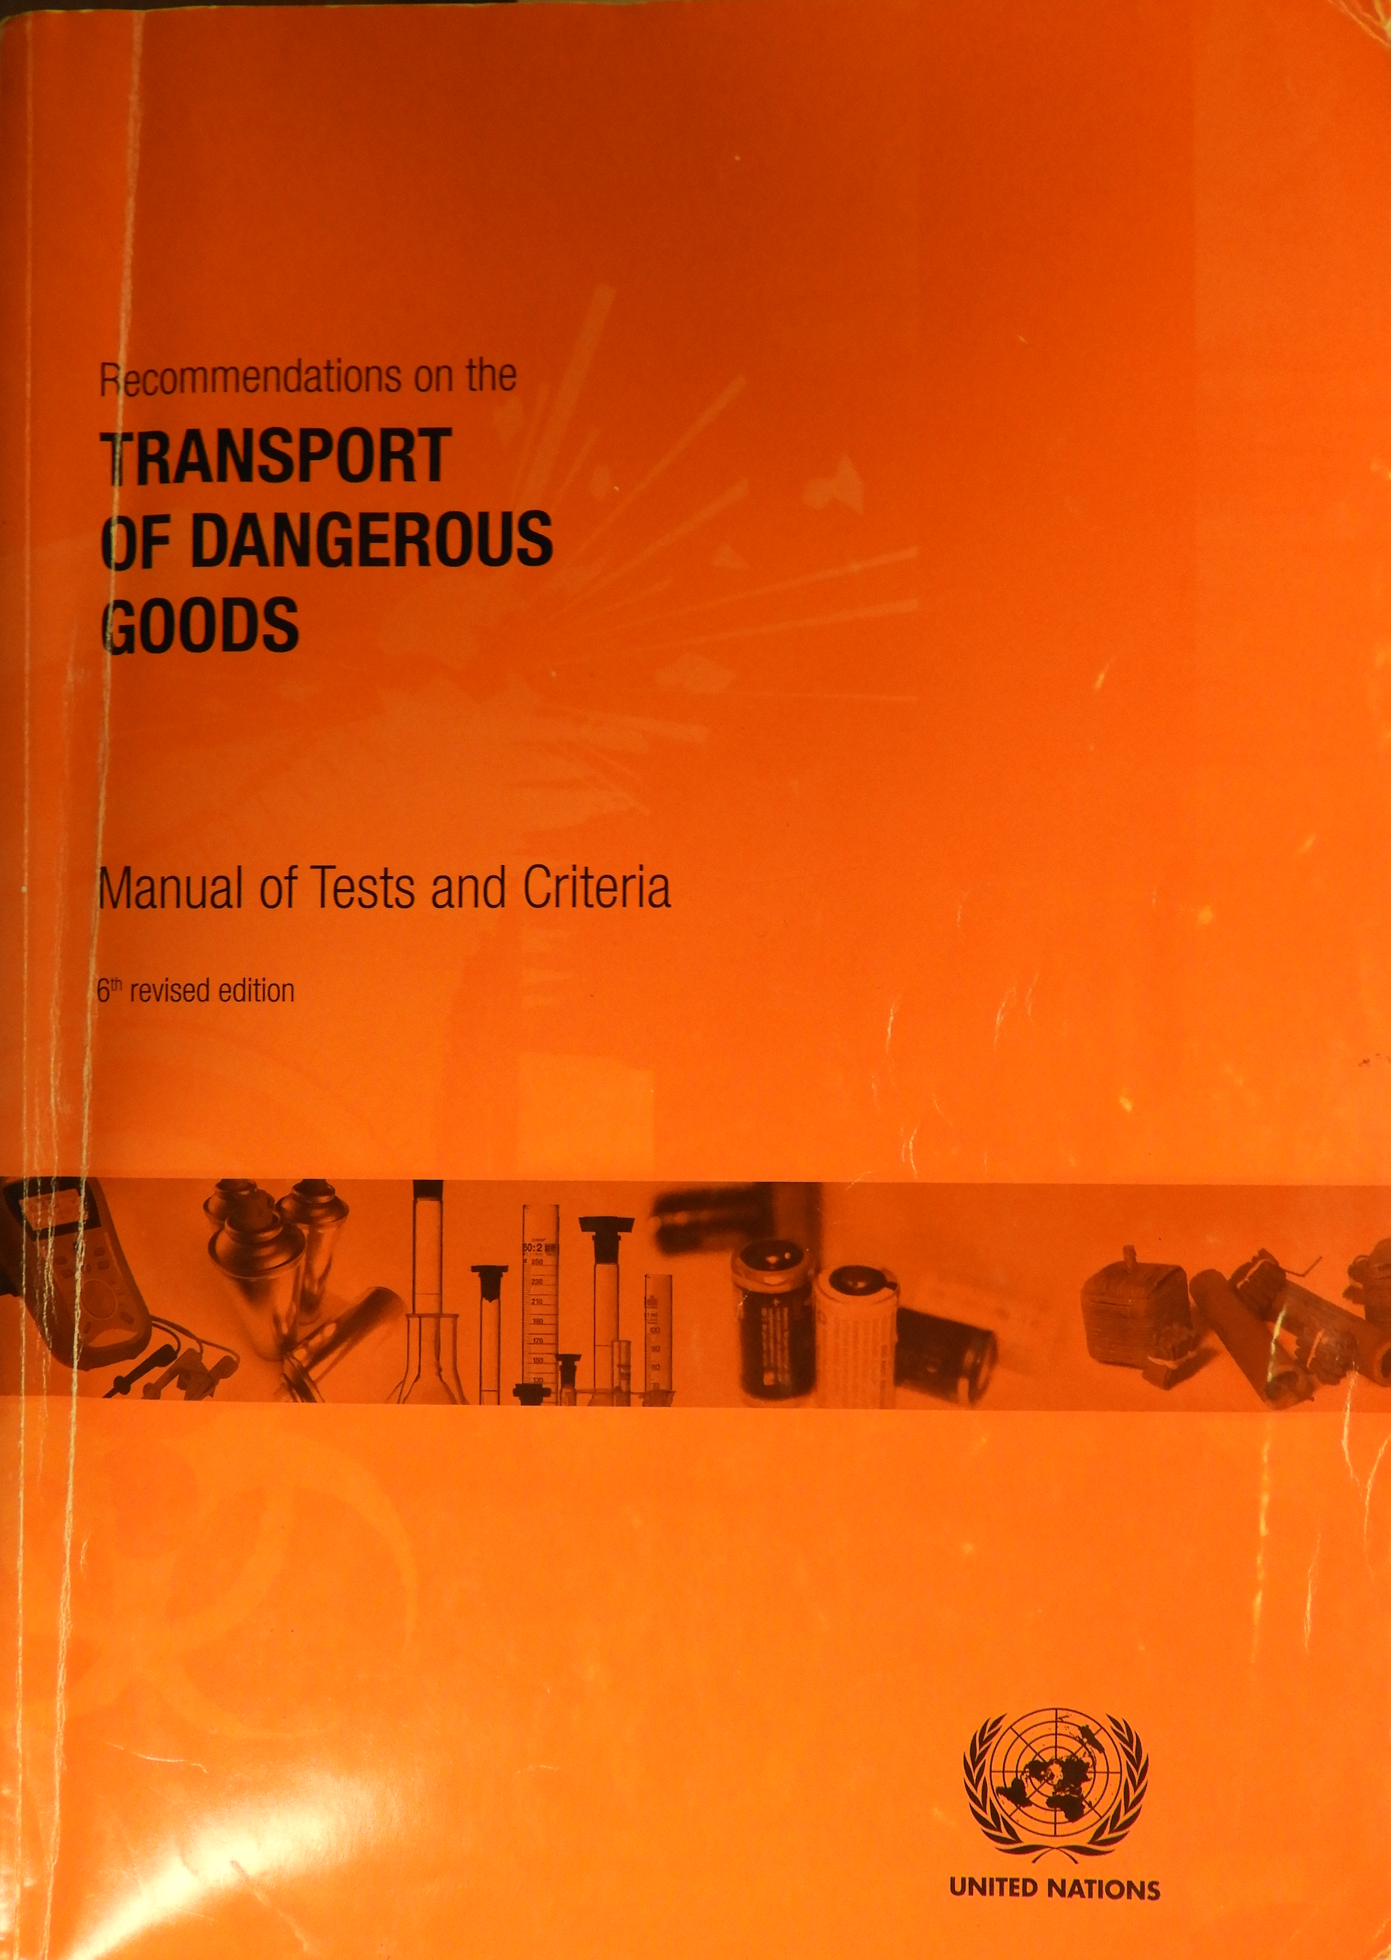
The Time-pressure test
Part of UN Tests Series 1 & 2; Measures the pressure rise time from 690 to 2070 kPa.
Tested substance is an expl.?

Slide 3
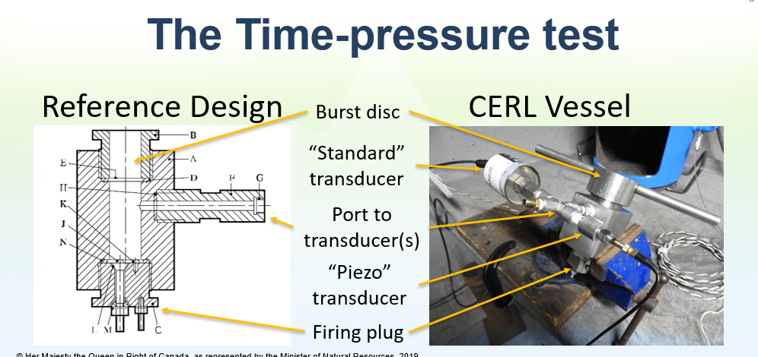
The Time-pressure test

Slide 4
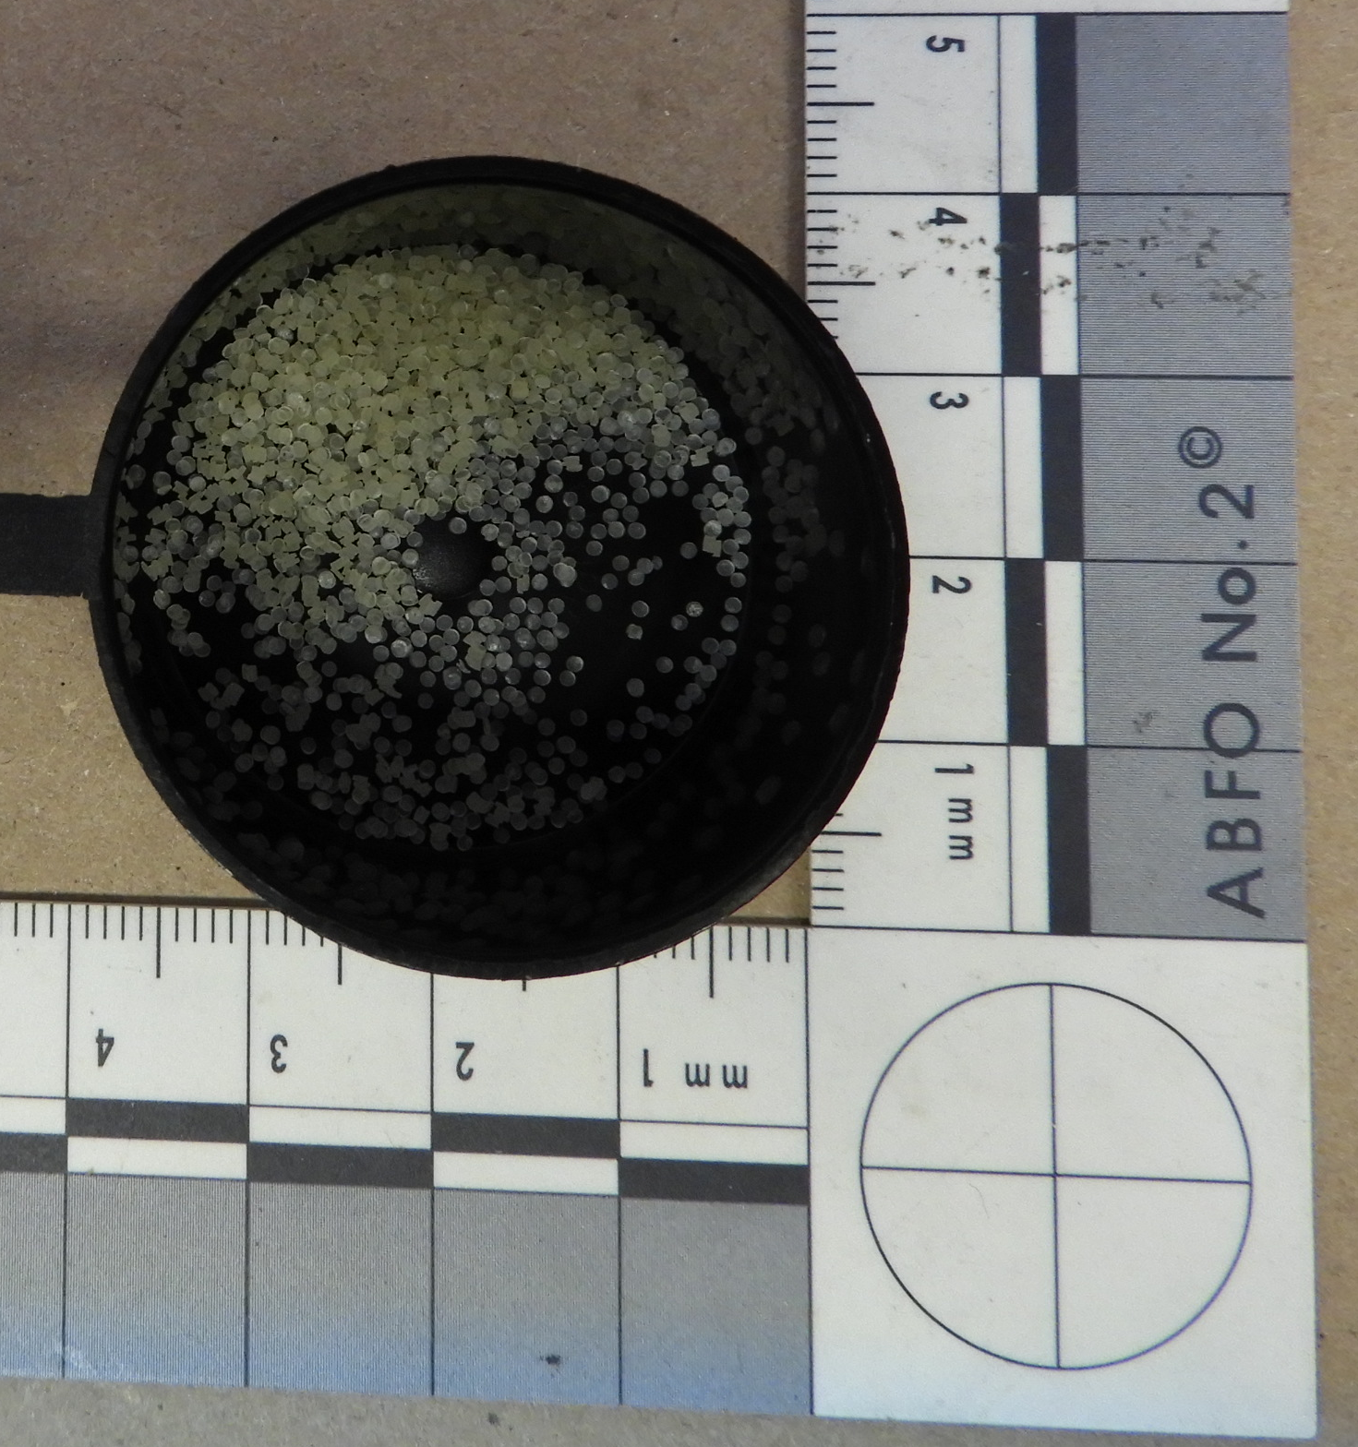
The Incident
Sample being tested: 5 g of celluloid (<12.6% N content nitrocellulose and camphor).
The sample ignited while operator was making the electrical connections for the firing system.
A loud noise ensued.

Slide 5
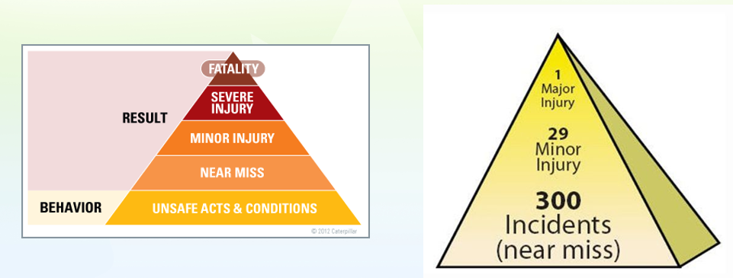
Injury Pyramid Theory

Slide 6
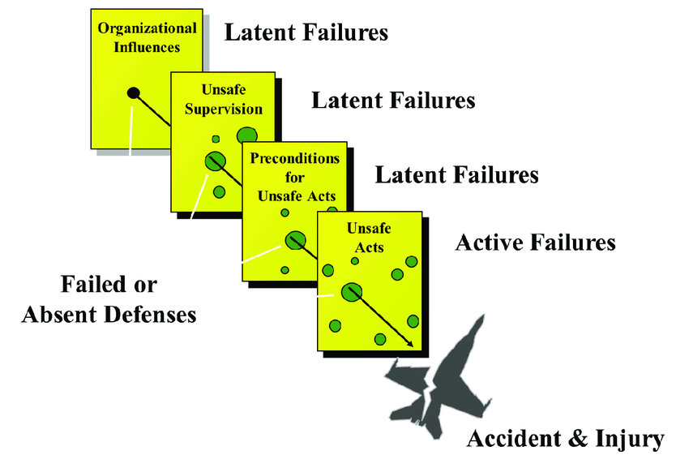
Cumulative Act Effect
Preconditions for unsafe acts include fatigued air crew or improper communications practices.
Unsafe supervision: e.g, pairing inexperienced pilots on a night flight into known adverse weather
Organizational influences: e.g, reduction in expenditure on pilot training in times of financial austerity

Slide 7
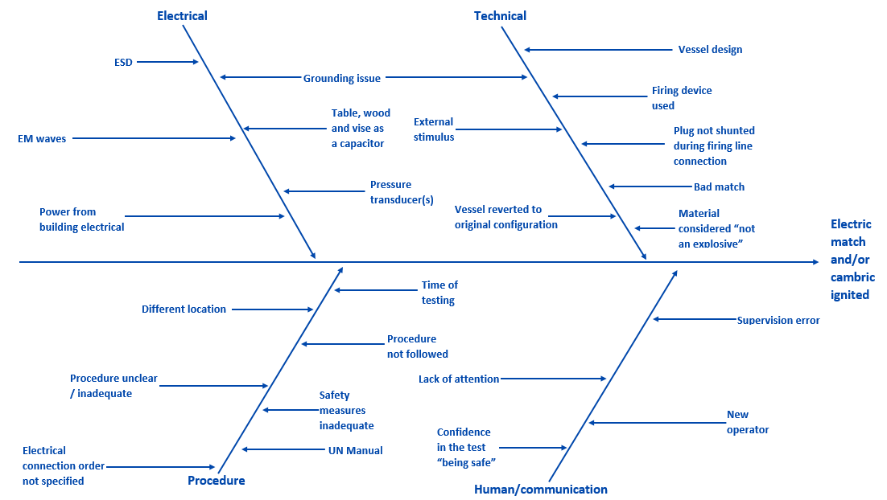
Brain Storming & Mapping

Slide 8
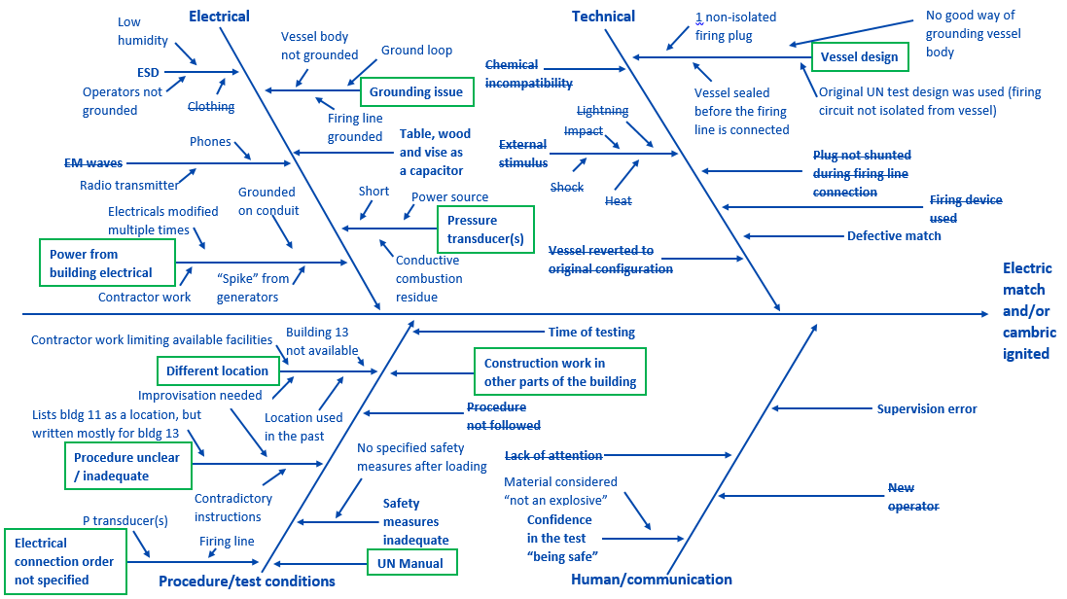
Brain Storming & Mapping

Slide 9
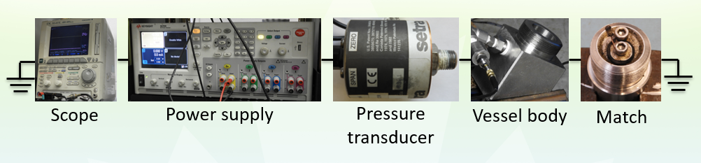
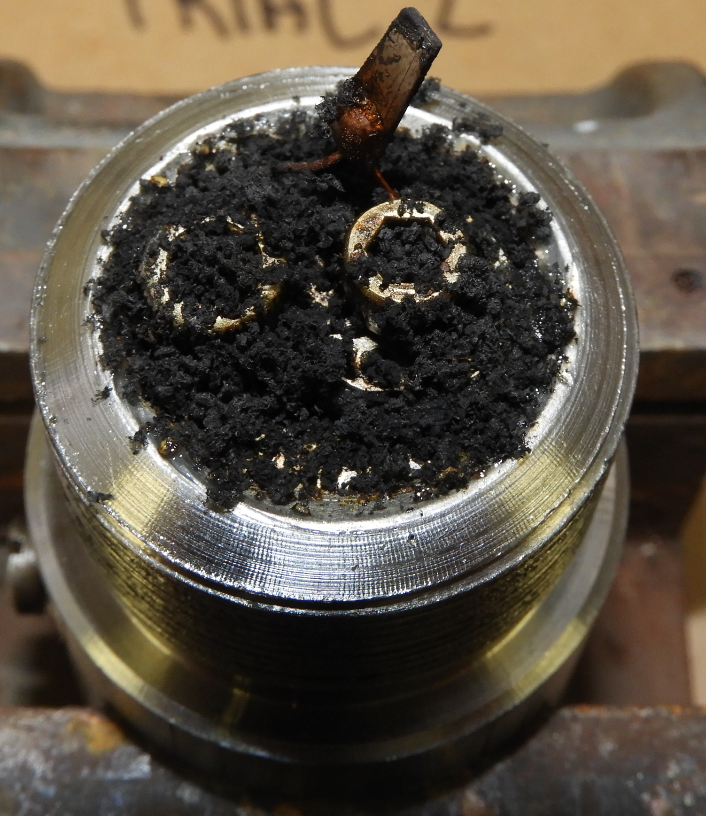
The “Root” cause
Pressure transducer

Slide 10
The “Root” cause
Operator connected the isolated terminal to the firing line first

Slide 11
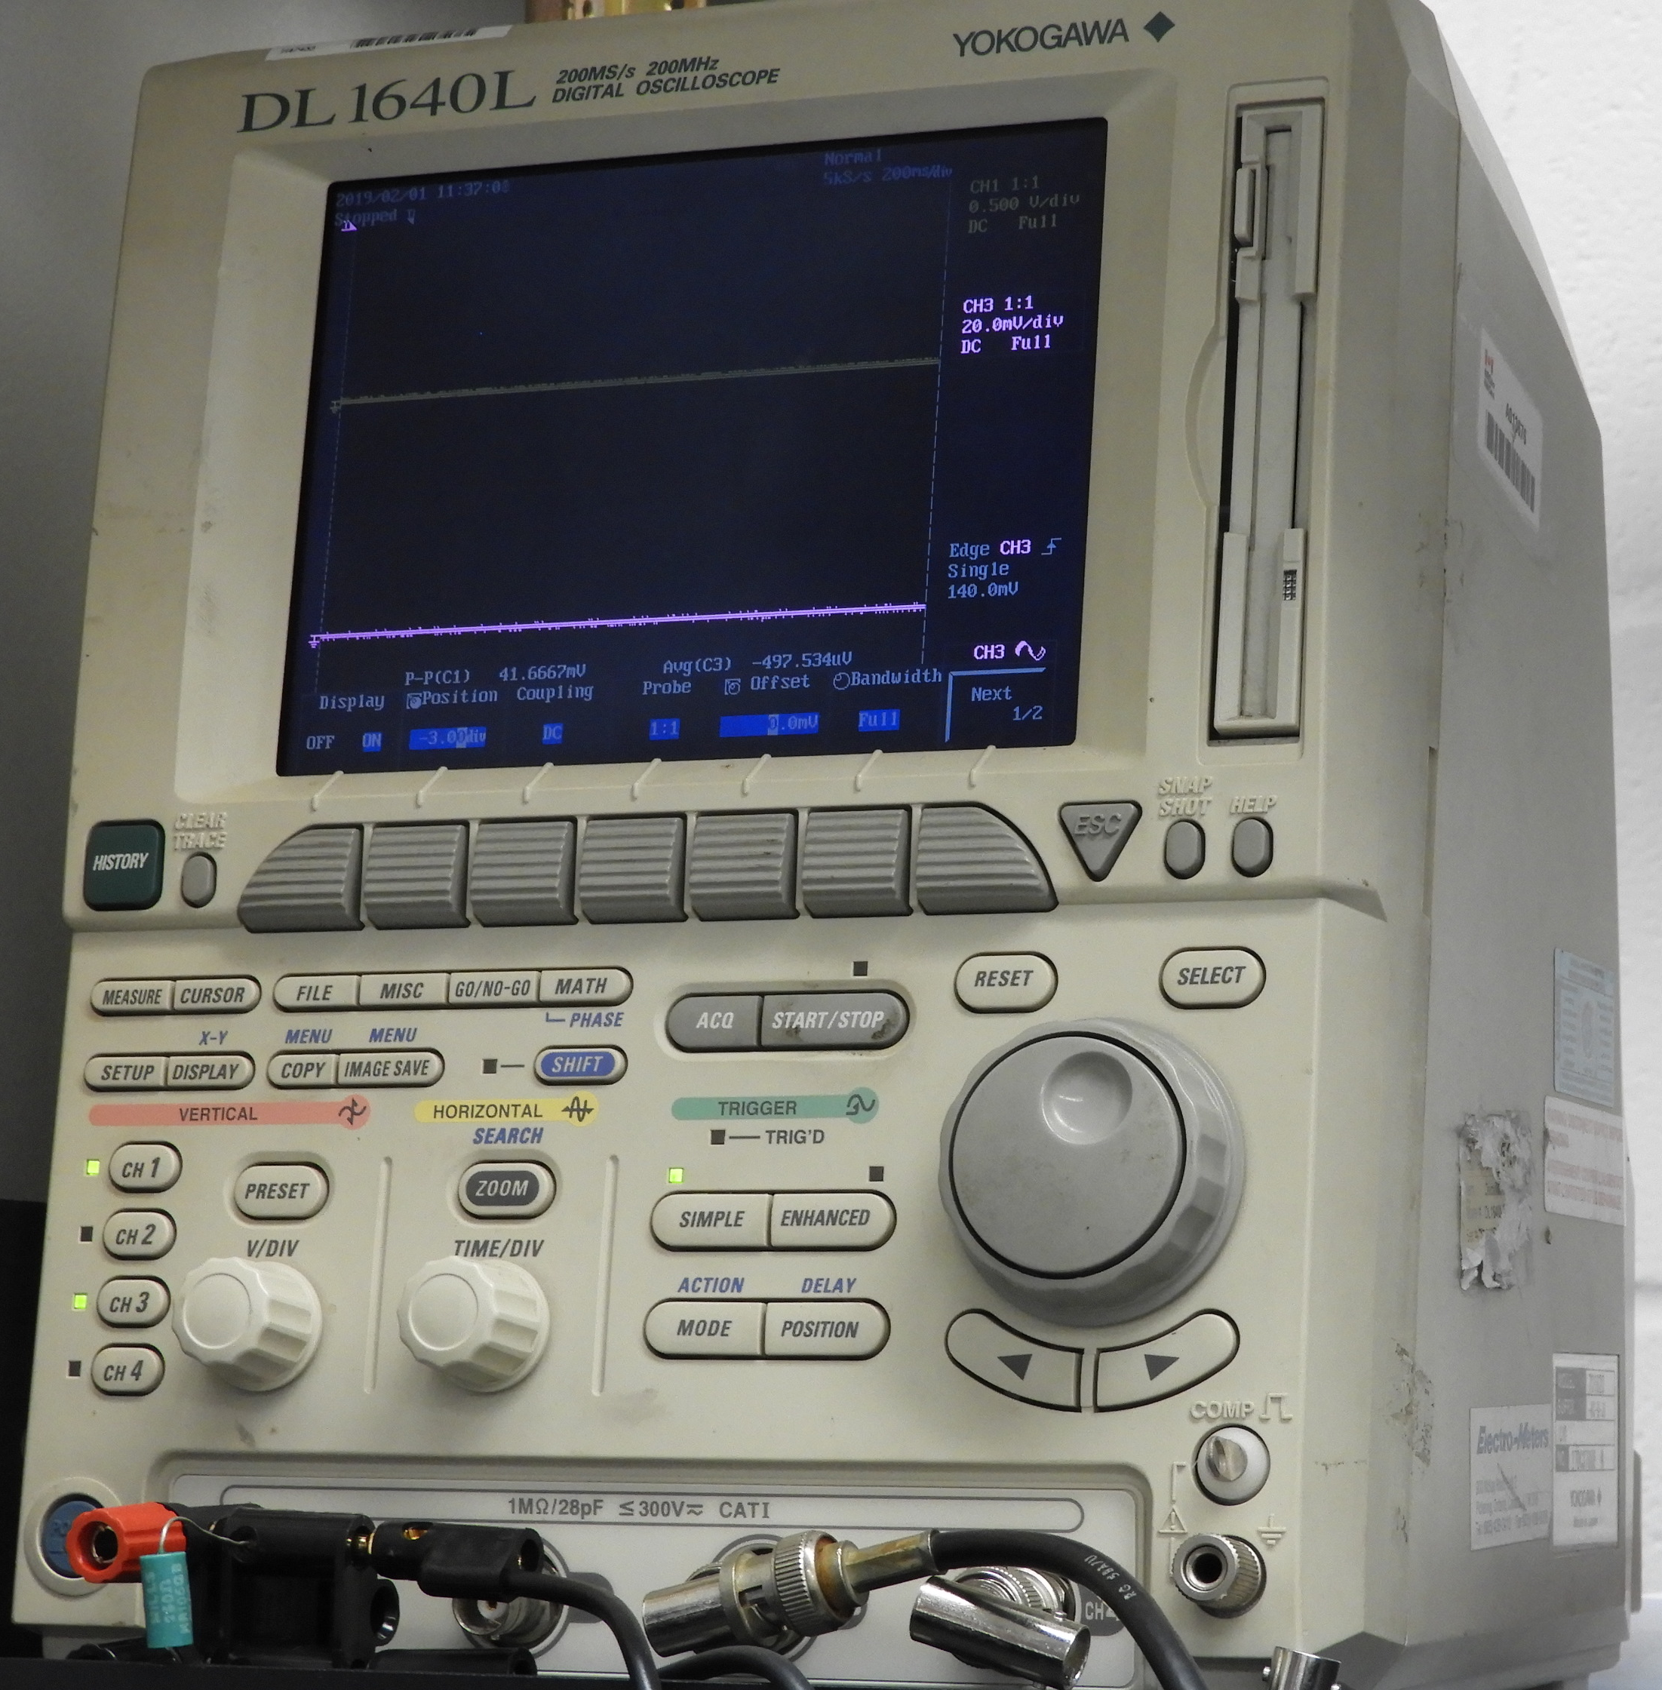
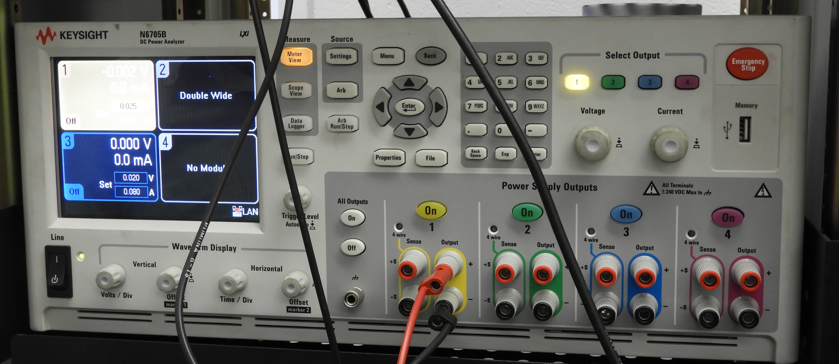
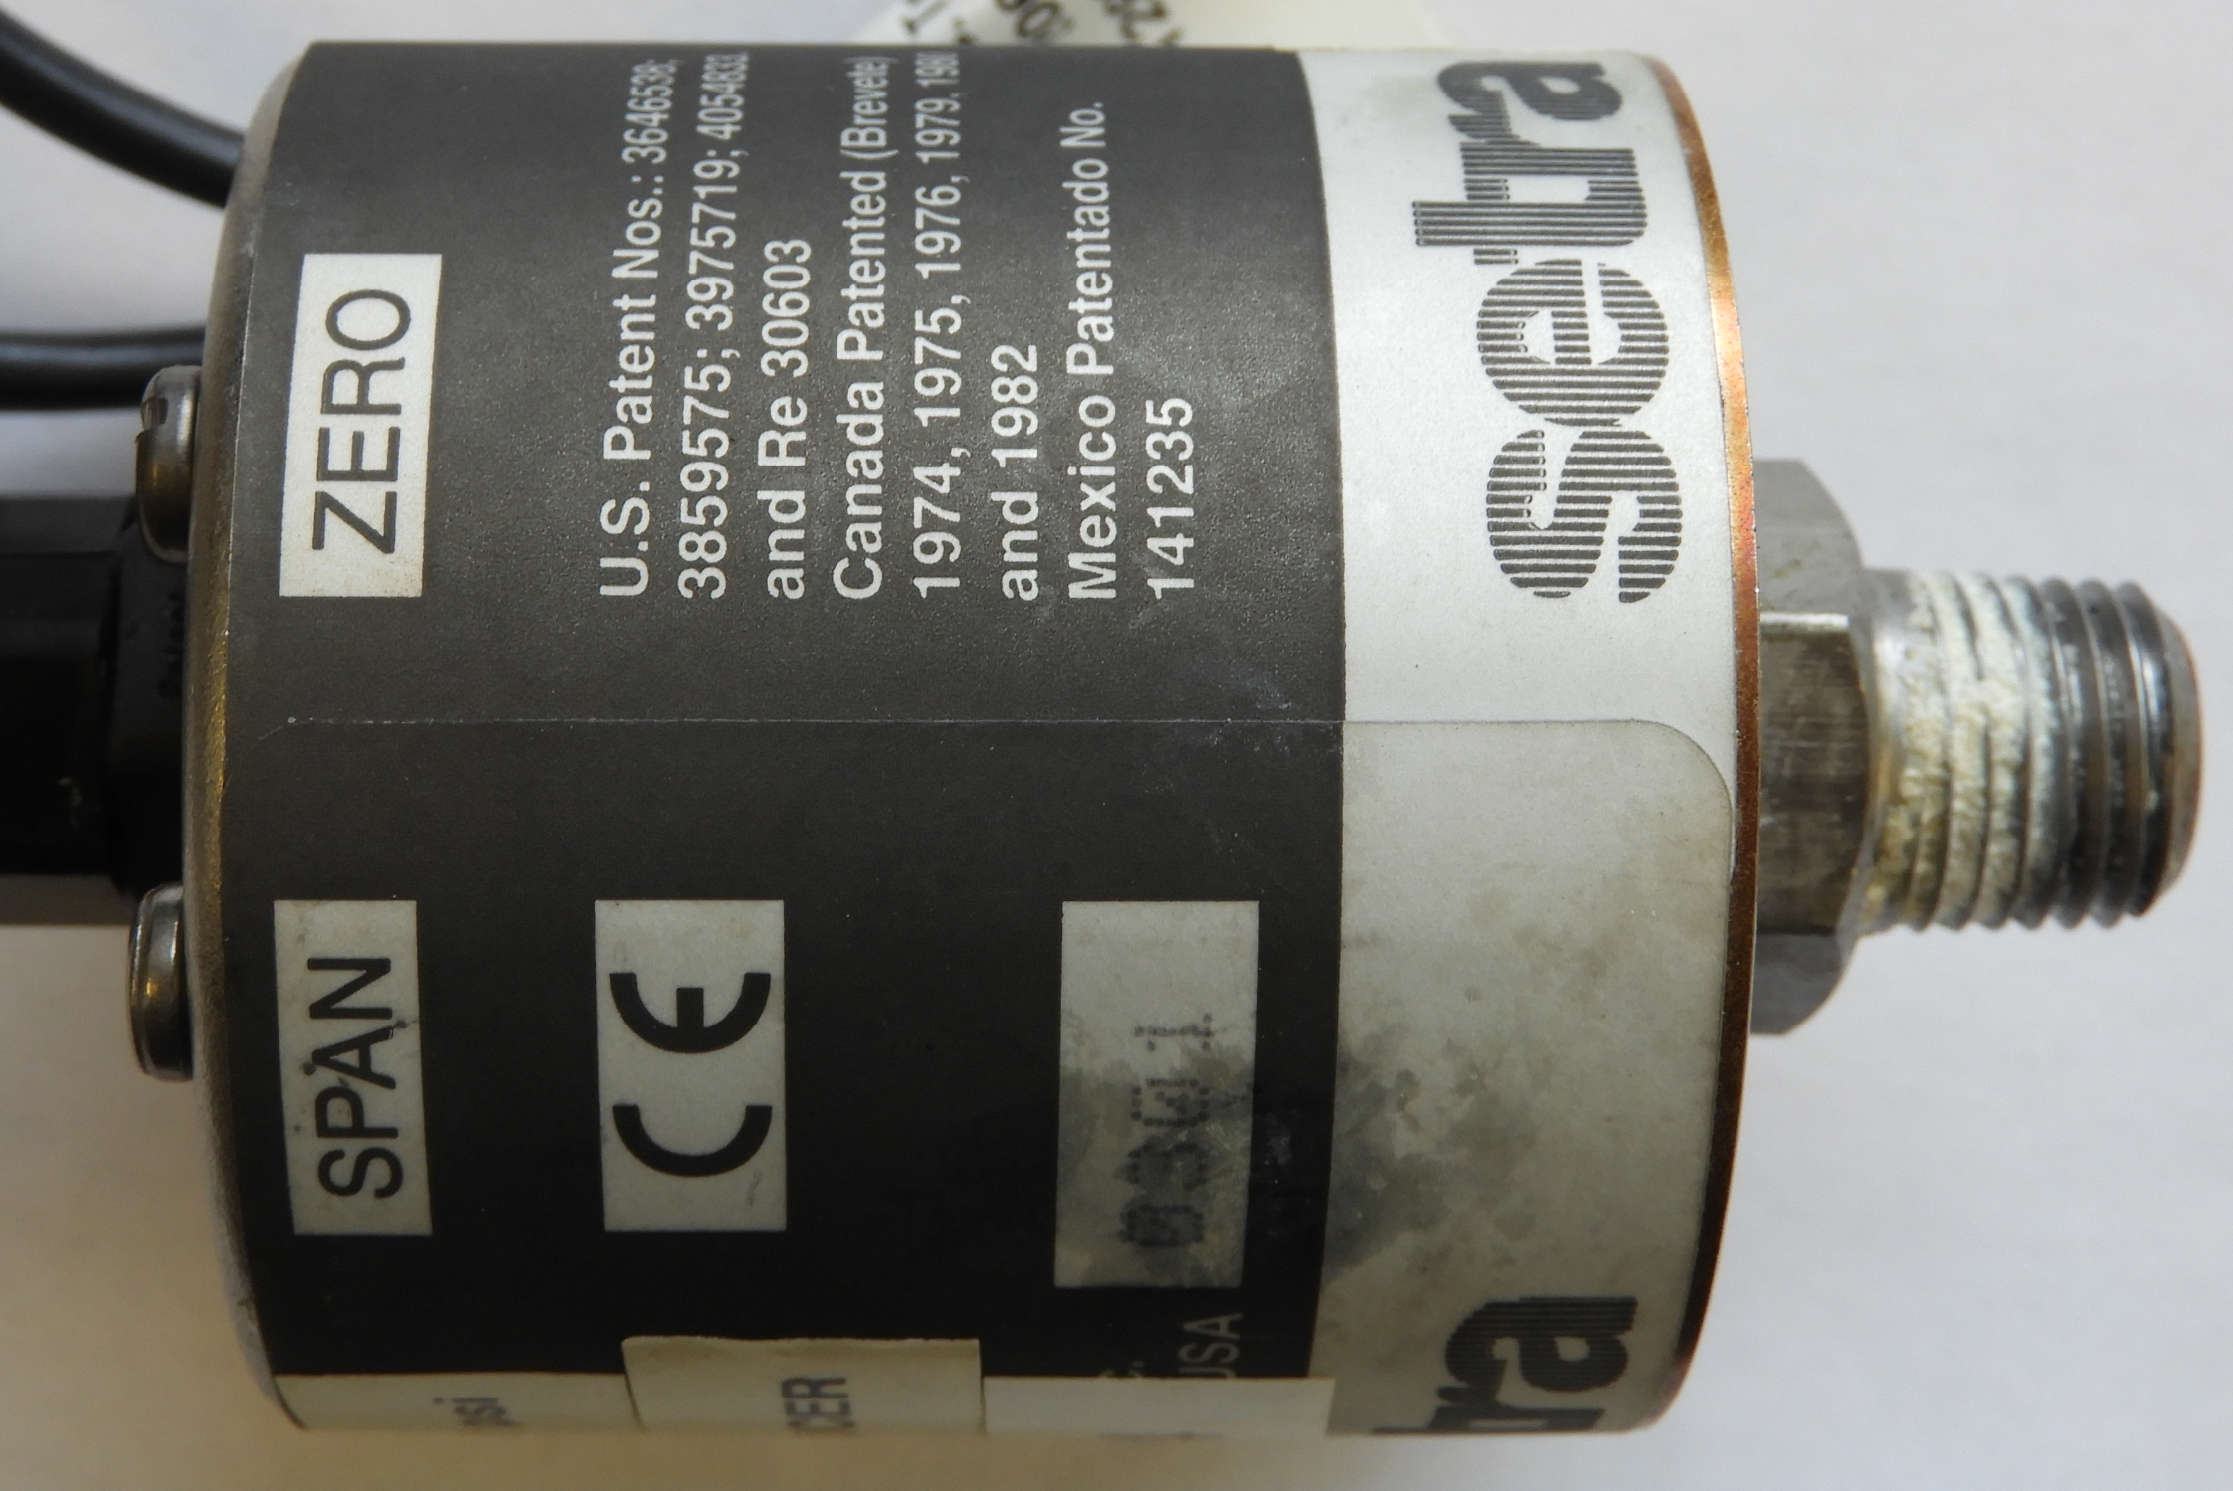
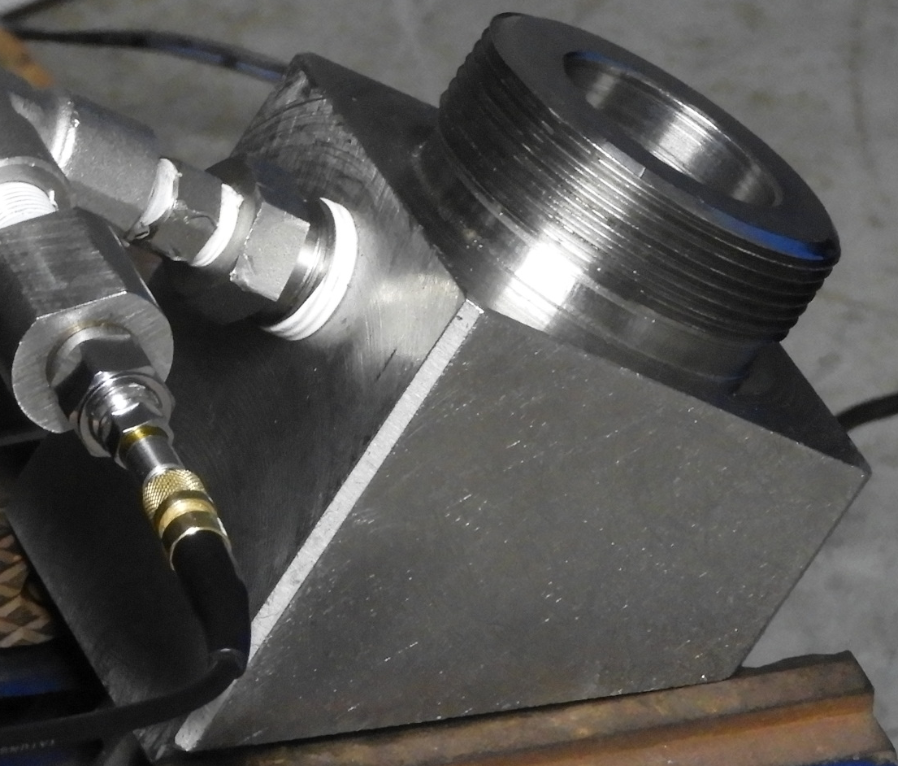
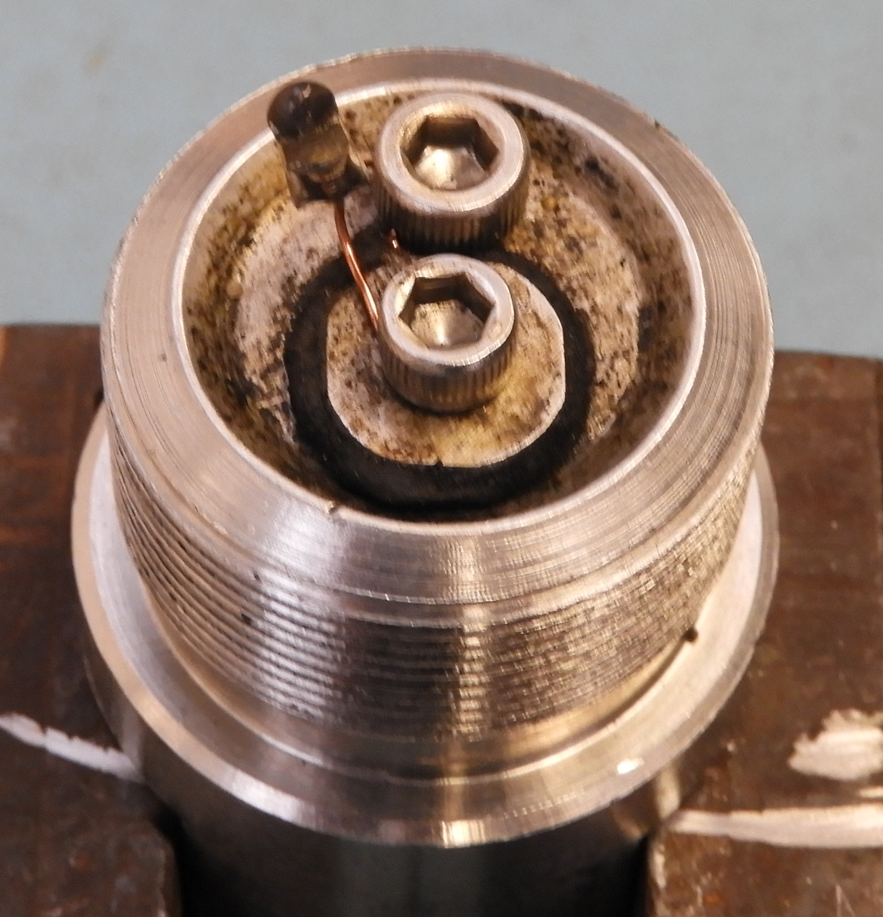
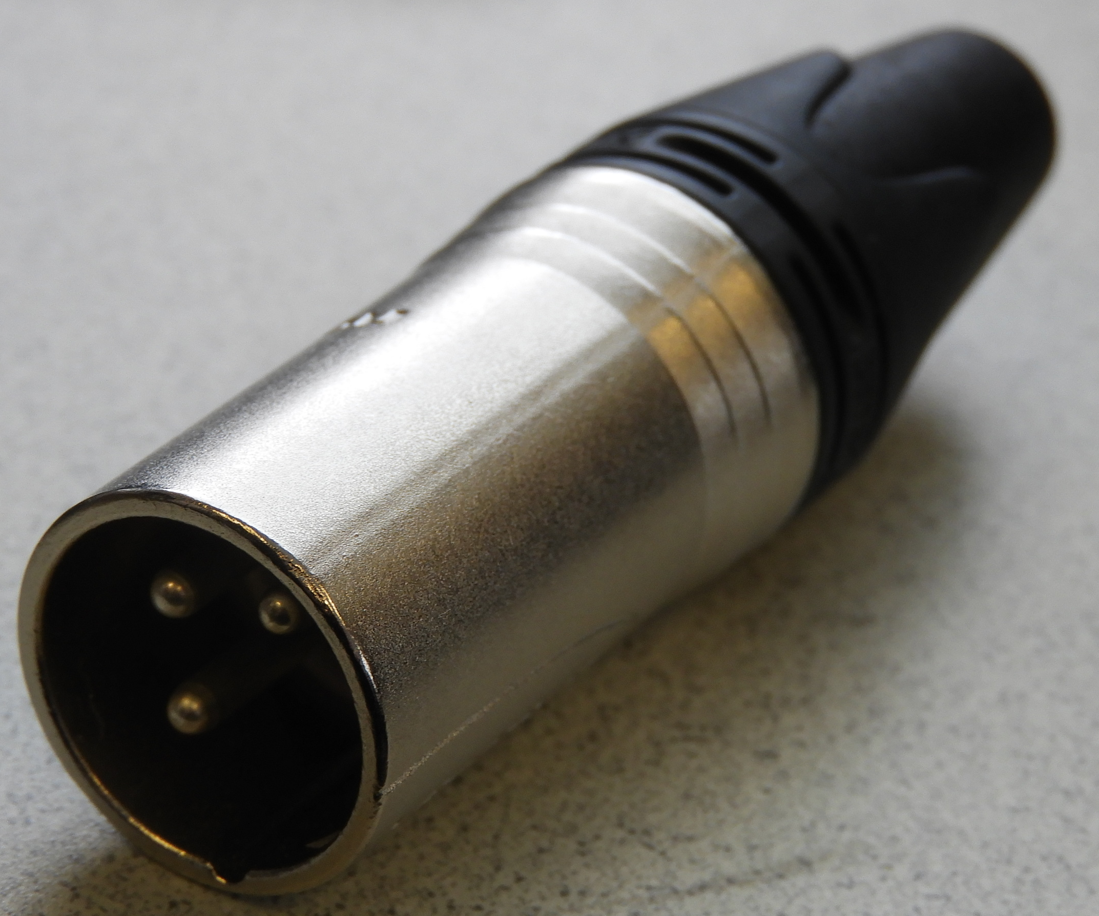
Findings & Recommendations
Scope
Power supply
Pressure transducer
Vessel body
Match
XLR type connector

Slide 12
Findings & Recommendations
The capacitor meant for signal noise reduction in the Setra pressure transducer acted as a “battery” which caused the initiation of the electric igniter when the connection to the firing line was made.
Instrumentation can act as an energy source in unexpected ways.
Safety assessment of testing with Electro-explosive Devices (EED) takes into account power sent to instrumentation, but not necessarily how the electronics inside the instrumentation are designed.
Likelihood of an event is low, but the consequences can be dire.
Always check the instrumentation for potential energy storage.
Always isolate firing lines?
Does the UN test need to be modified?

