Slide 1
NELSON BROTHERS, LLC
SAFEX Safety Congress
May 2020

Slide 2
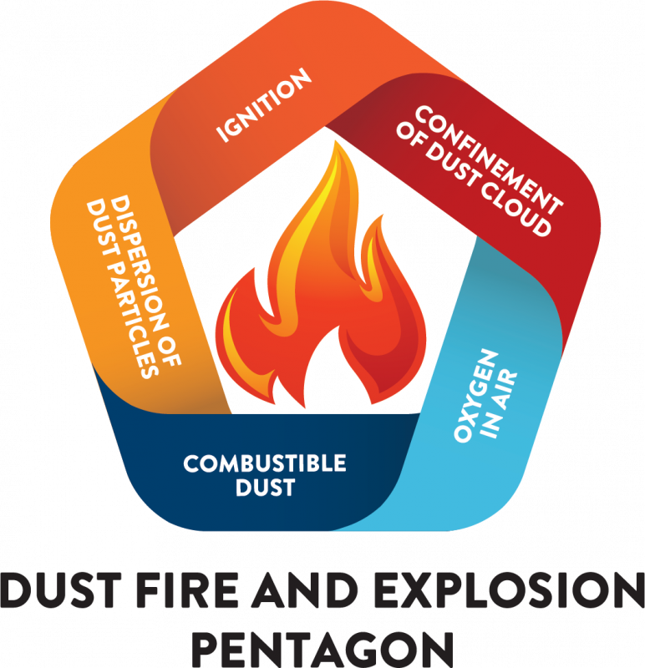

Slide 3
DUST EXPLOSION CLASSIFICATIONS
Dust Explosion Class Kst Characteristics
ST 0 0 No Explosion
ST 1 0-200 Weak Explosion
ST 2 200-300 Strong Explosion
ST 3 > 300 Very Strong Explosion

Slide 4
EXAMPLES OF COMBUSTIBLE DUSTS AND THEIR EXPLOSION CLASS
Sugar ST 1 – Weak
Saw Dust ST 2 – Strong
Aluminum Dust ST 3 – Very Strong
Unexpanded Microspheres ST 2 – Strong

Slide 5
EXAMPLES OF DUSTS AND THEIR REQUIRED MIE in MJ
Powdered Sugar requires 30 mJ
Saw Dust requires 10 mJ
Unexpanded Microspheres require 1.6 - 3.0 mJ

Slide 6
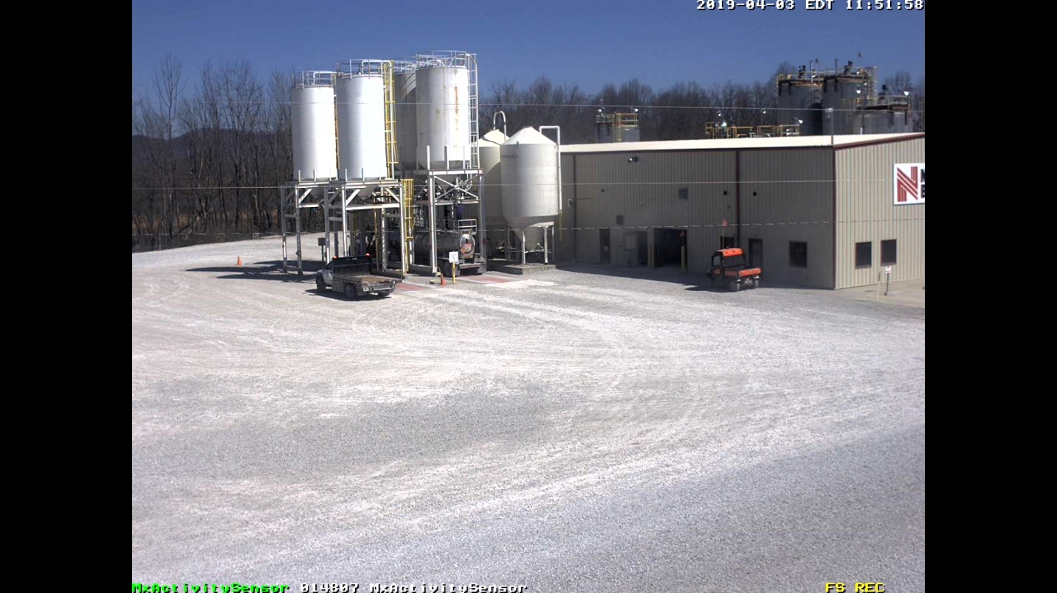
NELSON BROTHERS, LLC EMULSION MANUFACTURING FACILITY
(Photo 1)

Slide 7
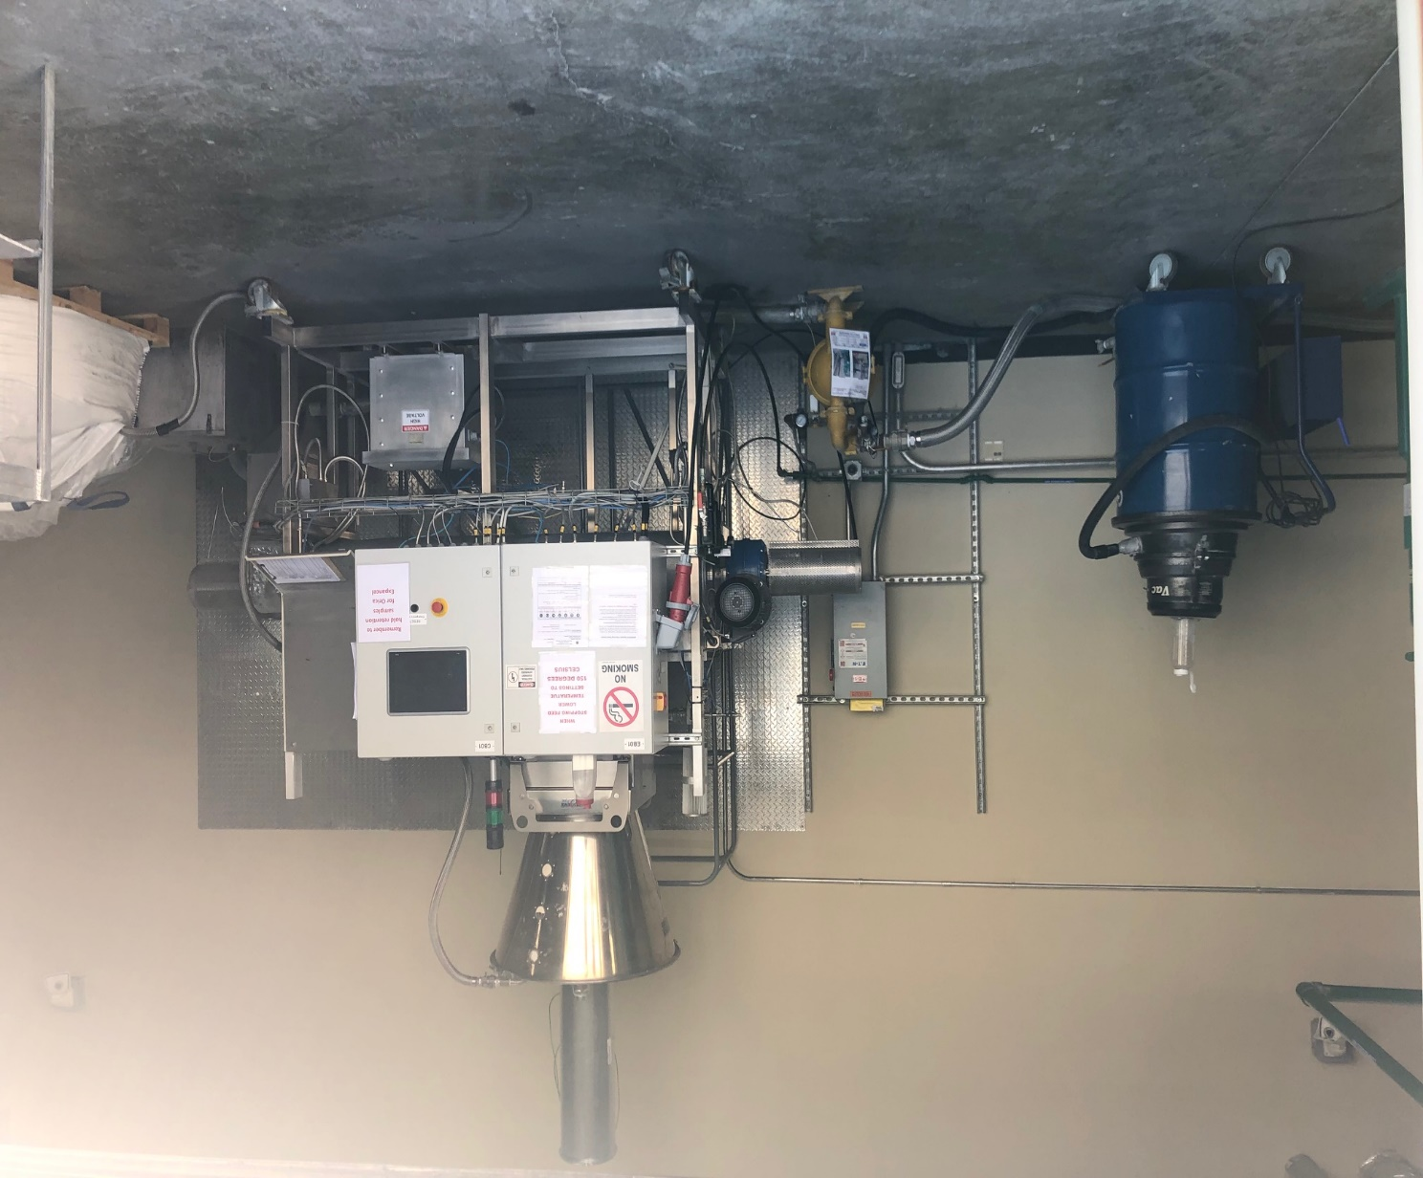
EXPANDER AND ROOM POST -INCIDENT
ALSO SIMILAR TO CONDITION PRIOR TO INCIDENT
(photo 2)

Slide 8
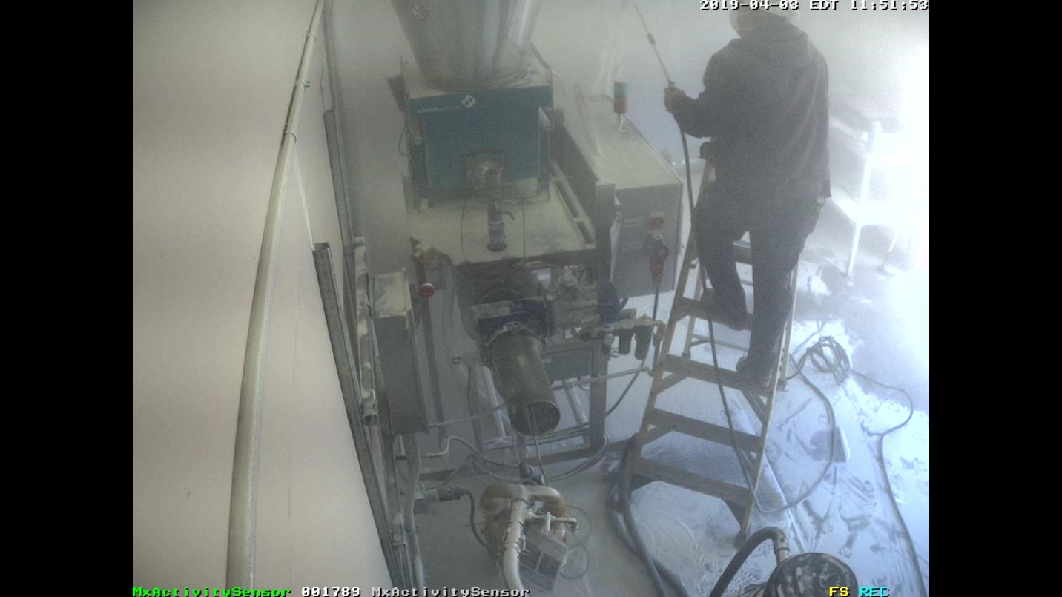
Just prior to introducing compressed air to pile of unexpanded plastic microspheres
(Photo 3)

Slide 9
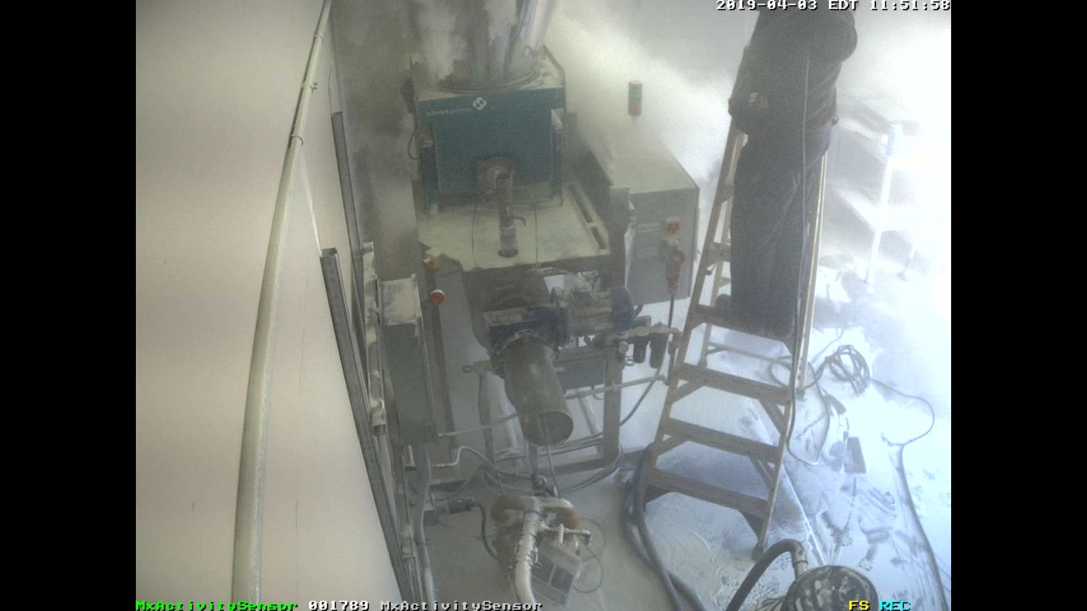
Introduction of compressed air and dust cloud beginning to form – 0.0 Seconds
(Photo 4)

Slide 10
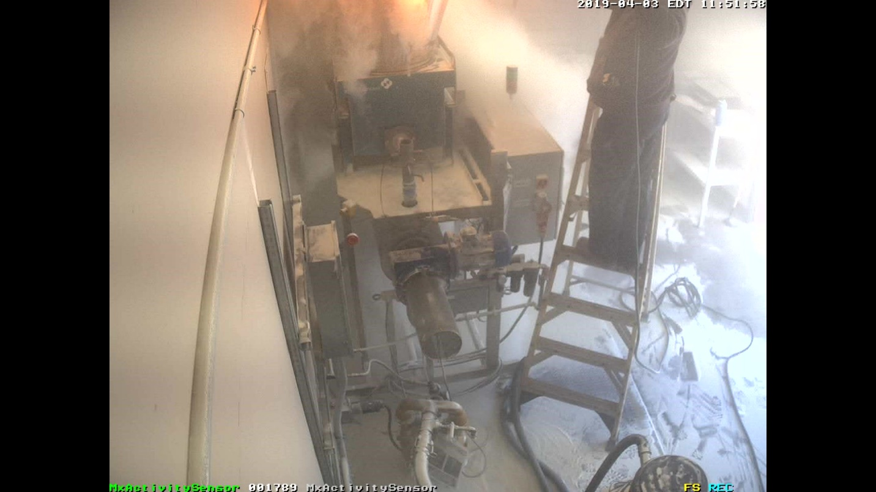
Dust cloud igniting – 2.0 Seconds
(photo 5)

Slide 11
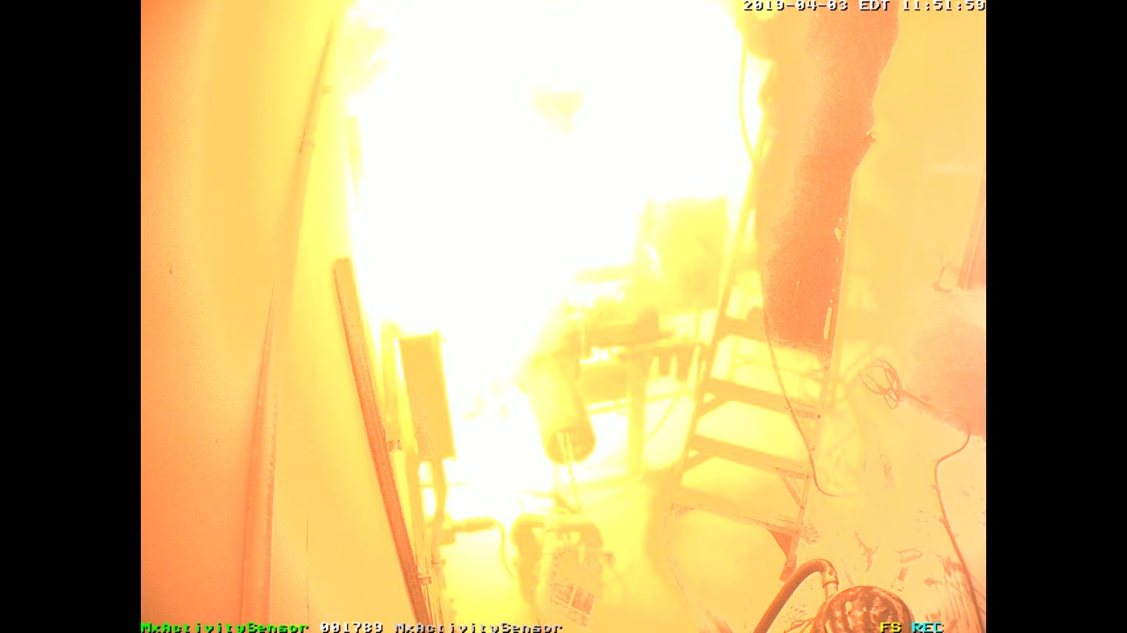
Fireball from ignition of dust cloud - at its fullest – 2.5 Seconds
(photo 6)

Slide 12
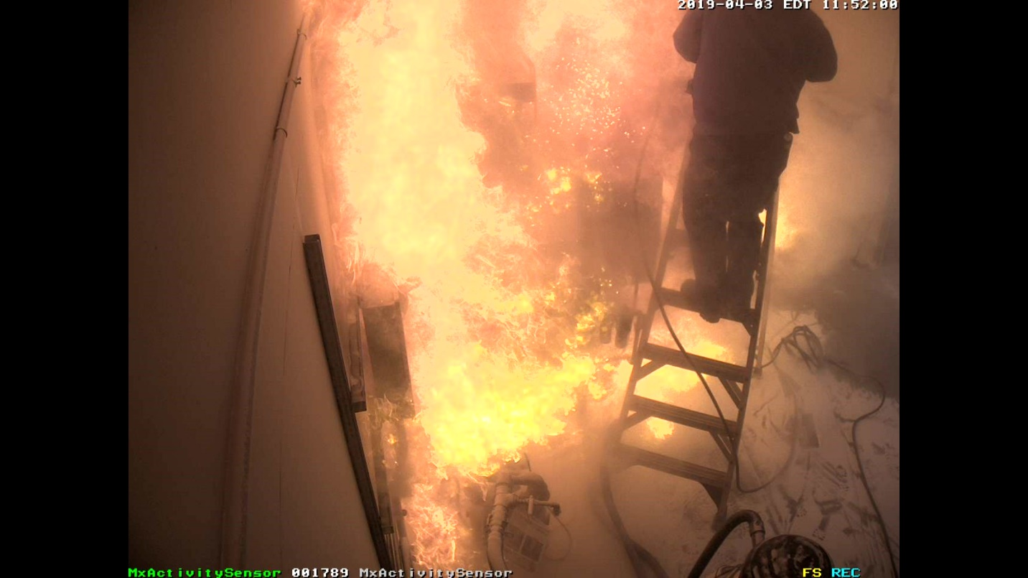
Dust Cloud Fireball and beginning of other smaller fires – 3.0 Seconds
(photo 7)

Slide 13
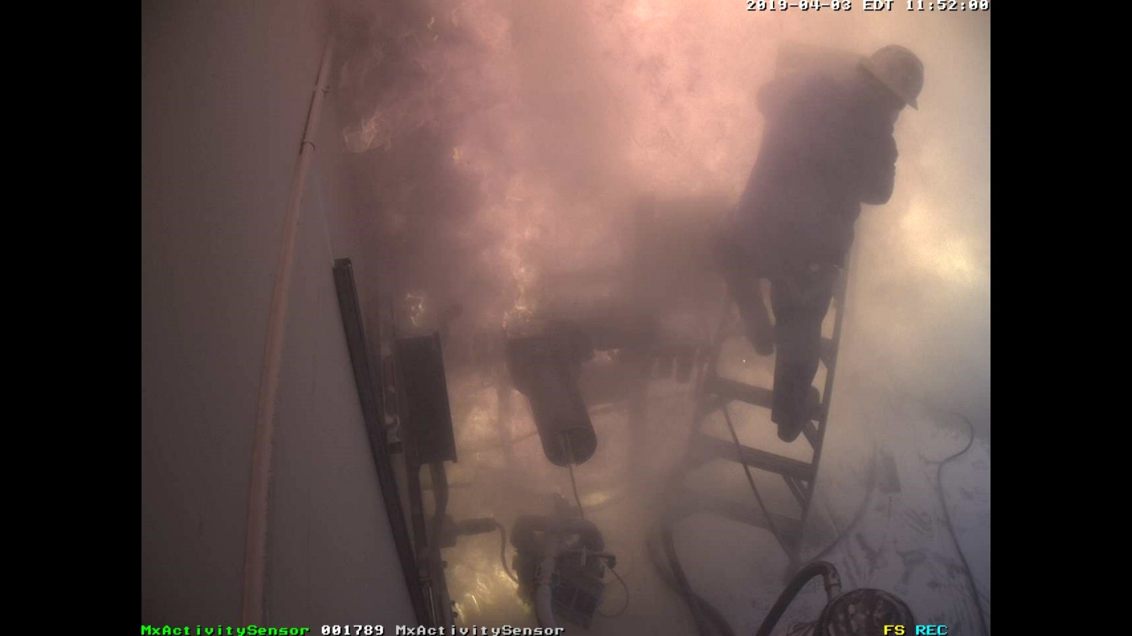
Fireball reaching termination while other fires continuing to burn – 3.5 Seconds
(photo 8)

Slide 14
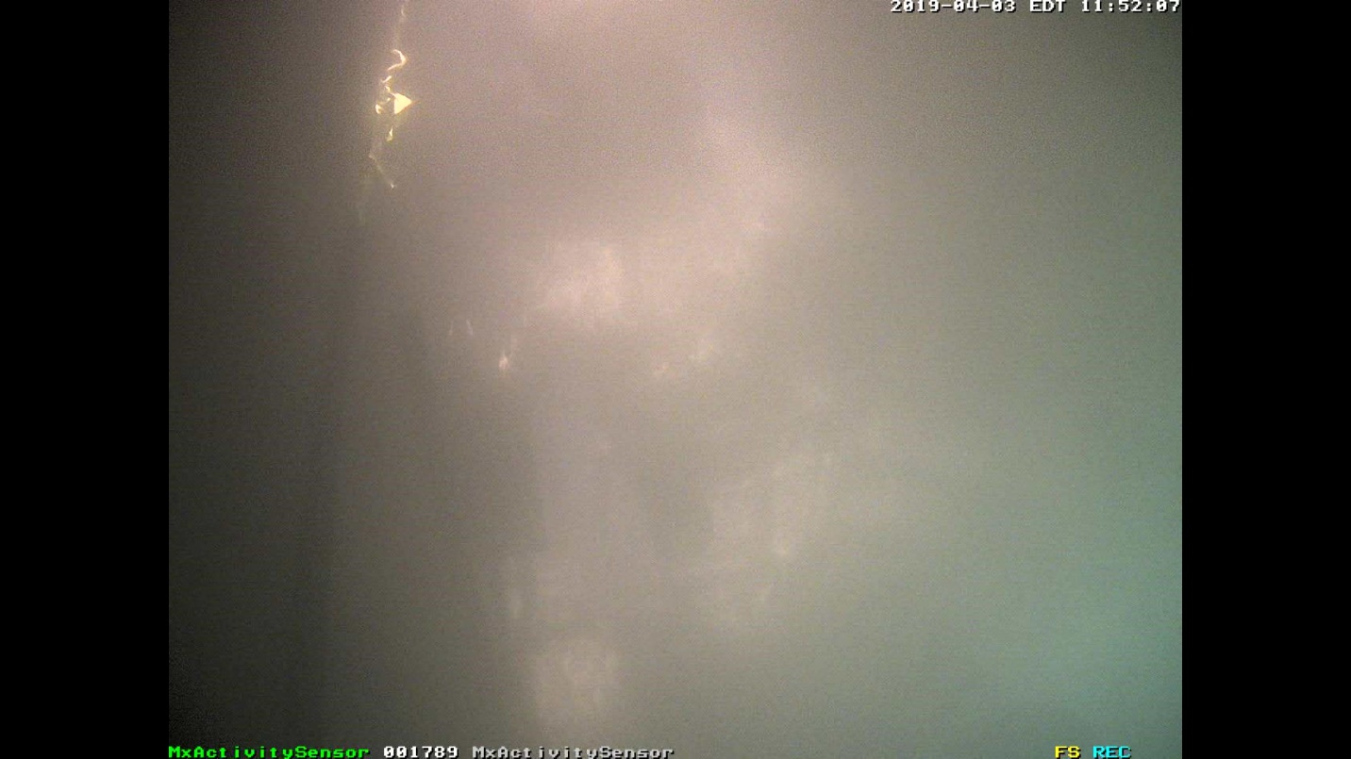
Fireball terminated and other smaller fires continuing – 5.0 Seconds
(photo 9)

Slide 15
View from parking lot just before the event
(photo 10)

Slide 16

The moment of the dust cloud explosion
(photo 11)

Slide 17

Burned plastic microspheres exiting from the explosion
(photo 12)

Slide 18
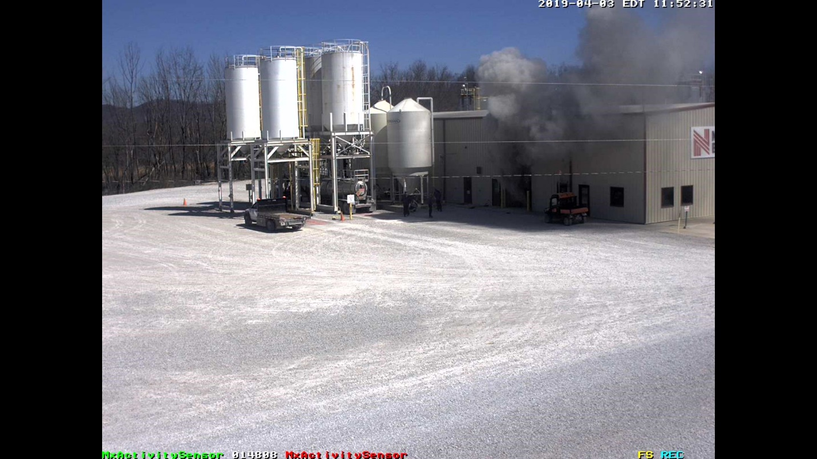
Followed by fire extinguishing agent exiting the building
(photo 13)

Slide 19
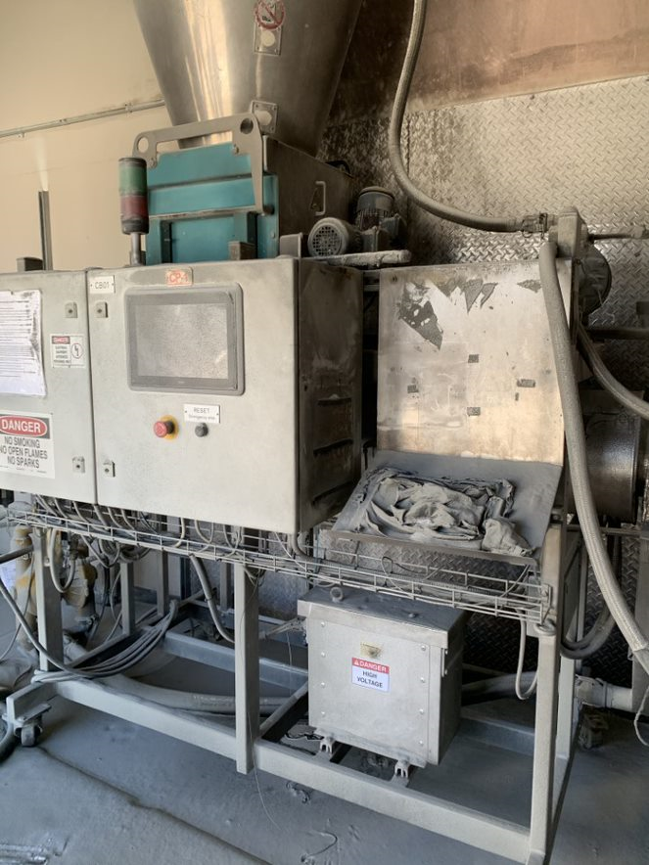
EXPANDER POST INCIDENT – MINIMAL DAMAGE
(photo 14)

Slide 20
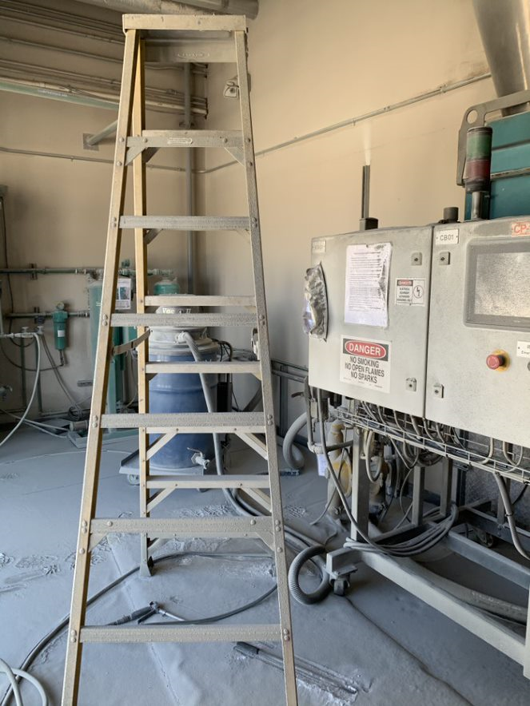
EXPANDER ROOM POST INCIDENT
(photo 15)

Slide 21
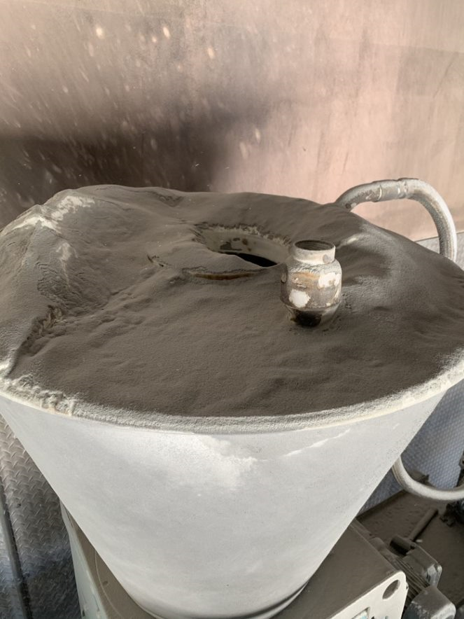
TOP SURFACE OF HOPPER – UNBURNED UNEXPANDED
MICROSPHERES POST INCIDENT
(photo 16)

Slide 22
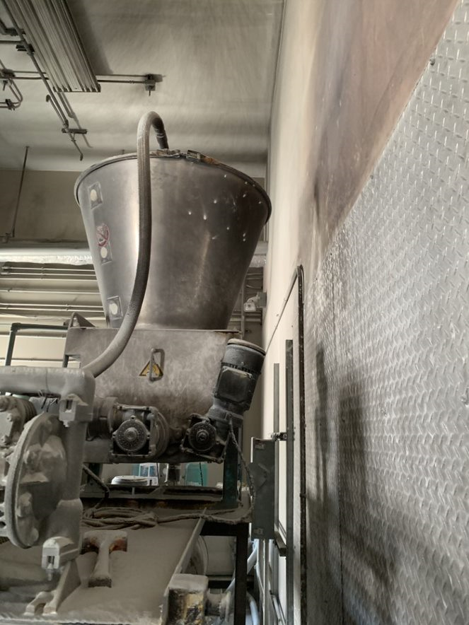
HOPPER AND ROOM POST INCIDENT
(photo 17)

Slide 23
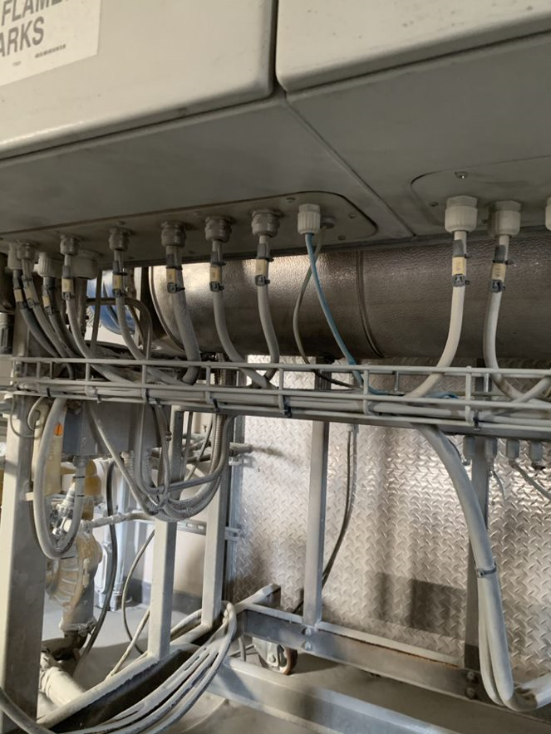
FLEX CONDUIT NOT DAMAGED – POST INCIDENT
(photo 18)

Slide 24
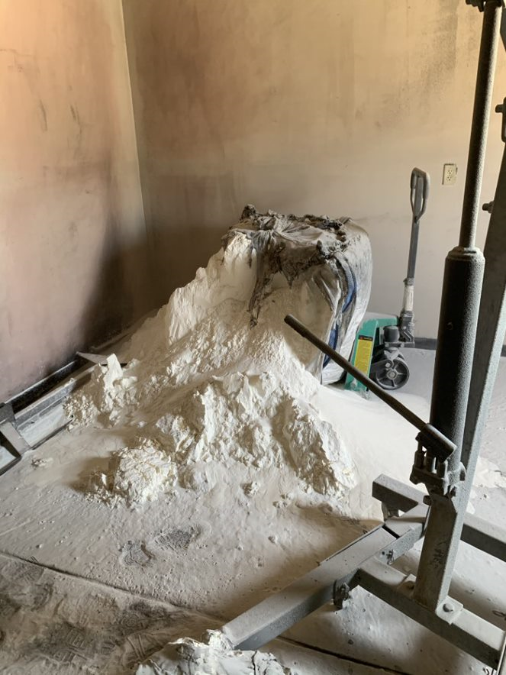
UNEXPANDED
MICROSPHERES IN STORAGE – TOTE PARTIALLY BURNED
(photo 19)

Slide 25
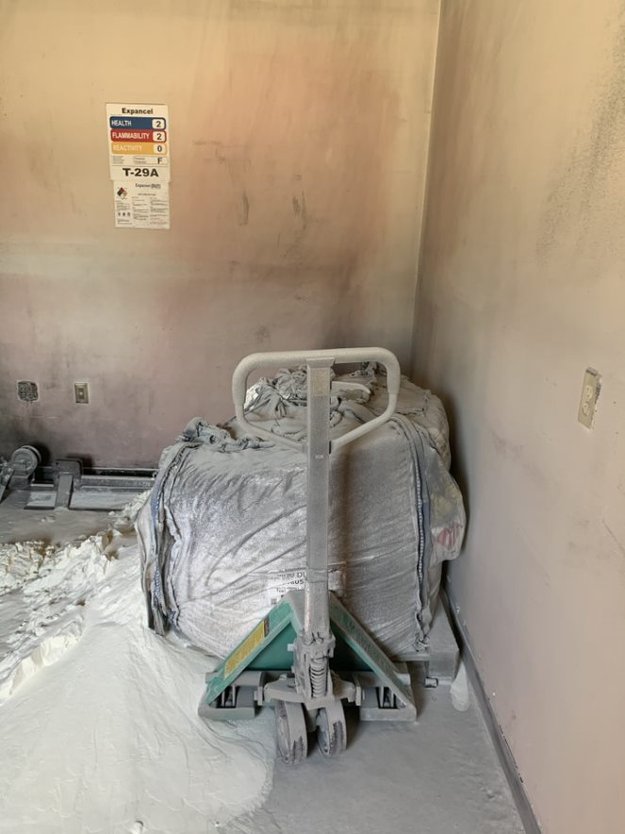
UNEXPANDED MICROSPHERES IN STORAGE – VIEW 2
(photo 20)

Slide 26
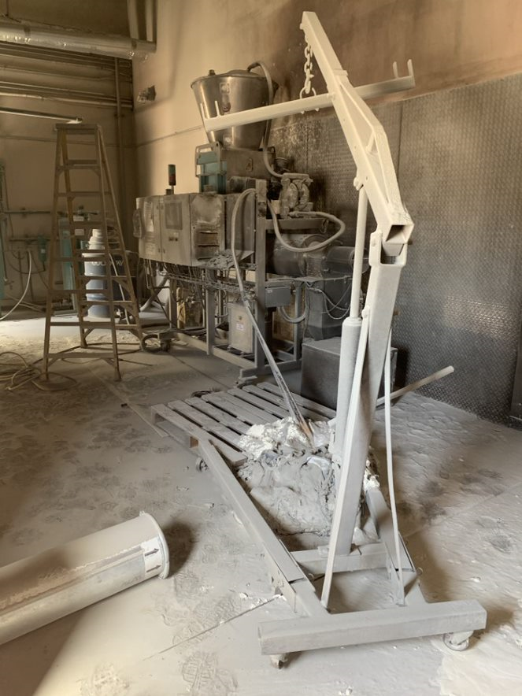
EXPANDER ROOM – IN PROCESS TOTE IN FOREGROUND
(photo 21)

