Slide 1
Selecting and Implementing GPS and
In-Vehicle Monitoring System (IVMS): obstacles and how to overcome
King Wei, Manager-Regional SHE | 2023-01-26

Slide 2
Definition
GPS
Global Positioning System in United States of America or
similar satellite positioning systems in other regions
IVMS
In-vehicle monitoring system
Devices installed to track, assess, and report driver behaviors such as cameras or microphones
Notes:
Started with US, NAVStar, then the rest Galileo (Europe), Beidou (China), Glonass (Russia), NavIC (India), QZSS (Japan)
Selective availability lifted, from L5 signal 5 meters to 30 cm to 2 cm accuracy (engineering/land survey) – US’s GPS
Commercial explosive transportation’s GPS may subject to countries’ rule and regulation
IVMS was common for aviation industry, “black box” technology. It is now common in road vehicles as well.

Slide 3
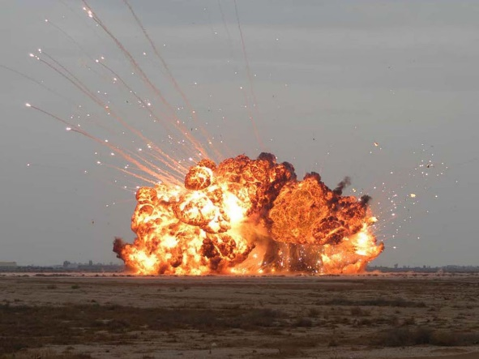

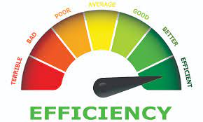

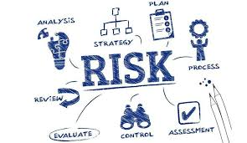
The “why”
Road
Transportation
Notes:
Reduce high consequences incidents involving transporting explosives/oxidizers
Available technologies. Industrial 4.0 including distribution of product via transport. IoT internet of things, imagine data that you can get from the GPS and IVMS
Improve driver efficiency and areas for improvement for drivers
Insurance offer reduced premium and other cost saving (accident cost, fuel consumption, reduced emission due to smooth driving, less wear and tear on brakes/tyre)
Risks based coaching/training, focus on at risk driver, driver KPI , identified root causes of unsafe driving behaviors (eg sleep apnea, time pressure, incompetent, flawed journey management) –harsh braking due to fatigue or distraction
Reduce 60% speeding ticket
Reduction of high consequences event ranging from 29% to 100%
Promote usage of safety belt
Identify harsh acceleration, harsh braking, tailgating, fatigue, eyes closing, distraction

Slide 4
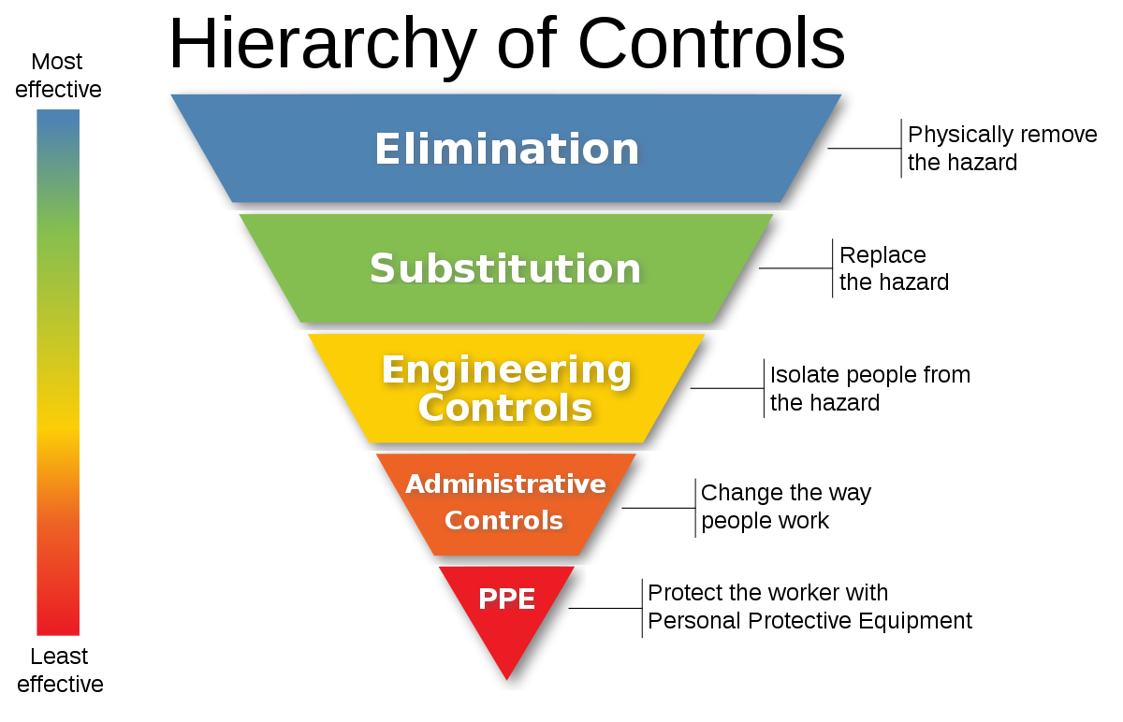
Hierarchy of Risk Controls
GPS & IVMS?
Notes:
In the hierarchy of risk controls in figure 1 below, at first glance, one may argue that it should be categorised under the “Engineering Controls” tier as it involved installing hardware such as in-cabin cameras and sophisticated software to monitor and analyse driver’s behaviours.
Through in-depth analysis into how the GPS and IVMS may help to improve transportation safety, the author thinks that the GPS and IVMS should fall under the category of “Administrative Controls” as it changes drivers behaviour instead of isolating drivers from any possible hazards.

Slide 5
Selecting GPS & IVMS
What are your objectives?
Set the scope
Many types and sources
Project management
Your “why”
Your “what”
Do a comparison
Time, cost and quality
Notes:
Too many in the markets, nice website but bad features or service
Know why u do it in order to set the scope right
Manage it like a project

Slide 6
Main Selection Criteria #1 - Accuracy
Accuracy
Location
Speed
Second-to-second data
Please consider
Not all suppliers able to provide second-to-second data
Important for incident investigation

Slide 7
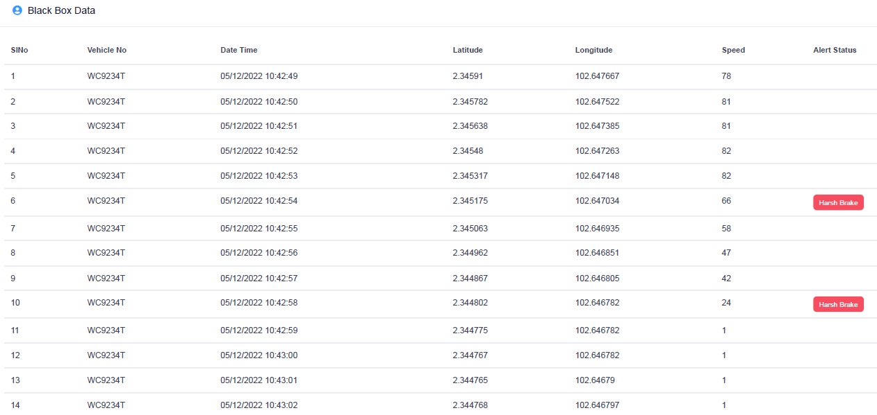
Second-to-second data

Slide 8
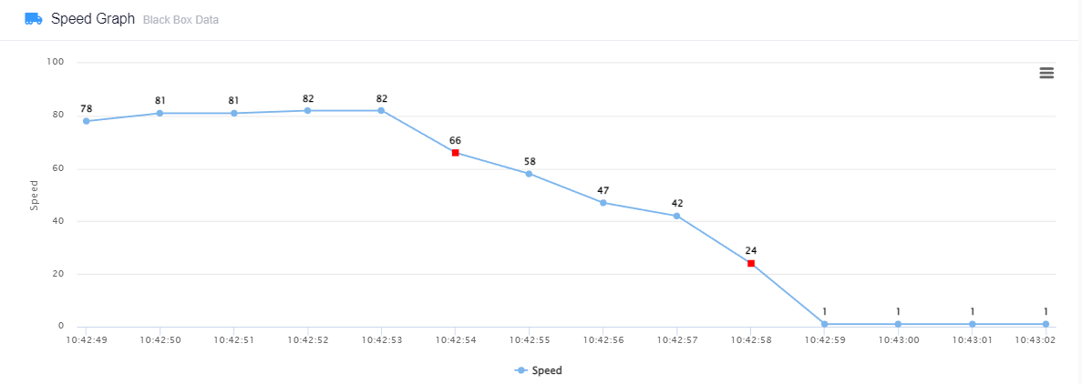
Second-to-second data

Slide 9
Main Selection Criteria #2 – Common Features
Please consider to include
Geofencing
Route setting
Email mobile alert
Panic button
Common features
Fuel sensor
Tracking on map
Fleet utilization dashboard
Others

Slide 10
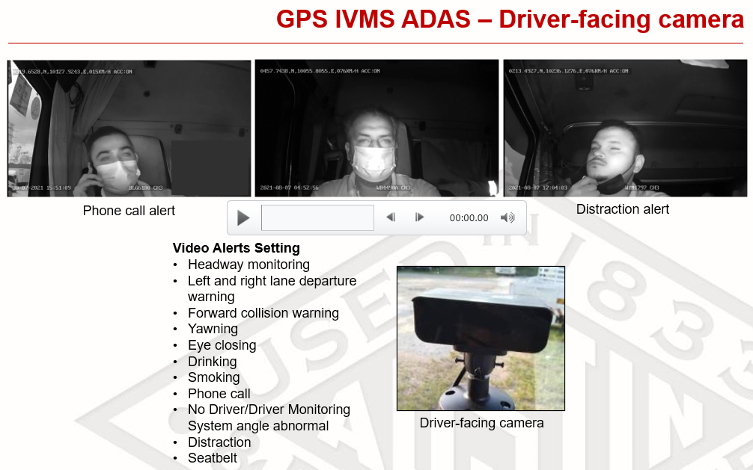
Main Selection Criteria #3 – Advance Features 1

Slide 11
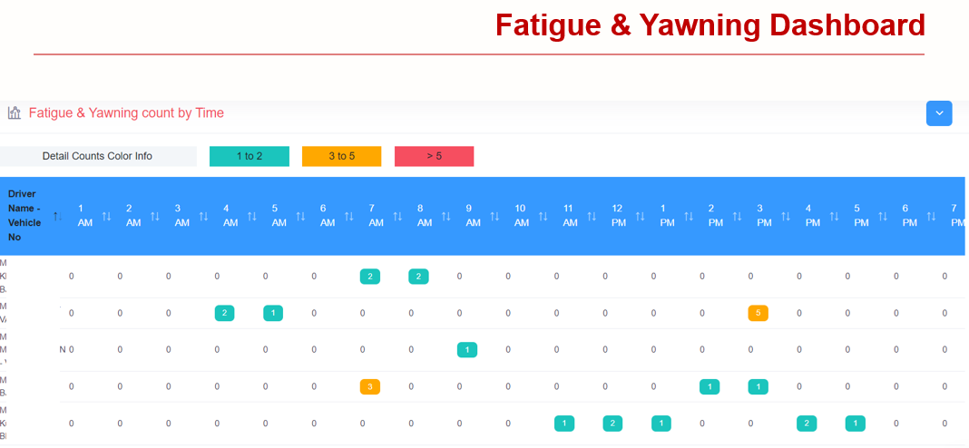
Main Selection Criteria #3 – Advance Features 1

Slide 12
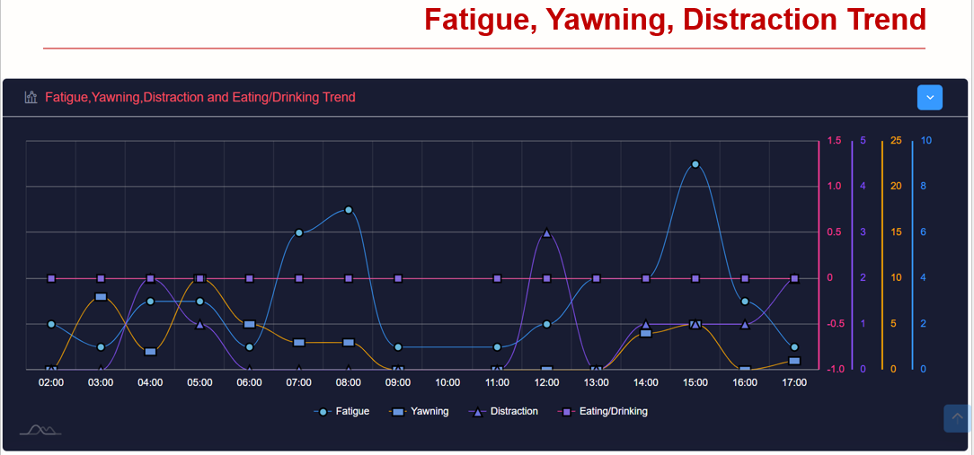
Main Selection Criteria #3 – Advance Features 1

Slide 13
Main Selection Criteria #3 – Advance Features 1
Advance features 1
Front/in-cabin cameras with ADAS (Advanced Driver Assistance System)
Please consider
Will not violate privacy/personal data related legislation
Consent may be needed from driver
Include (lane departure alert, distraction alert, no seatbelt alert, yawning, eyes closing, headway monitoring, forward collision alert

Slide 14
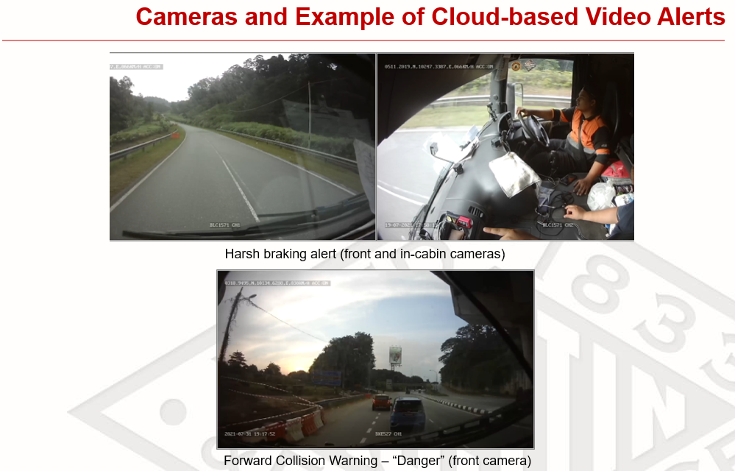
Main Selection Criteria #3 – Advance Features 2
Notes:
Cloud-based video alerts by default can be sent to the server in the datacentre by internet connectivity. This is useful in case the front/in-cabin camera with its micro-SD card or other storage device is damaged or missing following an incident. For example, a harsh braking video right before an incident accessed remotely may help to give insights on what are the immediate causes of a transportation incident.
However, cloud-based video alerts are subjected to internet connectivity and signal strength. Most of the quarries and mines are in the remote areas, so this may be useful only on highway or public roads with decent internet connectivity. In future, adoption of 5G may improve this feature and even more functionalities will be available like big data and artificial intelligence (AI) learning.

Slide 15
Main Selection Criteria #3 – Advance Features 2
Advance features 2
Video alerts with cloud-based access to be able to retrieve remotely.
Please consider
In-vehicle storage (micro-SD card, SSD and size) cater for “X” days of video footage
Cloud storage by video alert or full videos cater for “X” days of video footage
Internet connectivity and signal strength
Notes:
Cloud-based video alerts by default can be sent to the server in the datacentre by internet connectivity. This is useful in case the front/in-cabin camera with its micro-SD card or other storage device is damaged or missing following an incident. For example, a harsh braking video right before an incident accessed remotely may help to give insights on what are the immediate causes of a transportation incident.
However, cloud-based video alerts are subjected to internet connectivity and signal strength. Most of the quarries and mines are in the remote areas, so this may be useful only on highway or public roads with decent internet connectivity. In future, adoption of 5G may improve this feature and even more functionalities will be available like big data and artificial intelligence (AI) learning.

Slide 16
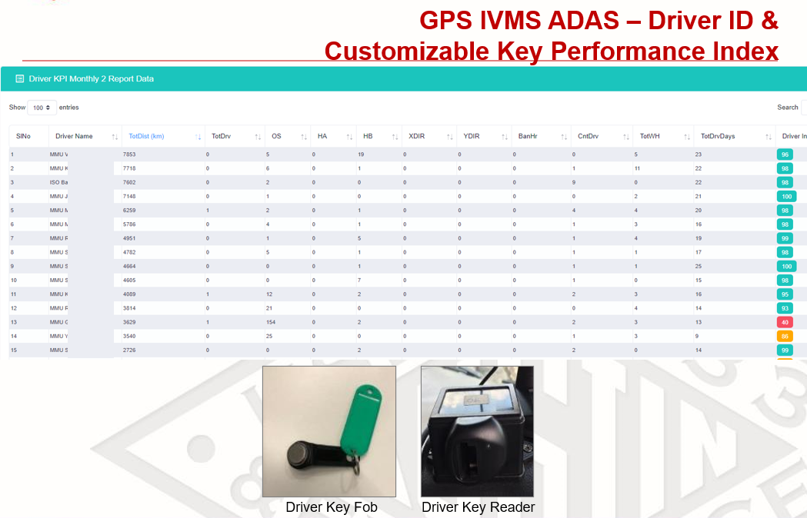
Main Selection Criteria #3 – Advance Features 3
Notes:
Each driver can be rated based on their driving behaviours and further coaching session can be given based on the alert categories.
It is important that the vendor provides the driver KPI dashboard and customisation of the driver KPI as different organisation may have different problem/driving cultures and goal setting processes to monitor the driving behaviour.
Some vendors are also able to provide mobile application access for the driver as direct feedback of their driving performance daily/weekly/monthly.

Slide 17
Main Selection Criteria #3 – Advance Features 3
Advance features 3
Driver ID with key fob
Drivers’ Key Performance Indicators (KPI) Dashboard
Driver application.
Please consider
Driver ID and name in system represent its category
Customization of KPIs & dashboard (what’s your benchmark?)
Coaching and review KPIs
BYOD (bring your own device), some drivers do not have compatible cell phones
Notes:
Each driver can be rated based on their driving behaviours and further coaching session can be given based on the alert categories.
It is important that the vendor provides the driver KPI dashboard and customisation of the driver KPI as different organisation may have different problem/driving cultures and goal setting processes to monitor the driving behaviour.
Some vendors are also able to provide mobile application access for the driver as direct feedback of their driving performance daily/weekly/monthly.

Slide 18
Main Selection Criteria #4 – Others
Others
Subscription model or buy it off
Please consider
Subscription may be a better option due to:
Rapid evolution of technologies
Better service quality

Slide 19
Main Selection Criteria #4 – Others
Others
Support from the vendor
Please consider
GPS IVMS is subject to breakdown/wear & tear issues
Maintenance is needed with strong support from vendor
Common issues: failed to read driver ID, camera faulty, tilted camera angle, ADAS failure

Slide 20
Implementing GPS IVMS – Obstacles & Overcome #1
Obstacle
Availability of vehicles for installation
Suggestions
Communication with stakeholders
Feasible schedule
Notes:
Installation of the GPS and IVMS may be affected by the availability of the vehicles. Delivery order and demands may affect your project progress.
Working together with the team who can manage the delivery order (if the project is being carried out by a different team than the team who has control over the assets) and arrive at a feasible schedule for installation and managing customers’ expectation.

Slide 21
Implementing GPS IVMS – Obstacles & Overcome #2
Obstacle
New hazard (wiring or others)
Suggestions:
Management of Change
Wiring by certified electrician
Battery isolators will shut down the devices
Backup batteries? Fire hazard
Notes:
May introduce additional hazards with the installation of the GPS and IVMS
Management of Change (MOC) need to be performed to properly address risks that may arise from the installation and implementation. For example, wiring of the electrical supply to the GPS and IVMS must be installed by a certified electrician. Use of battery isolators to prevent sources of ignition of the truck during parking or after a rollover may affect the functionality of the GPS and IVMS. Additional power sources for the GPS and IVMS must be reviewed properly without introducing new hazards to the truck.

Slide 22
Implementing GPS IVMS – Obstacles & Overcome #3
Obstacle
Driver ID mixed up/ misused
Suggestions:
Proper tracking
Periodic inspection
Notes:
Driver IDs or Driver key fob may be mixed up
Driver IDs or key fobs need to be assigned with proper tracking to prevent the error of your data in the system by wrongly identifying which ID belongs to which driver.

Slide 23
Implementing GPS IVMS – Obstacles & Overcome #4
Obstacle
Drivers are not informed
Suggestions:
Communication on objectives and functions of the system
Consent
Training and coaching
Set clear expectation on violation
Notes:
Driver is unaware of the introduction of the GPS and IVMS and its purpose
Engagement with drivers needs to be done properly. Consent may be needed if IVMS is involved to prevent violation of any personal data act in your country. Some IVMS systems come with Advanced Driver Assistance Systems (ADAS) and they may send alerts to the driver during a violation. Drivers need to be informed of the basic functionality of the GPS and IVMS such as the use of a panic button. They also need to be briefed on the conditions that may be considered a violation for transportation safety. If you want to introduce consequence management for violations, grace periods must be given for the driver and a clear policy must be written and cascaded down properly.

Slide 24
Implementing GPS IVMS – Obstacles & Overcome #5
Obstacle
Unclear roles and responsibilities (management, drivers)
Suggestions:
In-depth training to users
Assigned person to follow up maintenance with supplier
Clear handover to users
Periodic audit
Notes:
No clear responsibility and accountability to use and monitor the GPS and IVMS
Implementing of the GPS and IVMS seems to be just plug-and-play. It is bigger than that. A great system without anyone using it will be just another “nice to have white elephant” project. In-depth introduction training and multiple refresher training need to be given to the users who are responsible for monitoring and using the system. A party may also be assigned to deal with the vendor on maintenance and repair of the system as it may fail after some time period (just as anything else does). Clear handover of the system installed to the relevant parties who are responsible to run and maintain the system is also crucial to ensure its success. Periodical audits may be deployed to ensure that the system is maintained its intended functionality.

Slide 25
Implementing GPS IVMS – Obstacles & Overcome #6
Obstacle
Sustainability
Suggestions:
Remove obstacles
Reinstate objectives and target
Committee drive continuous improvement
Monitoring center with screens
Notes:
Lack of continuous effort to develop to use the GPS and IVMS
At the start of the project, everyone will be excited but when facing real life challenges during the implementation of the GPS and IVMS to improve transportation safety and drivers’ behaviours, the objective and vision of having the system may be lost. A transportation safety committee may be established to overcome this issue. Meetings should be held periodically to monitor the trend of the drivers’ behaviour, driver coaching arrangements, consequence management and other related transportation safety initiatives. These could include setting up a monitoring centre with big screens to accommodate the dashboards as well as enhancement project with vendor to add more sensors to the system or improve the dashboards.

Slide 26
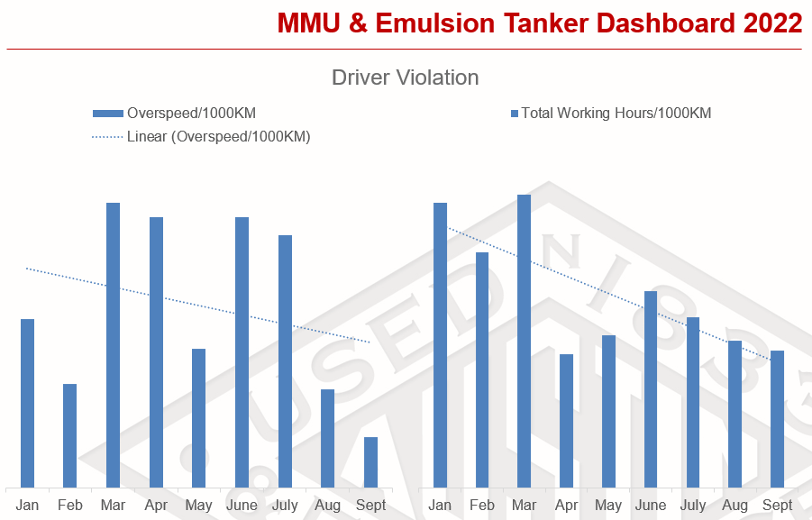
Improvements after implement GPS and IVMS
Notes:
After an emulsion MMU (mobile manufacturing unit) rollover incident happened in June 2020, Austin Powder Malaysia (APMY) consolidated their previous multiple platforms Global Positioning System (GPS) into one platform and added In-vehicle Monitoring System (IVMS) in the vehicles transporting Dangerous Goods.
The project began with scoping and selection of vendors in early 2021. Installation was completed towards the end of 2021. Following the implementation, we can see some improvements in MMU and Emulsion Tanker transportation safety in data collected in 2022 (see chart)
We can see that the fatigue violation (eyes closing in particular) and yawning detection have been reduced after the Total Working Hours violation was reduced from January to September 2022. Overspeed violation is on a downward trend after implementing the GPS & IVMS system together with a throttle limit introduced in 2021 (data not shown). However, there is still room for improvement. For some reasons distraction has increased (could be other distractions as the phone usage detection is on a downward trend) and the team is still investigating the trend.
The team will continue to monitor and improve the driver violation trend via driver coaching, training, and consequence management to improve the overall transportation safety in APMY. The numbers can be improved further. More work needs to be done for MMUs and emulsion tanker transportation safety and we expect to see some good results for explosive delivery as well soon. The system may also be extended to the third-party Ammonium Nitrate Transporter as well.

Slide 27
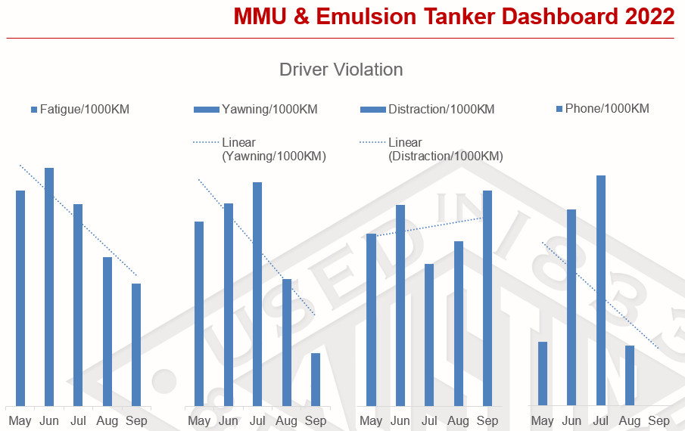
Improvements after implement GPS and IVMS
Notes:
We can see that the fatigue violation (eyes closing in particular) and yawning detection have been reduced after the Total Working Hours violation was reduced from January to September 2022. Overspeed violation is on a downward trend after implementing the GPS & IVMS system together with a throttle limit introduced in 2021 (data not shown). However, there is still room for improvement. For some reasons distraction has increased (could be other distractions as the phone usage detection is on a downward trend) and the team is still investigating the trend.
The team will continue to monitor and improve the driver violation trend via driver coaching, training, and consequence management to improve the overall transportation safety in APMY. The numbers can be improved further. More work needs to be done for MMUs and emulsion tanker transportation safety and we expect to see some good results for explosive delivery as well soon. The system may also be extended to the third-party Ammonium Nitrate Transporter as well.

Slide 28
Conclusion
One of the many tools
Aim to improve drivers’ unsafe behaviors, improve driving competency and efficiency
It is not a magic bullet
Other initiatives such as fatigue management, vehicle preventive maintenance program and defensive driving training are needed
Notes:
GPS and IVMS are some of the tools that we can deploy to help improve drivers’ behaviours. With this system we can monitor these behaviours and provide appropriate training and coaching to prevent any violations on the road. Other transportation safety aspects need to be covered as well, not limited to fatigue management, vehicle preventive, maintenance program and defensive driving training. Involvement of leadership is of the utmost importance to ensure the success of such initiatives. The transportation safety journey for APMY continues and the team wishes to continue to improve to ensure all drivers/crews and other innocent road users can go home safely every day.

Slide 29

Questions and Answers
Q&A?
Notes:
GPS and IVMS are some of the tools that we can deploy to help improve drivers’ behaviours. With this system we can monitor these behaviours and provide appropriate training and coaching to prevent any violations on the road. Other transportation safety aspects need to be covered as well, not limited to fatigue management, vehicle preventive, maintenance program and defensive driving training. Involvement of leadership is of the utmost importance to ensure the success of such initiatives. The transportation safety journey for APMY continues and the team wishes to continue to improve to ensure all drivers/crews and other innocent road users can go home safely every day.

Slide 30
Austin Powder Malaysia Sdn Bhd
No. 8, Jalan SS 22/21, Damansara Jaya, 47400 Petaling Jaya, Selangor
Malaysia
tel.: +603 7729 7464
https://www.austinpowder.com/malaysia/home/

