Slide 1
Reflections of a past Chief Inspector
Geoffery Downs BE (Chem), BA
Safex Expert Panel

Slide 2
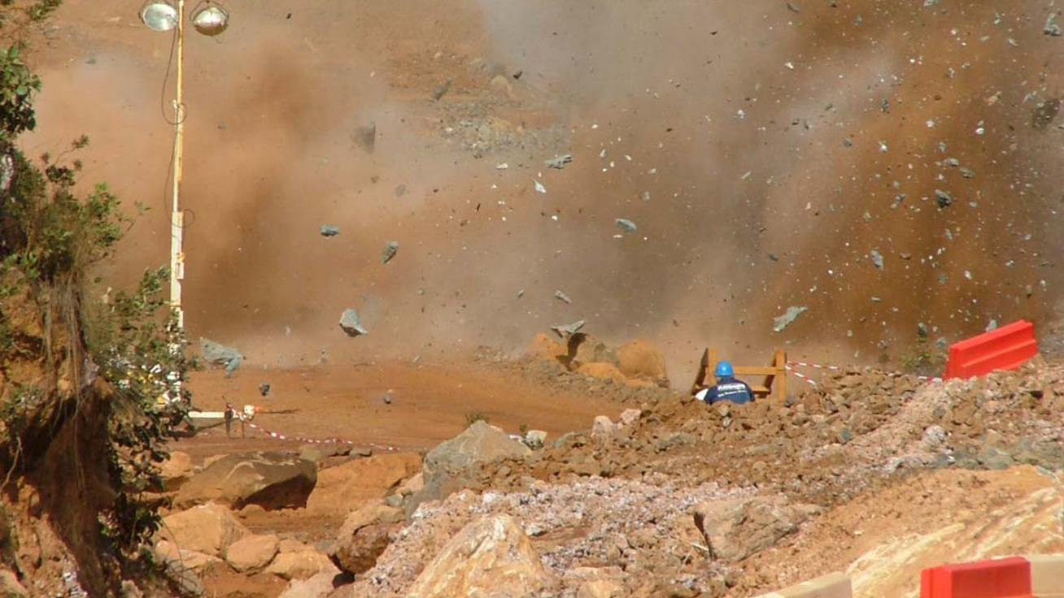
Summary
Disclaimer - Only from my experience
How operate – learnings
Risk management
Preventing incidents
Investigations
incidents
Strategies and approaches
Legislation standards, codes etc
A few examples

Slide 3
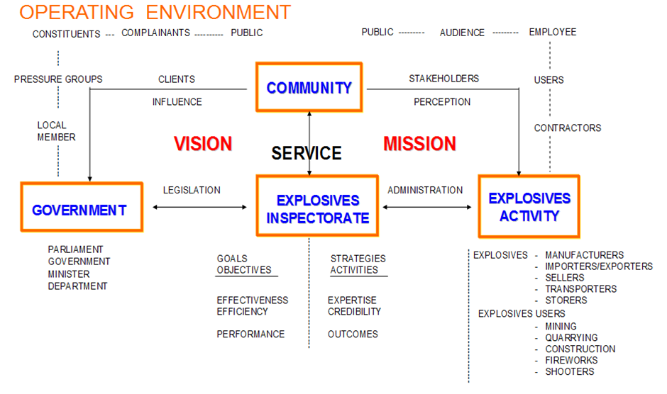

Slide 4

Role and vision
Leadership
Prevent incidents
Big picture
Value of good information
Reporting
Alerts
Identify emerging trends
Corporate memory
Duty of care
Information bulletins
Expectations
Liaison groups
Investigation reports

Slide 5
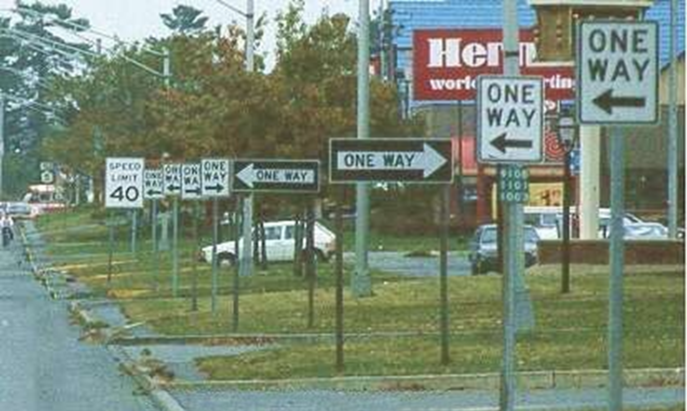
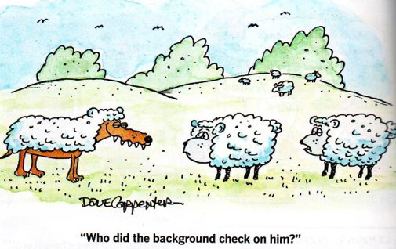
Operations
Mandatory activities – set by legislation
Licensing
Investigations
Optional – Policy -
Audits and inspections
Style and approach
Policy v legislation
Right people – all sides
Value adding

Slide 6
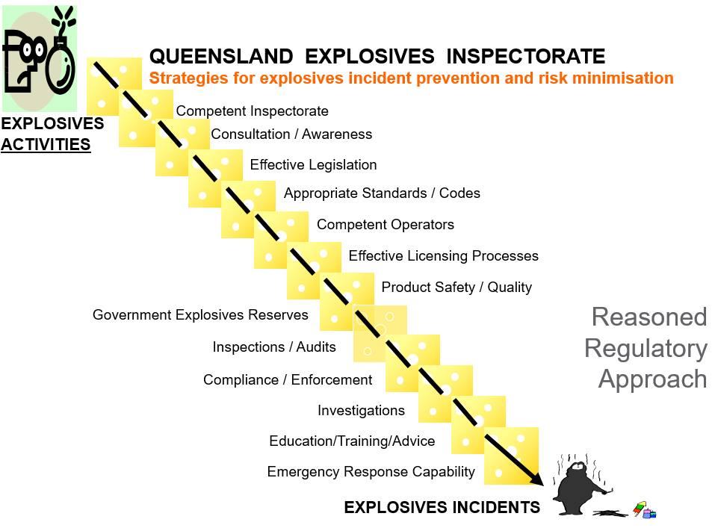
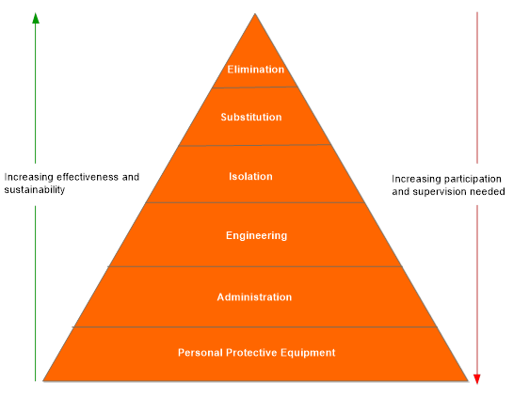
Risk management
Swiss Cheese Model (Prof James Reason)
Risk control hierarchy

Slide 7
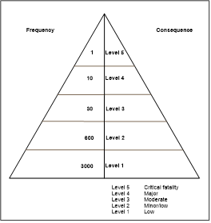
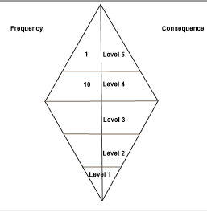
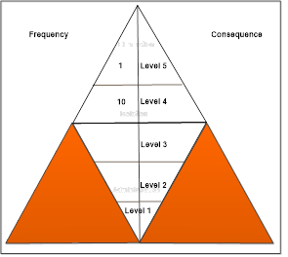
The safety triangle (Bird's Triangle)
First diagram – actuals
Second diagram – reported
Third diagram – orange is missing information
Only counting incidents – not behaviours and violations

Slide 8
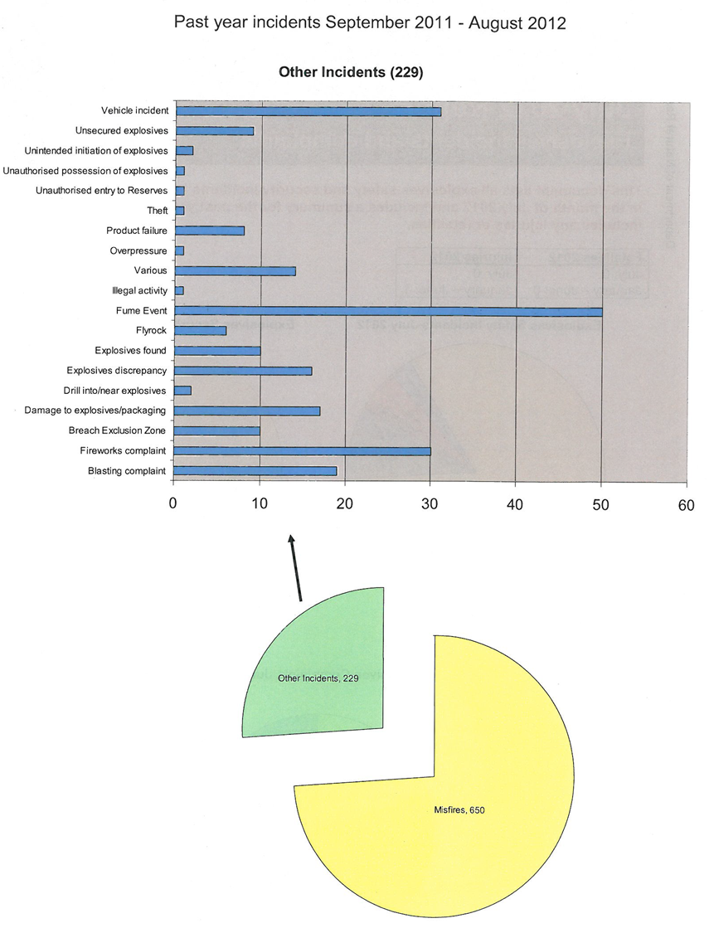
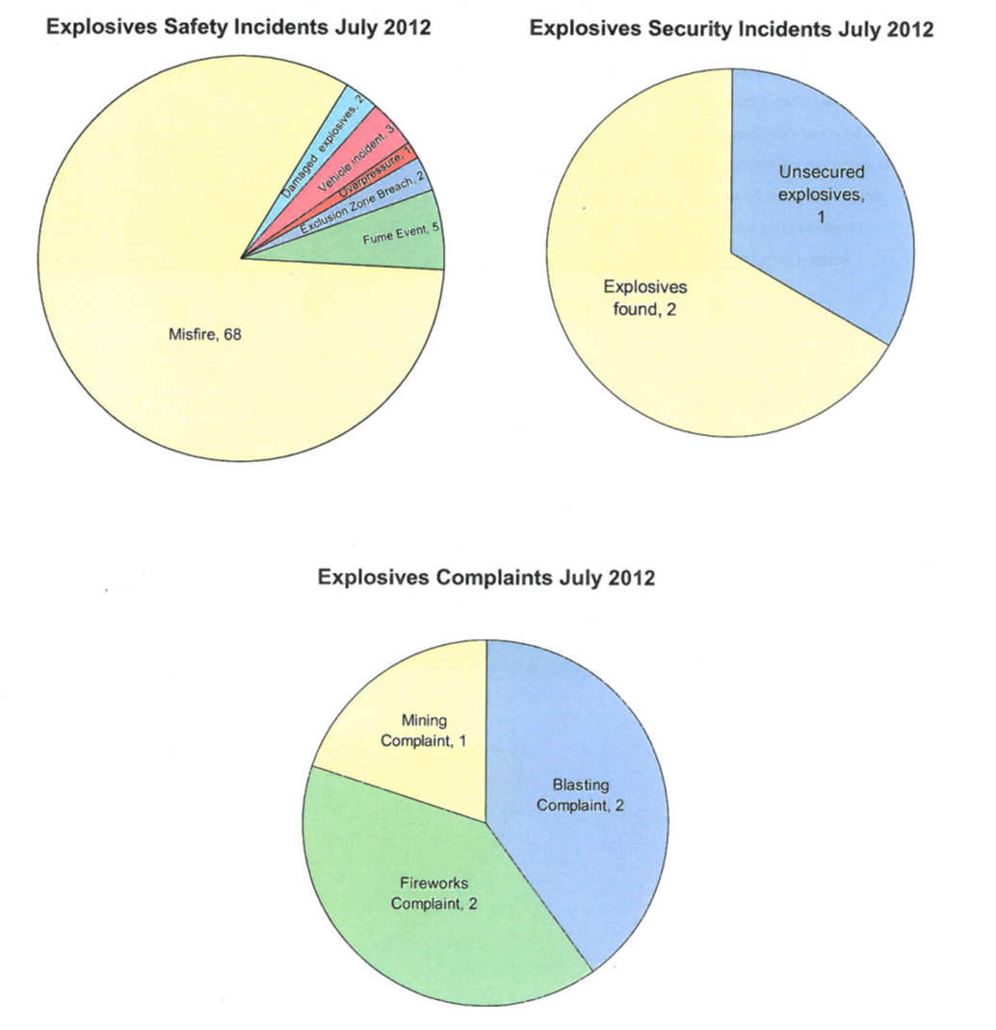
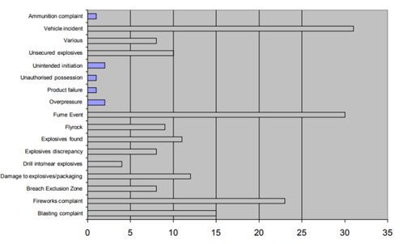
Reporting incidents
Monthly and annual rolling summary of incidents
Very few doing this
What are others doing?
Investigations
Safety Alerts and Security Alerts
Reporting

Slide 9
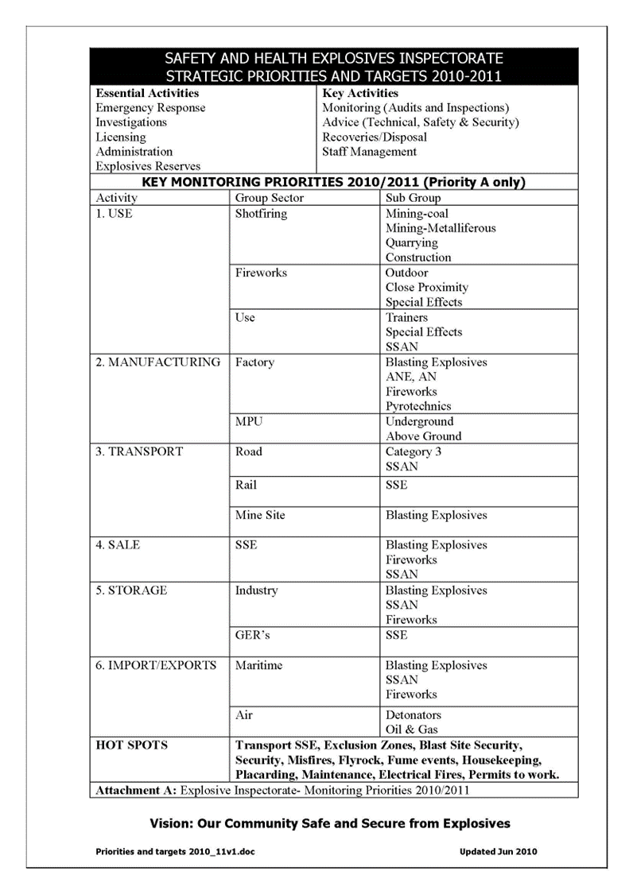
Audit and inspection schedules
How is the information used
Becoming effective with limited resources
Essential
Important but not essential
Hot spots – emerging trends
Targeted to key areas and key activities
Incidents, performance and compliance
Difficult ones first
New activities from international/national
Operators, activities, sectors ranked according to risk
Outcomes – hot spots (emerging trends) reduced

Slide 10
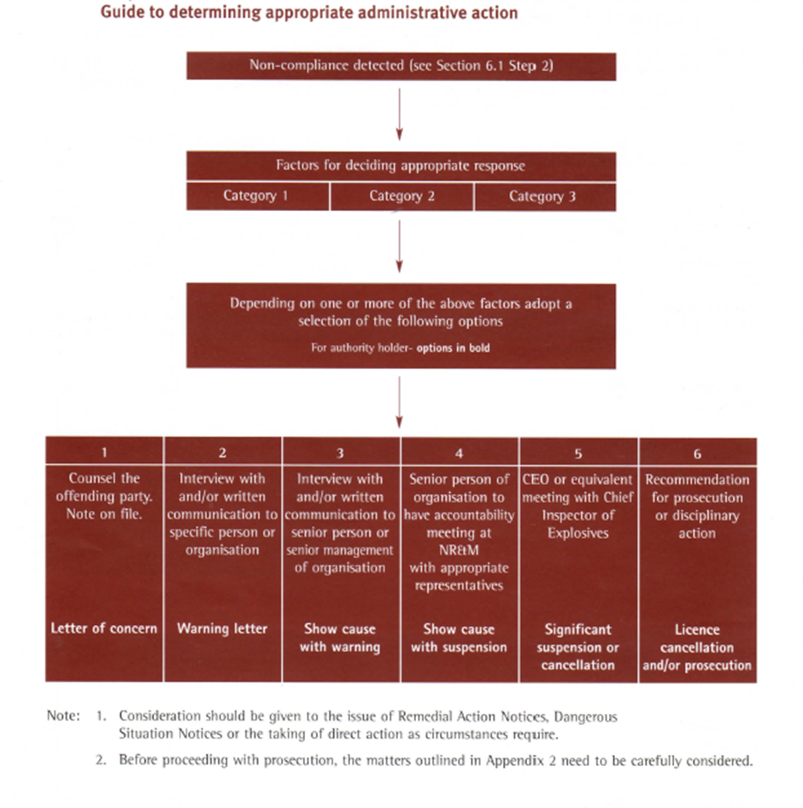
Compliance
Compliance issues can arise from
Incident
Audit & inspection
Complaint
Investigation (Compliance)
Not satisfied

Slide 11

Legislation, Standards, Codes
Act
Not always up to date
Slow to bring big changes e.g. security
Consultation essential
Natural justice – processes
Regulations
Easier to change
Consultation essential (exceptions)
Legislation overload – not consistent
Number
Within jurisdictions, overlap
Other jurisdictions
Standards and codes called up under legislation
Industry participation
Example with ports
Not consistent
Rule book
Applied differently
Not understood
Consistency
Other jurisdictions – different requirements
Different codes with different requirements
My way and my style
International, National and Local agreements, trends etc
International Companies using local laws

Slide 12
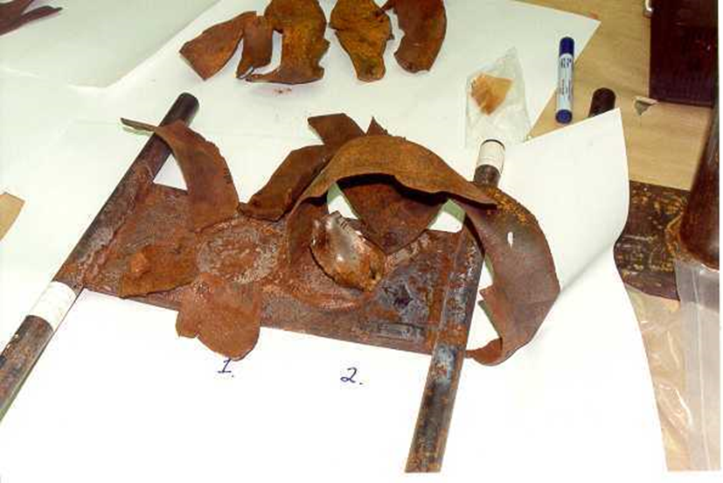
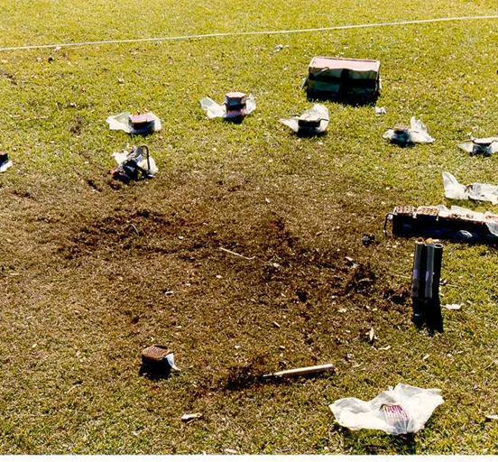
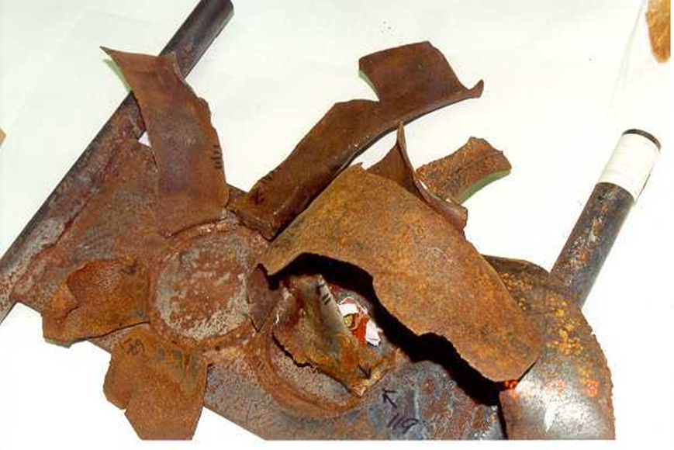
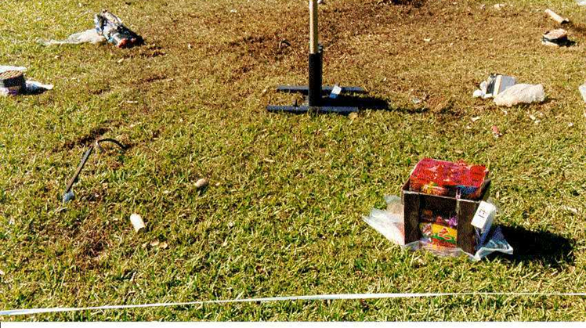
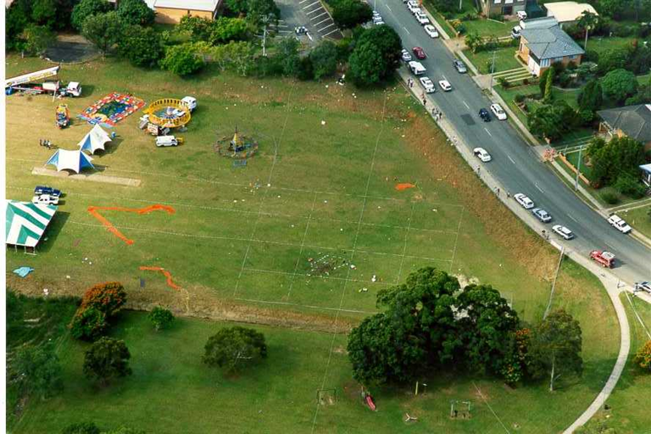
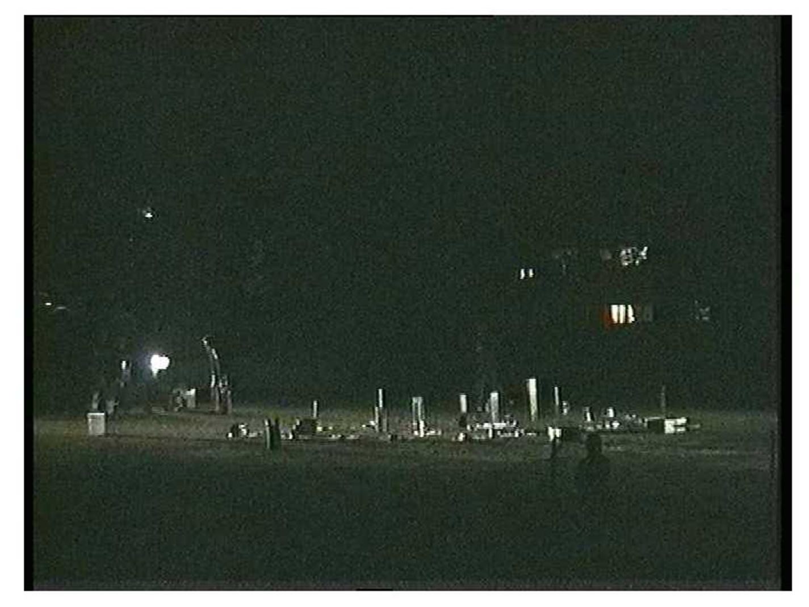
Bray Park Fireworks accident
1 fatality, many serious injuries
Inspector present
Implications
Special investigation
Extremely political
Police investigation
Separate
Industry attitude to faulty fireworks

Slide 13
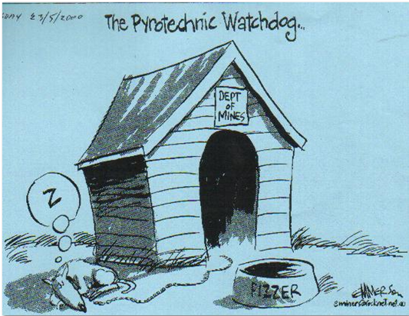
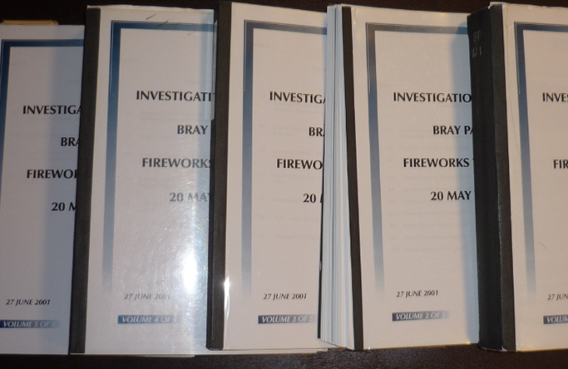
Bray Park Accident (Cont’d)
Nature and cause investigation for coroner (16 months)
Regulatory changes
Training competencies and licensing changes
Codes of practice drafted
Testing codes for fireworks
More inspectors
Compliance investigation – supplier and operator prosecuted
Others prosecuted
Litigation
Who should do investigations
Recommendations
Reform of fireworks industry

Slide 14
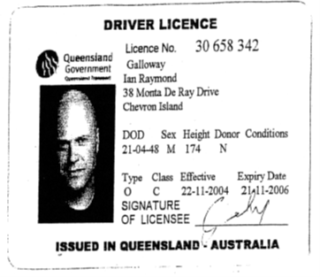
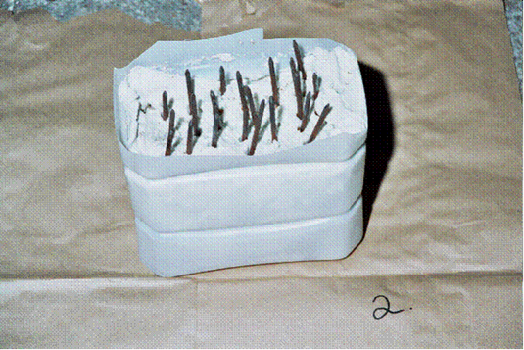

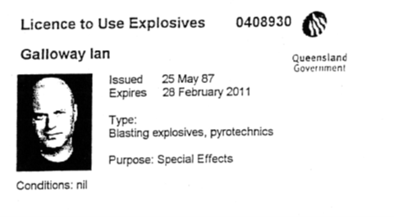
Beating the system
Pretended to Hollywood producer – many aliases
Forged licenses
Supplier assisted supply and advice
Sent photos of his devices to police
Working with special effects industry on a code
Caught very soon later
Regulation changes
Lessons

Slide 15
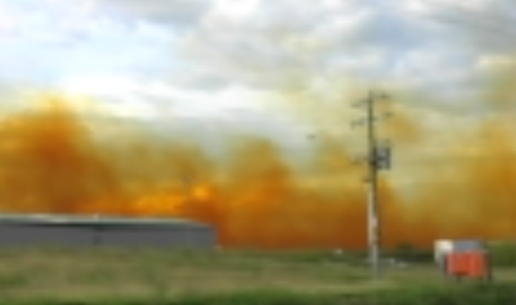
Blast fumes
After wet periods following drought, fumes frequent occurrence
On-site and off-site impacts
Working groups formed from mines, manufacturers, industry, mines inspectorate, explosives inspectorate, health professionals
Guidance notes, seminars etc

Slide 16

Summary
Challenge and changes
You have rights
Make the most of the lessons given e.g. incidents, corporate memory, science
Consistency
Partnership

